Slide 1
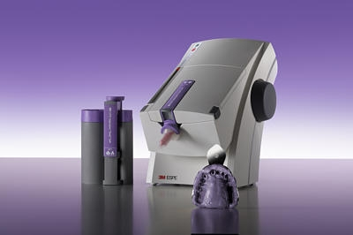
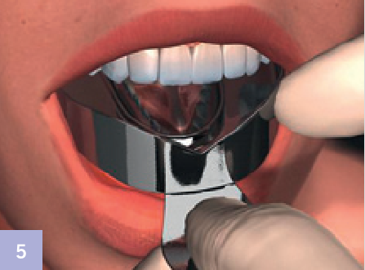
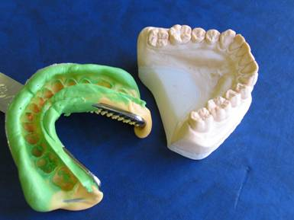
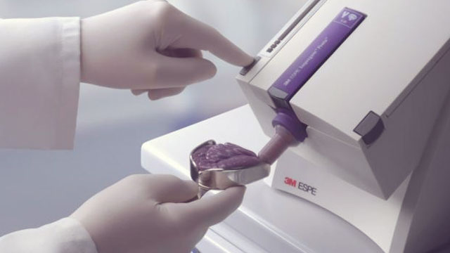
The theme of lecture:
«Impressions and classification of its. Methods of making. Classification of impression materials. Clinical and physical- chemical characteristic of its».

Slide 2
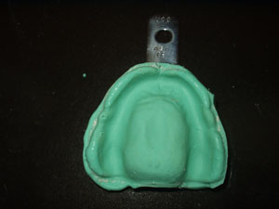
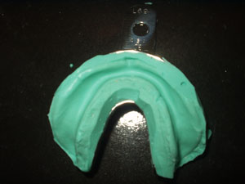
An Impression
is a negative imprint of hard (teeth) and soft tissues in the mouth from which a positive reproduction (or cast) can be formed.

Slide 3
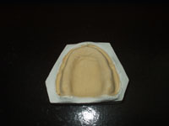
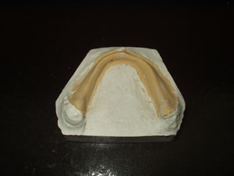
A model
is an direct image of surface of soft and hard tissues in the mouth

Slide 4
Classification of impressions (by Gavrilov)
Group I – preliminary (orientation)
Group ІІ – Final
Anatomical
Functional
Diagnostical
Auxiliary
By method of edge formation
With the help
of passive
movements
With the help
of functional
probes
With the help
of masticatory and
other movements
Working
Control
By the level of squeezing of
The mucosa
Partial
Occlusion
Under pressure
Combined
With minimal
pressure
Full
Arbitrary
Masticatory
Dosed

Slide 5
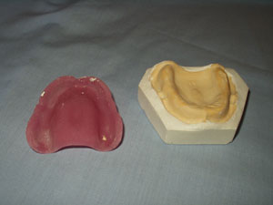
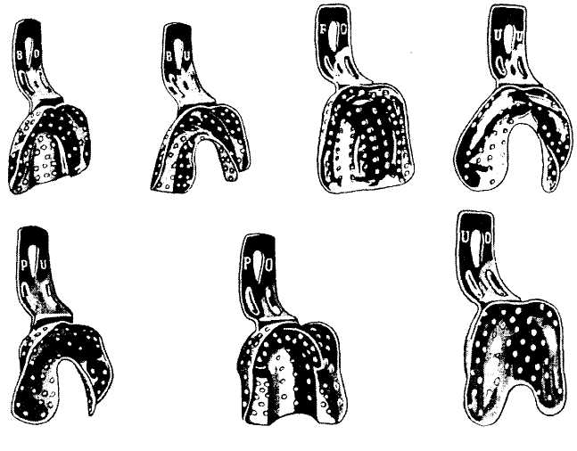
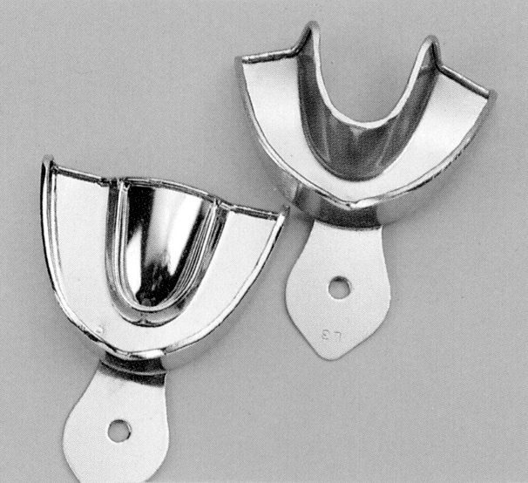
Impressions are taken with special dental trays.
An impression tray is a container which holds the impression material as it sets and supports the set impression.
Type of dental trays:
standard
individual
collapsible
Type of standard dental trays :
partial
complete (for the upper jaw and for the lower jaw)
occlusive
(а)
(b)
individual dental tray on the upper jaw
Perforated (a) and non perforated (b) standard trays for the upper and lower jaws

Slide 6
Trays individual
Methods of individual dental tray making :
• wax;
• plastics of cold polymerization;
plastics of hot polymerization;
• thermoplastics;
• light curing materials;
• combined methods.

Slide 7

Important terms
• Elastic/plastic deformations
• Strength
• Pseudoplastic / thixotropic
• Hydrophilic/hydrophobic
• Working time
• Setting time

Slide 8
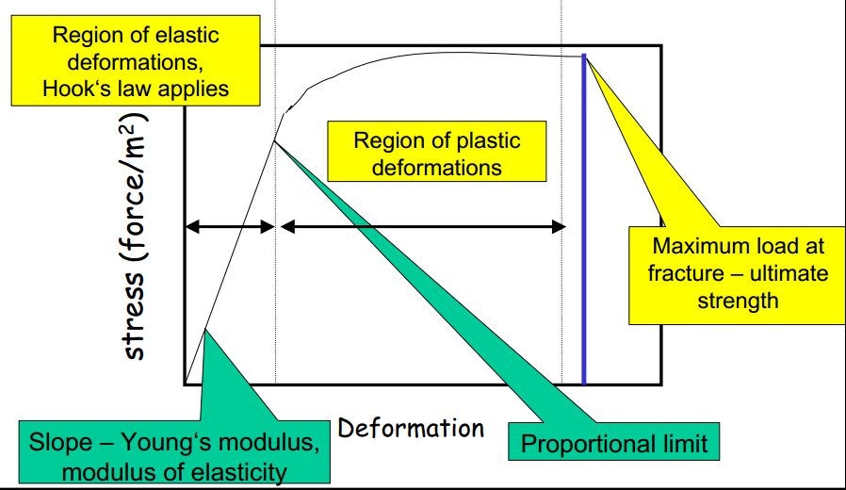
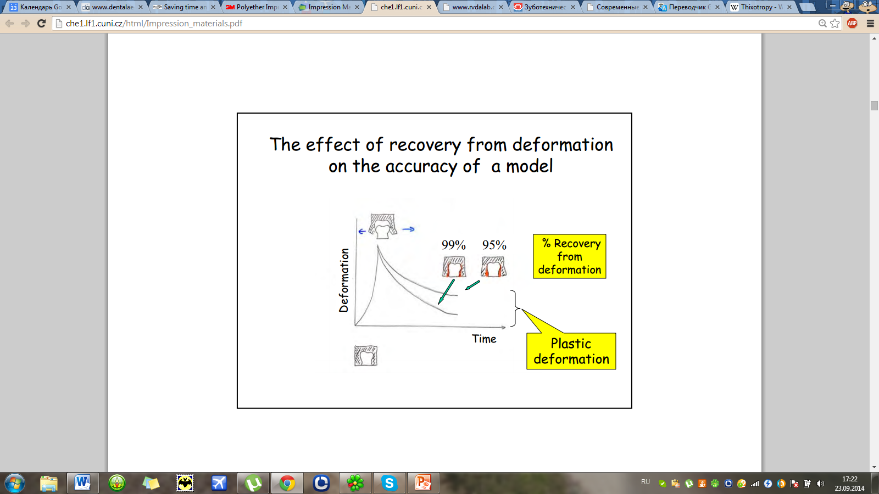
Important terms
• Elastic/plastic deformations
• Strength
• Pseudoplastic / thixotropic
• Hydrophilic/hydrophobic
• Working time
• Setting time
Elasticity/plasticity elastic/plastic deformation
Describes behavior of material under load

Slide 9
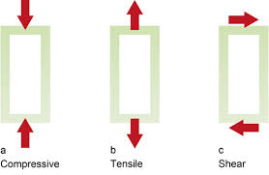
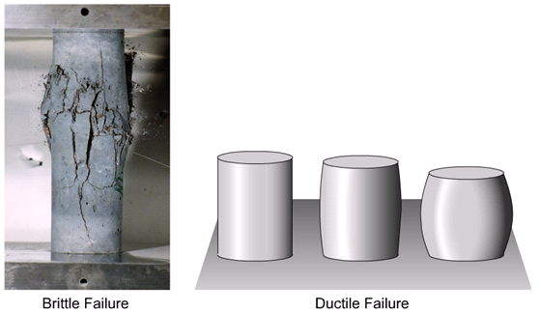
Important terms
• Elastic/plastic deformations
• Strength
• Pseudoplastic / thixotropic
• Hydrophilic/hydrophobic
• Working time
• Setting time
In materials science, the strength of a material is its ability to withstand an applied load without failure. The field of strength of materials deals with forces and deformations that result from their acting on a material.

Slide 10
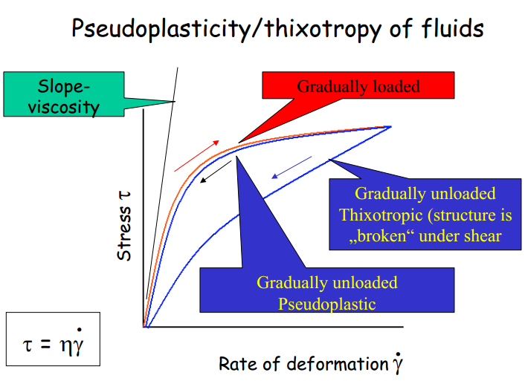
Important terms
• Elastic/plastic deformations
• Strength
• Pseudoplastic / thixotropic
• Hydrophilic/hydrophobic
• Working time
• Setting time
Thixotropy is a shear thinning property. Certain gels or fluids that are thick (viscous) under static conditions will flow (become thin, less viscous) over time when shaken, agitated, or otherwise stressed (Time Dependent Viscosity). They then take a fixed time to return to a more viscous state.

Slide 11
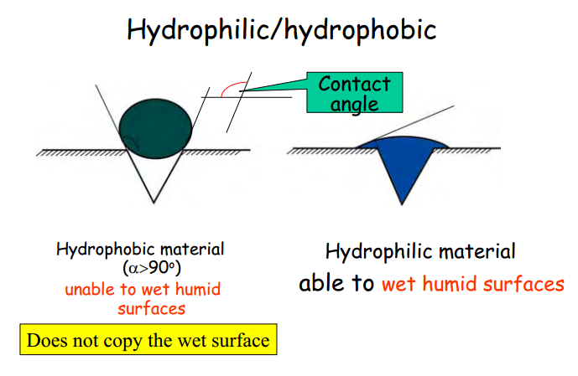
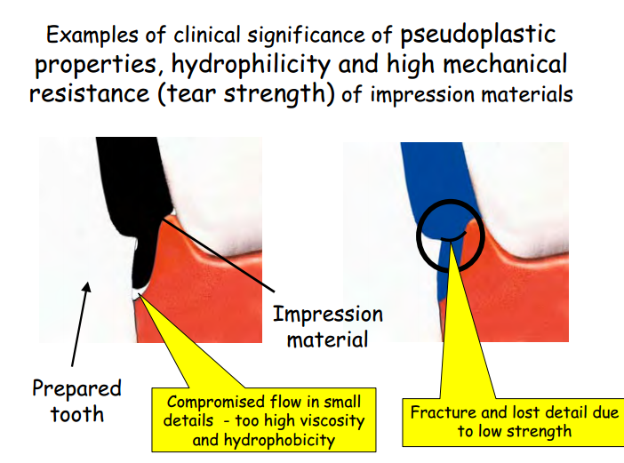
Important terms
• Elastic/plastic deformations
• Strength
• Pseudoplastic / thixotropic
• Hydrophilic/hydrophobic
• Working time
• Setting time
A hydrophile (Ancient Greek φίλυδρος, loving water from φιλεῖν to love, and ὕδρω, water. The compound ὑδρόφιλος does not exist in Ancient Greek.) is a molecule or other molecular entity that is attracted to, and tends to be dissolved by, water.
A hydrophobicity (from Ancient Greek ὑδρόφοβος, having a horror of water, constructed from ὕδωρ, water, and φόβος, fear) is the physical property of amolecule (known as a hydrophobe) that is seemingly repelled from a mass of water.

Slide 12
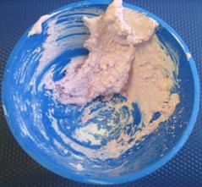
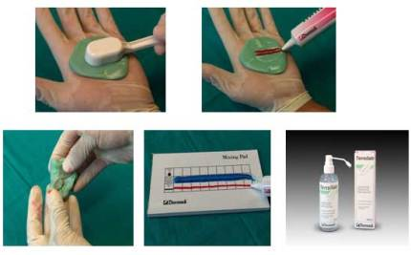
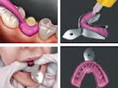
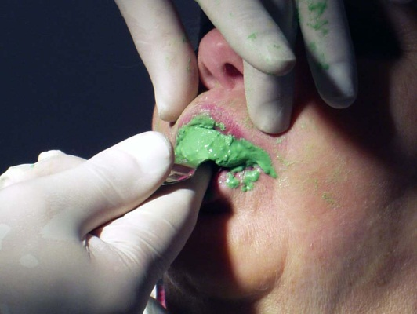
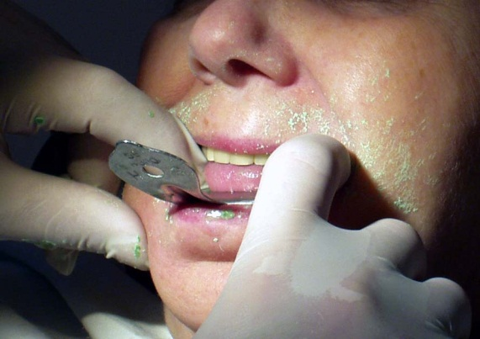
Important terms
• Elastic/plastic deformations
• Strength
• Pseudoplastic / thixotropic
• Hydrophilic/hydrophobic
• Working time
• Setting time
Working time – a period from the start of mixing to the final time at which the impression can be seated in the mouth without its distortion
Setting time – a period from the start of mixing till the impression becomes elastic enough to resist deformation during its withdrawal from the mouth

Slide 13
Requirements to the impression materials
1. Capable of plastic to rigid body transformation
2. Acceptable for a patient
- non-toxic, non-irritant, tasteless, reasonable
setting time up to 5-7 min
3. Good handling properties – easy to prepare/mix
plastic before set, but viscous enough not to flow
out of a tray (thixotropic), adequate working and
setting times
After being set:
4. Accuracy and detail reproduction (25-50µm),
5. Dimensionally stable
6. Resistant to mechanical stress - elastic and rigid
7. Compatible with model materials
8. Resistant to disinfectant solutions
9. Cost effective

Slide 14
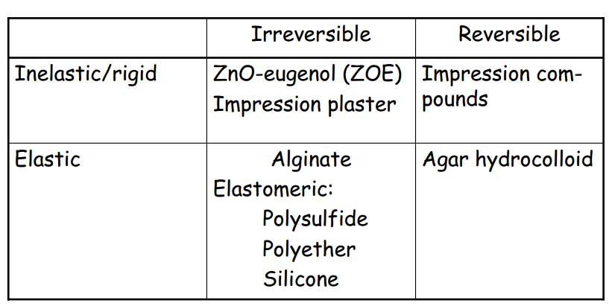
Impression materials

Slide 15
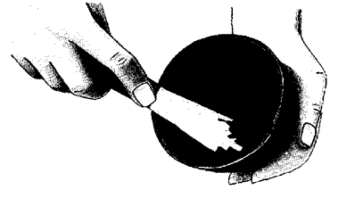
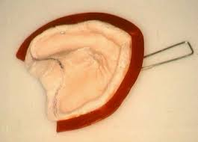
Plaster
CaSO4 х 0.5H2O + 3 H2O → 2 (CaSO4 + 2H2O)
Accelerator of reaction: salt and Sulfate potassium.
Inhibiting Agent – borer, sugar, glycerin

Slide 16
Plaster
Main indication: impression of edentulous ridges
Advantages:
1. Cheap and long shelf life, easy to prepare
2. Very good surface detail reproduction
3. Excellent dimensional stability
Disadvantages:
1. Very rigid – often need to be fractured when removed from the mouth
2. Fractures if undercuts are present
3. Non-toxic but may dry soft tissues - unpleasant to patients
Old fashioned – not frequently used

Slide 17
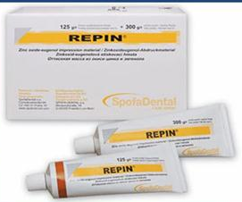
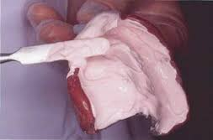
Zinc-oxide eugenol impression pastes (ZOE)
Main indication: impression of edentulous ridges, surgical dressing
low viscosity is a favorable to avoid displacement of tissues
Advantages:
1. Low viscosity – no compression of soft tissues
2. Dimensional stability (shrinkage less than 0.1 %)
3. Good surface detail reproduction
4. Low price
Disadvantages:
1. Cannot be used in deep undercuts
2. Eugenol allergy in some patients (o-ethoxybenzoic acid [EBA] to replace eugenol)

Slide 18
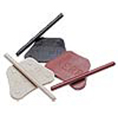
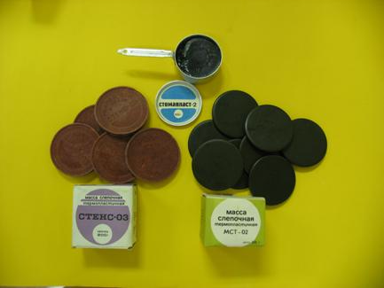
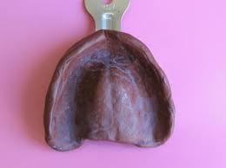
Impression compounds
(Kerr‘s, Stent‘s impression compounds)
Thermoplastic material (softens when heated to 50° C
and hardens on cooling) for making impressions of
edentulous ridge, tooth impressions in a copper band
Composition:
1. Resins (wax, shellac, guttapercha)
2. Filler (talc)
3. Lubricants (stearic acid, stearin)
Advantages:
1. Can be reused, easy to use
2. Non-irritant and non-toxic
Disadvantages:
1. Poor dimensional stability
2. Easy to distort when withdrawn from the mouth
Old fashioned – not frequently used

Slide 19
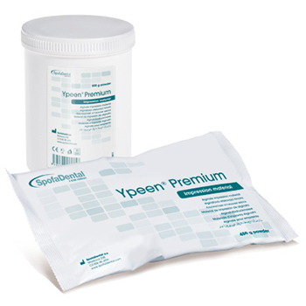
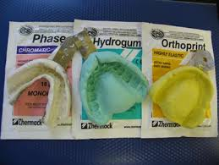
Hydrocolloid impression materials
Alginate impression materials (Irreversible hydrocolloid impression material,
preliminary, orthodontic impressions etc.)
Properties:
1. Set after mixing with water
2. Shrink due to loss of water by Syneresis – expression of water from the surface of
impression (if contains Na2SO4 – decreased quality of stone surface); by Evaporation of water from the surface
3. Imbibition – sorption of water causing a
dimensional change
4. Chromatic phase indicator may be incorporated to signal the impression setting
Store in a closed container with a
towel saturated with water !

Slide 20
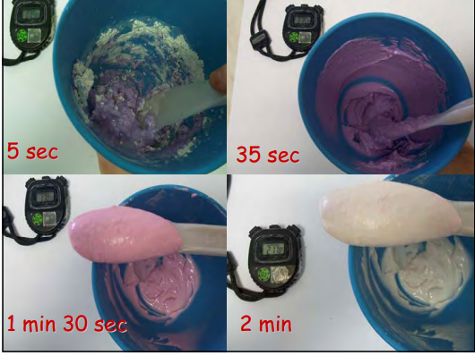
Hydrocolloid impression materials
Alginate impression materials (Irreversible hydrocolloid impression material,
preliminary, orthodontic impressions etc.)
Advantages:
1. Very good biological tolerance
2. Easy to use and mix
3. Fast setting
4. Low price
Disadvantages:
1. Poor dimensional stability
2. Setting dependent on water temperature and water hardness
3. Although 100 h pouring time is also recommended they should be poured as soon as possible
4. Sometimes problems with a model stone compatibility
Main indication:
Auxiliary impressions
Control impressions
Diagnostical impressions
Impressions for partial prostheses (removable)
Impressions for SWAGED crowns and bridges (fixed)
Most frequently used impression material

Slide 21
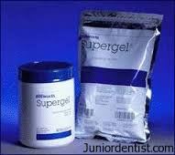
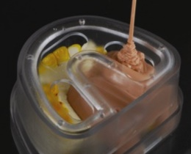
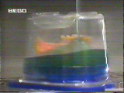
Hydrocolloid impression materials
Agar impression materials (Reversible hydrocolloid impression material)
Based on thermoreversible gelation of natural polysaccharide – agar (isolated from red algae/seaweeds)
Composition:
1. Agar
2. Borax to increase the gel strength
3. Potassium sulfate as a gypsum hardener
4. Water – dispersion medium
Advantages:
1. Very good biological properties
2. Excellent surface detail reproduction
Disadvantages:
1. Need special equipment (water bath) and special technique
2. Dimensionally instable - evaporation or imbibition
3. Low strength and poor tear resistance
4. Slow setting time
Other applications of hydrocolloid materials
Reversible hydrocolloid impression materials are used as duplicating materials to prepare dental cast models (gypsum or from investment materials)

Slide 22
Elastomeric (non-aqueous) impression materials
Polysulfide
Silicone
- condensation
- addition
Polyethers
Synthetic polymers with rubber properties after setting
Main indications:
· impressions for partial prostheses (removable)
· impressions for crowns and bridges (fixed)
· impressions for implantology
Polymerization shrinkage of elastomers is usually compensated for using a combination of:
1. Highly filled-viscous material „Putty“ for preliminary impression (low polymer
content - of low shrinkage)
2. Low filled-low viscosity „wash“ or „light“ impression material (high polymer content - higher elasticity but higher shrinkage)

Slide 23
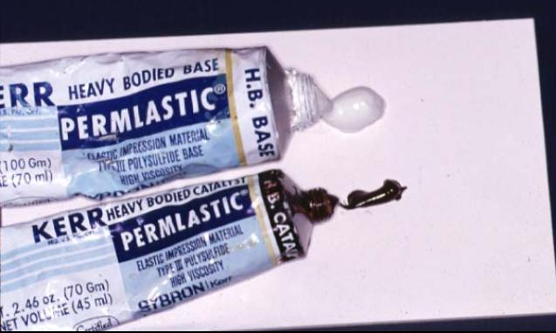
Elastomeric (non-aqueous) impression materials
Polysulfide
The very first elastomeric impression material
(Thiokol rubbers, mercaptan rubbers)
Based on reaction between polymer with free mercaptan (-SH) groups and oxidizing agent PbO2 which lenghtens and cross-links chains via reaction of terminal and pendant -SH groups)
Advantages:
1. Low price
2. Long working time
Disadvantages:
1. Should be poured within 0.5 – 1 hour
2. Lead oxide may cause toxic effects
3. Unpleasant mercaptane smell
4. Long setting time app. to 10 min
5. Poor elastic recovery – prone to plastic deformation
Old fashioned – not frequently used

Slide 24
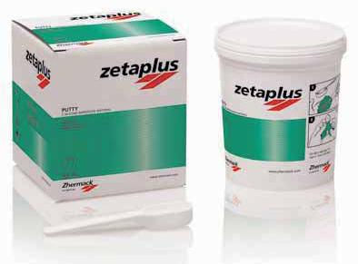
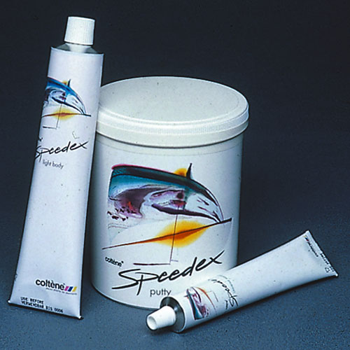
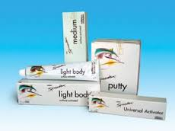
Elastomeric (non-aqueous) impression materials
Silicone
C-silicone impression materials (condensation silicones)
Based on cross-linking polycondensation reaction of hydroxy terminated polysiloxane prepolymer with tetra alkoxy silanes catalyzed by dibutyl-tin dilaurate (DBTD)
Composition:
Supplied as a two-component system
Base paste:
• Hydroxyterminated polysiloxane polymer
• Filler (cristobalite, talc, starch)
Catalyst:
Liquid catalyst:
• Cross-linking agent (e.g tetraethoxy silane) +
activator (dibutyl-tin dilaurate)
Paste catalyst:
• Cross-linking agent, activator, inert oil
• Filler
Advantages:
1. Accurate impressions when poured soon
2. Good elastic recovery
3. Lower price
Disadvantages:
1. Hydrophobic
2. Shrinking of impression over time, pouring time till 4 h
3. Catalyst may cause allergic reaction
4. Difficult to dispense proper volumes of both components
5. Usually hand-mix version only

Slide 25
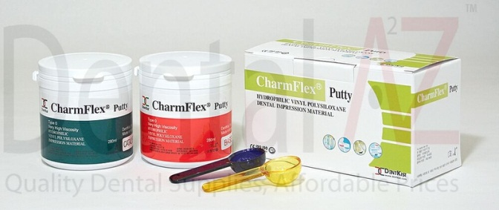
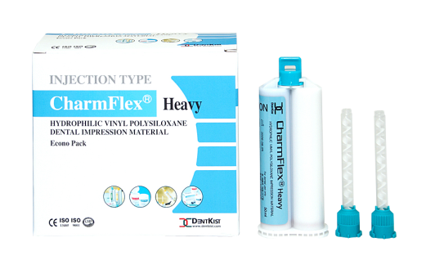
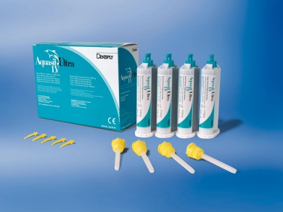
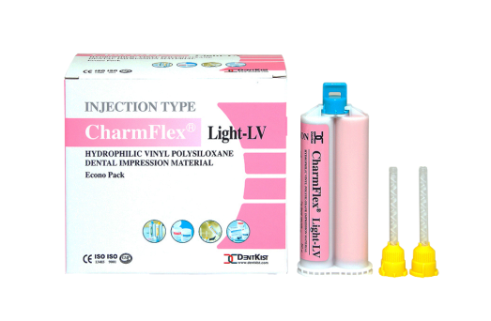
Elastomeric (non-aqueous) impression materials
Silicone
A-silicone impression materials (addition silicones, vinyl siloxane, poly(vinyl siloxane))
Based on cross-linking polyaddition reaction of vinyl terminated polysiloxane polymer with methylhydrogen silicone cross-linking agent in the presence of platinium catalyst
Composition:
Supplied as a two-component 1:1 system
Base paste:
1. Vinyl terminated polysiloxane polymer
2. Pt catalyst
3. Filler (cristobalite, talc)
4. Surfactant (hydrophilic agent)
Catalyst:
1. Vinyl terminated polysiloxane polymer
2. Cross-linking agent
3. Filler, silicone oil (adjust viscosity of duplicating materials)
Advantages:
1. Accurate impressions, very low shrinkage
2. Very good surface detail
3. Highly elastic
4. Perfect elastic recovery
5. Dimensionally stable
6. Non-toxic and non-irritant
Disadvantages:
1. Hydrophobic – necessary to add a surfactant
2. Setting inhibited by latex gloves or some astringents (sulfur, heavy metals)
3. Hydrogen release – surface bubbles – pouring time 1 h after removal from the mouth
4. High price

Slide 26
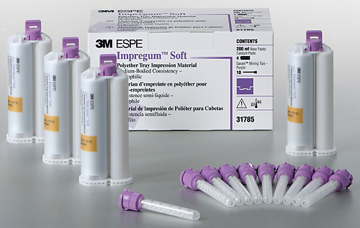
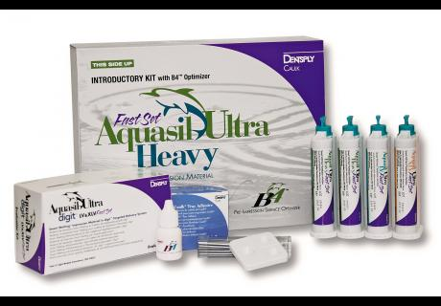
Elastomeric (non-aqueous) impression materials
Polyether
Based on cross-linking of polyether chains via cationic polymerization of aziridine rings using a aromatic sulfonate ester as an initiator
Composition:
Supplied in a two-paste system
Base paste:
• Polyether
• Filler, plasticizer
Catalyst paste:
• Sulphonic acid ester
• Inert oil
• Filler
Advantages:
1. Naturally hydrophillic
2. Accurate and high dimensional stability
3. Good elastic recovery
4. Low setting contraction
5. Excellent surface detail reproduction
Disadvantages:
1. Rather stiff when set material (difficult to remove from mouth)
2. Very expensive
3. May cause allergic reaction due to the sulphonic acid ester

Slide 27

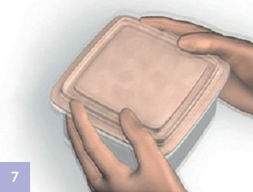
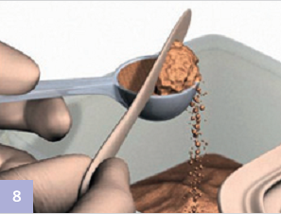
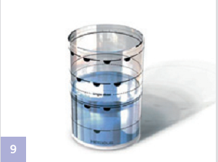




Impression techniques
Procedure with Alginate Impressions
It is important when ﬁtting
the tray that there is sufﬁcient room
(minimum 5 mm) for the alginate
material between both the tray wall
and dentition.
The container with the alginate powder should be shaken each time before dispensing powder to loosen the powder. This ensures that the powder can be dispensed accurately.
Smooth off any powder
excess with a spatula.
Measuring the required
amount of water in a measuring
beaker
Loosen the tray with the
alginate impression at both sides
from the labial vestibule with the
fingers and remove gradually to
prevent permanent deformation of
the alginate material or loosening
the impression from the tray.
Before insertion of the loaded
impression tray, spread a portion
of alginate into the fissures with a finger to improve the accuracy of the impression.
The powder and water should be mixed quickly and thoroughly and spatulated to a uniformly smooth mixture.
Place the alginate impression in a plastic bag until it is poured.

Slide 28

Impression techniques
Procedure with Silicone Impressions

Slide 29

Impression techniques
Procedure with Silicone Impressions

Slide 30










Impression techniques
Procedure with Polyethers Impressions

Slide 31


Optical impressions
The accurate basis for various kinds of restorations
Digital impressions represent cutting-edge technology that allows dentists to create a virtual, computer-generated replica of the hard and soft tissues in the mouth using lasers and other optical scanning devices. The digital technology captures clear and highly accurate impression data in mere minutes, without the need for traditional impression materials that some patients find inconvenient and messy. Many patients find digital impressions an easier and more comfortable procedure because traditional impression materials are avoided. The impression information then is transferred to a computer and used to create restorations, often without the need for stone models.

Slide 32

Thank you
for your time!

