Slide 1
Lecture:
“The basic technologicals procedures the production of removeble and the fixed constructions of the dental prostheses and the characteristic materials for their making”

Slide 2
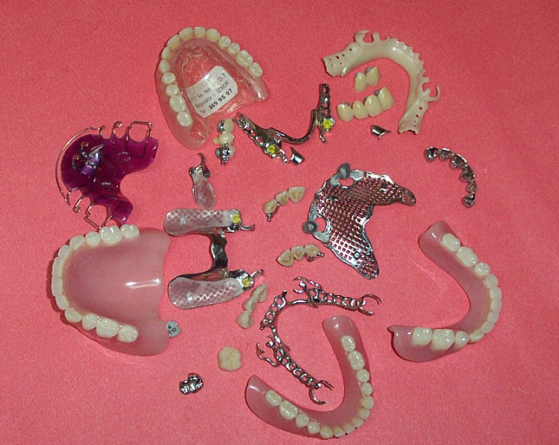
Prosthesis - (French Of protesie) - the artificial lost part body, teeth, jaw, nose, eye)

Slide 3
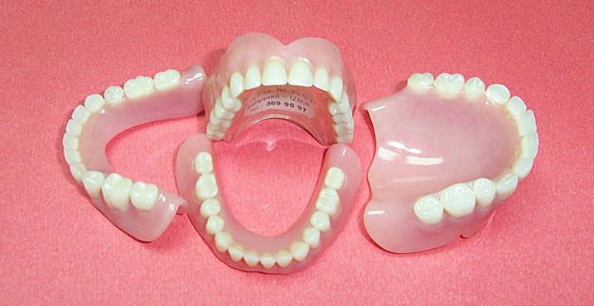
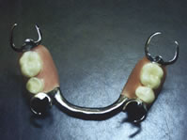
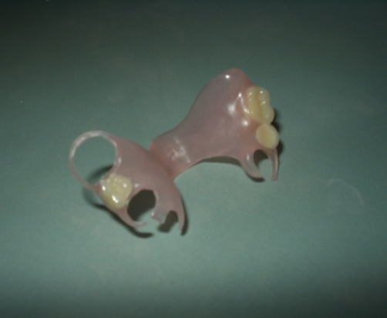

Slide 4
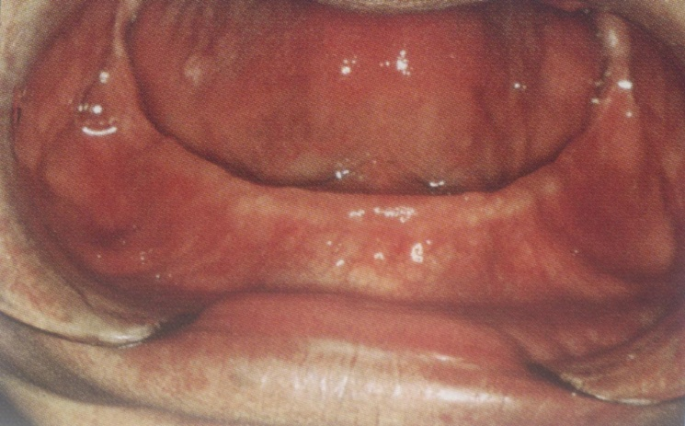
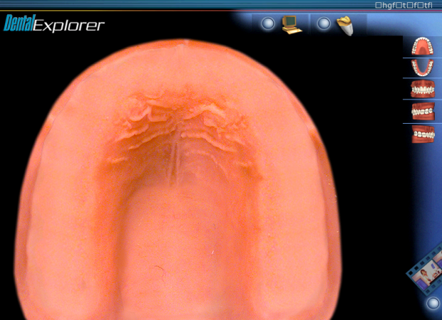
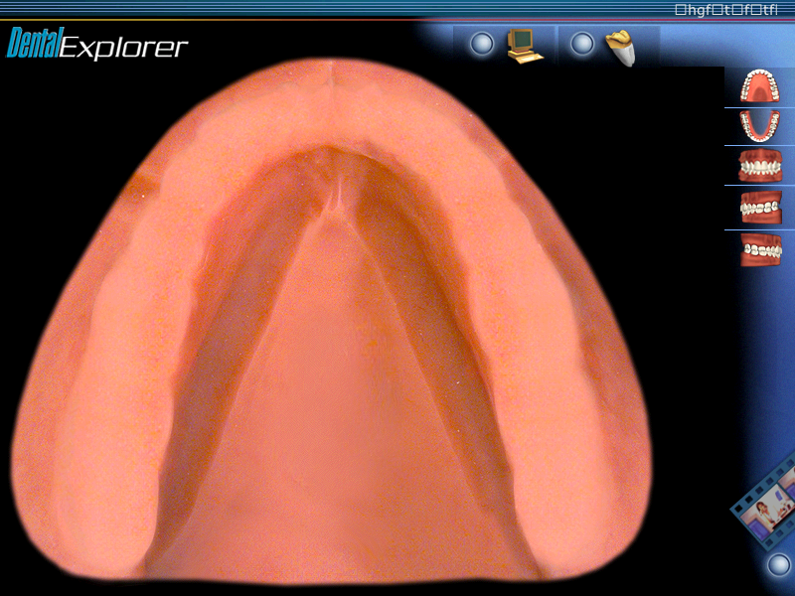
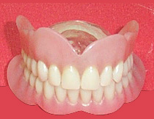
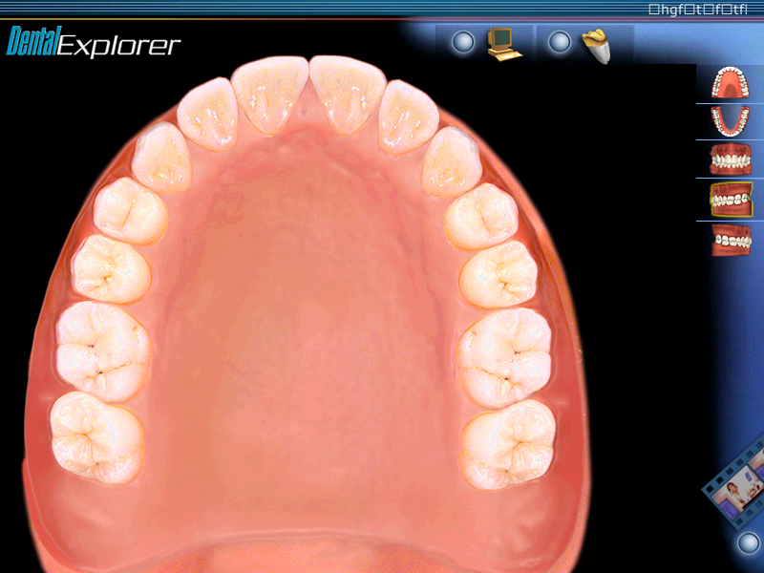
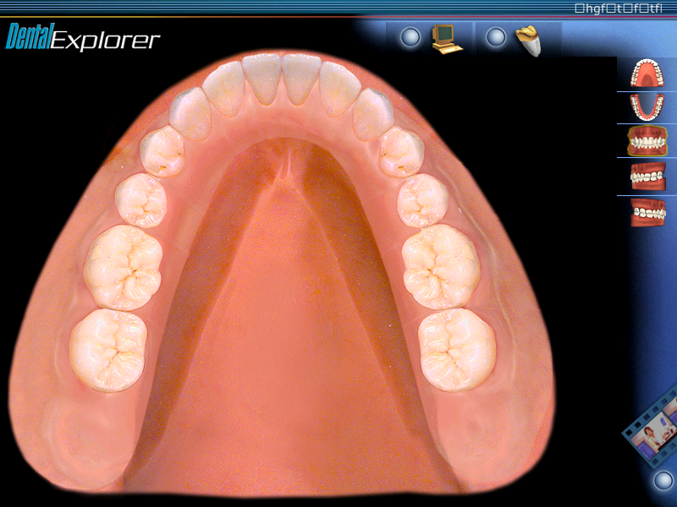
Complete of denture

Slide 5
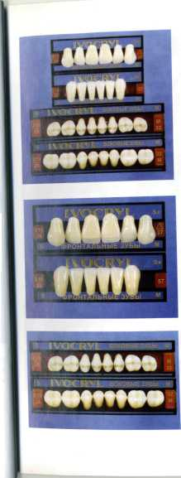
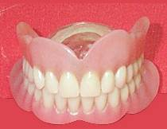
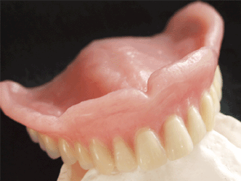
Parts of the complete denture
(CD)
Metallic or
the acrylic, nylon, polypropylen
basis
Acrylic or porcelan
the teeth

Slide 6
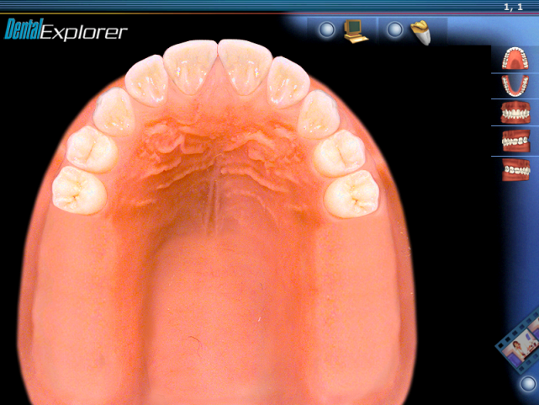
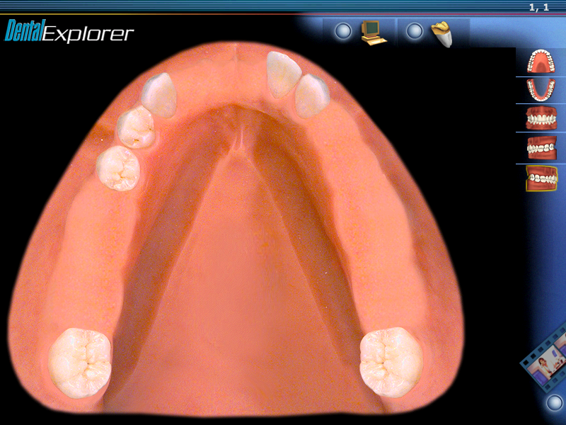
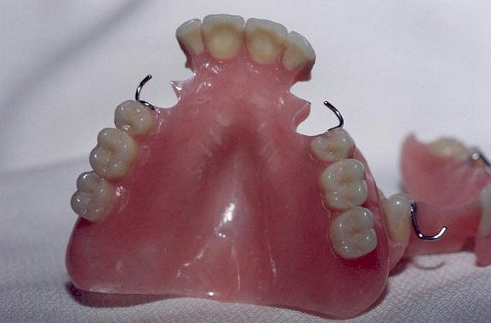
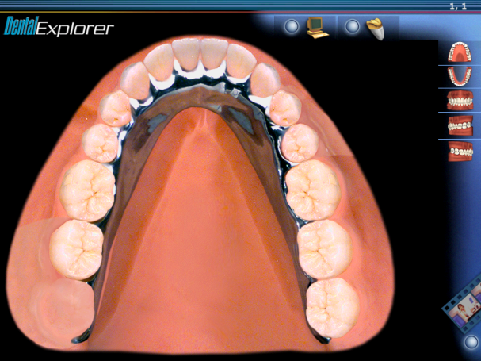

Partial denture

Slide 7
Parts of the partial denture
System of the fixation
(Clamps)
Acrylic or porcelane
the teeth
Acrylic,
nylon, polypropylen basis

Slide 8
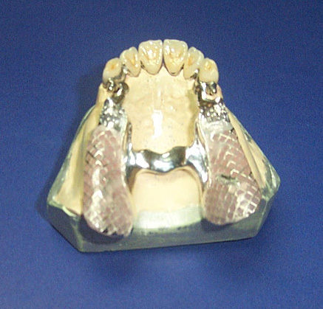
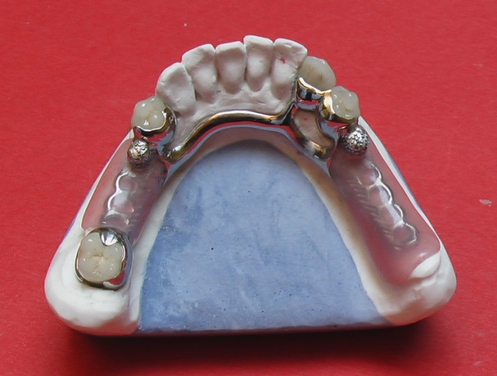
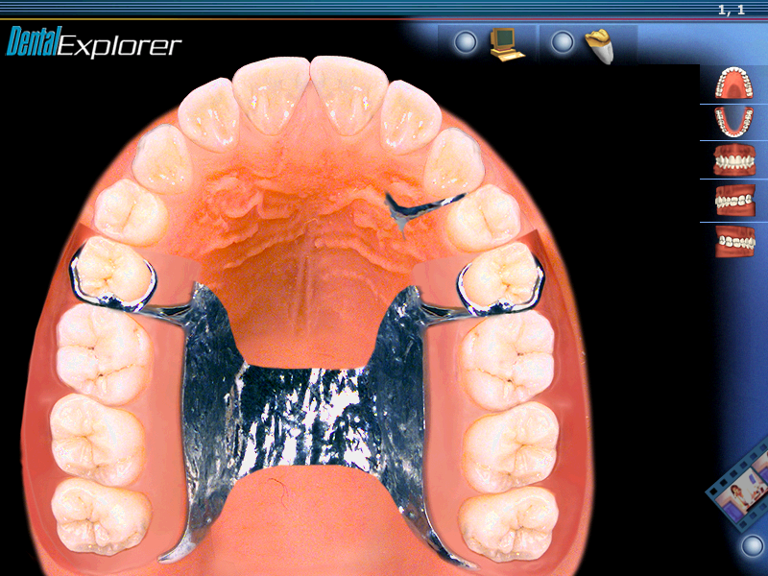
Bugel

Slide 9
Parts of a bugel
System of the fixation
(Clamps)
Acrylic or porcelane
the teeth
ARC
Acrylic basis

Slide 10
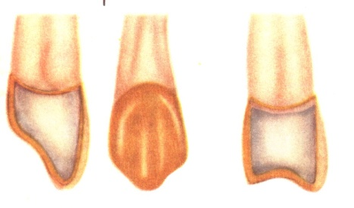
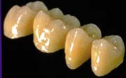
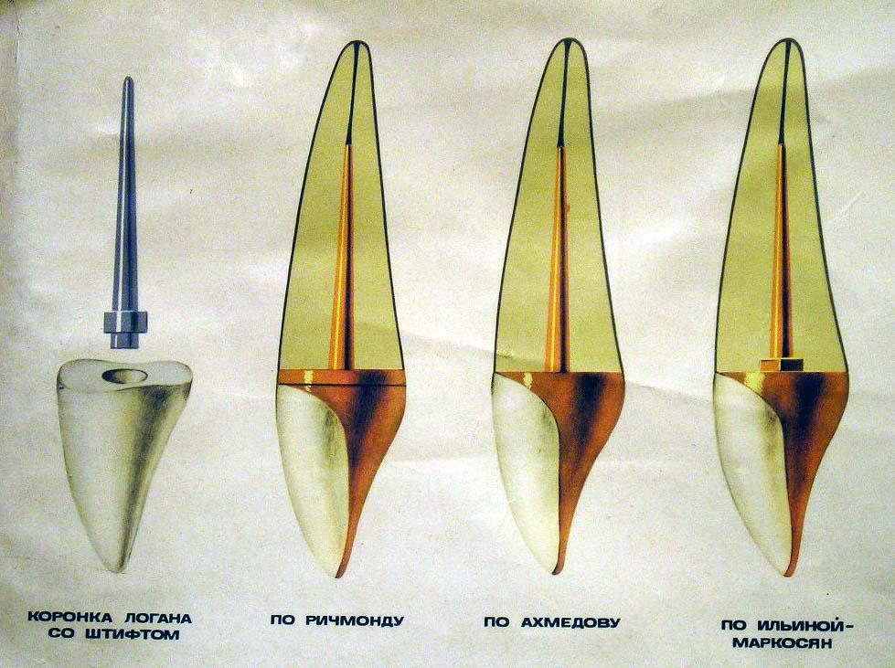
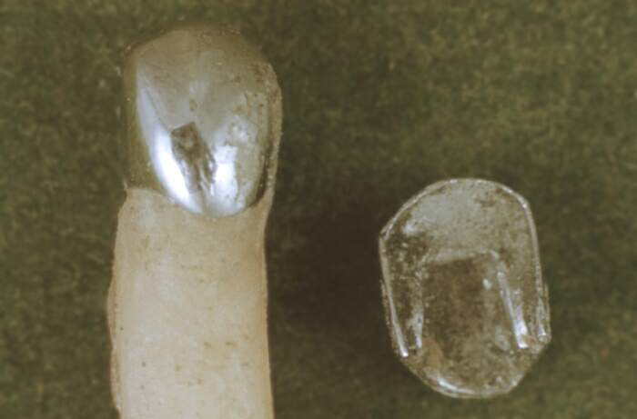
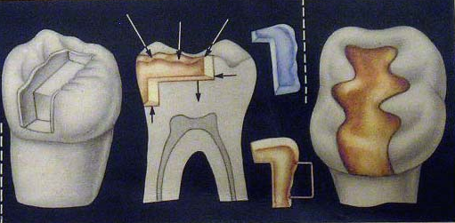
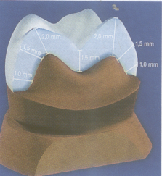
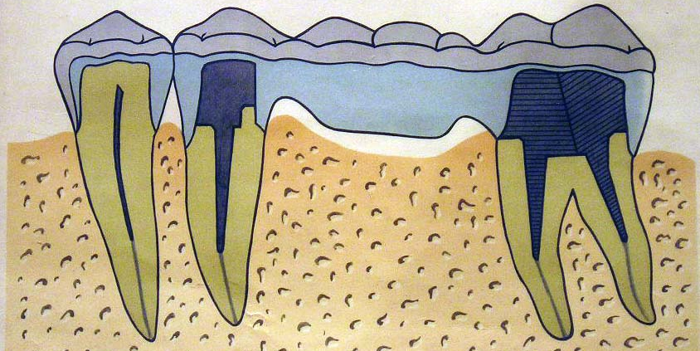
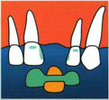
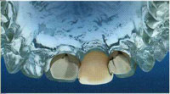
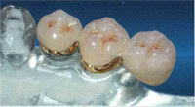
Fixed dental prostheses
Crowns
Half-crown
(three-quarter crown)
Pin tooth
Inlay, onlay, overlay
Bridge-shaped
prosthesis
Reteyner
Cansol prosthesis

Slide 11
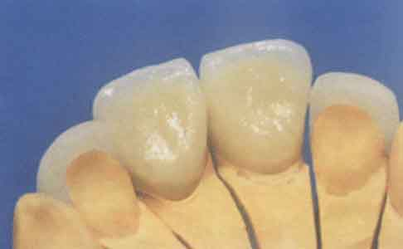
Crowns

Slide 12
It is accepted to distinguish:
the complete artificial crowns
stump crowns with the pin
telescopic crowns

Slide 13
Partial artificial dental the crown
equator crown
Armored crown
Halfcrown
Three-quarter crown
7/8 crown

Slide 14
Classification of the artificial the dental crowns
FULL
Crowns
PARTIAL
metalic
combine
Non metalic
plastic
ceramic

Slide 15
Classification of the artificial the dental crowns
PERMANENT
Crowns
PROVISIONAL
individual
standards
manufacturing
laboratory

Slide 16
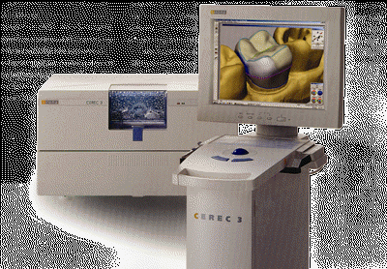
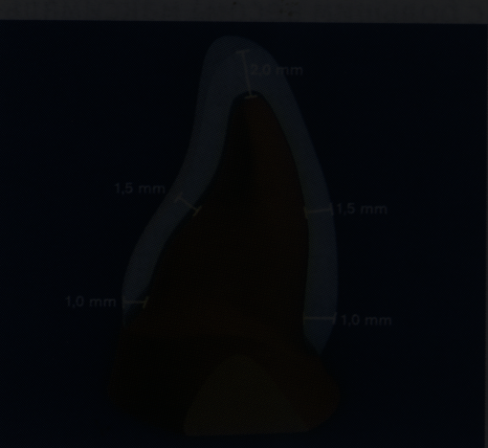

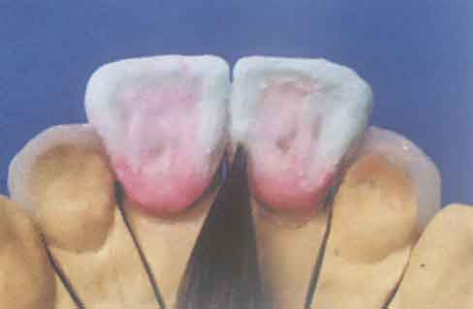
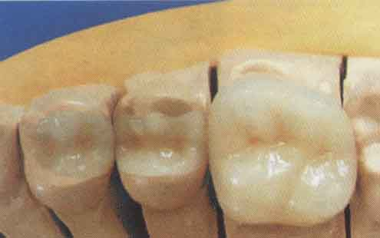
China crown

Slide 17
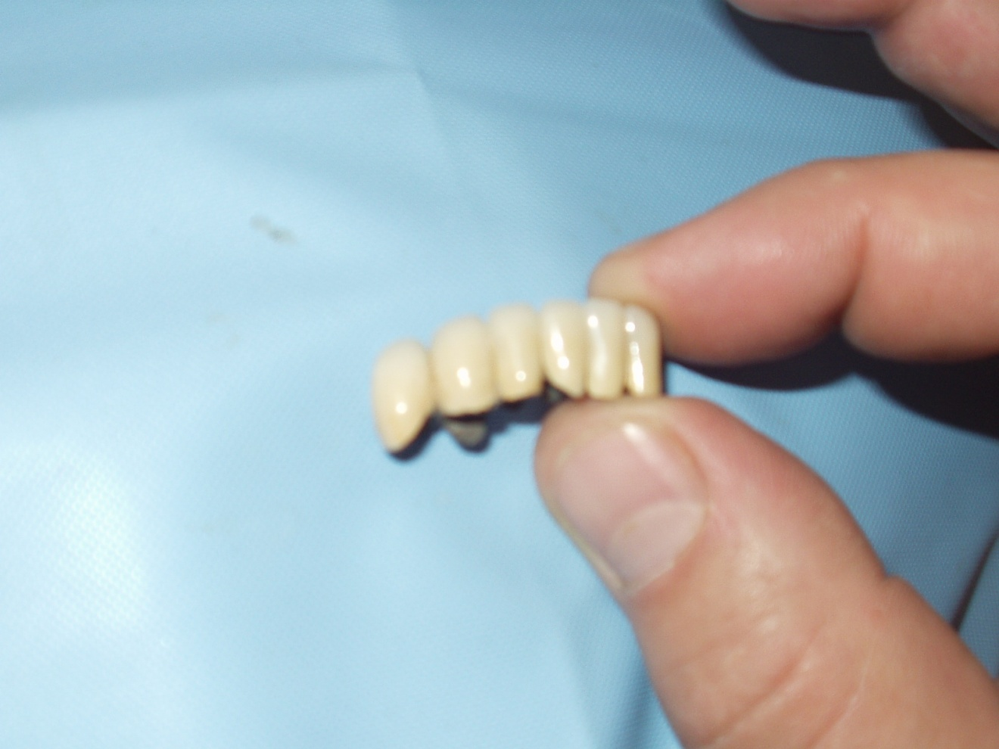
Bridge of prothesis

Slide 20
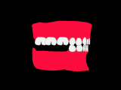
Bridge-shaped prosthesis on the implants

Slide 21
pin prothesis

Slide 22
PIN TEETH
according
to Akhmedov
on ilina-Markosyan
on Logan

Slide 23
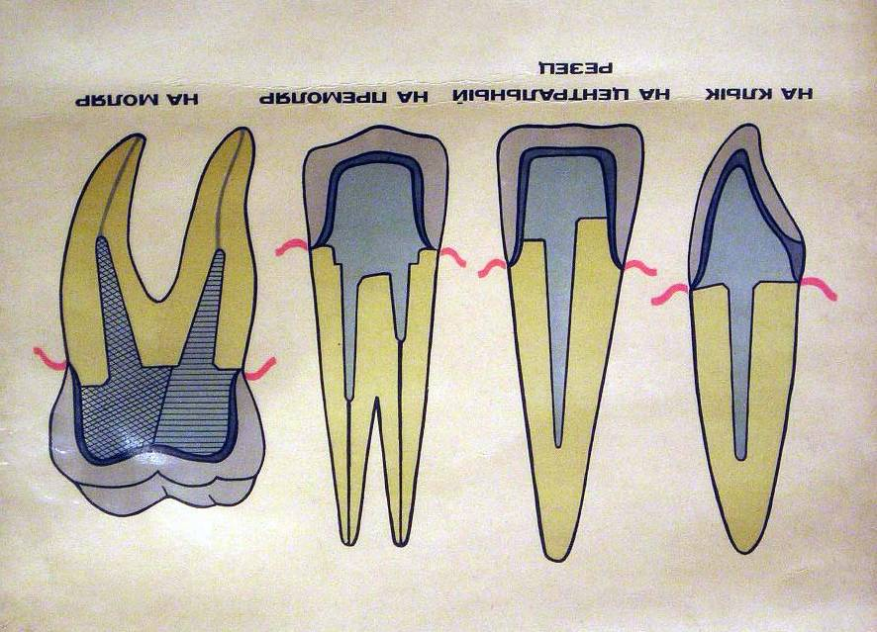
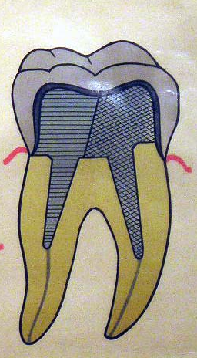
Pin inlay
cutter
canine tooth
premolar
molar

Slide 24
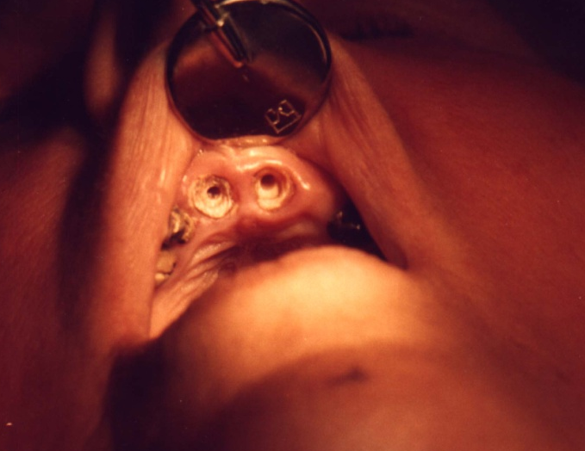
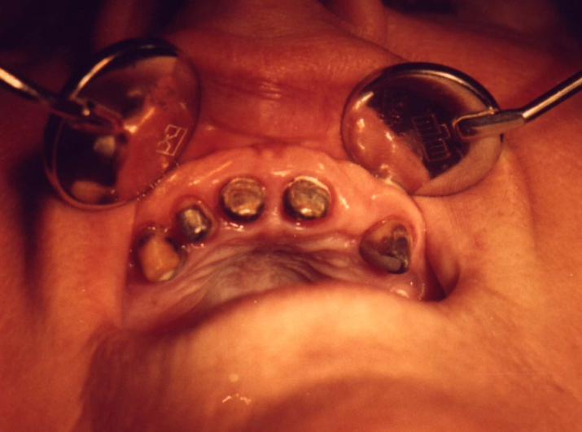
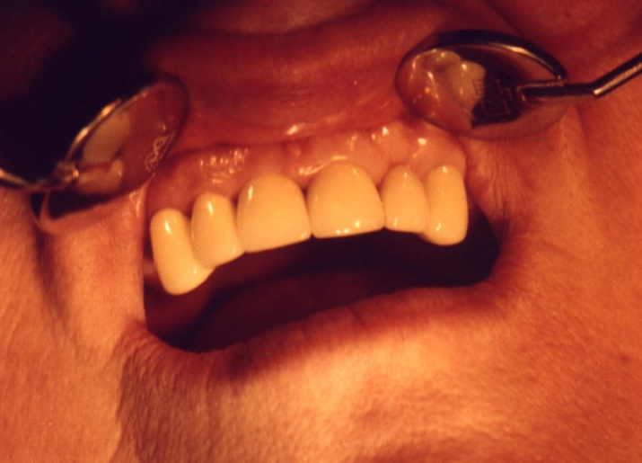
Clinical example
Preparation of the roots
the teeth
Fixation of the pin inlay
Finished of the making

Slide 25

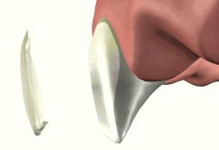
Micro-prostheses
inlay
overlay
vineer

Slide 26
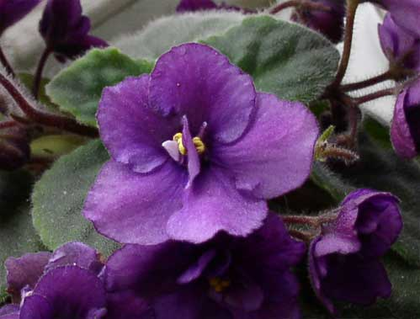
Thanks
at the point
of the attention!

