Slide 1
Biomechanics of masticator apparatus. Bites. The impressions and its classification. Methods of making.
Docent Shuturminskiy V.

Slide 2
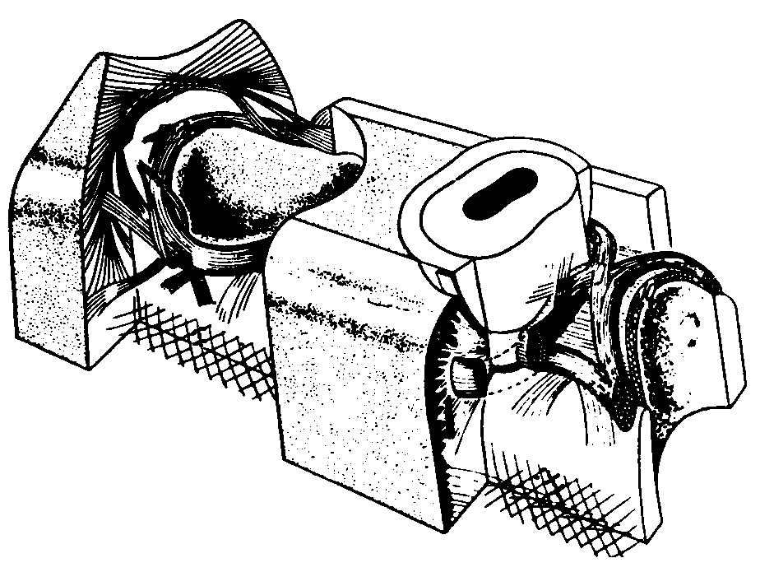

Periodontium – the tissues that support and surround the teeth

Slide 3
Articulation, occlusion
Occlusion– the state or process of being occluded or closed
Articulation– the jointed movement of the upper and lower teeth in contact

Slide 4
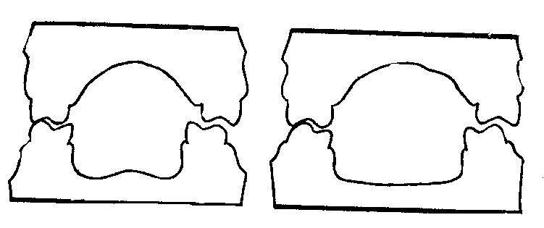
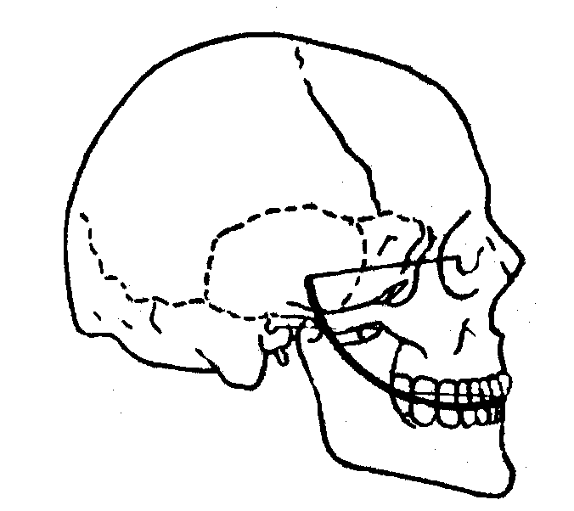
Kinds of occlusions
Central– maximal closed of teeth in start and finish of act of swallow and chewing
Right lateral
Left lateral
Frontal

Slide 5
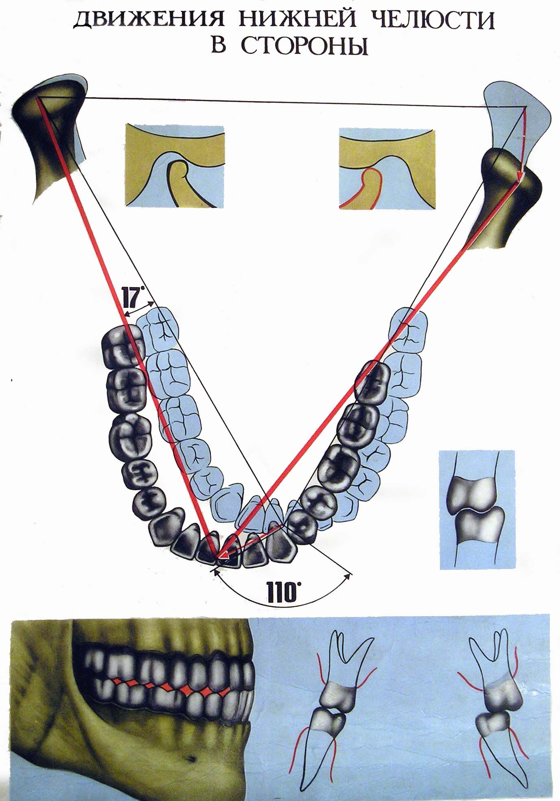

Slide 6
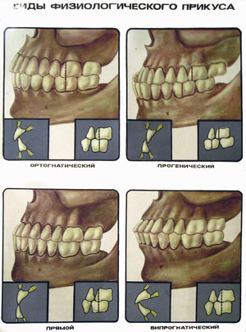
The bite
The bite – relations of dental arches in central occlusion.
Kinds - physiological
and pathological

Slide 7
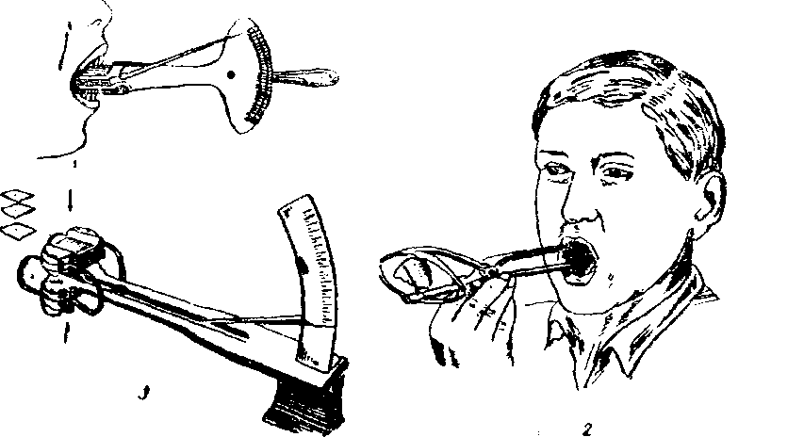
Masticator force —force, that may be matured with all chewing muscular.
Masticator pressure — a part of mastycatory force, which press to same area of chewing apparate.
Masticator efficient— the degree of crushing of food by teeth.

