Slide 1
Indications and contraindications for the replacement of partial defects of dentition with bridge prostheses. The design of bridge prostheses, their biomechanics.
Associate Professor, Candidate of Medical Sciences
Romanova Julia Georgievna

Slide 2
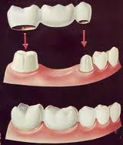
Bridge prosthesis - medical device to replace the partial absence of teeth and restore the functions of chewing, speech, the prevention of deformation of dentition, abnormal abrasion, overload the remaining teeth, and aesthetics. Bridge prosthesis transfers chewing pressure on periodontium by supporting elements bridge construction, which is regulated by periodontal-muscle reflex.
Bridge prosthesis consists
of the support elements and the intermediate parts.

Slide 3
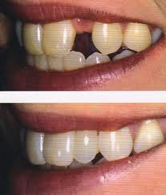
Partial adentia - a disease characterized by the violation of the integrity of the dentition and dentition of formed dentoalveolar system in the absence of pathological changes in the remaining teeth.
Adentia - lack of one or more teeth in the dentition (partial adentia), the complete absence of teeth (full adentia). Adentia primary - a result of violation of tooth primordia (true) (retention). or the delay of the eruption
Adentia secondary - a result of caries and its complications, periodontal diseases, trauma, surgery for inflammatory processes and neoplasms.

Slide 4
Indications for prosthetic bridges
Loss of one to four cutters
Loss of a canine
The loss of a premolar or some premolars
The loss of two premolar and the first molar
Permissible by loss on one side of the jaw of the two premolars, first and second molars when preserving and well-developed third molar
By correspondence in calculations of the coefficients of teeth chewing efficiency after N.I. Agapov, I.M. Oxman, V.K. Curlandskiy.

Slide 5
Contraindications for prosthetic bridges
the presence of a rudimentary third molar
lack of a canine, two premolars and first molar
periodontal disease
low clinical crowns of teeth

Slide 6
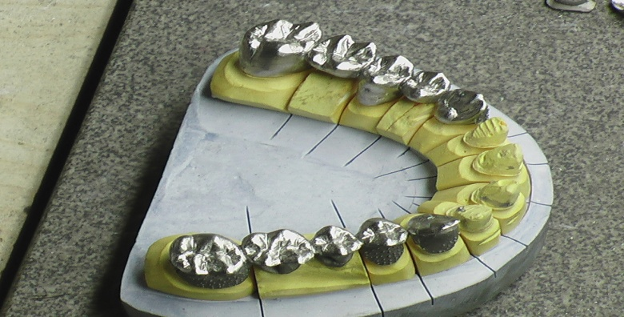
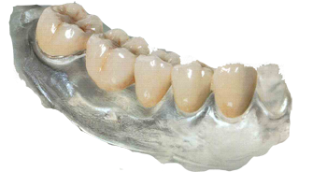
Signs of the classification of dental bridges
By material:
plastic
metal
porcelain
combined

Slide 7
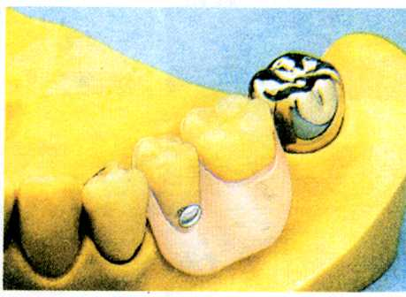
By the nature of attachment :
removable
non-removable

Slide 8
by method of production:
soldered
welded
casted
compound

Slide 9
By the relationship between intermediate part and alveolar process:
tangential
rinsing
saddle

Slide 10
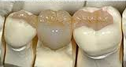
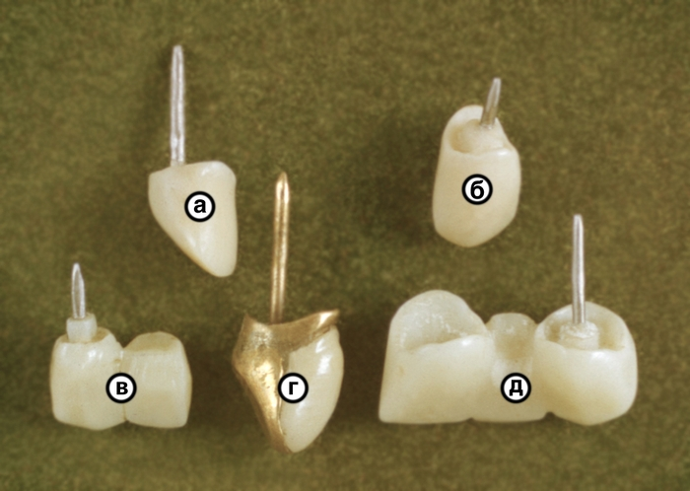
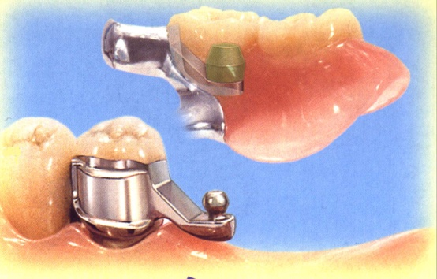
By abutment teeth position:
with double-sided reliance on natural teeth (bridge prosthesis)
with double-sided reliance on oral or occlusal surfaces (adhesive bridges (retainers; Merilendovskie; Rotchetovskie)
with unilateral distal support (cantilever prosthesis)
with unilateral medial support (cantilever prosthesis such as 'Brooklyn')

Slide 11
By construction of the core part of the prosthesis:
different kinds of crowns
semicrowns
tabs, pin teeth, and their combinations
options of clamp system or attachments
implants
lining

Slide 12
Clinical and laboratory stages of bridge manufacture (cast, compound)
History taking, examination, diagnosis, selection of construction and removal of diagnostic impressions, anesthesia, dissection, removal of the worker and the support of prints, the fixation of the central occlusion.
Getting the collapsible combination of the working models and plaster - auxiliary, plastering in the articulator in the position of central occlusion, the allocation of fragments of the model, modeling of bridge made of wax (in the manufacture of unit-cast bridge modeling of framework (in the manufacture of compound bridge), passing the wax composition to the casting lab.
Casting - replacement of wax on the metal pretreatment.
Fitting the metal structure in the mouth. Determines the color of artificial teeth (in the manufacture of compound bridge)
In the manufacture of unit-cast bridge - processing, polishing, the manufacture of compound bridge - the application of veneer (ceramic or plastic).
Fixation of cast bridge. Fitting of design of combined bridge, colour clarification (for the production of the combined bridge)
Fixation of the combined bridge.

Slide 13
Bridge prostheses biomechanics
Nature of the distribution and quantity of chewing pressure incident on the bridge prosthesis body and transmitted to the abutment teeth, depends primarily on the location of application and direction of load, length and width of the body of the prosthesis.

Slide 14
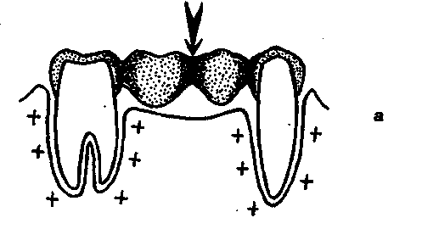
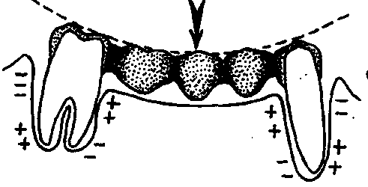
If the functional load falls in the middle of the intermediate part of the bridge (Fig. a), the entire design and periodontal tissue are loaded evenly and turn out in this connection in the most favorable conditions. However, these conditions are in the process of chewing food are observed only rarely. At the same time it should be borne in mind that when the length of the intermediate part, or not expressed in the elastic properties of the alloy body of the prosthesis may bend and cause additional functional overload in the form of a counter, or converging, the slope of the abutment teeth (Fig. b). In this regard, functional overload is unevenly distributed in the periodontal tissues, contributing to the development of local degenerative process.
Fig.a
Fig. b

Slide 15
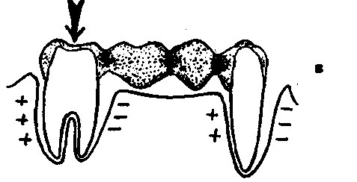
Thus, to prevent possible changes in the periodontium of abutment teeth under the bridges of his body must have sufficient thickness and not exceed the maximum length, excluding the deflection of the metal in the dentition defect.
When occlusal load to the one on the abutment teeth takes place offset of both poles on a circle whose center is the opposite, less loaded abutment tooth. This explains the tendency of the abutment teeth to a discrepancy or divergence. Under these conditions, functional overload is also unevenly distributed in the periodontal tissues (Fig. c)
Fig.c

Slide 16
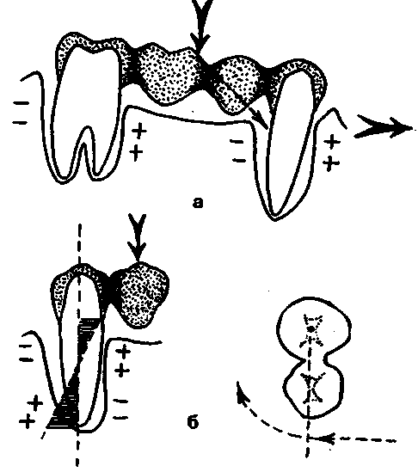
If bridges are used in severe sagittal occlusal curve or significant deformation of the occlusal surface of the dentition, for example, against the background of a partial loss of teeth, part of the vertical load is transformed into a horizontal one. The latter shifts prosthesis in sagittal way , causing the slope of the abutment teeth in the same direction (Fig. c).
Fig.c

Slide 17
Extremely dangerous for periodontal vertical loads is falling on the body bridge with one-sided support (ie the console) in this case the functional load causes the slope of the abutment in the direction of the missing. In periodontal tissues also have an uneven distribution of elastic stresses. The probability of the development of functional overload in the decompensation stage can be reduced significantly with increasing number of abutment teeth cantilever prosthesis in the case of a defect length of not more than one tooth (Fig. d).
Fig.d

Slide 18
When only the body of the prosthesis gets a piece of food, its pressure will have a dislocating effect. Thus, in this case, a tipping point that will be greater, the longer the lever, and expressed the force applied to it. A somewhat different situation arises when the lateral movement of teeth . In this case, the body of the prosthesis will be shifted to the printed outside turning abutment. The resultant torque will be equal to the product of the length of the lever on the force. As upsetting as well as torque creates an unusual functional load direction. Functional overload of dental prostheses in the console, replacing molars, leading to abnormal tooth mobility, tilt them toward the defect, causing the end of the graft body at low clinical crown begins to put pressure on the mucous membrane, forming bedsores.

Slide 19





Thank you for your attention

