Slide 1
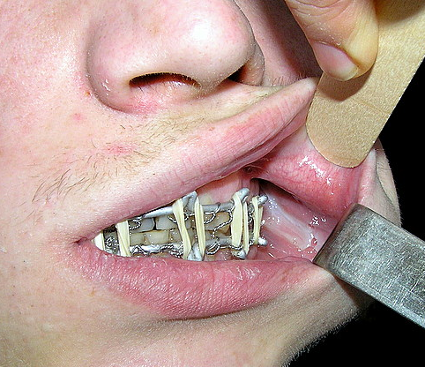
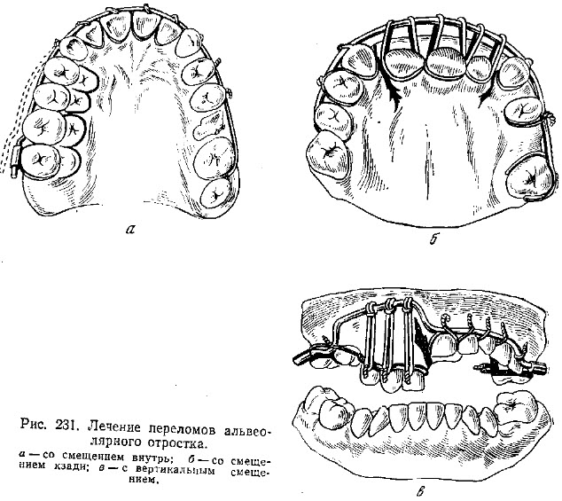
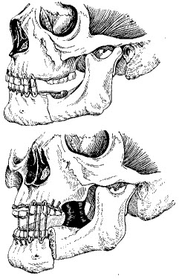
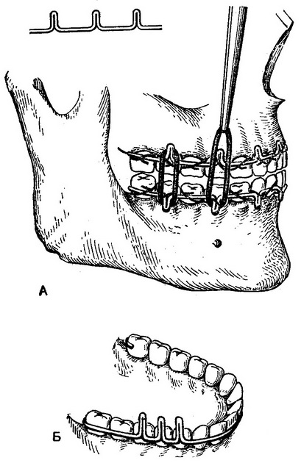
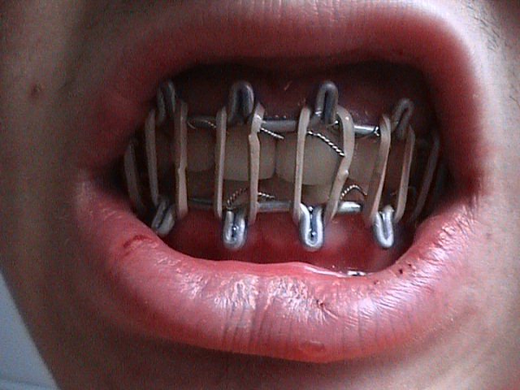
Fractures of jaws with a steady displacement of bone fragments

Slide 2
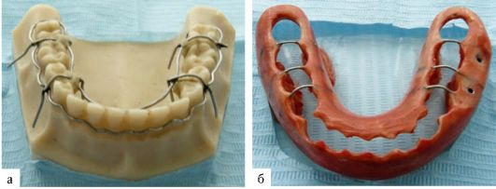
Splint by Weber
For the treatment of single mandibular fractures with full mobility of fragments in the case of a small number of teeth on the bone fragments or mobility of teeth, special removable teeth-gum splint by Weber.
This splint covers the rest of the dentition and gums on both fragments, leaving open the chewing and cutting surfaces of the teeth. It can be used for follow-up care of fractures of the mandible.

Slide 3
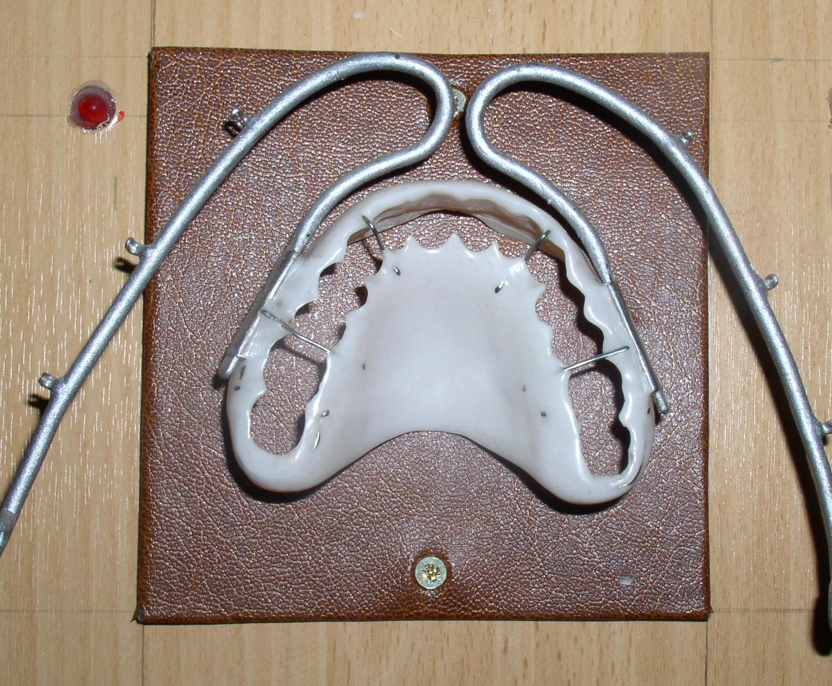
Veber’s splint for fixing upper jaw fragments

Slide 4
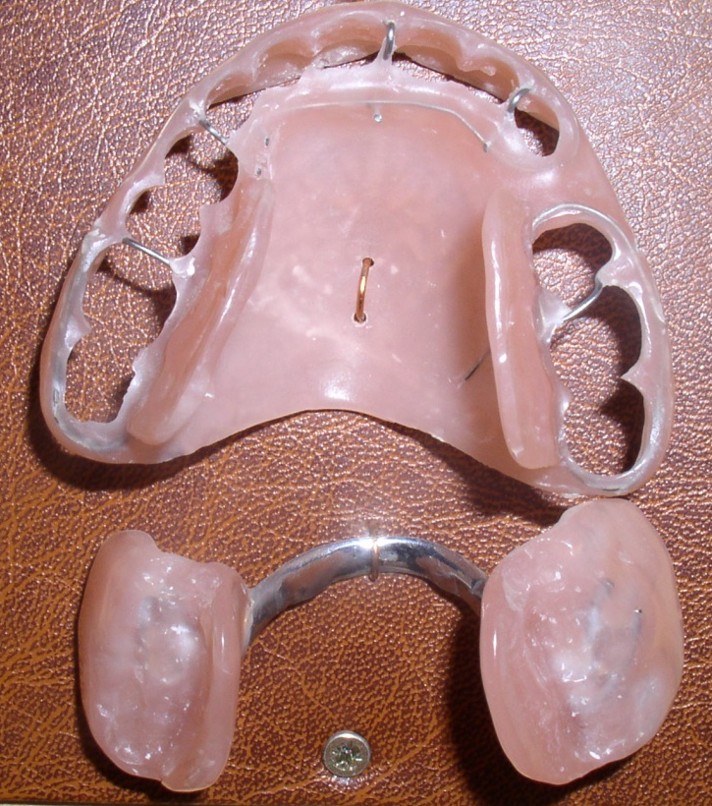
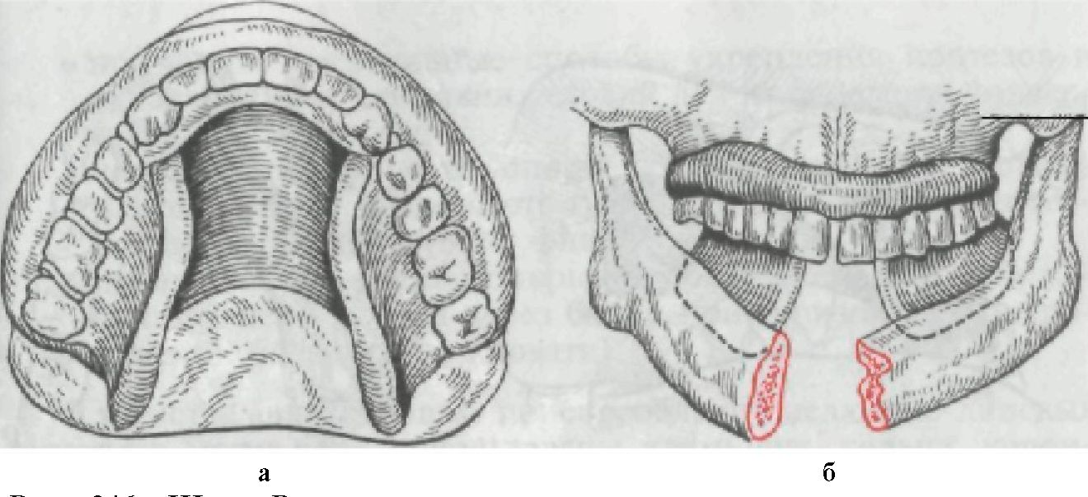
Splint by Vankevich
Splint is used for fixing the lower edentulous jaw or jaw with little number of teeth. It consists of a base part fixed on the upper jaw, and two vertical processes adjacent to the edentulous mandible with the lingual side. These processes hold the fragments of the lower jaw in position.

Slide 5
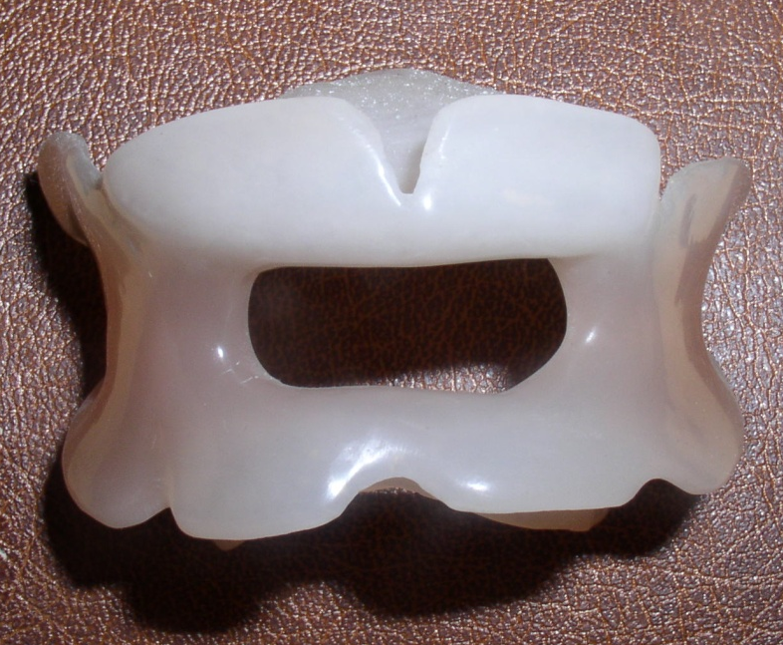
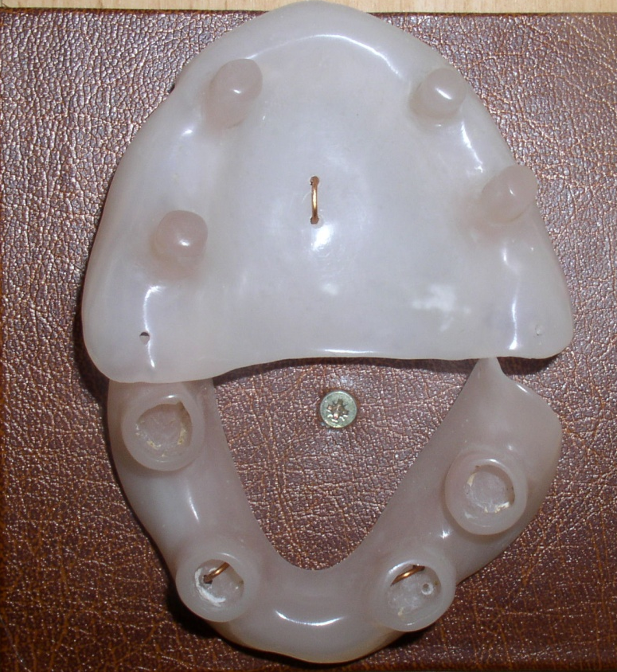
Port’s-Gunning’s splint
Dismountable splint
by A. Limberg
It is used along with four-tailed bandage.

Slide 6
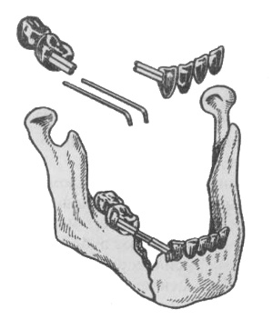
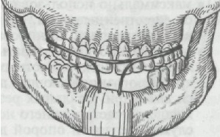
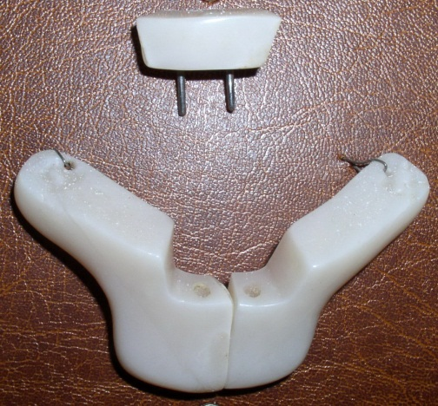
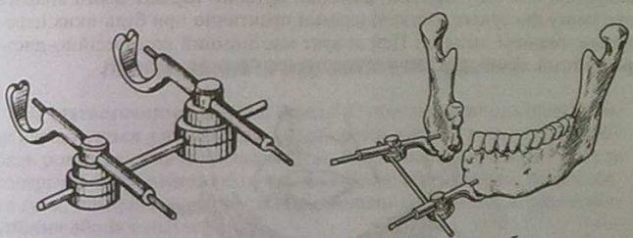
Formative apparates
Apparatus by Kurlyandskiy.
by Betelman
Apparatus by Rudko
Instruments (splint), which retain the body parts(e.g. jaw) in a certain position.

Slide 7
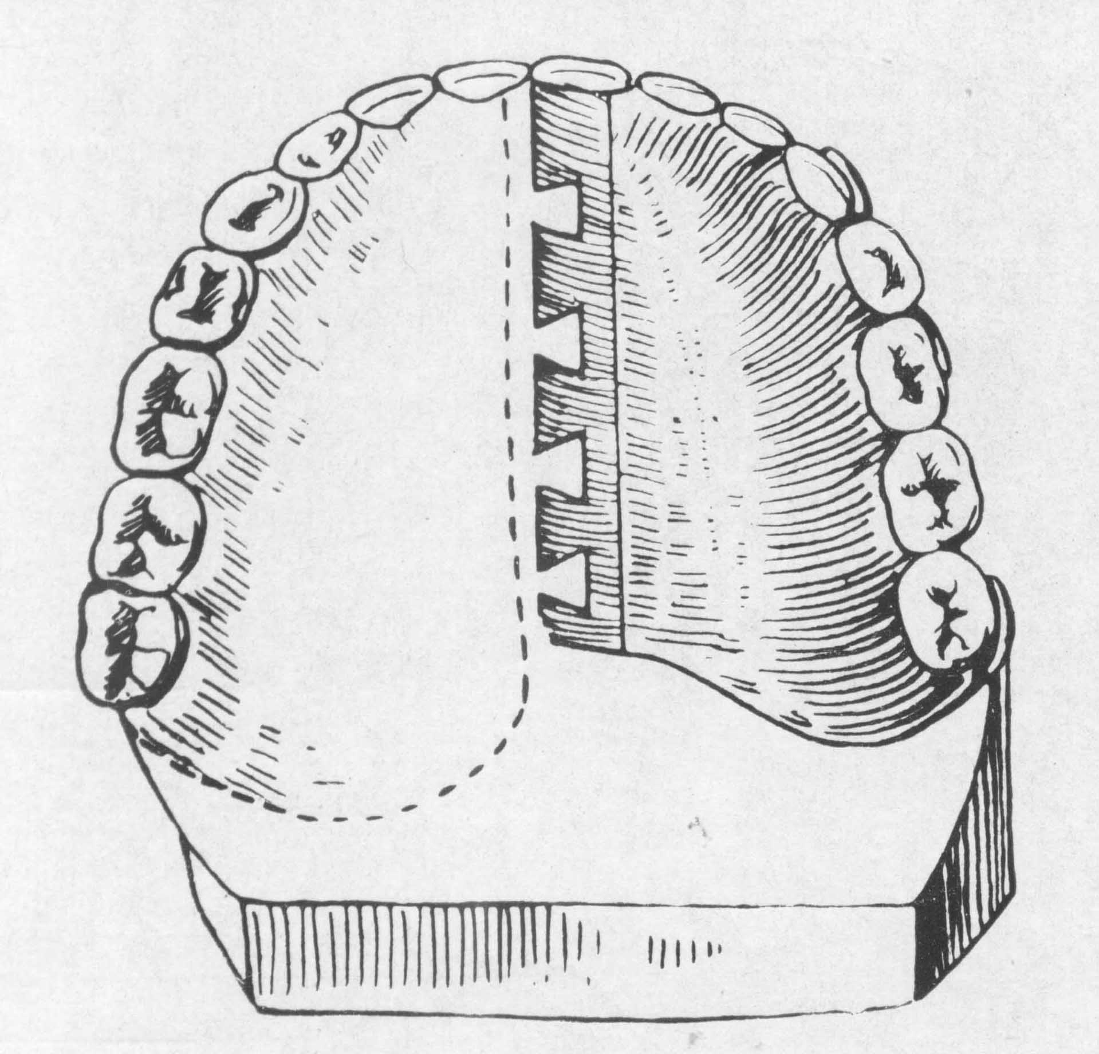
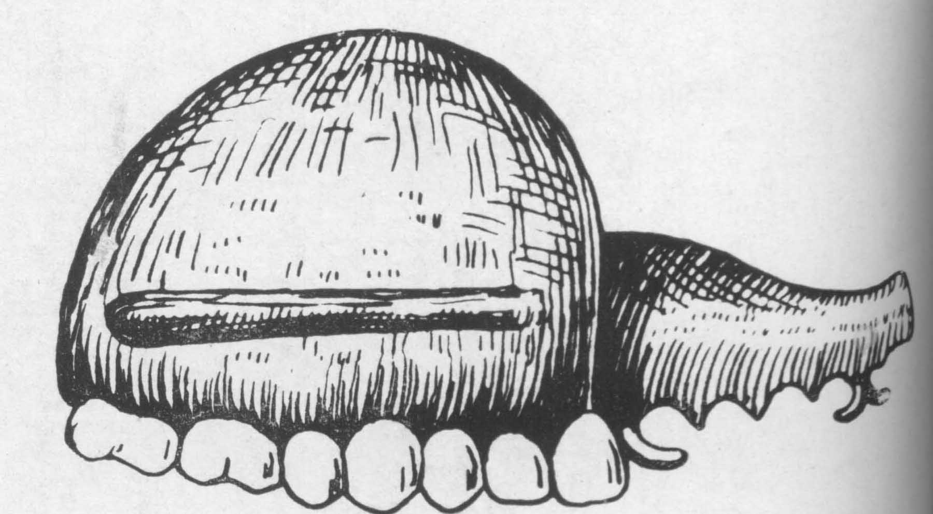
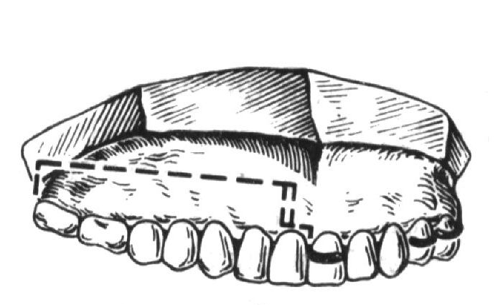
Prosthesis after resection of upper jaw
Apparatus of Oksman
Stages of preparation
1 stage: making of fixating lamina.
For fixation use lean-hold or double clasps
2 stage – making post-resection part of prosthesis.
3 stage – making obturative part of prostesis

Slide 8
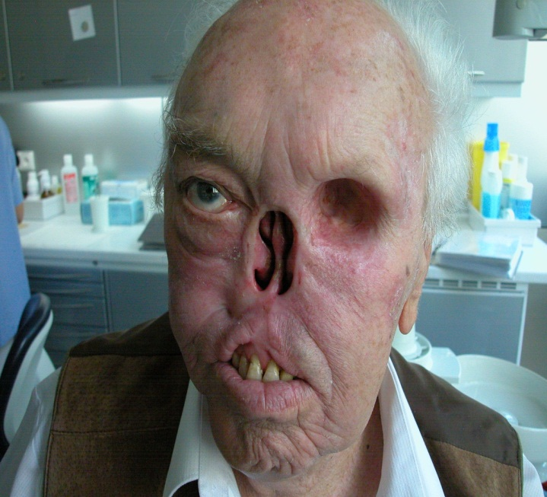
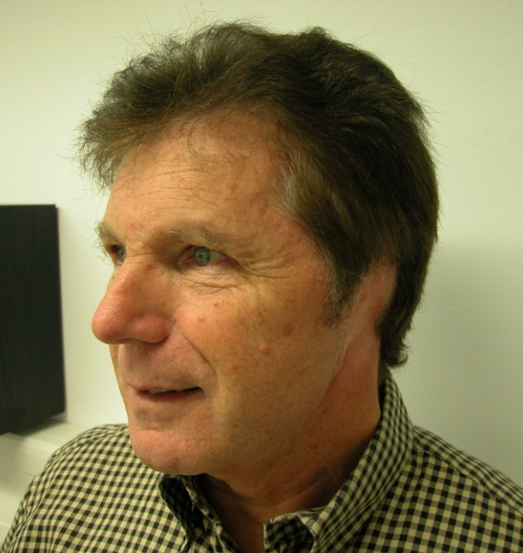
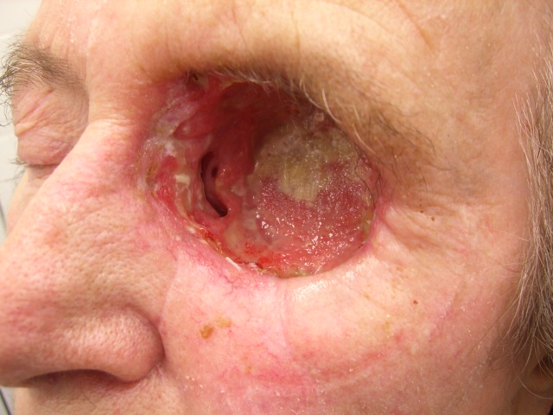
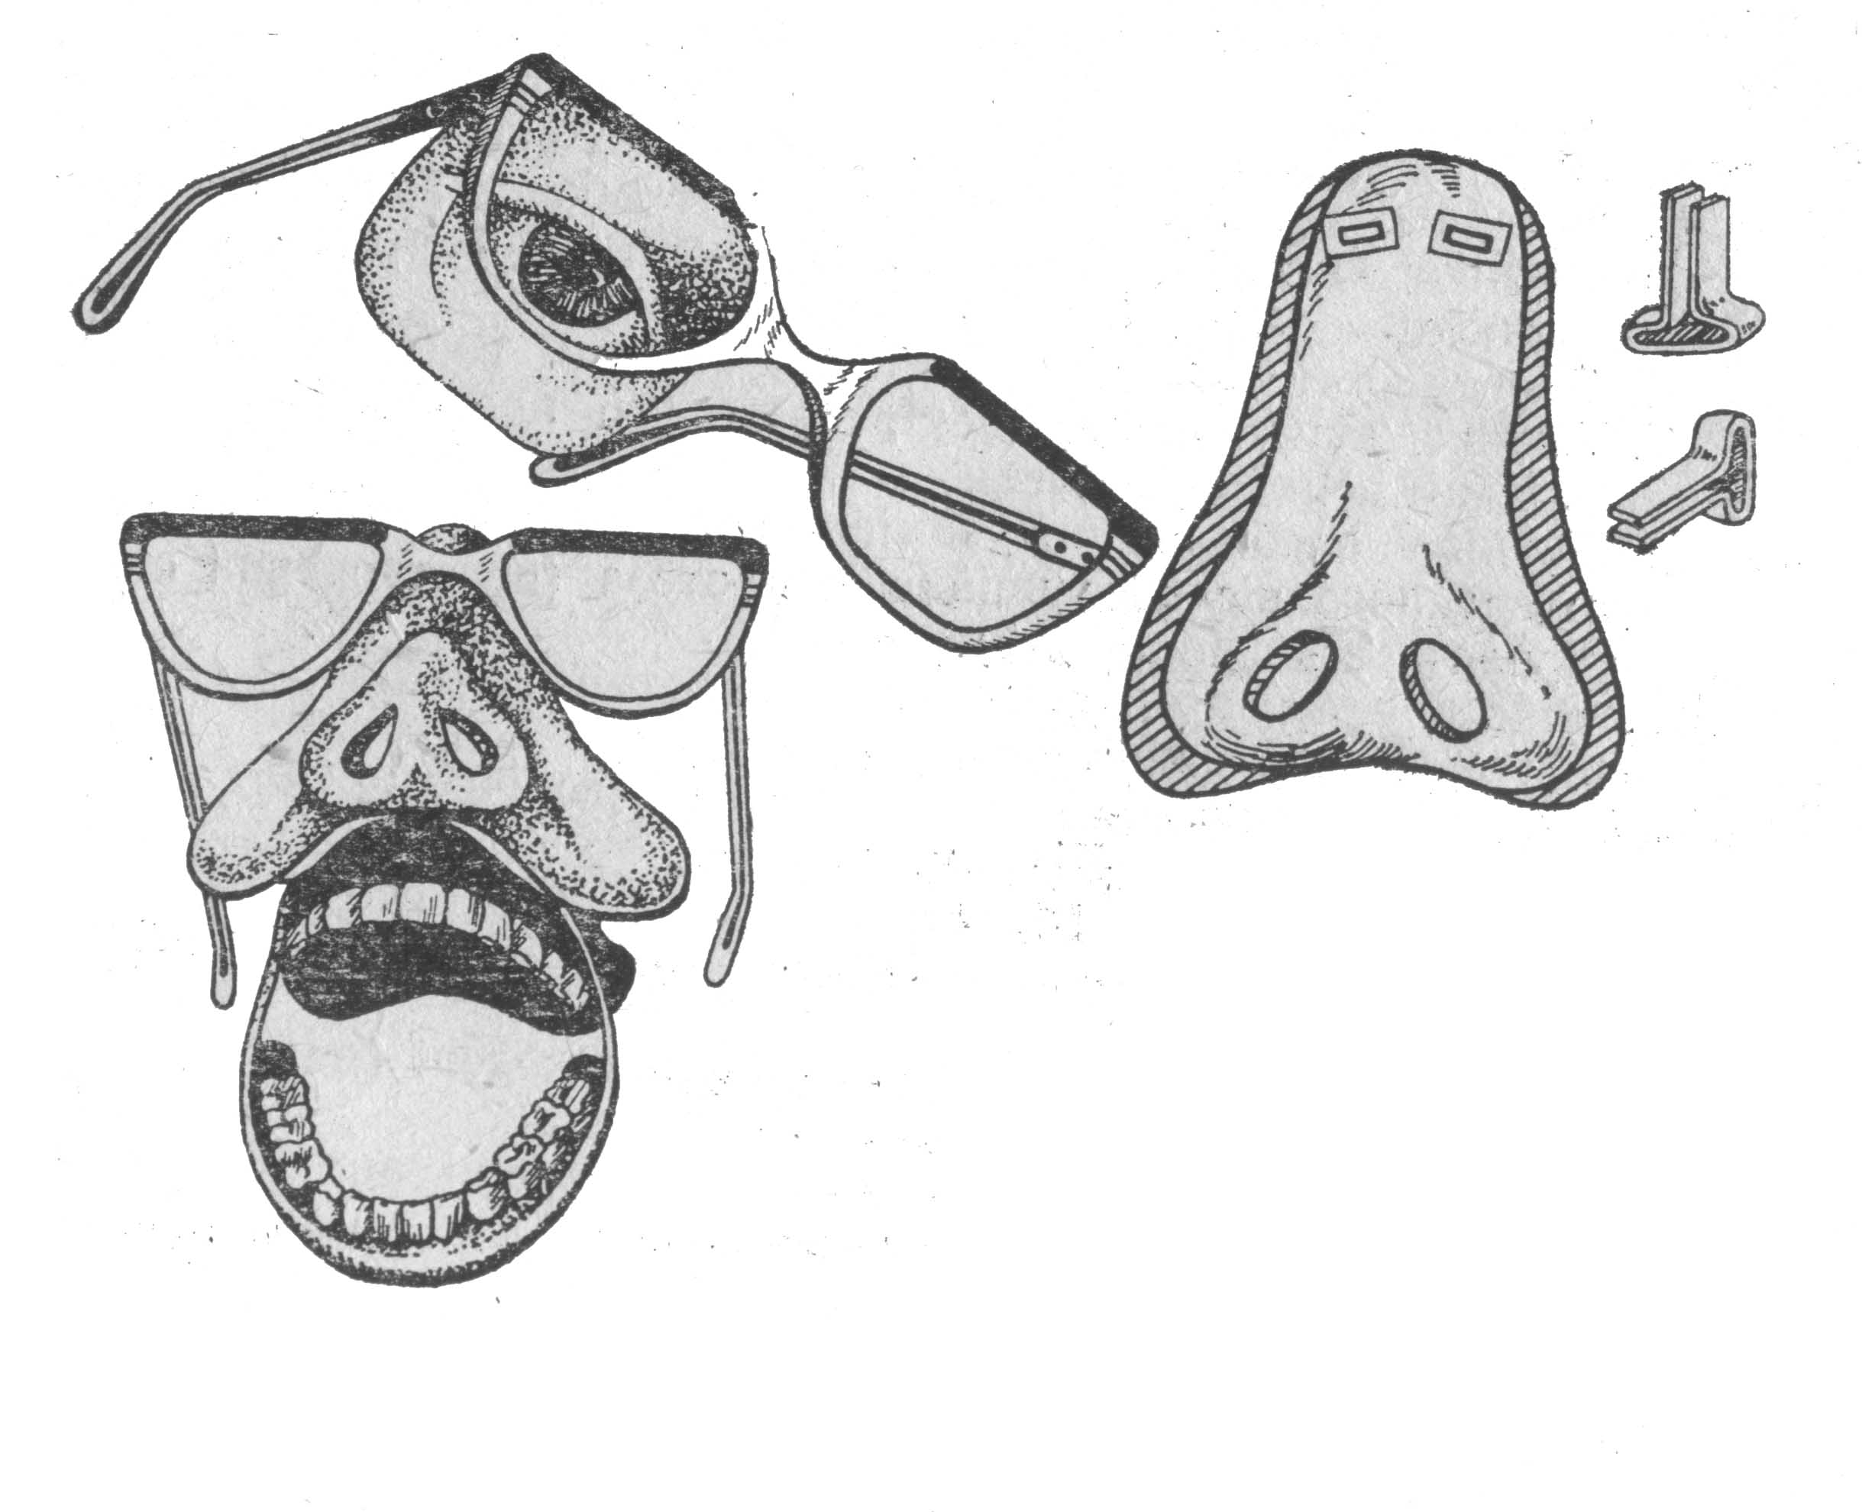
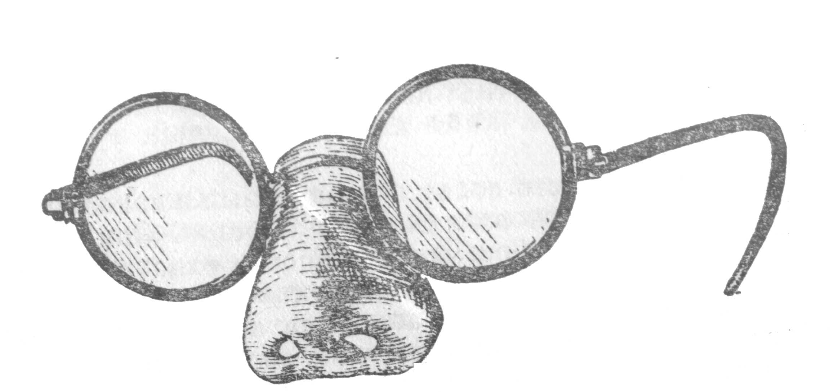
Prosthesis of the face

Slide 9
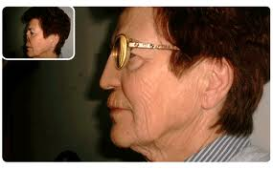
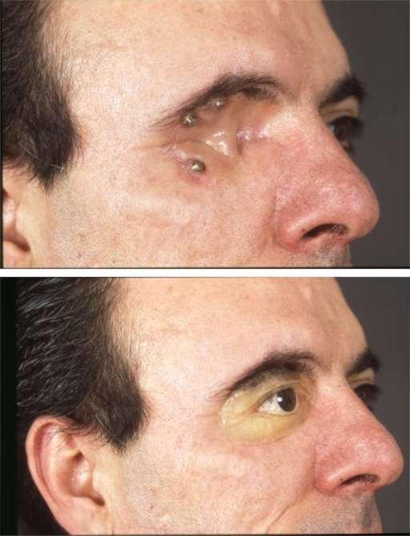
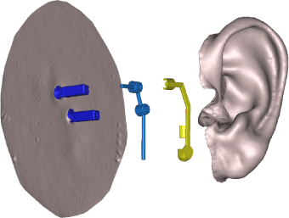

Slide 10
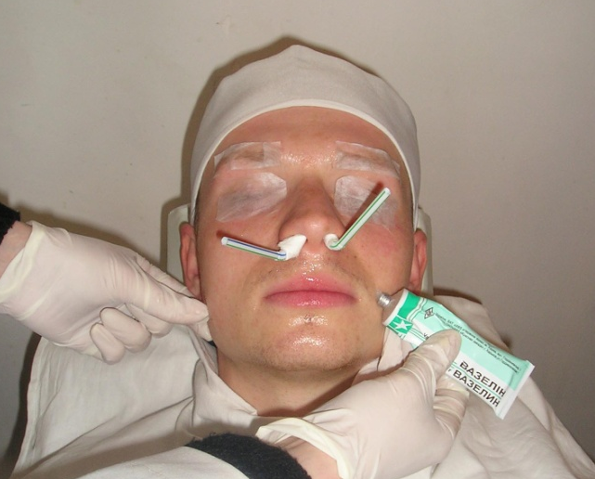
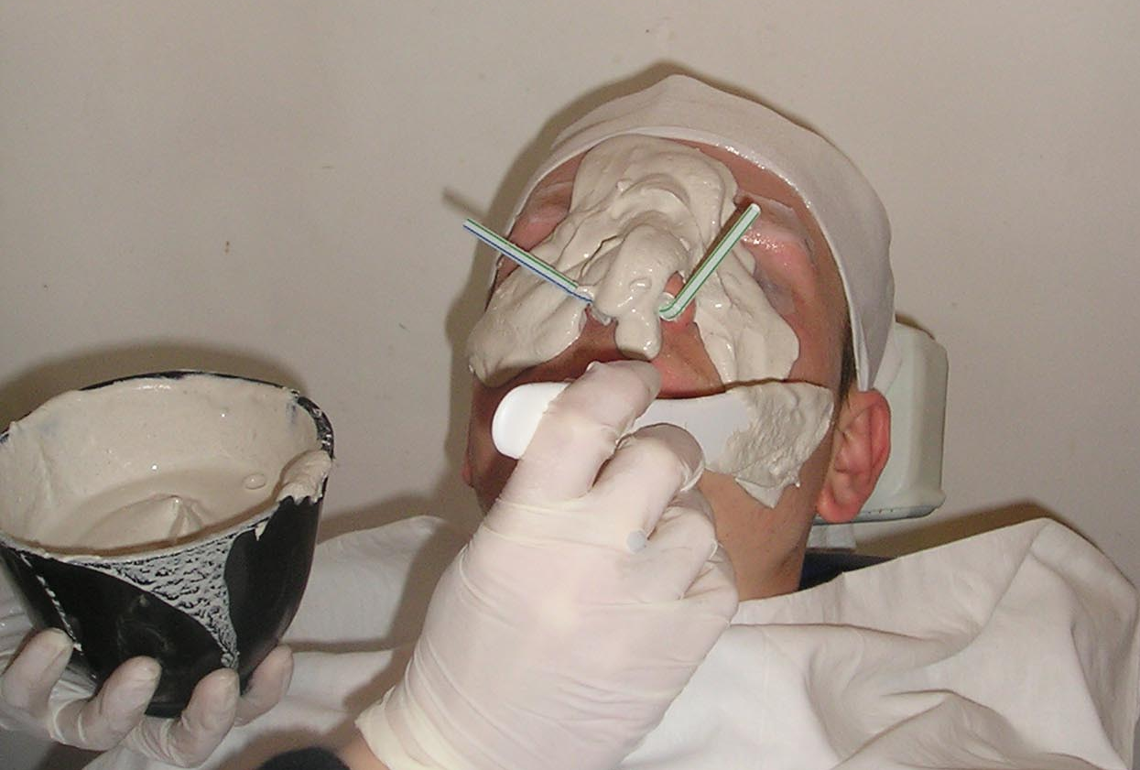
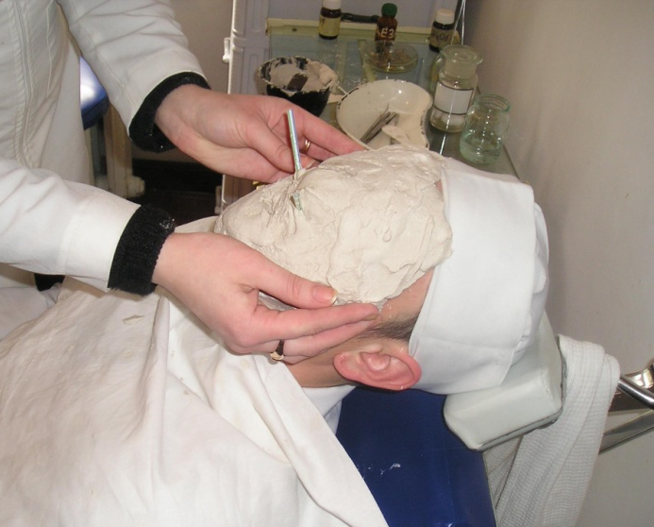
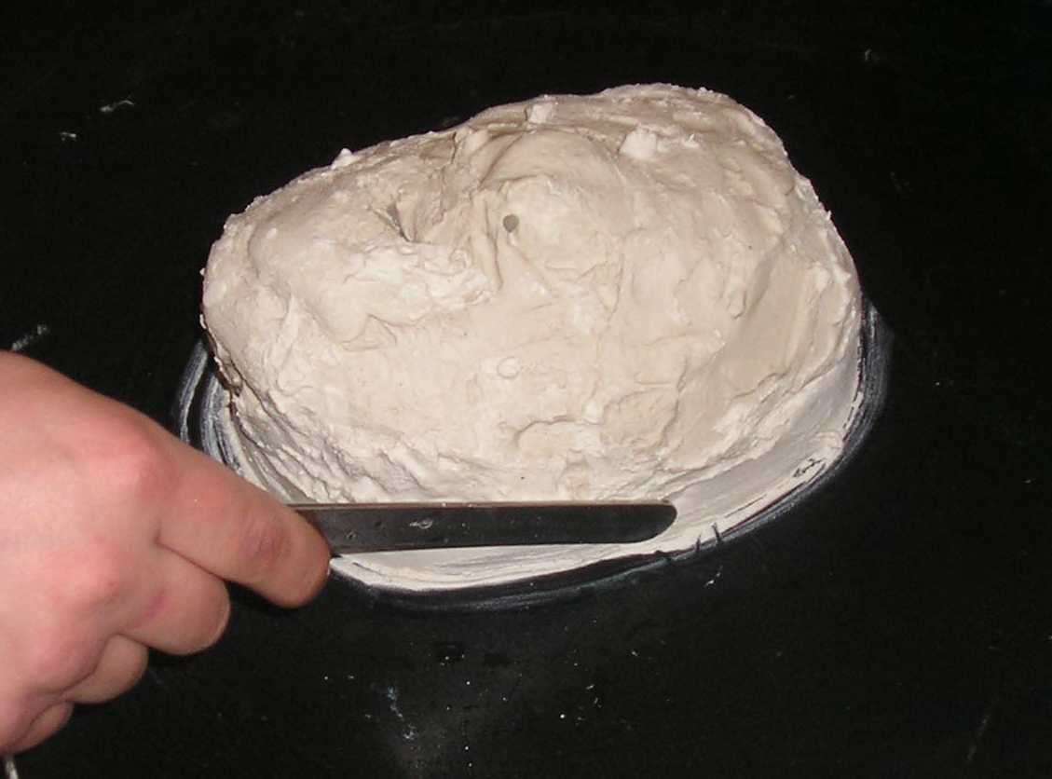
Preparing face mask
Isolation of face
Application of gypsum 1.5-2 cm
Removal of impression to
the front and down ward
Making the model

Slide 11
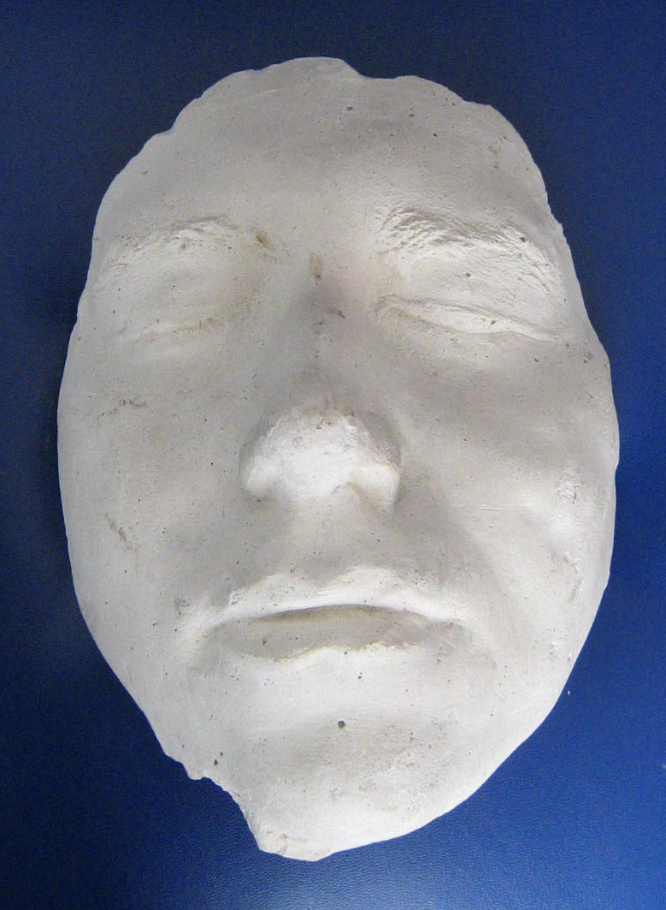
Preparing face mask
End result of face mask

Slide 12
Tests for KROK - 2
Patient, 93 years old, is made face mask for preparation of ectoprosthesis. In which direction should the mask be taken off.
Front and down
Front and up
Front and right
Front and left
Front

Slide 13
Tests for KROK - 2
Patient, 93 years old, is made face mask for preparation of ectoprosthesis. In which direction should the mask be taken off.
Front and down
Front and up
Front and right
Front and left
Front

Slide 14
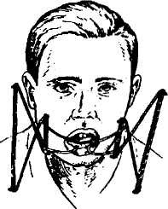
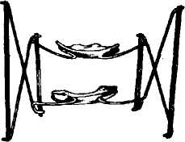
Etiology, pathogenesis, clinical contractures of the lower jaw, their classification. Prevention of contractures and methods their prosthodontics treatment.
Contracture jaws - restriction or complete inability to open the mouth due to pathological changes in the soft tissues, functionally related to the temporomandibular joint.
Reasons: 1) reflex tonic contraction of masticatory muscles in various pathological conditions. 2) ankylosis of the temporomandibular joint, and 3) scars of admaxillary tissues.
Distinguish between unstable and persistent contraction of jaws.
By the degree of contraction of the mouth openings are divided on light (2-3 cm), medium (1-2 cm) and heavy (up to 1 cm).
Treatment of contractures - conservative, surgical and combined.

Slide 15
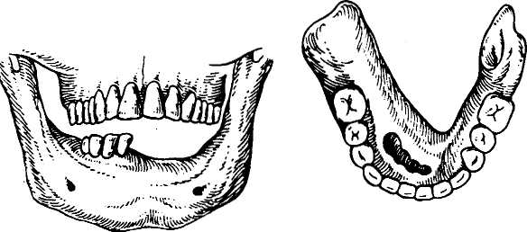
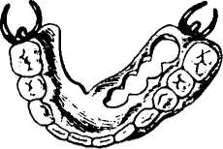
Etiology, pathogenesis, clinical and orthopedic treatment of wrong intergrown fractures.
Relatively small occlusive disorders can be corrected by prosthodontics.
We can use fixed or removable prostheses: metal crowns, denture with cast occlusal overlay for align vertical disorders.
When violations transversal occlusion and a small number of remaining teeth denture with duplicated dentition apply.
To eliminate occlusal disorders surgical and orthodontic techniques can be used.

Slide 16
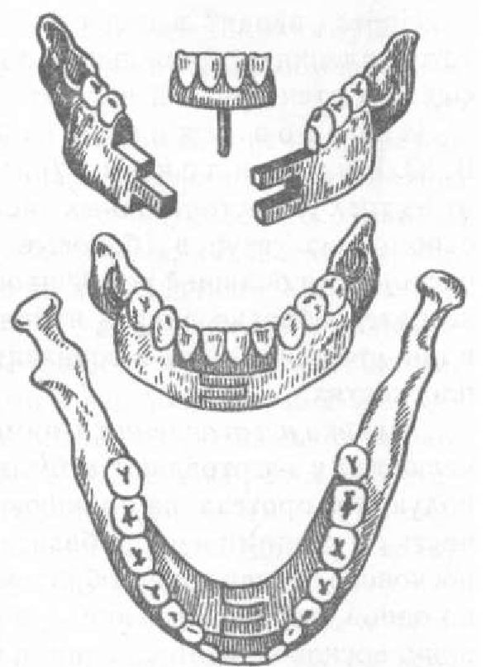
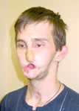
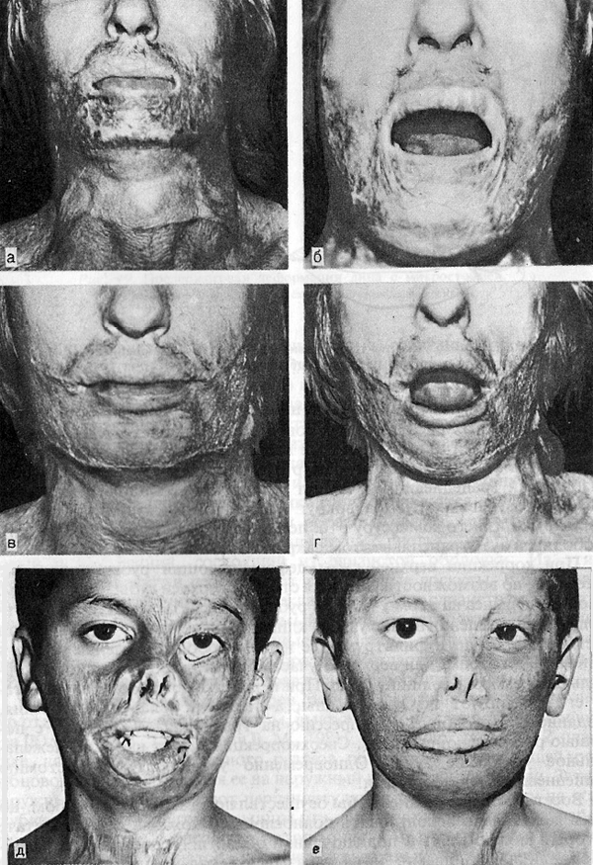
Microstomy. Etiology, clinical. Especially dental treatment microstomy. Prosthetics patients with microstomy.

Slide 17
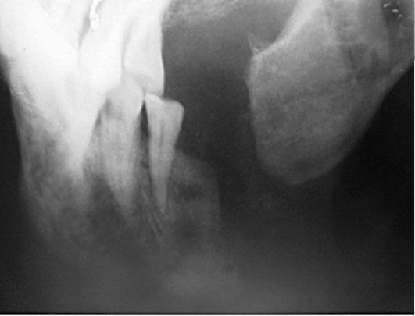
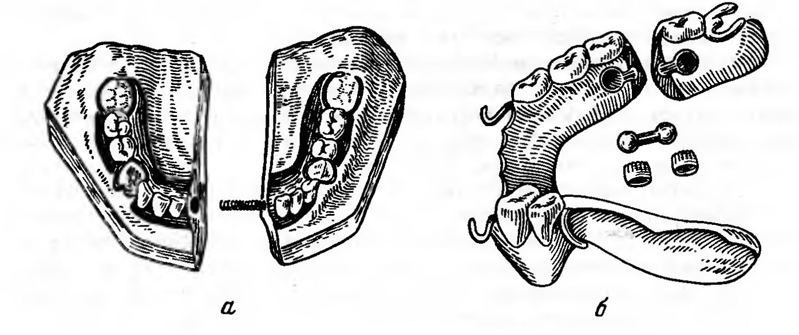
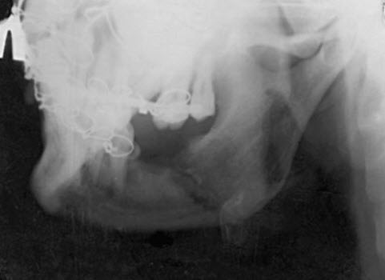
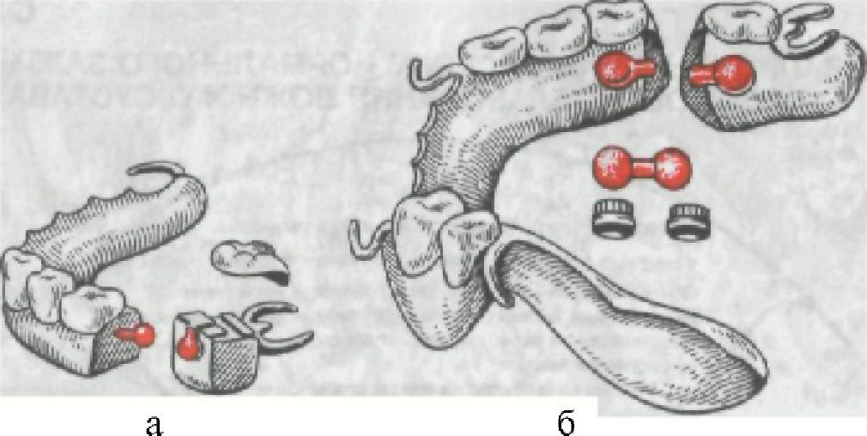
Wrong intergrown fractures

