Slide 1
Methods of manufacturing complete removable denture. Check of complete removable denture structure, fitting of complete removable denture, its correction. An adaptation to complete removable denture.

Slide 2


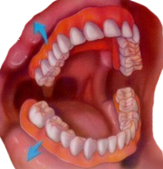
For preservation of stability of prosthesis during function it is necessary to achieve the greatest possible fixation of prosthesis on a jaw and to create certain conditions of teeth articulation. Remember,
Stabilization is retention of prosthesis during non-chewing movements.
Fixation is the retention of prosthesis at rest.
Balance is a retention of a prosthesis during chewing.

Slide 3
  Fixation and stabilization of prosthesis are provided with adhesion, cohesion, anatomic retention, functional suction.
  Qualitative of balance of prosthesis is also provided with placement and an articulation of artificial teeth.

Slide 4
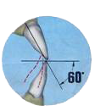
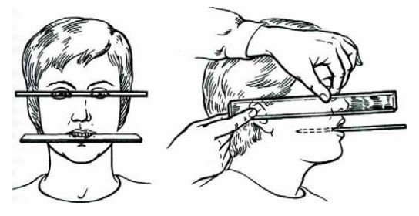

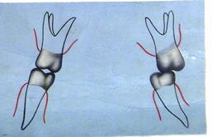
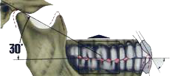
The articulation of teeth depends on (five signs of Ganau):
overlapping of the incisors
From an inclination of an articulate way
heights of cusps
sagittal and transversal curves
inclination of an approximate plane

Slide 5
Thus accurate interaction of all five factors is supposed. Placing artificial teeth, multiple contacts during mandible movements in relation to maxilla can be formed in the event that correct correlation values of sagittal articulate way and an angle of sagittal incisor ways with expressive sagittal, transversal occlusion curves and height of cusps.

Slide 6
In this connection a number of the basic demands which are necessary to follow when designing the dentitions. They are expressed in following positions:
during the formation of dentitions the priority is the conservation of soft and hard tissues of the jaws;
maintenance of stabilization of the prosthesis, using an optimum method of placement of the teeth, and normalization of their contact correlation;
dentitions should be places in position of the central occlusion without supracontacts and provide small and uniform pressure on basis of the prosthesis upon the supporting tissues with multiple proximal contacts of identical force;
during the achievement of balanced articulation correlation it is necessary to achieve whenever possible the most uniform load on alveolar crest and an alveolar part of the jaws.
It means that during any functional movements of a mandible, dentitions throughout keep uniform contacts. If on the working side occur overturning moments they should be compensated by means of contacts on the balancing side.

Slide 7
In our country placement of artificial dentitions are usually done in the next ways:
• in a hinged strait-line articulator on glass;
• in a hinged articulator on spherical surfaces;
• in a hinged strait-line articulator on individual occlusion surfaces;
• in articulators after extra oral records movements of a mandible.

Slide 8
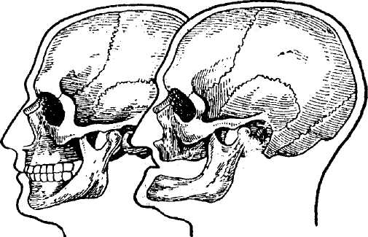
Stages of determination of central occlusion in patients with complete absence of teeth.
1) Formantion of vestibular surface of upper bite block;
2) Determination of the height of the occlusion block of upper jaw
3) Determination of occlusion plane

Slide 9
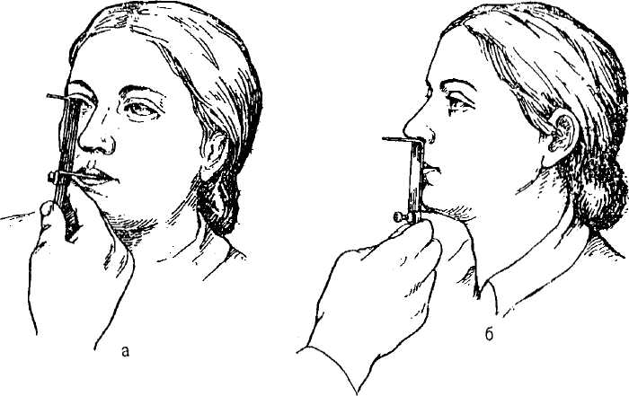
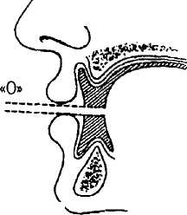
Stages of determination of central occlusion in patients with complete absence of teeth.
4) Determination of intraalveolar height;
Anato-physiological
Method of determination of intraalveolar height
Calm, relaxed state of muscle of maxillofacial region called the position of physiological rest. It is characterized by clearance between the teeth in the range of 2-3 mm.
Speaking test. Patient is asked to pronounce a few letters or syllables (A, E, S, etc.) and watch the degree of separation of the bite block. At normal amplitude it reaches a separation of 5-6 mm.

Slide 10
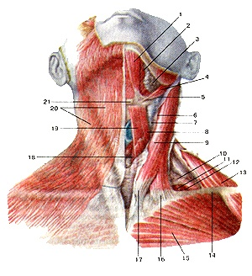
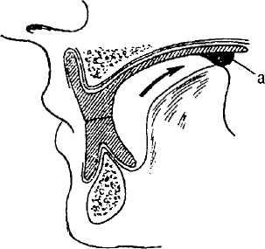
Stages of determination of central occlusion in patients with complete absence of teeth.
5) Determination and fixation of central relation of toothless jaws;
1. Ask the patient to swallow saliva. During swallowing jaws reflex is to position themselves to the central occlusion.
2. Maximum put back the patient's head. During the closure of dentition in such a position due to tension subcutaneous muscles of the neck, set jaw in a central occlusion.
3. Ask the patient to reach the soft palate with the tip of the tongue. During the closure of dentition in such position due to tension in the muscles of the hyoid, jaw set in a central occlusion.
4. Put index fingers between the side teeth. Ask the patient to bite his fingers. At the time of closing, his fingers go separate ways. Simultaneous bilateral posterior closure is just typical for central occlusion.

Slide 11
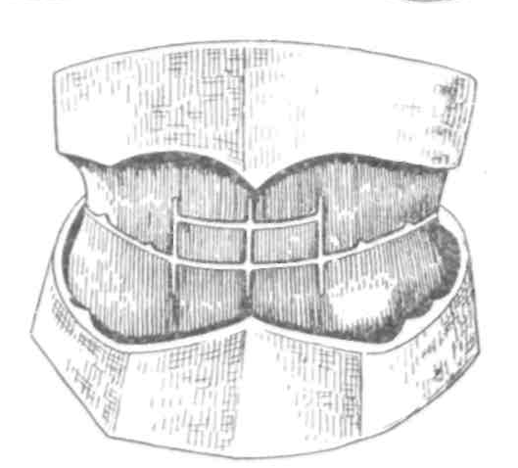
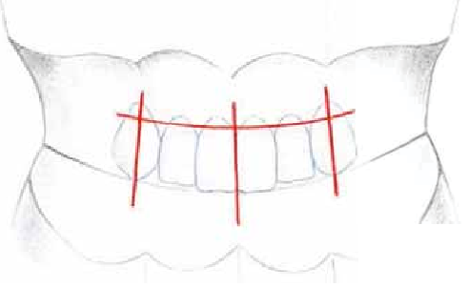
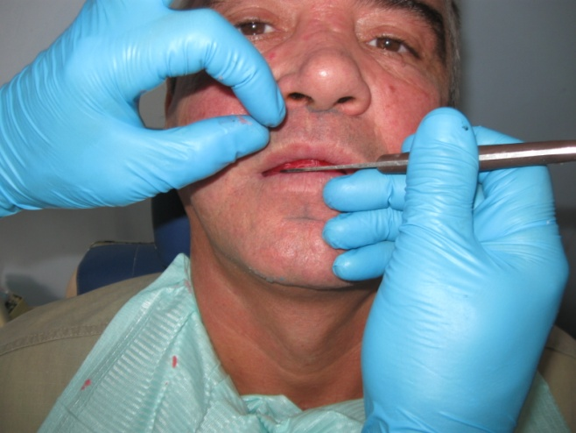
Stages of determination of central occlusion in patients with complete absence of teeth.
6) Appliance on the vestibular surface of the occlusion blocks,
anatomic landmarks for fixation of artificial teeth (central face line,
Line of canines and line of smile).
Line clamping teeth - should in principle match the upper bite block.
The median line of face, is drawn in such a way that it divided under nose groove of the upper lip and “Cupid's bow” in equal parts (upper lip frenulum is better not to be guided, as it is often shifted to the side). The crossing of the median line with prosthetic plane - the location of mesial corners of the central incisors.
Line of canines - perpendicular drawn from the outer wings of the nose, canine divides in half, between the middle and a line of canine on each side is located 2.5 teeth.
Smile line - is made under the upper lip during maximal smile, a landmark for the location of necks of artificial teeth

Slide 12
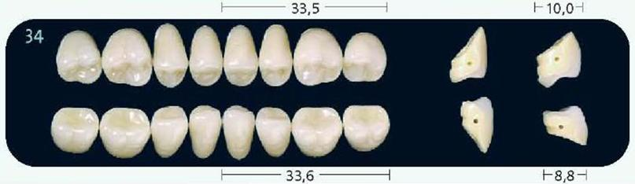
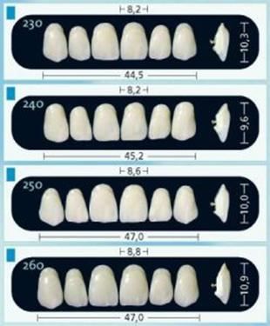
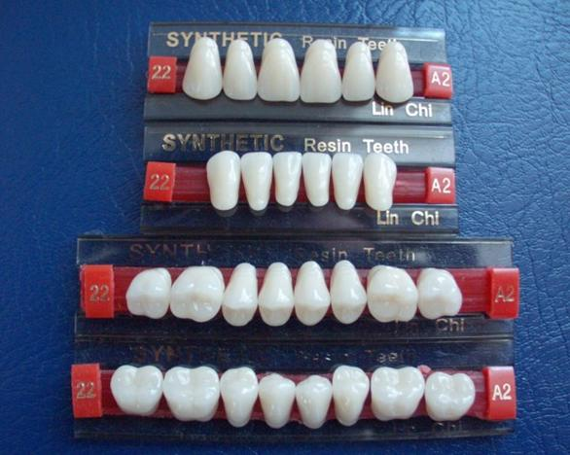
Artificial teeth are constructive elements of prosthesis.
Their value consists mainly in maintenance of function of the chewing apparatus, in mastication, speech and aesthetics improvement. The basic criterion of quality of artificial teeth is degree of their similarity with natural, both on appearance, and by chewing efficiency. Teeth for laminar prostheses are made from plastic and porcelain.

Slide 13
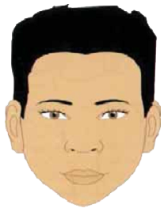
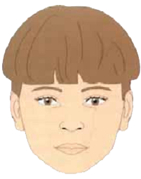
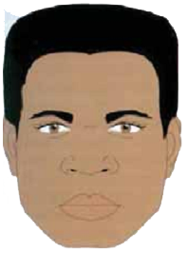
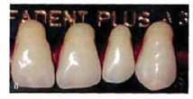
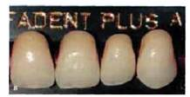
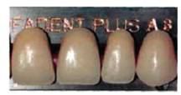

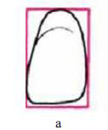

Williams (1913) has established frequent conformity of the form of the face and the central incisors of the maxilla. These patterns still in use during manufacturing of the artificial teeth.
а — square; б — oval в — triangular.

Slide 14
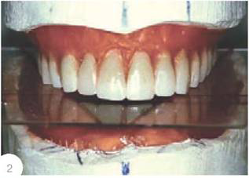
In our country the most wide spread placement of artificial teeth is «on glass», developed by M.E. Vasilev.
Anatomic placement of artificial teeth on glass (by Vasilev)
Indications to application of anatomic placement of teeth are following:
an orthognathic correlation of dentitions;
a small or moderate atrophy of an alveolar crest and part, as well as favorable intergnathic correlations (relative parallelism between an alveolar crest and a part of jaws);
presence of a steady, easily defined central correlation of jaws;
prevalence of vertical movements of a mandible.

Slide 15
Anatomic placement on glass perform as follows.
After making cast of models with occlusion platens in a hinged articulator take glass, and slightly glue it on with hot wax to the top of occlusion platen. Then it is necessary to transfer the glass on to bottom occlusion platen.
After fixing the glass with melted wax to the bottom occlusion platen, on glass mark perimeter of the top occlusion platen, an median line and a line of canines. Remove glass from the top platen and put it aside. On the top model make new wax basis with small diameter (3-4 mm) platen which then glue strictly on top of an alveolar process.

Slide 16
Placement begin with teeth of the maxilla. Vestibular teeth relation to the top of an alveolar process place so that vertical axes of the teeth are 2/3 of their cervical parts are located ahead of top of an alveolar process, and axes of a lateral teeth passed on interalveolar lines. Such placement provides stability of prostheses during mastication.
The upper dentition design in the form of semi ellipse, bottom - parabola.
The central incisors are placed symmetrically to a median line so that cutting edges have contact with the glass.
Lateral incisors are some what tilted from the median line in cervical parts and their cutting edges do not reach glass surface by 0,5 mm.

Slide 17
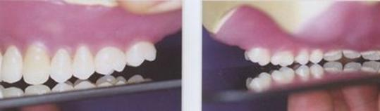
Canines touch the glass with their tearing cusps and form turning points of a tooth arch, and the forward part of a facing of a canine should be continuation of an arch of a forward teeth, and back - refer an arch in the field of a lateral teeth.
The first premolar tooth is placed so that it touches the glass only with buccal cusp, and palatal cusp does not reach the glass by 1 mm.
The second premolar tooth touches the glass with both cusps.
The first molar tooth touches the glass only with its mesio-palatal cusp. Mesio-buccal cusp does not reach glass by 0,5 mm, disto-palatal - by 1 mm, disto-buccal - by 1,5 mm.
The second molar tooth does not touch the glass with the cusps and continues a line of the first molar tooth.

Slide 18
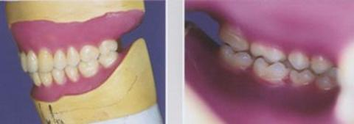
After placement of teeth of the maxilla, place teeth of mandible referring to maxilla.
Placement begin with the second premolar teeth as they are well placed between the first and the second premolar teeth of the maxilla.
Then place the molar teeth and last - vestibular teeth.

Slide 19
During placement of artificial teeth on wax basis during any correlation of toothless jaws pay attention to:
relationship of axes of artificial teeth with top of an alveolar crest and an alveolar part of jaws;
relationship of axes of artificial teeth among themselves and in relation to a horizontal plane;
relationship of cutting edges and occlusion surfaces of an artificial teeth with a horizontal plane;
correlation of cervical part of artificial teeth among themselves;
position of artificial teeth in a tooth arch;
correlation of artificial teeth with a teeth antagonists.

Slide 20
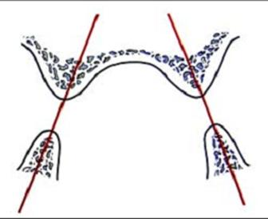
Relationship of axes of artificial teeth with top of an alveolar crest and an alveolar part of jaws.
Artificial teeth located at the top of an alveolar crest and copy its inclination. It is necessary to watch that the axis of each tooth coincided with the interalveolar line crossing tops of an alveolar crest and an alveolar part of both jaws.
This condition provides stability of prostheses during function as chewing pressure on a tooth axis is transferred to the middle of an alveolar crest and an alveolar part of jaws and does not displace the prosthesis.

Slide 21
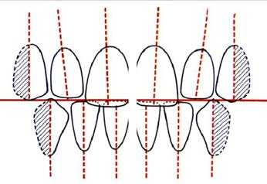
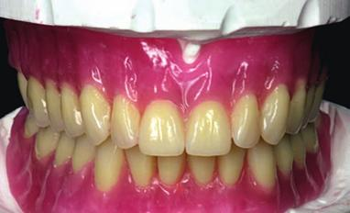
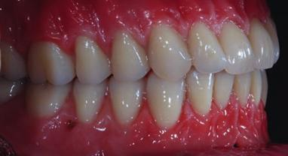
2. Relationship of axes of artificial teeth among themselves and in relation to a horizontal plane.
The central incisor, lateral incisor and canine of the maxilla placed under an angle of 5-10 ° to the cosmetic center and among themselves.
The first and second premolar teeth stand parallel and perpendicularly to prosthetic plane (glass).
The first and second molar teeth are inclined by the axis to the cosmetic center.
The first and second bottom incisors stand parallel among themselves. Canines are inclined by the axis to the cosmetic center. The bottom molar teeth also are inclined towards the cosmetic center.

Slide 22
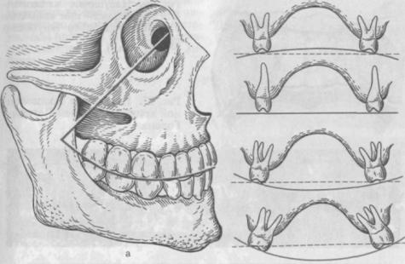
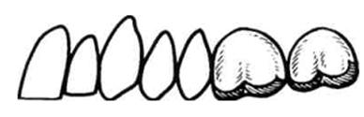
3. Relationship of cutting edges and occlusion planes of an artificial teeth with a horizontal plane.
The cutting edge of the central incisors touch glass. The cutting edge of lateral incisors is raised over glass by 0,5 mm. Canines touch glass with the tearing angles. Cutting edges of the bottom central incisors stand on one straight line. The tearing angle of a canine should be raised by 0,5 mm. The first premolar teeth touch glass with buccal cusps. Palatal cusps are raised by 1 mm. The second premolar teeth touch glass with both cusps. The first molar teeth touch glass with mesio-palatal cusps, the others are raised - mesio-buccal - by 0,5 mm; disto-buccal - by 1,5 mm; disto-palatal - by 1 mm.
Thanks to such orientation of the masticatory teeth, forms sagittal and transversal curve convex toward the bottom form, providing multiple contacts of teeth during various movements of the mandible.

Slide 23
4. Correlation of cervical part of an artificial teeth among themselves.
Cervical part of the central incisors and canines are at one level. Cervical part of lateral incisors little lower (≈ 0,5 mm). Cervical part of premolar teeth are located at one level. Cervical part of molar teeth are raised with respect to prosthetic plane and are parallel to curve of Spee. Cervical part of lateral bottom teeth also located parallel to the curve of Spee, thus the distance to the glass decreases. From vestibular bottom teeth the lowest locating of the cervical part of canine.
The bottom lateral incisor position of a cervical part of a tooth is above the cervical part of a canine by ≈ 0,5-1 mm; even higher - at the central incisor ≈ 1-2 mm, depending on size of an artificial teeth.

Slide 24
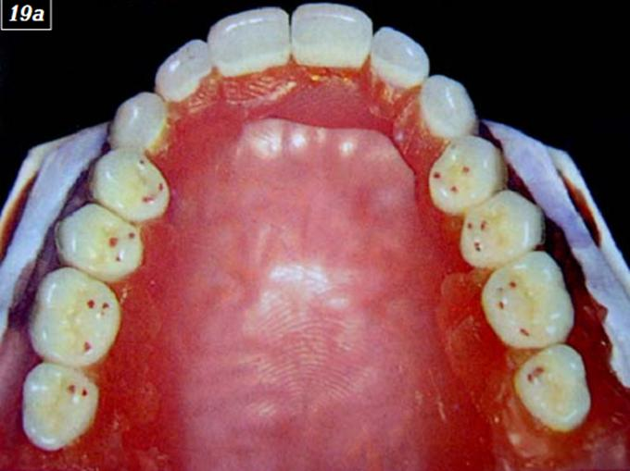
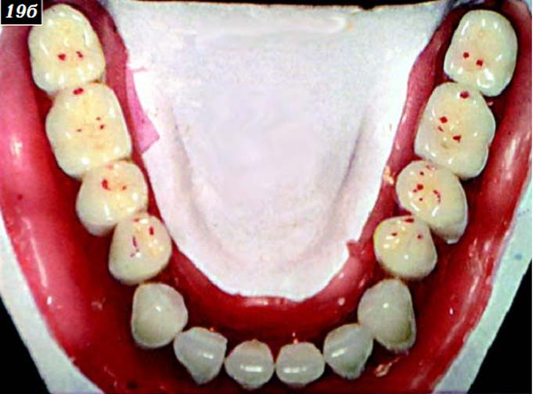
5. Position of an artificial teeth in a tooth arch.
The upper dentition during placement should form a semi ellipse, and bottom - a parabola. Placement of teeth begin with the top central incisors, lateral incisors, canines, then continue with placement of masticatory group of a teeth.
It is better to put group of a posterior teeth on one side, and then on the other. Symmetry of placement of the top vestibular teeth can be checked by means of compasses. Compasses leg put on sagittal lines behind line "A" and form an arch on cutting edges of teeth. During correct placement of the top vestibular teeth, cutting edges form a semicircle. Masticatory teeth are placed according to marking of the model so that their fissures stand on one straight line. The inclination of axes of masticatory group of teeth should correspond to an inclination of interalveolar lines.

Slide 25
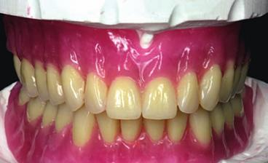
6. Correlation of teeth-antagonists.
During placement of vestibular teeth it is necessary to form a lumen in 0,5-1 mm which is called as functional clearance. It can be formed at the expense of the placement or fitting off the cutting edges.

Slide 26
6. Correlation of teeth-antagonists.
The upper vestibular teeth are established so that their vestibular surfaces could serve as support for an upper lip, and for a lower lip - vestibular surfaces of the bottom vestibular teeth.

Slide 27
6. Correlation of teeth-antagonists.
Upon finishing placement of the top group of teeth continue to placement of the bottom, starting with the second premolar teeth as they are easily placed between the first and the second premolar teeth of the top jaw.
Then place molar teeth of one side, then another, and last the vestibullar group of teeth is put. Also on posterior teeth need to achieve multiple contact of occlusion surfaces.

Slide 28
6. Correlation of teeth-antagonists.
Having finished the placement of teeth, between dentitions put a transfer paper and with an easy taping of the top dentitions on bottom dentitions receive black points, which file off. Thus make filling off of teeth in a vertical direction. During lateral movements filling off of teeth make in an oral cavity of the patient during trying on of prostheses.

Slide 29
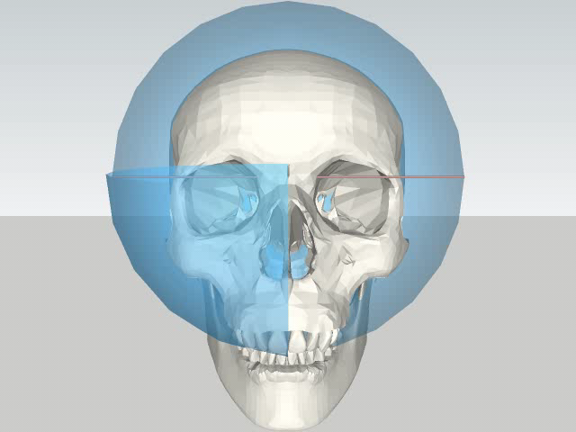
Placement of an artificial teeth on spherical occlusal surfaces
Placement of an artificial teeth on spherical occlusal surfaces
The spherical theory of articulation Monson (1918) assumes movement of mandible round the general center. Consider, that there are more contacts between teeth happens at radius of the sphere, equal to 9 cm. Monson developed articulators with the average placement occlusion curves.

Slide 30
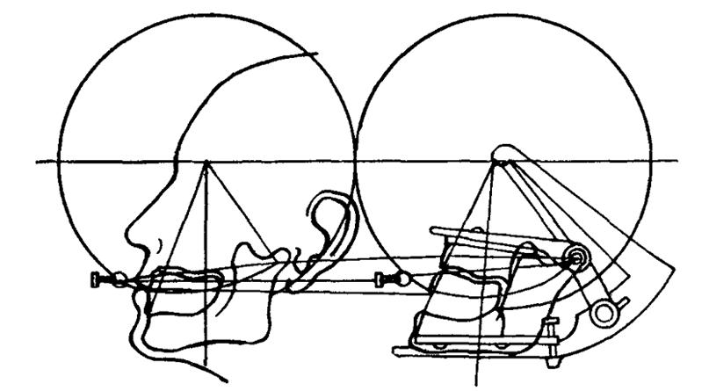
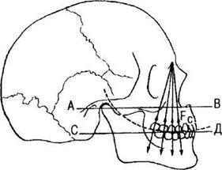
Placement of an artificial teeth on spherical occlusal surfaces
For the purpose of reception of the best results take the artificial teeth which masticatory surfaces are made in the form of the small cusps bordered with a boarder on periphery. Occlusal surfaces of such teeth are done by spherical surface with radius 9 sm and practically do not demand fitting off.
Placement of a teeth on spherical surfaces improves fixation of prostheses, provides freedom of chewing movements, slows down atrophic processes in tissues of a prosthetic bed.
However, this theory does not consider anatomy and physiology TMJ data and features of movement of a mandible.

Slide 31
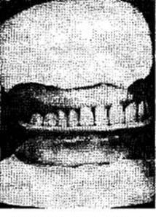

Placement of teeth on individual occlusal spherical surfaces (M.A.Napadov and А.L. Sapojnikov (1972))
From functional impressions make cast models on which from autopolymer plastic prepare dental try with special wax abrasive platens.
Wax abrasive occlusal platens attach to dental try so that they corresponded to direction of interalveolar lines, and so that the occlusion height is more by 2 mm on each platen. This overestimate by 4 mm is necessary so that when receiving of intraoral record there was no diminishing of height of the bottom part of the face.
Spoons with platens enter into a mouth, and the patient grinds on them, making various chewing movements by a mandible. As a result the structure of an occlusal surface comes to conformity with character of movements of a mandible. Thus, the contacting surfaces corresponding to various movements of a mandible are formed.

Slide 32
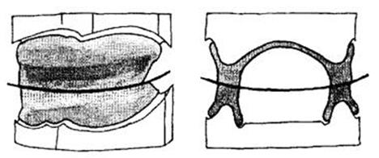
After formation of individual occlusal surfaces the central correlation of jaws is very easily defined. Then receive functionally-suction impressions in the conditions closely related to formed during functioning of prostheses.
During designing of artificial dentitions on individual occlusal surfaces it is not necessary to use articulators and placement of artificial dentitions can be made in an ordinary hinged articulator. All teeth, except for the second incisors, touch with cutting edges and cusps of an occlusal surface the bottom platen. The bottom dentition is put in relationship to the top.

Slide 33
Placement of an artificial teeth by Gerber
The best effect of the balanced articulation relationship (at various movements observed contacts in all areas of a dentition) can be received only in that case when the complex of articulate movements is compensated by corresponding formation of contacts of chewing surfaces by means of a minisegment in each separate chewing surface. For this purpose there is a method of placement and the form of an artificial teeth by Gerber, Shreder.
The artificial teeth offered by Gerber, have a number of specific criteria which distinguish them from a natural teeth. These features bring the essential contribution to improvement of stabilization of prostheses of full dentition, providing in certain degree a uniform load to mucous and bone tissues of a prosthetic bed. Gerber has transferred communication of the form and function of mandibular joint on chewing surfaces of an artificial posterior teeth.

Slide 34
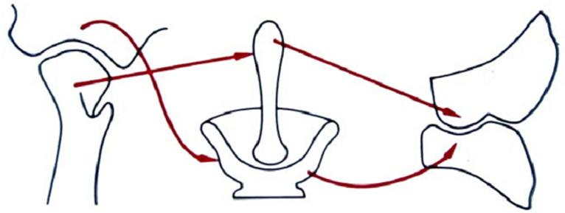
Chewing groups of teeth of the upper jaw have accurately formed palatal cusps("pestle").
Mandible teeth characterized «by the expressed chewing flute - a minisegment» ("mortar").

Slide 35
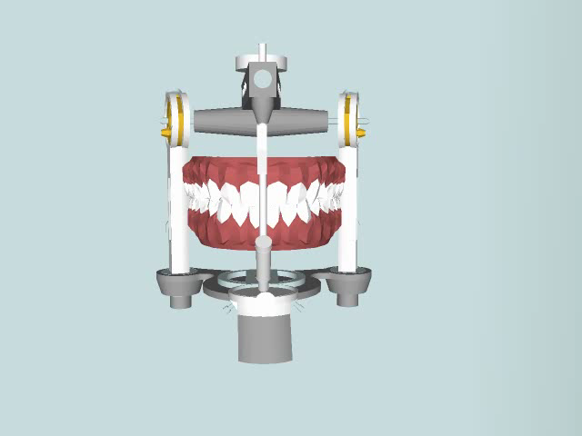
Placement of teeth on model of jaws in an articulator
Provides the balanced occlusion, during which in the region of posterior teeth formed their bilateral contacts both on the working, and on balancing sides, which provides stabilization of prostheses on toothless jaws during chewing, a uniform load on toothless alveolar processes.

Slide 36
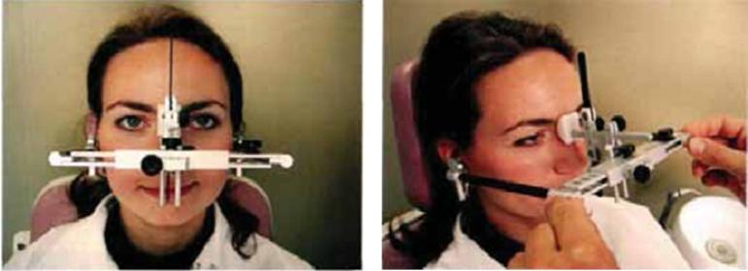
Placement of teeth on model of jaws in an articulator
Models of toothless jaws should be oriented between bows of articulator by means of a facebow.

Slide 37
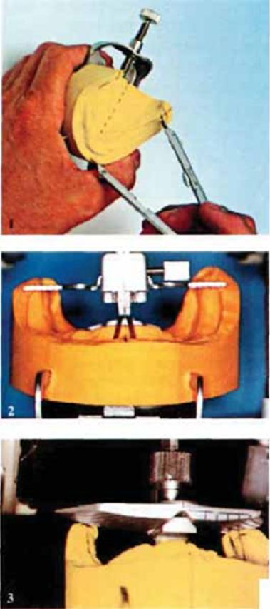
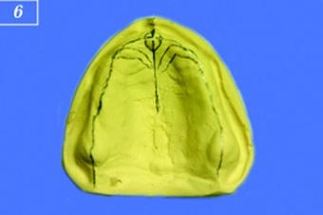
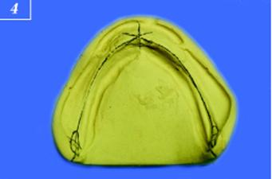
Before placing of teeth on models of toothless jaws make a marking of anatomic reference points. On model of the upper jaw outline incisor papilla, maxilla tuber, the big palatal folds, a palatal seam, the middle of an alveolar process; on mandible model mark its median-sagittal line, a line of the middle of an alveolar process and designate a retro molar triangle.

Slide 38
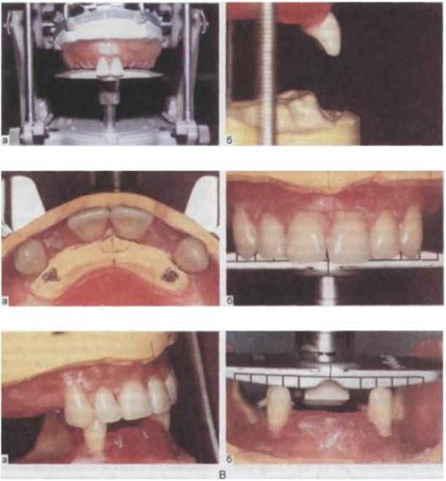
Further fix plaster models of jaws in an articulator.
In the place of the bottom model put spherical callote.
Placement of teeth begin with two central incisors of the top jaw, using thus marks on calotte and anatomic reference points.
A - placement of the top central incisors (a), cutting edges of incisors are tilted towards a transitive fold of a mandible (b);
B - placement of canines and lateral incisors with orientation to the ends of the big palatal folds (a) and on edge calotte (b);

Slide 39
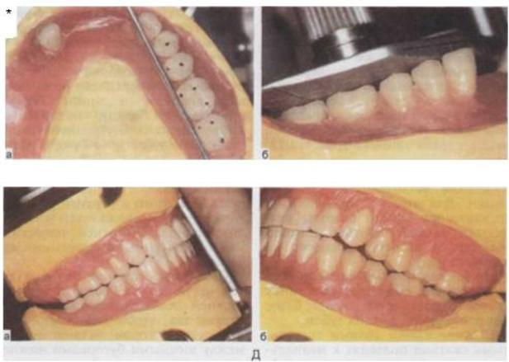
C - the bottom canines are placed between the top canines and lateral incisors (a).
D - the bottom posterior teeth are established toward outside from line Paunda (a) and in contact with calotte (b); (LINE PAUNDA - an imagined line from medial edge of the bottom canine to internal edge mandibular tuber. An artificial teeth should not cross this line.)
E - the bilateral balanced occlusion on demountable prostheses during full absence of a teeth: a - the working side - contact of canines and buccal cusps of premolar teeth; b - the balancing side - contact of buccal cusps of the lower molar teeth and palatal cusps of the upper molar teeth.
It is necessary to notice, that occlusal contacts of full demountable prostheses in the field of a posterior teeth essentially differ from those at intact dentitions (9-10 points on each half of each jaw).

Slide 40
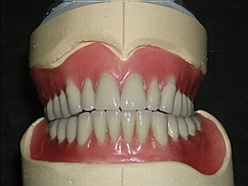
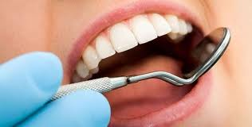
Checking the design of prosthesis.
1. An estimation of quality of gauges with an artificial teeth on models in an articulator
2. Check prosthesis borders
3. Check height of an occlusion
Inserting gauges with an artificial teeth into a mouth and suggest to close teeth and judge correctness of height of the central occlusion by closing of the lips, by depth of wrinkles in the field of mouth angles, by the form nasolabial and chin-lip folds, and also on the general configuration of the face, especially the bottom third.
Suggest to the patient to say some words in which thee are many labial sounds. Simultaneously watch an interval formed between the top and bottom incisors during conversation. It should be equal on the average 5-6 mm.
If these anatomic signs are satisfactory - the occlusion height is correct.

Slide 41
4. Check the mesio-distal correlation of dentitions.
There could be errors caused by movement of the mandible forward or aside. Therefore during the check of a horizontal placement of teeth resort to the same receptions, as when defining the central occlusion, i.e. Suggest to lift tongue up and backward, and then to close teeth or to swallow saliva.
If the mutual relation between the top and bottom teeth at check remains same as on model, means, the central occlusion has been defined correctly.
5. Check balance of an occlusion
During correct placement of an artificial teeth three-point contact of Bonville in vestibular and posterior occlusions should be observed.
6. Check aesthetics of a prosthesis
Pay attention to an external configuration of the face, a line of closing of teeth, a median line, a smile line, colour, the form, the size of teeth, consider wishes of the patient.

Slide 42

Final fitting and surrendering the prosthesis to the patient
Surrendering the prosthesis is rather responsible moment in prosthetics and demands a lot of attention from the doctor.
1. An estimation of quality of prosthesis.
Pay attention to quality of plastic of the basis: presence of defects (a pore, moire, etc.), quality of polishing. Edges should be roundish, equal, smooth, not sharp.
2. Check borders of prosthesis
Enter gauges with an artificial teeth into a mouth and check fixation and prosthesis stabilization.
3. Check height of an occlusion and a mesio-distal correlation of dentitions.
4. Check balance of an occlusion
5. Check aesthetics of prosthesis
6. References on care of removable prostheses
After each food intake with removable prostheses it is necessary to take them out from an oral cavity and carefully wash out with water. The prosthesis should be clean.
Twice a day (in the morning and in the evening) clean the prosthesis with pasta or a denture powder (without fluorine) and a rigid brush (HARD). Could use cleaning tablets.
An estimation of quality of prosthesis.
2. Check borders of prosthesis
3. Check height of an occlusion and a mesio-distal correlation of dentitions.
4. Check balance of an occlusion
5. Check aesthetics of prosthesis
6. References on care of removable prostheses

Slide 43


References on care of removable prostheses
Tablets (Protefix®) Corega tabs
When using removable prosthesis it is necessary to visit dentist 2 times per year.
In order to avoid prosthesis breakage, and also damage of mucosa of an oral cavity it is not recommended to eat and chew very rigid food (for example, crackers) to bite off big pieces (for example, from the whole apple).

Slide 44
References on care of removable prostheses
In order to avoid breakage of prosthesis do not allow them to fall on a tiled floor, in a sink and on other firm surfaces.
At night if the patient takes out prostheses, it is necessary for putting them in wet medium (after cleaning, place the prostheses in a wet napkin) or in a vessel with water. It is possible to sleep in prostheses.
During disturbance of fixation of the prosthesis it is necessary to come in to the clinic of orthopedic stomatology
In no event, under no circumstances try to correct, repair or make other influences on prosthesis.
In case of breakage or crack occurrence in basis of a removable prosthesis it is necessary for patient to come it urgently in to clinic of prosthodontics dentistry for prosthesis repairing.
Service life of the removable prosthesis is 3 - 4 years.

Slide 45

Correction of prosthesis
The first correction of prosthesis should be done the next day.
Having placed prostheses in an oral cavity, check closing of dentitions and fixation of bases.
For the purpose of check of fixation of the top prosthesis in the beginning try to take it out, having clasped big and index fingers in the field of premolar teeth, and presence of the back valve check by pressing on cutting edges of vestibular teeth in a vertical direction.
Balance of the bottom prosthesis define by pressing from one and other sides in the field of a lateral teeth, and suction, trying to take out it - holding the cutting edges of the bottom vestibular teeth, in up and backward direction.
The sites of prosthesis causing pain, are noted on mucosa with special marker, a plaster powder or a tooth-paste, and then transfer on a prosthesis.

Slide 46
Correction of prosthesis
Also carefully verify articulation contacts of teeth, eliminate dumping moments.
Between dentitions place a transfer paper and suggest to the patient to close the teeth, and then consistently to make movements by a mandible forward and to the sides. This leaves on the teeth black points, which slightly file off, accomplishing more tighter closing of dentitions.
In the event that the patient complains of tongue or cheek biting, it is necessary to grind off slightly (to "tip") palatal cusps of the top teeth or buccal cusps of the bottom chewing teeth and give it a good polish.
By "Tipping" the cusps, we give the chance to for cusps of a teeth-antagonists to constrain soft tissues of tongue or a cheek, owing to which they do not get to lumen between teeth and are not bitten.
After correction it is necessary to make filling and polishing.
The subsequent corrections are done at first once in 3 days, then in a week.

Slide 47
Adaptation to removable prosthesis
In prosthodontics dentistry the concept of adaptation has rather narrow value - accustoming of the patient to a tooth prosthesis. However this problem is one of cardinal in dentistry.
Prostheses are perceived by tissues of a prosthetic bed as an alien body, being an irritant for the nerve ends of mucosa of an oral cavity. From sensitive receptors of an oral cavity the irritation is transferred on a reflex arch to the centers of salivation, speech etc. therefore appear the increased sialosis, desires to vomit, speech, swallowing and mastication dysfunction.
Distinguish three phases of adaptation to prostheses.
The first - irritation phase - is observed in day of applying of prosthesis and shown in the form of the increased sialosis, the changed diction, weak chewing power, a vomiting reflex.
The second - partial inhibition phase - comes during the period of 1st till 5th day after applying of prostheses. During this period speech, chewing power are restored, the sialosis decreases and the vomiting reflex dies away.
The third - full inhibition phase - comes during the period of 5th till 33rd day after applying the prosthesis. During this period the patient does not feel the prosthesis as an alien body, and, on the contrary, feels discomfort without them.

Slide 48
Patients for whom prostheses are made for the second time and so on, adapt to them much faster - 5-7 days.
Duration of the period of adaptation is influenced by fixation, stability of prostheses and absence of painful sensations.
It is important for dentist to know, by what motivation the patient is guided, deciding to wear prostheses or not to wear.
According to the theory of persons behavior, is developed on the basis of requirements and situation. People with partial or full loss of teeth have a requirement for their compensation which is in direct dependence on a situation.
The desire to use prostheses is influenced by different factors: psychosomatic, social, age and others. Consider, that if removable prostheses view as medical help and there is a conscious relation to them, this positive motivations provide favorable result.

Slide 49





According to classification of temperament Hypocrite-Galen distinguish four types of higher nervous activity, or as they are usually named, temperament:
1) choleric, characterized by strong unbalanced nervous processes with prevalence of excitation;
2) phlegmatic, to which inherent strong counterbalanced, but inert nervous processes;
3) sanguine, characterized by the strong counterbalanced and mobile nervous processes of excitation and inhibition;
4) melancholic, characterized by weak nervous processes with prevalence of brake, arising under the influence of irritation of the increased force.

Slide 50
Sanguine persons, being counterbalanced people, full of optimism, as a rule, co-operate with the doctor, fulfill their demands, but sometimes can have thoughtless concern for their own health. Accustom to tooth prostheses usually comes quickly, without complications.

Slide 51
Phlegmatic persons - sluggish, disciplined, sometimes mistrustful, difficultly contacting with the doctor. Usually take well the inconveniences bound to adaptation to tooth prostheses. Characteristic for them stability of mood allows slowly enough, but favorably to finish the accustoming period. It is essentially help for the doctor to have patience and ability to convince.

Slide 52
Choleric persons - active, thoughtless, undisciplined and unbalanced, easily contact with the doctor, but at the first difficulties with prosthesis, ready to refuse all of it. If the doctor manages to explain in advance to the patient forthcoming difficulties and inconveniences of the period of adaptation the patient perceives them as self-evident understood, and the adaptation period occurs very quickly.

Slide 53
It is necessary to notice, that the most adverse forecast and complexities in accustoming to tooth prostheses are noted at melancholics as they easily hurt, process of adaptation in them can become complicated absence of the incentive reasons to accustoming. Melancholics easily give in to suggestion, and the doctor should take advantage of that. However it is necessary to track, that the same positive influence was rendered on the patient by not only the doctor, but also by someone from relatives of the patient.

Slide 54

Thank you for your time

