Slide 1
Pathological erase of hard tissue of teeth. Prosthodontical methods of treatment.
Department of Prosthodontics
Odessa National Medical University
Associate Professor
Bas Andrei Alekseyevich

Slide 2
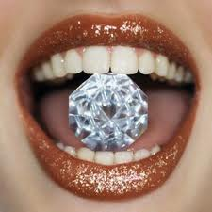
The tooth is the alone part of the human body, which is unable to repair itself.
Tooth enamel is the hardest tissue produced by the human body.
The physiological erase is developing during the grinding of food during chewing movements and unchewing contacts of jaws.

Slide 3
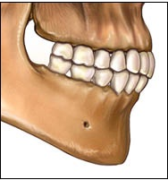
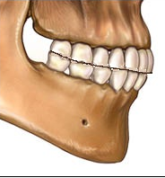
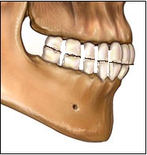
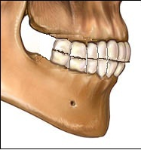
Chewing cusps and proximal surfaces of the teeth are subjected to physiological erase. Result of that is the formation of facets and pads, and dental arch is shortened at 1 centimeter.
erase teeth often changes the curve of Spee.
Physiological erase teeth
- supports convergence the teeth and keeps contact between them
- prevents entering the food into the interdental space, injury and the gap tissue between the teeth
- also supports to a more free and smooth running of the dentitions
- eliminates overloading separate groups of teeth and improves the function of mastication

Slide 4
Chewing cusps and proximal surfaces of the teeth are subjected to physiological erase. Result of that is the formation of facets and pads, and dental arch is shortened at 1 centimeter.
erase teeth often changes the curve of Spee.
Physiological erase teeth
- typical for adults and older persons.
- within the teeth's enamel
- does not reduce the height of the bite

Slide 5
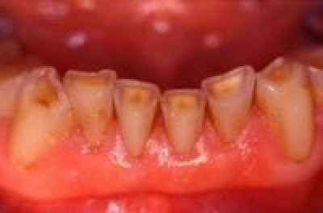
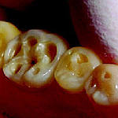
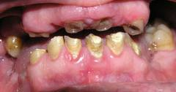
Pathological dental erase
Signs
of pathological dental erase
- typical for younger persons
- exposed dentine
- it's possible sharp edges of enamel injure mucosa
- it's possible appearance of hypersensitive teeth
- it's possible reduce the height of the bite

Slide 6
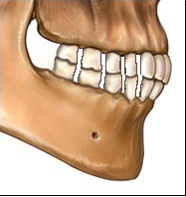
Pathological dental erase
The types of
dental erase
the horizontal;
the vertical;
- the combined

Slide 7
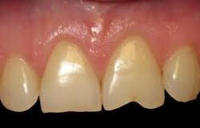
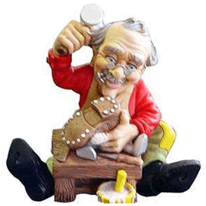

The etiology of
pathological dental erase
metabolic disorders,
defective structure of the hard tissues of the tooth,
neurodystrophic processes in them,
violation of mineralization of dental hard tissues,
dysfunction of the endocrine glands,
the influence of acids.
features of bite, particularly incisive overlap
nervous system disorders (bruxism, teeth grinding)
occupational hazards,
bad habits
diseases of the gastrointestinal tract,
localization of traumatic occlusion nodes,
functional overload of teeth
the shoemaker
the tailor

Slide 8
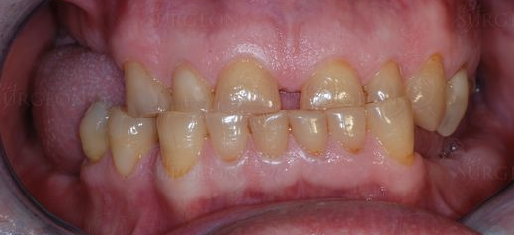
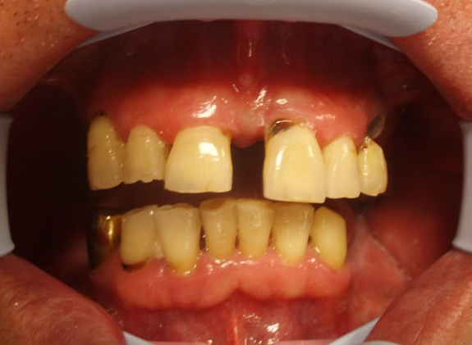
The functional overload of teeth
There are primary and secondary traumatic occlusion.
The primary is then large load acts on a healthy periodontium due to various reasons. Most often, this is an increase the height of the bite on single crowns and loss of lateral teeth.
The secondary is, if there is periodontal weakening, and then the normal load is too much for it.

Slide 9
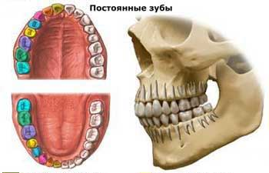
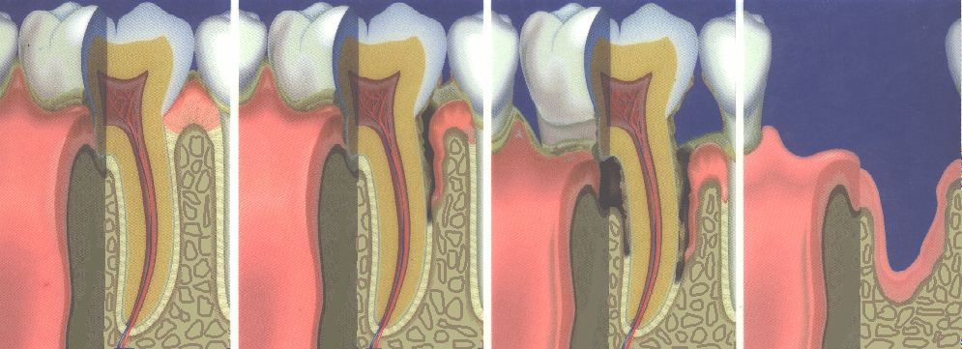
The functional overload of teeth
Functional overload depends on:
condition of the remaining teeth
number of opposite teeth,
kind of bite,
general condition of a patient
etc.
Morphological expression of the overload is
the defeat of the pulp of teeth,
resorption of a cement and а dentin
and in some cases - hypercementosis,
damage to nerve fibers,
damage to periodontium
and erase of hard dental tissues

Slide 10
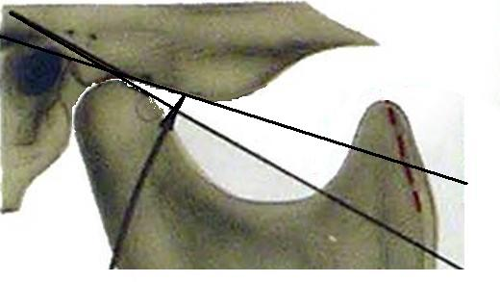
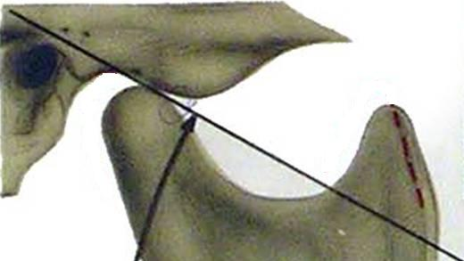
Pathological erase, loss of teeth, reducing height of bite significantly affect the health of the temporo-mandibular joints.
The articular tuber is erased.
The articular slope becomes sloppy.
The articular disc is deformed, shifted.
This may cause a breach of the articulation and development of arthritis of temporomandibular joint.

Slide 11
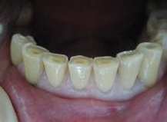
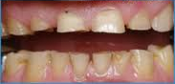
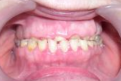
Stages of development of tooth erase
I. Physiological - within the enamel.
II. Transition - in the enamel and dentin in part.
III. Pathological - within the dentin.
1) Depth of defeat:
a) up to 1/3 of the crown;
b) from 1/3 to 2/3 of the crown;
c) from 2/3 to the gums.
2) The plane of the lesion:
a) horizontal;
b) vertical;
c) combined;
3) The length of the lesion:
a) limited;
b) generalized.
4) The sensitivity of dentin:
a) in the normal range;
b) with hyperesthesia.

Slide 12
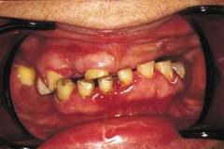
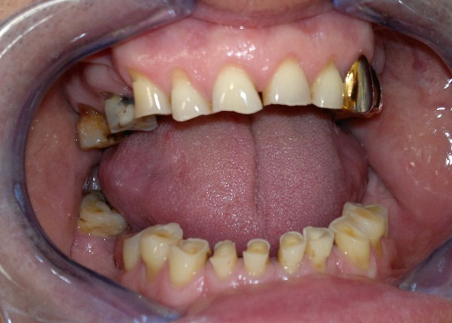
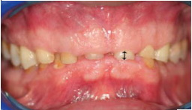
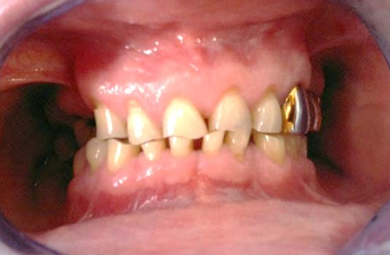
The reducing bite
The clinical manifestation of complications pathological erase of teeth is the reducing bite.
The clinical signs:
pain or crunch in the temporomandibular joint
facial pain
fatigue of masticatory muscles
pain in the masticatory muscles
feeling of fullness in the ear
hearing loss
headaches
dry mouth
glossodinia, glossalgia

Slide 13
The reducing bite
The clinical manifestation of complications pathological erase of teeth is the reducing bite.
In addition to pathological erase of hard dental tissues causes of the reducing bite are varied:
early loss of posterior teeth,
functional overload of some groups of teeth,
changes in the periodontium,
pathological conditions of the neuromuscular system,
irrational prosthesis.

Slide 14
The reducing bite
The clinical manifestation of complications pathological erase of teeth is the reducing bite.
Classification the reducing bite (by M.G. Bushan)
The first stage | The second stage |  | The third stage
initial | developed with predominant localization of the pathological process in the dental system |  | with predominant localization of the pathological process in the dental system and temporomandibular joints
 | а) without significant deformation of dental and alveolar arches | b) with the deformation of tooth and alveolar arches | а) without significant deformation of dental and alveolar arches | b) with the deformation of tooth and alveolar arches
In addition to pathological erase of hard dental tissues causes of the reducing bite are varied:
early loss of posterior teeth,
functional overload of some groups of teeth,
changes in the periodontium,
pathological conditions of the neuromuscular system,
irrational prosthesis.

Slide 15
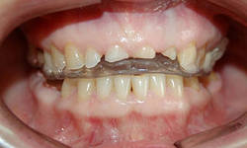
The treatment of the pathological erase
Medicamentous methods
apply in initial stages
Local treatment:
remineralization of the surface layers of enamel and dentin
calcification formed secondary dentin of the teeth.
complex of the general treatment:
I. Calcium medicines:
II. Complex of polyvitamins and polyminerals:
III. At the raised tone of chewing muscles, a bruksizm - sedative medicines.
IV. Dietotherapy.
Prosthodontics treatment
1. Small violations of occlusion and very sharped edges of the teeth as a result of pathological erase we may eliminate with help of polishing teeth.
2. Filling cavity of teeth is possible when they are in small numbers.
3. We create 2-3 points of contact between opposite teeth at patients with the first degree of pathological erase and 4-6 points of contact at patients with the second degree of pathological erase.
4. Treatment of patients with advanced stage of reducing bite and localization of the pathological process in the dental system and temporo-mandibular joint is two-step:
I - identify and restore the height of the bite of the teeth-gum cap;
II - fixing that height with help of prostheses.

Slide 16
The prevention of the pathological erase
and its complications
Timely removal of defects of dentition.
Treatment of dentofacial anomalies.
Combating harmful habits.
Control of occupational hazards
Treatment of diseases of organs and systems, which have a pathogenetic link with increased erase of teeth (bruxism in violation of the central nervous system, endocrine pathology, disturbance of calcium-phosphorus metabolism in the body, etc.).
Prevention of acid necrosis.

Slide 17

Thank you for your time

