Slide 1
Modern technologies in the treatment and prevention of recurrence of the disease of the oral mucous membrane

Slide 2

Please turn off your smartphones

Slide 3
Desiases which can become recurrent:
Erythema multiforme
Secondary, or Recurrent, Herpes Simplex Infections
Candidiosis
Lichen planus
Recurrent Aphthous stomatitis

Slide 4
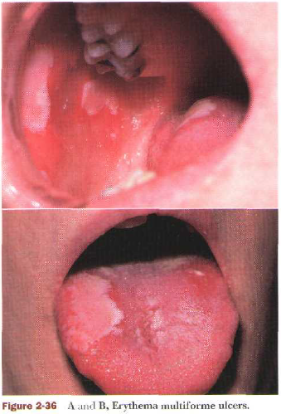
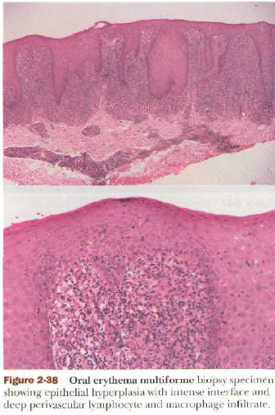
Erythema multiforme

Slide 5
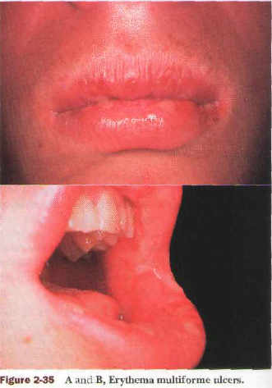
Erythema multiforme (EM)
Erythema multiforme (EM) is a self-limiting hypersensitivity reaction characterized by target skin lesions and ulcerative oral lesions. It has been divided into two subtypes:
a minor form, usually associated with an HSV trigger.
a major severe form, triggered by certain systemic drugs.

Slide 6
Clinical Features
EM is usually an acute, self-limited process that affects the skin or mucous membranes or both. It may on occasion be chronic, or it may be a recurring acute problem. Young adults are most commonly affected. Individuals often develop EM in the spring or fall and may have such recrudescences chronically. It consists of concentric erybiotics thematous rings separated by rings of near-normal color. Typically, the extremities are involved, usually in a symmetric distribution.
Other types of skin manifestations of EM include macules, papules, vesicles, bullae, and urticarial plaques. Orally, EM characteristically presents as an ulcerative disease, varying from a few aphthous-type lesions to multiple superficial, widespread ulcers in EM major.

Slide 7
Clinical Features
Any area of the mouth may be involved, with the lips, buccal mucosa, palate, and tongue being most frequently affected. Recurrent oral lesions may appear as multiple painful ulcers similar to those of the initial episode or as less symptomatic erylhematous patches with limited ulceration.
Symptoms range from mild discomfort to severe pain. Systemic signs and symptoms of headache, slightly elevated temperature, and lymphadenopathy. At the severe end of the EM spectrum {EM major). intense involvement of the mouth, eyes, skin, genitalia, and occasionally the esophagus and respiratory tract may be seen concurrently.

Slide 8
Treatment
In EM minor:
symptomatic treatment
keeping the mouth clean with bland mouthrinses, is necessary.
In EM major:
topical corticosteroids with antifungals may help control disease. The use of systemic corticosteroids is controversial and is believed by some to be contraindicated.
Acyclovir at 400 to 600 mg daily may be effective in preventing recurrences in patients who have an HSV-triggered disease, although the efficacy is not clear. Supportive measures, such as oral irrigation, adequate fluid intake, and use of antipyretics, may provide patients with substantial benefit.

Slide 9
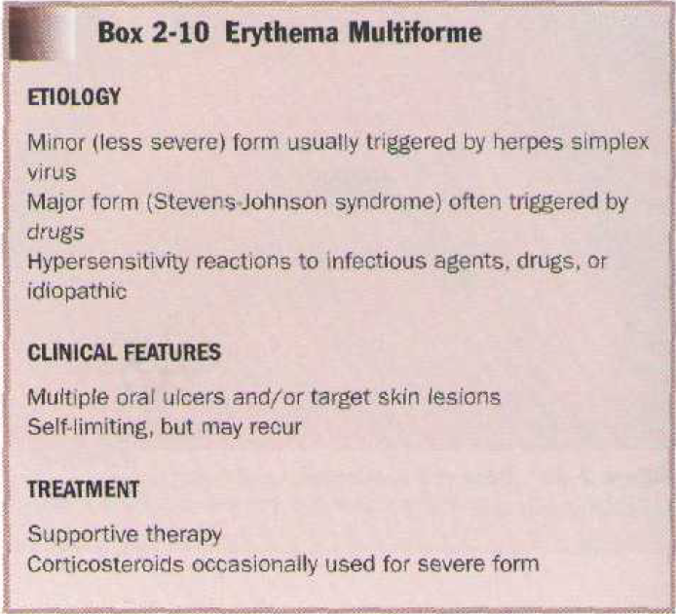

Slide 10
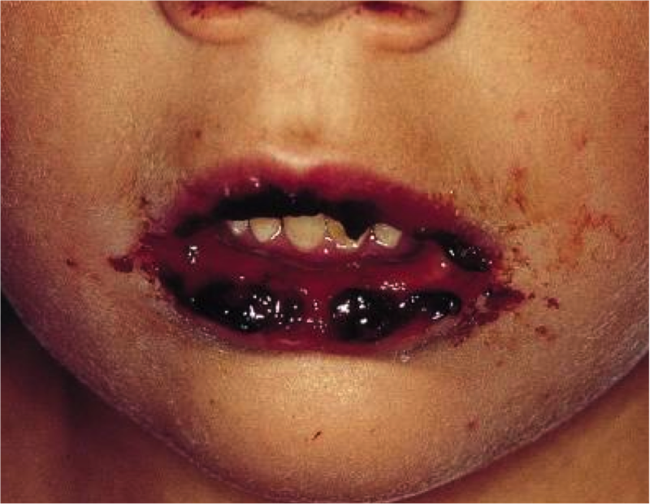
Erythema multiforme

Slide 11
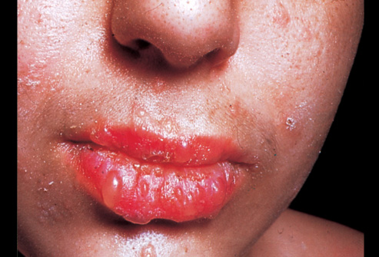
Erythema multiforme

Slide 12
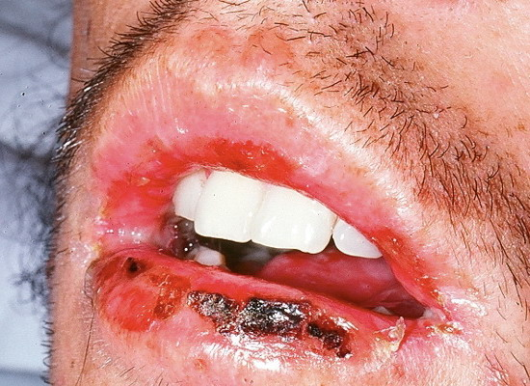
Erythema multiforme

Slide 13
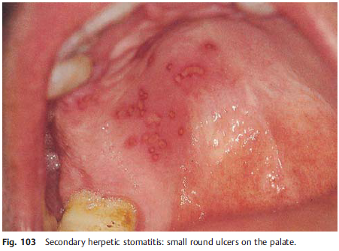
Secondary, or Recurrent,
Herpes Simplex Infections

Slide 14
Secondary, or Recurrent,
Herpes Simplex Infections
Secondary herpes represents the reactivation of latent virus. It is believed that only rarely does reinfection from an exogenous source occur in seropositive individuals.
CLINICAL FEATURES:
Patients usually have prodromal symptoms of tingling, burning, or pain in the site in which lesions will appear. Within a matter of hours, multiple fragile and short-lived vesicles appear. These become unroofed and coalesce to form map-like superficial ulcers. The lesions heal without scarring in 1 to 2 weeks and rarely become secondarily infected. The number of recurrences is variable and ranges from one per year to as many as one per month. The recurrence rate appears to decline with age with each individual. The secondary lesions typically occur at or near the same site with each recurrence. Regionally, most secondary lesions appear on the vermilion and surrounding skin. This type of disease is usually referred to as herpes labialis. Intraoral recurrences are almost always restricted to the hard palate or gingiva.

Slide 15
Treatment
Acyclovir in the treatment of mucocutaneous infections. Systemic acyclovir (200- to 400-mg tablets five times per day) is effective in the control of primary genital herpes and, to a lesser degree, primary oral herpes.
Supportive therapy (fluids, rest, oral lavage, analgesics, and antipyretics) is an essential component of any primary herpes simplex regimen.
Secondary herpes can be controlled to some degree with systemic acyclovir. Recurrences are not prevented, but the course and severity of the disease are favorably affected. Prophylactic systemic acyclovir is effective in problematic cases and in immunosuppressed patients. In HIV-positive patients with severe disease, aggressive therapy that may include intravenous acyclovir or ganciclovir may be necessary. Topical acyclovir, although it is only somewhat effective, has been advocated by some for the treatment of secondary herpes. A 5% acyclovir (or analog) ointment applied five times per day when symptoms first appear slightly reduces the duration of herpes lesions and may abort some lesions.

Slide 16
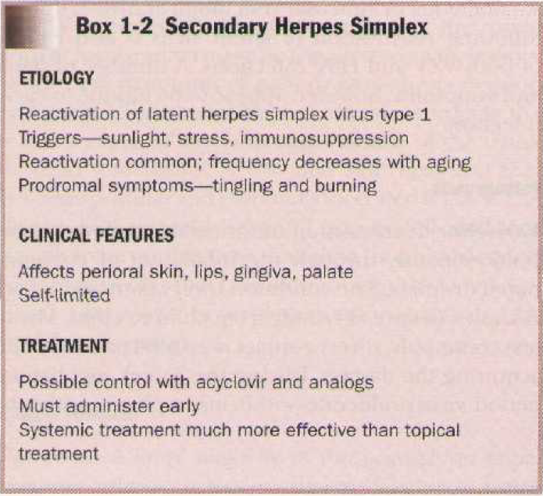

Slide 17
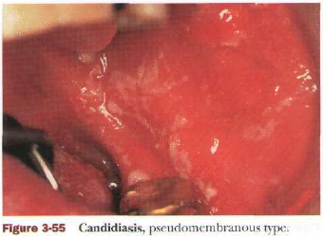
Candidiosis

Slide 18
Candidiosis
Definition Candidiosis is the most common oral fungal infection. Over the last two decades, the disease has taken on major importance.
Etiology It is usually caused by Candida albicans, and less frequently by other fungal species (C. glabrata, C. krusei, C. tropicalis, C. parapsilosis). Predisposing factors are local (poor oral hygiene, xerostomia, mucosal damage, dentures, antibiotic mouthwashes) and systemic (broad-spectrum antibiotics, steroids, immunosuppressive drugs, radiation, HIV infection, hematological malignancies, neutropenia, iron-deficiency anemia, cellular immunodeficiency, endocrine disorders).

Slide 19
Candidiosis etiology
Chronic erythematous candidiasis is a commonly seen form occurring in people who wear complete maxillary dentures (denture sore mouth).it affects the maxillary mucosa more.
The clinical appearance is that of a bright red, somewhat velvety to pebbly surface, with relatively little keratinization. Also seen in individuals with angular cheilitis.. Clinically, the lesions are moderately painful, fissured, eroded, and encrusted.

Slide 20
Candidiosis etiology
Angular cheilitis may also occur in individuals who habitually lick their lips and deposit small amounts of saliva in the commissural angles.The skin is fissured and demonstrates a degree of brown discoloration on a slightly erythematous base. Chronic candida infections are also capable of producing a hyperplastic tissue response (chronic hyperplastic candidiasis). When occurring in the retro commissural area, the lesion resembles speckled leukoplakia and, in some classifications, is known as candidal leukoplakia.

Slide 21
Candidiosis etiology
Hyperplastic candidiasis may involve the dorsom of the tongue in a pattern referred to as median rhomboid glossitis. It is usually asymptomatic and is generally discovered on routine oral examination. The lesion is found anterior to the circumvallate papillae and has an oval or rhomboid outline. It may have a smooth, nodular, or fissured surface and may range in color from white to a more characteristic red. A similar appearing red lesion may also be present on the adjacent hard palate ("kissing lesion"). Whether on the tongue or on the palate, the condition may occasionally be mildly painful, although most cases are asymptomatic. Since it is never seen in children, it more likely a hyperplastic form of candidiasis.

Slide 22
Treatment
Topical antifungal agents (nystatin, azole derivatives, amphotericin)
Amphotericin 10 mg lozenge sucked, 4 times daily for 14 to 21 days
Systemic azoles (ketoconazole, fluconazole, itraconazole).
Miconazole 2% gel, 2.5 mL orally, 4 times daily, after meals, for 14 to 21 days.
-Miconazole can potentiate the effect of warfarin

Slide 23
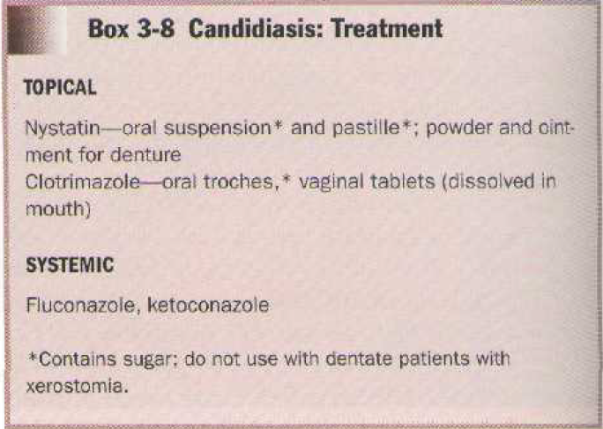

Slide 24
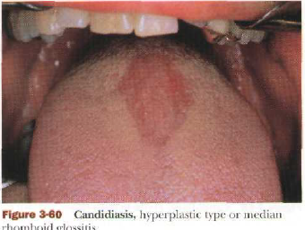
Candidiosis

Slide 25
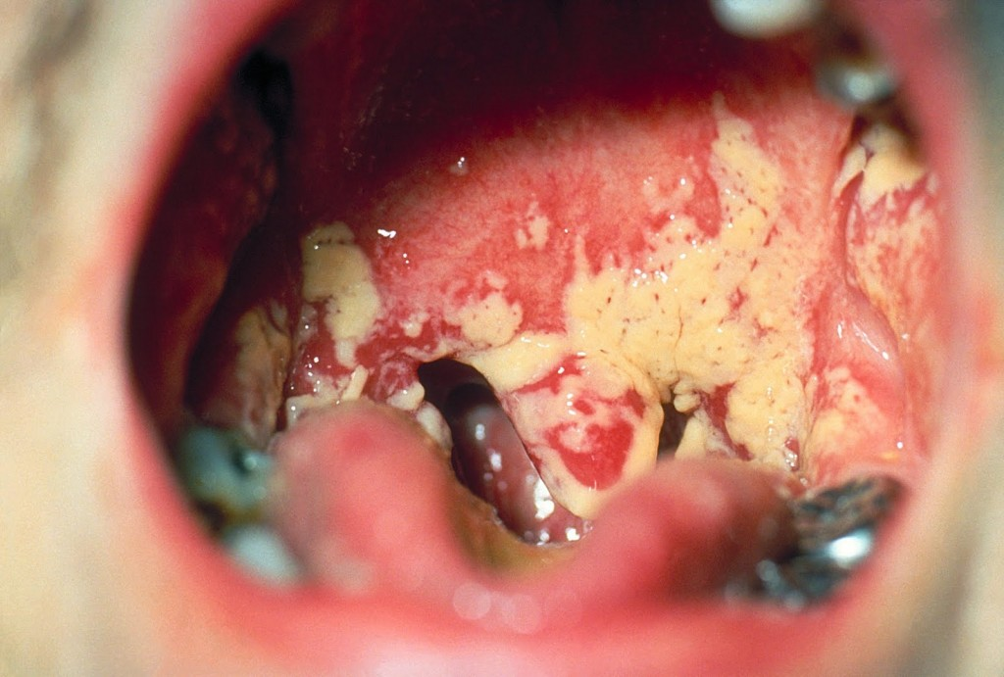
Candidiosis

Slide 26
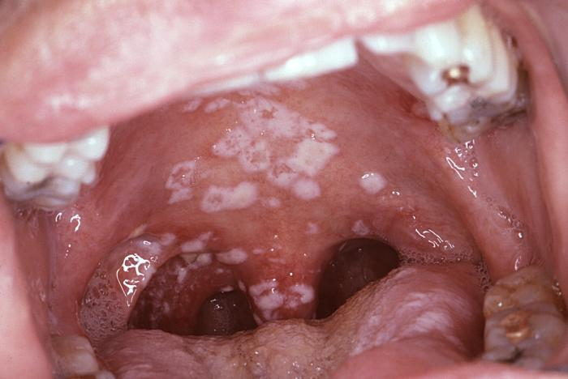
Candidiosis

Slide 27
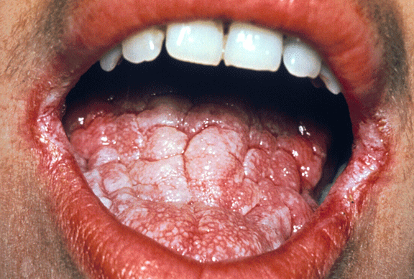
Candidiosis

Slide 28
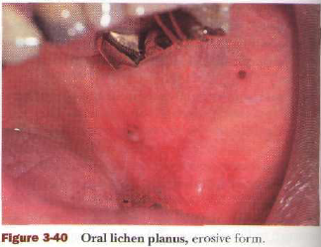
Lichen planus

Slide 29
Lichen planus
Lichen planus is a chronic mucocutaneous disease of unknown cause. In oral mucosa it typically presents as bilateral white lesions, occasionally with associated ulcers.
Etiology and Pathogenesis. Although the cause of lichen planus is unknown, there have been various theories.

Slide 30
Lichen planus
Lichen planus is a chronic systemic disease of established immune-mediated pathogenesis.¹ It most commonly involves the mucosa of the oral cavity ,but it can involve other sites, namely the skin, the scalp (with inflammation around and affecting the hair follicles resulting in alopecia).
There are six recognized oral presentations of lichen planus: (1) reticular; (2) papular (3) plaque-form (4) atrophic (5) ulcerative (erosive) and rare (6) bullous form. These latter three forms can be associated with significant discomfort requiring either topical or systemic immunosuppressive therapy.

Slide 31
Clinical Features
Lichen planus is a disease of middle age that affects men and women. Children are rarely affected. The severity of the disease commonly because of stress. An association between lichen planus and hepatitis C infection has been suggested. Many of these cases likely represent lichenoid drug reactions to the medications used to manage these conditions, which may mimic lichen planus clinically. The most common type is the reticular form, which is characterized by numerous interlacing white keratotic lines or striae (so-called Wickham's striae) that produce an annular or lacy pattern. The buccal mucosa is the site most commonly involved.

Slide 32
Clinical Features
The striae, although occurring typically in a symmetric pattern on the buccal mucosa bilaterally, may also be noted on the tongue and less commonly on the gingiva and the lips. Almost any mucosal tissue may demonstrate manifestations of lichen planus. This form generally presents with minimal clinical symptoms and is often an incidental discovery.

Slide 33
Treatment
Although lichen planus cannot generally be cured, some drugs can provide satisfactory control. Corticosteroids are the single most useful group of drugs in the management of lichen planus. The rationale for their use is their ability to modulate inflammation and the immune response. Topical application and local injection of steroids have been successfully used in controlling but not curing this disease. In circumstances in which symptoms are severe, systemic steroids may be used for initial management. The addition of antifungal therapy to a corticosteroid regimen typically enhances clinical results. This is likely a result of elimination of secondary C. albicans growth in lichen planus-involved tissue. Antifungals also prevent the overgrowth of C. albicans that may be associated with corticosteroid use.

Slide 34
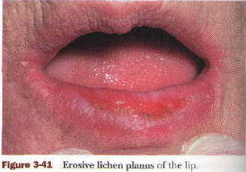
Erosive Lichen planus

Slide 35
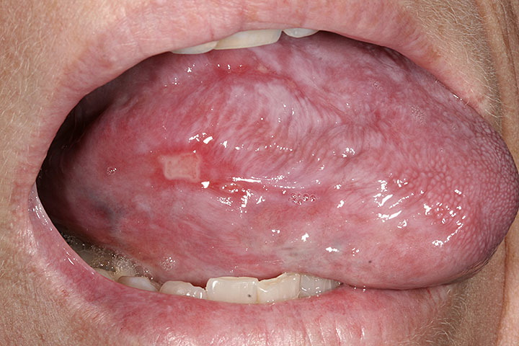
Erosive lichen planus oral

Slide 36
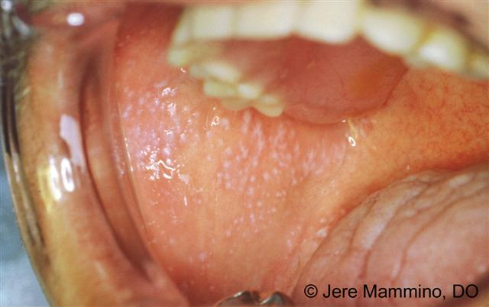
Lichen planus

Slide 37
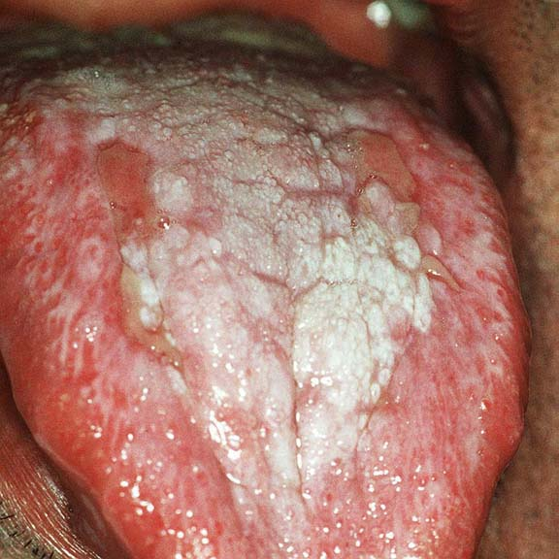
Lichen planus tongue

Slide 38
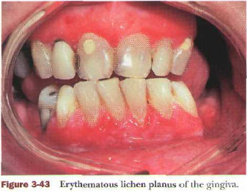
Erythematous Lichen planus

Slide 39
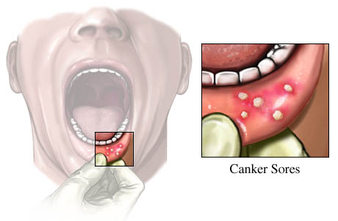
Recurrent Aphthous stomatitis

Slide 40
Recurrent Aphthous stomatitis
Aphthous stomatitis is a common condition characterized by the repeated formation of benign and non-contagious mouth ulcers (aphthae) in otherwise healthy individuals. The informal term canker sores is also used.
The cause is not completely understood, but involves a T cell-mediated immune response triggered by a variety of factors. Different individuals have different triggers, which may include nutritional deficiencies, local trauma, stress, hormonal influences, allergies, genetic predisposition or other factors.
These ulcers occur periodically and heal completely between attacks. In the majority of cases, the individual ulcers last about 7-10 days, and ulceration episodes occur 3–6 times per year.
The condition is very common. The onset is often during childhood or adolescence, and the condition usually lasts for several years before gradually disappearing. There is no cure, and treatments aim to manage pain, reduce healing time and reduce the frequency of episodes of ulceration.

Slide 41
Types
Minor apthae
Mjor apthae
Herpetiform apthae

Slide 42
Clinical features
Generally, symptoms may include prodromal sensations such as burning, itching, or stinging and pain, which is often out of proportion to the extent of the ulceration and is worsened by physical contact, especially with certain foods and drinks (e.g., acidicIf there are lesions on the tongue, speaking and chewing can be uncomfortable, and ulcers on the soft palate, oropharynx, or esophagus can cause odynophagia (painful swallowing). Signs are limited to the lesions themselves.
Aphthous ulcers typically begin as erythematous macules (reddened, flat area of mucosa) which develop into ulcers that are covered with a yellow-grey fibrinous membrane that can be scraped away. An erythematous "halo" surrounds the ulcer. The size, number, location, healing time, and periodicity between episodes of ulcer formation are all dependent upon the subtype of aphthous stomatitis.

Slide 43
Treatment
Pharmacotherapies used in aphthous stomatitis
Drug type | Intended action | Example(s)
Topical covering agents / barriers | Reduce pain | Orabase (often combined with triamcinolone).
Topical analgesics / anesthetics / anti-inflammatory agents | Reduce pain | Benzydamine hydrochloride mouthwash or spray, Amlexanox paste, viscous lidocaine, diclofenac in hyaluronan.
Topical antiseptics | Hasten healing (prevent secondary infection) | Doxycycline, tetracycline, minocycline, chlorhexidine gluconate, triclosan.
Topical mild potency corticosteroids | Reduce inflammation | Hydrocortisone sodium succinate.
Topical moderate potency corticosteroids | Reduce inflammation | Beclomethasone dipropionate aerosol, fluocinonide, clobetasol, betamethasone sodium phosphate, dexamethasone.
Orally administered drugs | Various, mostly modulating immune response | Prednisolone, colchicine, pentoxifylline, azathioprine, thalidomide, dapsone, mycophenolate mofetil, adalimumab, vitamin B12, Clofazimine, Levamisole, Montelukast, Sulodexide, levamisole.

Slide 44
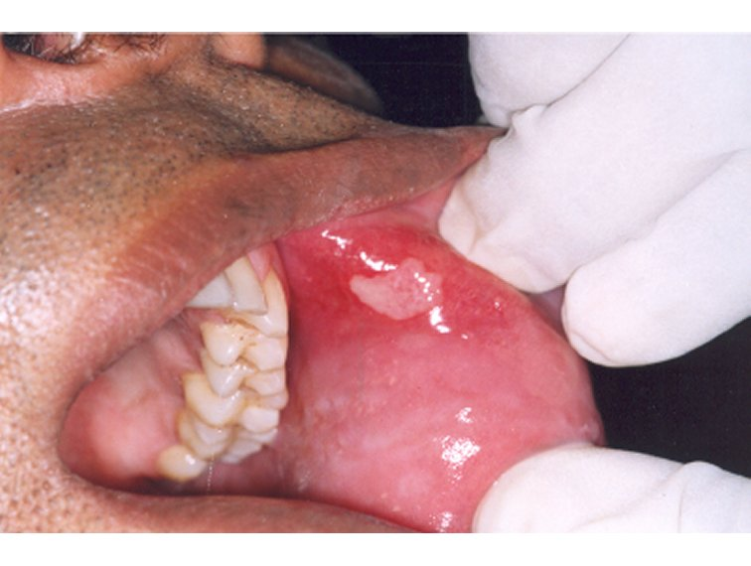
Recurrent Aphthous stomatitis

Slide 45
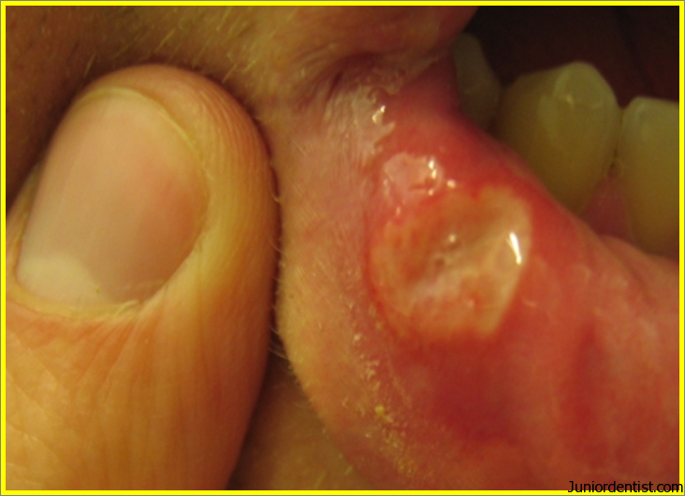
Recurrent Aphthous stomatitis

Slide 46
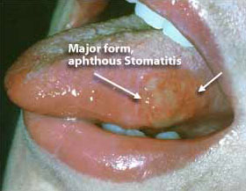
Recurrent Aphthous stomatitis

Slide 47
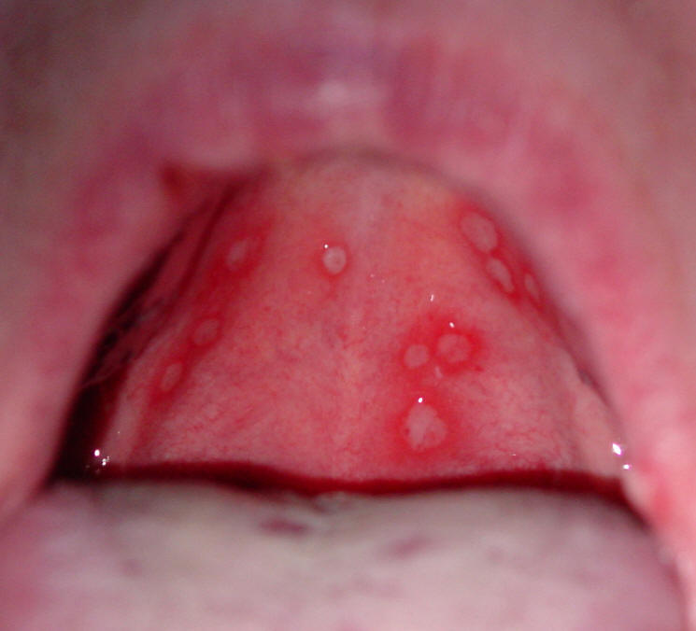
aphthous ulcers

Slide 48

Thank you for your attention

