Slide 1
Physical method

Slide 2
Cryotherapy
Cryotherapy is the local or general use of low temperatures in medical therapy. Cryotherapy is used to treat a variety of benign and malignant lesions. The term "cryotherapy" comes from the Greek cryo (κρυο) meaning cold, and therapy (θεραπεια) meaning cure. Cryotherapy has been used as early as the seventeenth century.
Its goal is to decrease cellular metabolism, increase cellular survival, decrease inflammation, decrease pain and spasm, promote vasoconstriction, and when using extreme temperatures, to destroy cells by crystallizing the cytosol. The most prominent use of the term refers to the surgical treatment, specifically known as cryosurgery. Other therapies that use the term are cryogenic chamber therapy and ice pack therapy.

Slide 3
Cryosurgery is the application of extreme cold to destroy abnormal or diseased tissue. Cryotherapy is used to treat a number of diseases and disorders, most especially skin conditions like warts, moles, skin tags and solar keratoses. Liquid nitrogen is usually used to freeze the tissues at the cellular level. The procedure is used often because of its efficacy and low rates of side effects.
Cryosurgery in dentistry is bloodless and sparing method of treatment, it is tolerable for even elderly patients and for those with severe pathology of intestinal organs and systems.

Slide 4
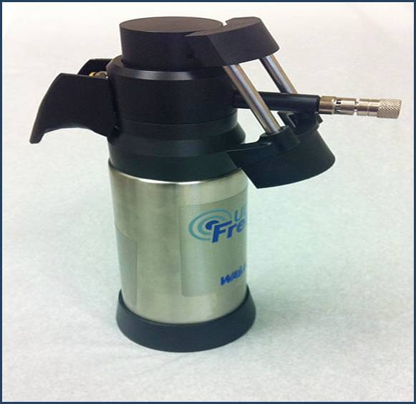
Stomatologic purposes need special cryodevices with temperature not less than -150°С, where complicated topographic and anatomic relationships of all complexes of periodontal tissues and tunica mucosa of mouth are considered in construction of cryoinstrument working part, and cryoagent supply should be calculated for the long time of application.

Slide 5
Main periodontal diseases that can be treated by cryosurgery are parodontosis, hypertrophic gingivitis, papillitis, epulis, and pericoronitis. Practically, there are no contraindications to cryotherapy. It is expedient to use cryosurgery at the diseases bound to disturbance of a coagulating property of a blood, nephroses, an endocrine pathology, the general{common} neurosis with cardiovascular responses, a climacterium.
On tunica mucosa of mouth, such diseases, as a leukoplakia, red flat herpes, chronic recurrent aphthous stomatitis, декубитальные and trophic ulcers, papillomas, fibromas, hemangiomas, retention cysts, cheilitis glandularis, long-term persisting labial fissures, Manganotti cheilitis and some other benign and malignant neoplasms are quite often.

Slide 6
As experience shows, cryotherapy in many diseases of tunica mucosa of mouth, both in elderly and in young age is not only method of choice, but expedient necessity in comparison with surgical treatment or electrocoagulation.
Cryosurgery allows destroying tumoral or any other pathological tissue in strictly defined limits, thus depth of tissue destruction can be controlled precisely enough. The focus of cryodestruction is always clearly delimited from intact tissues. Cryosurgery excludes mechanical trauma of tissues (abruption, dissection) thereof tumor cells dissemination is excluded. The possibility of complications is negligible. Side effects are not observed.

Slide 7
Mechanism of Tissue Death (Biological Mechanisms of Cryonecrosis)
There are various distinct mechanisms by which tissues may be damaged by freezing. These mechanisms co-exist at the time of a single cryosurgical treatment, and since the preponderance of each varies according to the apparatus used, the physical nature of the tissues being treated, the distance from the cryoprobe, and the rate and degree of cooling, an understanding of these mechanisms enables one to vary the technique according to the nature, site, size and depth of the lesion to be treated. Cold sensitivity varies. Melanocytes are the most susceptible cells, followed by basal cells, keratinocytes, bacteria, connective tissue, axon myelin sheath and virus.

Slide 8
Factors associated with cryodestruction are as follows.
Direct effects
- Ice crystal formation or cellular disruption
When the rate of freezing is rapid (greater than 5°C per second), particularly in the immediate vicinity of the probe tip where the cooling rate approaches −70°C per second, ice crystals form in both extracellular and intracellular fluid. The more rapid the cooling rate, the larger the ice crystals formed, and incidentally the greater the degree of adhesion of the tissues to the probe. Large ice crystals produce physical disruption of cell membranes.

Slide 9
- Cellular dehydration and electrolyte disruption
Within the outer zone of ice ball where the temperature is about −10°C, the cooling rate approximates to −1/2°C per second. At such a rate, freezing occurs in the extracellular space only, the cell membranes acting as a barrier to the propagation of ice crystals. This slower freezing captures extracellular water molecules, so that ionic concentration of electrolytes in the extracellular space increases. Intracellular water then passes out of the cells, but in turn becomes trapped in the propagating ice front. The cells thus become dehydrated and undergo physical shrinkage. Moreover, the concentration of electrolytes both inside and outside the cell membranes increases to levels which become irreversibly toxic to cellular function.

Slide 10
- Thermal shock
It most likely relates to cell membrane damage caused by rapid freezing rates which in the systems described can be of the order of 1000°C/minute.
- Inhibition of enzymes
As each cellular enzyme system operates optimally over a narrow temperature range, sudden cooling acts as an inhibitor. This renders the cells more vulnerable to the metabolic disturbances.

Slide 11
- Protein changes
Lipoprotein complexes in both the cell membranes and mitochondria are denatured by the profound fall in temperature, with consequent damage to cellular metabolism.
- The effects of thawing
When the freezing process stops and the tissues are allowed to rewarm, further damaging effects may take place. If the intracellular water was supercooled, then on thawing, ice crystals form leading to damage from crystallization. Also, because of raised concentrations of intracellular electrolytes, there is water intake in the cells, which then vacuolate, swell and rupture. A slow thaw prolongs the duration of these damaging effects.

Slide 12
Indirect effects
- Vascular effects
Ischemic necrosis produced by vascular stasis and microthrombus formation is a significant part of the cryodestructive process. Large vessels continue to function, although with increased permeability.
- Immunological effects
These may add to the destruction of a lesion treated by cryosurgery. Such an effect could be due to a massive release of pathological cell antigens and/or changes to the antigenic nature of the frozen and thawed cells, thus making them susceptible to host surveillance mechanisms.

Slide 13
Instrumentation
The application of cryotherapy to the mouth requires equipment that has the following capabilities:
The cold source (which is really a means of extracting heat - a heat sink) must be small and sufficiently maneuverable to reach the various parts of the mouth.
It must be controllable to the extent that selected areas can be frozen without damaging the nearby structures.
Should maintain the required temperature for as long as required.
Temperature of the cold source should be variable.
Rate of thawing should be controllable.
Should be fitted with a thermocouple so that temperature at the tissue surface can be easily read by the surgeon.
Most commonly used cryogens are liquid nitrogen (−191°C), nitrous oxide (−81°C) and carbon-di-oxide (−79°C).

Slide 14
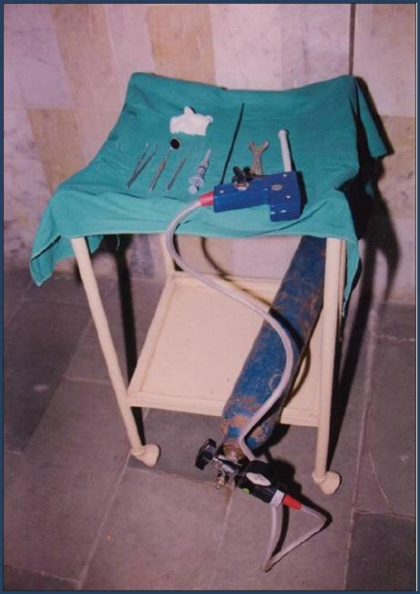

Slide 15
Cryosurgery and oro-facial lesions
Vascular malformations:
Cavernous hemangioma: Cryosurgery produces complete regression of these malformations, whether of skin or of mucosa, with minimal scarring. Two freeze-thaw cycles of 1½ minutes each are usually sufficient. The nevi are emptied by compression with the probe before and during treatment. Cryosurgery is very effective in cases of strawberry nevi where there is lot of bleeding, ulceration or overwhelming parental demands.
Capillary nevi respond to cryosurgery.The most satisfactory technique is to freeze the entire nevus site by site for 2-3 seconds only. A second freeze is applied for approximately 10 seconds. By restricting the duration of freezing, scarring is avoided.
Lymphangiomas, especially those with moderate fibrous element, are less responsive to cryosurgery. A combined excisional and cryosurgical approach is sometimes useful.

Slide 16
Hyperkeratosis and leukoplakia
Wide excision may be difficult in areas such as tongue, lips and commissures, and there is always the possibility of further changes developing in adjacent areas. Cryosurgery is a simple and effective means for fissured or granular types of leukoplakia and also for thick plaques as well as in cases in which candida are found. Following biopsies, each area is given two freeze-thaw cycles of up to 1½ minutes depending on the site and thickness of the lesion. Thick irregular plaques are planed with a surgical blade and the area is moistened with saline prior to freezing. In extensive or multifocal leukoplakia, the toluidine blue test helps to establish the priority of one area over another

Slide 17
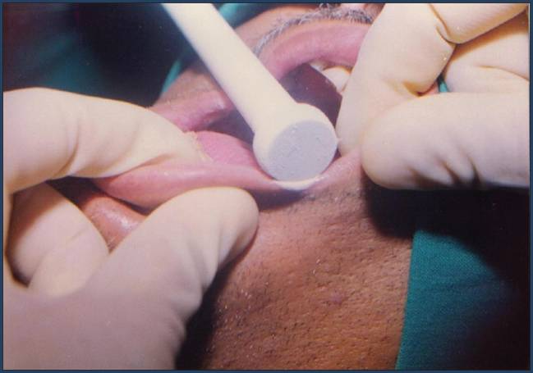
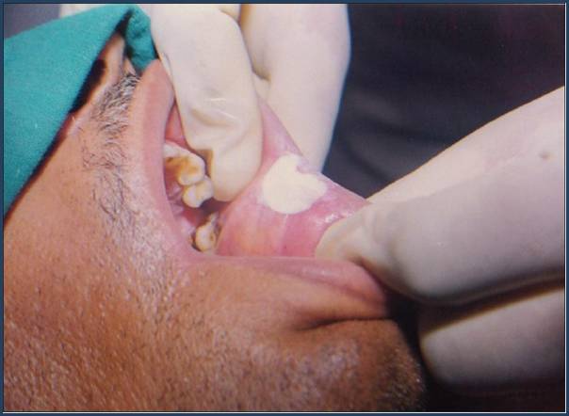

Slide 18
Granulomatous and hyperplastic conditions
Cryosurgery is a satisfactory alternative to excision or cautery for the treatment of papillary hyperplasia of the palate, fibrous epulis, fibroepithelial polyps, myeloid epulides and viral warts.
Hyperplastic conditions
Denture hyperplasia: In the lower labial sulcus, hyperplastic folds may be multiple and relatively broad based. Simple excision in these cases leads to loss of sulcus depth, which may necessitate more radical approach to the problem, such as vestibuloplasty. In the elderly and debilitated, cryosurgery may be used. Necrosis of the hyperplastic tissue may be achieved with minimal alteration of sulcus depth.

Slide 19
Electrophoresis
Electrophoresis is the motion of dispersed particles relative to a fluid under the influence of a spatially uniform electric field.
This electrokinetic phenomenon was observed for the first time in 1807 by Ferdinand Frederic Reuss (Moscow State University),who noticed that the application of a constant electric field caused clay particles dispersed in water to migrate. It is ultimately caused by the presence of a charged interface between the particle surface and the surrounding fluid. It is the basis for a number of analytical techniques used in biochemistry for separating molecules by size, charge, or binding affinity.

Slide 20
Ionophoresis is a kind of physical process, in which ions flow diffusively in a medium, driven by an electric field. Iontophoresis is to be distinguished from the carriage of uncharged molecules by diffusive fluxes of other molecules, especially of solvent molecules, for example by electro-osmosis, that is to say by flux of uncharged solvent molecules carried as a cross-effect of iontophoresis. The combination of iontophoresis and electro-osmosis is called electrophoresis. This is active transport of matter due to an electric field. The transport is measured in units of chemical flux, commonly µmol/cm2h.

Slide 21
Iontophoresis in dentistry can be used for:
- preventive anticarious prophylaxis
- diagnosis of vitality of dental pulp
- desensitization in the more diverse cases of dentin hypersensitivity
- superficial anaesthetics: general and local

Slide 22
- therapeutics of oral and dental diseases and lesions: aphtha ulcers, herpes simplex, erosion and retraction of the gums, lichen planus, post-surgery and post-electrosurgery wounds, marginal periodontoses and synergistic to periodontal treatments.
- algo-disorder syndrome of tmj
- destruction of broken endocanal instruments
- endodontic treatments of infection with or without periapical reaction.

Slide 23
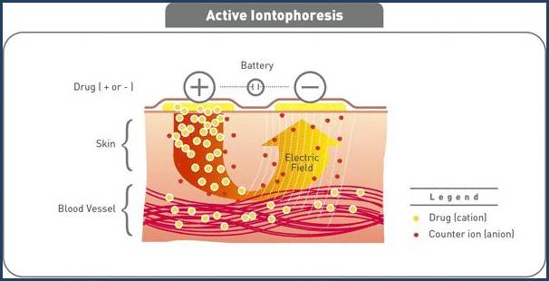
Active iontophoresis – how it works.

Slide 24
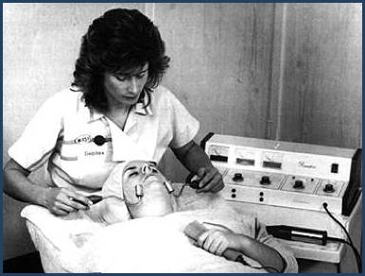
A galvanic machine in operation during iontophoresis. Note the client is holding onto the return electrode to complete the circuit.

Slide 25
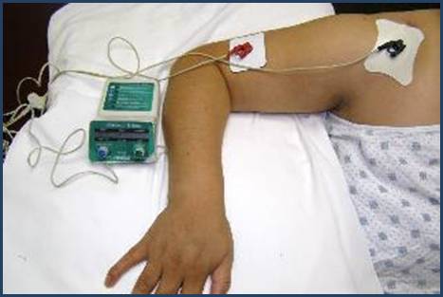
Ionized medication, (e.g. the steroidal anti-inflammatory dexamethasone) is driven through the skin by an electric current so that it reaches deep tissues. Iontophoresis is used to treat acute and subacute inflammation. It is a relatively painless and sterile procedure, but the passage of the electric current through the skin sometimes causes minor galvanic burns.

Slide 26
ULTRA HIGH FREQUENCY (UHF) THERAPY
During the UHF therapy, the body is subjected to ultra high frequency electric field. It is influence on the patients organism by the variable electric field (in a less measure magnetic) of ultrahigh frequency (40,68 mH)
Therapeutic effect:
- reduction of all stages of inflammatory processes;
- pain relief;
- spasm relief;
- lowering of blood pressure.

Slide 27
Indications:
- acute skin and under skin cell inflammatory diseases;
- acute internal organ inflammatory diseases;
- motor apparatus diseases and injuries;
- trophic ulcers, cold injuries, bedsores;
- inflammatory gynaecological diseases.

Slide 28
Contraindications:
- malignant tumours;
- fever;
- active tuberculosis;
- blood diseases, bleeding;
- aortic aneurysm;
- cerebral haemorrhage;
- pregnancy;
- metal foreign bodies;
- pacemaker present in the area to be impacted.

Slide 29
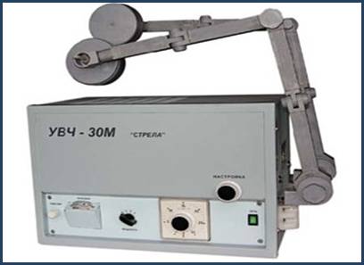
Apparatus classificate after its initial power on 3 groups:
- small power (to 5W) is the ENT apparate (for ENT-organs diseases treatment, panariciy);
- middle power (60-80W) are the UHF-30, UH -62, UHF-66 apparatus(for treatment of thorax, abdominal organs, medium-sized joints diseases);
- large power (350W) are the UHF -300, "Screen -1", "Screen -2" apparatus (for treatment of big sized joints diseases)

Slide 30
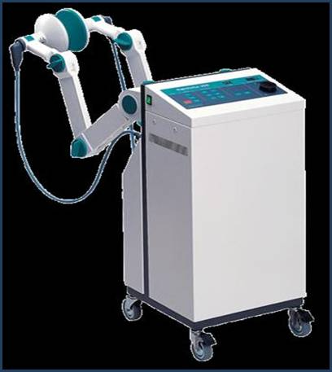
Method. It is possible to influence through clothes, gipseous or bandages, if they are dry. The metallic objects in the area of action must be absent. Procedure can not be influence on the heart.

Slide 31
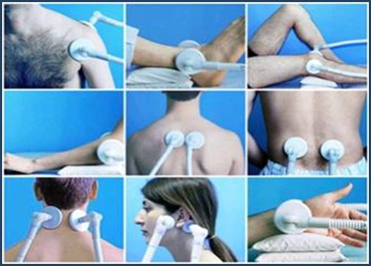

Slide 32
Depending on initial power 3 doses of UHF influence are distinguished:
· unthermal;
· oligothermal;
· thermal.
Duration of procedure of UHF-therapy is 7-10 min (rarely 15 min), depending on the form of disease, character of its motion (acute, subacute, chronic) and distribution of pathological process.
Procedures of UHF-therapy are conducted daily, however at the acute inflammatory diseases, including at festering ones, appoint them 2 times per a day. At the chronic diseases, by especially an out-patient, procedures are conducted in a day. Course of treatment - from 5 to 15 procedures.

Slide 33
Darsonvalisation
It is the method of electrotherapy, which is based on application of alternating current of high-frequency (160-400 kH), high tension (10-100 kV) and small force (10-15 mA).
An alternating current is used as impulses with gradually increasing and handing down amplitude and frequency 50 Hertzs. Intervals between impulses are far more than duration of impulses.
An electric digit which arises up between an electrode and body of patient is an operating factor. Intensity of digit can be changed from «quiet» to sparking.

Slide 34
Mechanism of action.
Darsonvalisation can be general and local.
At general darsonvalisation is normalized tone vessels of brain, arterial pressure, sleep, metabolism.
At the local darsonvalisation the physiology reaction, as a rule, is local or segmentary. A thermal effect is insignificant, that is explained by small strength of current and it impulsive character.
The irritation of receptors of skin reflexly causes the changes in the internal organs and systems of organism. As a rule, at first there is the brief spasm of vessels, that causes the selection of BAS over and a next expansion of vessels and stimulation metabolism in tissues.

Slide 35
A sparking digit created in a skin and mucus numerous micronecrosis, that is causes the activation of phagocytosis.
On the whole, it is possible to indicate the following therapeutic effects of darsonvalisation:
- vessels tone is normalized
- vein stagnation diminishes
- tissues trofic gets better
- bactericidal and bacteriostatical actions increases
- anaesthetic effects are activated

Slide 36
Indications:
- skins trofic violation, hairs fall;
- parodontosis, gingivitis, glosalgia;
- vasomotorial rhinitis, the Reino illness, initial stage of obliterative endarteritis;
- varicose veins, haemorrhoidal veins dilated;
- paraaethesia, migraine;
- wounds which are healing slowly.

Slide 37
Contra-indications:
general;
- acute infectious diseases;
- pregnancy on the second half;
- infarct myocardium (to 6 months);
- hysterical neurosis;
- sensitivity to current.

Slide 38
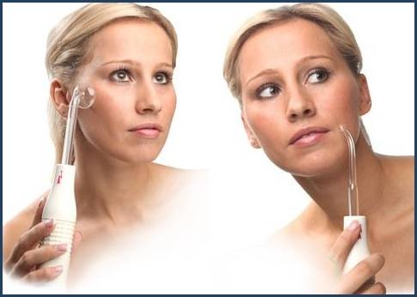
Apparatus. For treatment the apparatus "Spark-1", "Spark-2 "are applied.

Slide 39
Ultratonetherapy
It is application of alternating sinusoidal current of high-frequency (22 kH), high tension (4-5 kV) with initial power to 10 WT with the medical purpose.
As well as at darsonvalisation tension to the area of influencing is deliver by a vacuum electrods, which gives bright red luminescence. A current is delivering not in impulsive, but in the continuous mode. A quiet electric digit and tissue endogenous heat is an operating physical factor, formation of which is a result of large initial power.

Slide 40
The current of ultratone frequency causes in tissues the similar physiological reactions as a quiet electric digit at darsonvalisation, that is:
- vessels tone is normalized
- vein stagnation diminishes
- tissues trofic gets better
- bactericidal and bacteriostatical actions increases
- anaesthetic effects is activated
It is necessary to remember, that all noted effects are weaker, than at darsonvalisation, but at ultratonetherapy the sedative and contra inflammation effects are greatly marked.

Slide 41
Indications:
- acute and chronic inflammatory processes in a nonactive phase;
- pain syndromes (except for contra-indications);
- scars, solderings.
Contra-indications:
The same as for darsonvalization

Slide 42
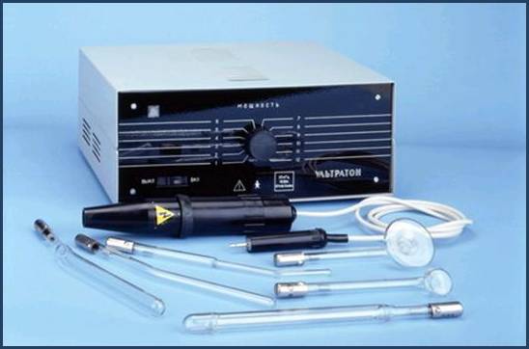
Method and apparatus.
Is used such apparatus as " Ultratone - 10-1".
Apparatus “Ultratone”

Slide 43
To the apparatus 6 glass gas-unloading electrodes are added - 4 for intracavity procedures and 2 for external. A method is only contact, influencing can be local and reflex-segmental (when operates along a columna vertebralis). In the area of influencing a patient feels a weak prickling sensation and a wear heat.
Power, that is given to the patient select on 3 doses:
small - to 3 W;
middle - 4-6 W;
great; - 7-10 W.
Duration of procedure - 5-20 min. Procedures are conducted every day or in a day, on a course - to 20 procedures.

Slide 44
Laser
A dental laser is a type of laser designed specifically for use in oral surgery or dentistry.
Lasers have been used in dentistry since 1994 to treat a number of dental problems.
Several variants of dental laser are in use, with the most common being diode lasers, carbon dioxide lasers, and yttrium aluminium garnet laser. Different lasers use different wavelengths and these mean they are better suited for different applications. For example, diode lasers in the 810–900 nm range are well absorbed by red colored tissues such as the gingivae increasingly being used in place of electrosurgery and standard surgery for soft tissue applications such as tissue contouring and gingivectomy

Slide 45
Hard Tissue (Tooth) Laser Dentistry Procedures
- Cavity Detector: Low intensity soft tissue dental lasers may be used for the early detection of cavities by providing a reading of the by-products produced by tooth decay.
- Dental Fillings/Tooth Preparation: Hard tissue dental lasers may eliminate the need for a local anesthetic injection and the traditional turbine dental drill. Lasers used in dental filling procedures are capable of killing bacteria located in a cavity, potentially leading to improved long term tooth restorations. However, dental lasers are not appropriate for the replacement of amalgam fillings, onlays or crowns.
- Tooth Sensitivity: Dental lasers may be used to seal tubules (located on the root of the tooth) that are responsible for hot and cold tooth sensitivity.

Slide 46
Soft Tissue (Gum) Laser Dentistry Procedures
- Crown Lengthening: Dental lasers can reshape gum tissue (soft tissue laser) and bone (hard tissue laser) to expose healthier tooth structure. Referred to as crown lengthening, such reshaping provides a stronger foundation for the placement of restorations.
- Gummy Smile: Dental lasers can reshape gum tissue to expose healthy tooth structure and improve the appearance of a gummy smile.
- Muscle Attachment (Frenula): A laser frenectomy is an ideal treatment option for children who are tongue tied (restricted or tight frenulum) and babies unable to breast feed adequately due to limited tongue movement. A laser frenectomy may also help to eliminate speech impediments.
- Soft Tissue Folds (Epulis): Dental lasers may be used for the painless and suture-free removal of soft tissue folds often caused by ill-fitting dentures.

Slide 47
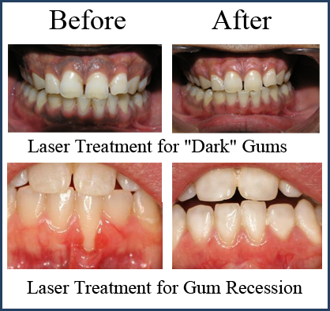

Slide 48
Other Laser Dentistry Applications
- Viewing Tooth and Gum Tissues: Optical Coherence Tomography is a safer way to see inside tooth and gums in real time.
- Benign Tumors: Dental lasers may be used for the painless and suture-free removal of benign tumors from the gums, palate, sides of cheeks and lips.
- Cold Sores: Low intensity dental lasers reduce pain associated with cold sores and minimize healing time.
- Nerve Regeneration: Photobiomodulation can be used to regenerate damaged nerves, blood vessels and scars.
- Sleep Apnea: In cases where sleep apnea is a result of a tissue overgrowth in areas of the throat (which sometimes occurs with age), a laser assisted uvuloplasty or laser assisted uvula palatoplasty (LAUP) procedure can be performed to reshape the throat and relieve the correlating breathing problems associated with sleep apnea.
- Teeth Whitening: Low intensity soft tissue dental lasers may be used to speed up the bleaching process associated with teeth whitening.
- Temporomandibular Joint Treatment: Dental lasers may be used to quickly reduce pain and inflammation of the temporomandibular jaw joint.

Slide 49
