Slide 1
SUPERIOR VENA CAVA SYNDROME
Chandrabhan

Slide 2
SVC Syndrome
Constellation of signs and symptoms caused by obstruction of blood flow in the superior vena cava.
Secondary to external compression, invasion, constriction or thrombosis of the SVC
Can be partial or complete obstruction

Slide 3
SCVS (cont)
Leads to increased venous pressure and results in edema of the head, neck, arms, and upper chest
Dilated veins on the chest wall
Pleural/pericardial effusions
Cerebral edema/Increased IC pressure

Slide 4
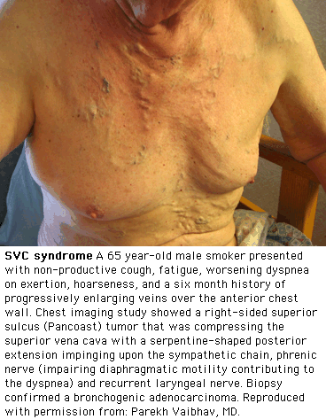
Patients

Slide 5
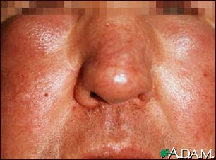
Patients

Slide 6
Clinical Features of SVC
SYMPTOMS FREQUENCY
Short of Breath 50%
Chest Pain 20%
Cough 20%
Dysphagia 20%
Markman, M. Cleveland Clinic Journal of Medicine, 1999

Slide 7
Clinical Features of SVCS
SIGNS FREQUENCY
Thorax Vein Distention 70%
Neck Vein Distention 60%
Facial Swelling 45%
UE/Trunk Swelling 40%
Cyanosis 15%
Markman, M. Cleveland Clinic Journal of Medicine, 1999

Slide 8
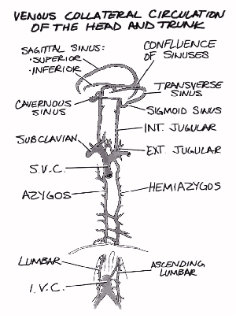
A/P #1

Slide 9
A/P #2
Formed by merger of left/right brachiocephalic veins + azygous
Venous blood from head/neck/upper extremities
6 to 8 cm in length
1.5 to 2 cm wide
Abner, A. Chest, 1993

Slide 10
A/P #3
SVC surrounded by rigid structures (ie mediastinum, sternum, right mainstem bronchus and LN)
Thin walled and easily compressible secondary to low pressure
Prone to obstruction relative to its “neighbors”

Slide 11
A/P #4
As obstruction develops, venous collaterals form
Alternate pathways for venous return to the RA
Severity of sx depends on the time course of obstruction

Slide 12
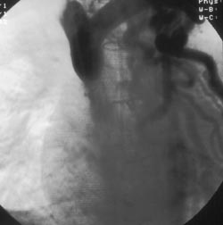
SVCS

Slide 13
Etiology of SVC
Malignancy
  Lung cancer
  Lymphoma
  Thymoma
  Metastatic
  Germ Cell
“Benign”
  Infection/Inflammation
  Benign Neoplasms
  Iatrogenic
  Trauma

Slide 14
Malignancy
Account for 80-97% of SVCS cases
Lung Cancer 75-80%
Lymphoma 10-15%
Others 5%
  Metastatic
  Thymoma
  Germ cell tumor
Markman, M. Cleveland Clin JOM, 1999.
Ostler, P. Clin Onc, 1997.

Slide 15
Lung Cancer
5-10% Lung cancer pts develop SVCS
SCLC pts account for 50% SVCS in this group--yet only 25% of lung cancers
Tend to arise in central/perihilar
Right>>>>Left
Markman, M. Cleveland Clin JOM, 1999.
Ostler, P. Clin Onc, 1997.

Slide 16
Lymphoma
MD Anderson experience
915 pts treated for NHL
36 pts (3.9%) presented with SVCS
23 Diffuse LCL
12 Lymphoblastic
1 Follicular LCL
Perez-Soler, R. J Clin Onc, 1984.

Slide 17
Benign
1st case of SVCS described by William Hunter in 1757
Secondary to aortic aneurysm 2/2 syphilis
Pre-abx era---->approx 50% SVCS cases
Current----->3-5% SVCS cases

Slide 18
Mediastinitis
Histoplasmosis 50%
  Fibrosing mediastinitis
Others 50%
  TB
  Actinomycosis
  Syphilis
  Post XRT
  Majahan, V. Chest, 1975

Slide 19
Benign Neoplasms
Substernal thyroid
Teratoma/Dermoid cysts
Benign Thymoma
Cystic hygroma

Slide 20
Iatrogenic
Thrombus formation 2/2 venous catheters
PM implantation
TPN lines
Swan-Ganz catheters
HD catheters
Mahajan, V. Chest, 1975.
Bertrand, M. Cancer, 1984.

Slide 21
Diagnosis
Chest radiograph
Duplex ultrasound
CT/MRI/MRV
Venogram
Radionuclide studies

Slide 22
Chest Radiograph
CXR FINDINGS FREQUENCY
Mediastinal Mass
or Widening 59-84%
Hilar LAD 19-50%
Pleural Effusions 25%
Armstrong, B. Int J Radiot Onc Biol Phys, 1987
Markman, M. Cleveland Clinic JOM, 1999
Parish, JM. Mayo Clin Proc, 1981

Slide 23
CT/MRI/MRV
Provide accurate info on location obstruction
Determine etiology of obstruction
Info on the extent of collaterals
Guide biopsy attempts

Slide 24
Venography
Can give precise level of obstruction
Less information on etiology of SVCS
Requires larger contrast dose
Usually done during IR mgmt

Slide 25
Tissue Diagnosis
Procedure Yield
Sputum cytology 33-40%
Bronchoscopy 33-60%
LN biopsy 46-80%
Mediastinoscopy 100%
Thoracotomy 100%
Ostler, J. Clin Onc, 1997
Schindler, N. Surg Clin N Am, 1999

Slide 26
Which First---> Tx or Dx?
Ahman
Literature search 1934-1984
1986 cases SVC reviewed
Only 1 clearly documented death 2/2 SVCS
Ahman, F. J Clin Onc, 1984.

Slide 27
1st--->Tx or Dx?
843 inv dx proced Comps
119 Thoractomies 2
53 Mediastinoscopies 3
217 Bronchoscopies 2
120 LN biopsies 1
197 Venograms 1

Slide 28
Treatment
Tailored to etiology
Historically standard tx----->XRT
Emergent tx before tissue dx 2/2 presumed risk of bleeding
Current standard----> tissue dx prior to initiating tx

Slide 29
Treatment
Goal
  treat symptoms
  treat underlying cause
Tx should be tailored to histologic diagnosis---->determine if curative vs palliative

Slide 30
Treatment
Chemotherapy
XRT
Surgery
Interventional Procedures
Spiro, S. Thorax, 1983
Perez-Soler, P. J Clin Onc, 1984

Slide 31
Treatment
Chemo vs XRT=equally effective
Combination of chemo/xrt did not improve response rate, symptoms or LT survival
Decreased LR in lymphoma but no change in OS
Armstrong, B. Intl J RO Biol Phys, 1984.
Perez-Stoler, P. J Clin Onc, 1984.

Slide 32
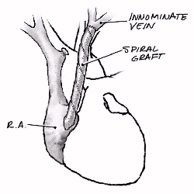
Surgical Tx

Slide 33
IR Treatment

Slide 34
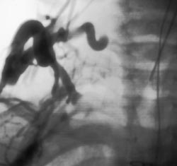
IR Tx #2

Slide 35
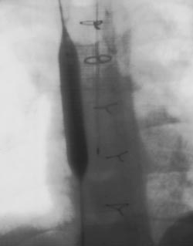
IR Tx #3

Slide 36
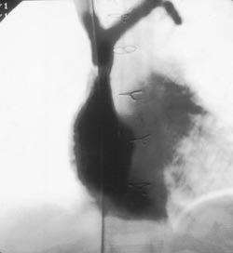
IR Tx #4

Slide 37
Prognosis
Varies depending on the etiology
SVCS in its own right is rarely fatal
10-20% survive at least 2 years
Ahman,F. J Clin Onc, 1984
Ostler, PJ. Clin Onc, 1997
Perez & Brady, 2004.

Slide 38
Prognosis
Reviewed 5052 patients tx at MIR 1/1965-12/1984
125 patients tx SVCS 2/2 malignancy
Lung Cancer 79%, Lymphoma 18%, Other 6%
XRT+/- chemotherapy
Armstrong, B. Int J Radiot Onc Biol Phys, 1987

Slide 39
Prognosis Overall
Median Survial=5.5 months
1 year survival=24%
5 year survival= 9%
Armstrong, B. Int J Radiot Onc Biol Phys, 1987

Slide 40
Prognosis-SCLC
1 year survival=24%
5 year survival= 5%
Armstrong, B. Int J Radiot Onc Biol Phys, 1987

Slide 41
Prognosis-Lymphoma
1 year survival=41%
5 year survival=41%
Armstrong, B. Int J Radiot Onc Biol Phys, 1987

Slide 42
Prognosis-NSLC
1 year survival=17%
2 year survival= 2%
Armstrong, B. Int J Radiot Onc Biol Phys, 1987

Slide 43
Prognosis
No statistical difference in survival rates between patients treated with chemoradiation vs either tx alone
Pts who responding clinically within 30days of treatment had better 1 year survival (27% vs 7%)
Armstrong, B. Int J Radiot Onc Biol Phys, 1987

Slide 44
Prognosis-BSVCS
Depends on collateral circulation
20-50 years
GreenbergA. Ann Thorac Surg, 1985
Mahajan, V. Chest, 1975
Murdock, W. Scott Med J, 1960

