Slide 1
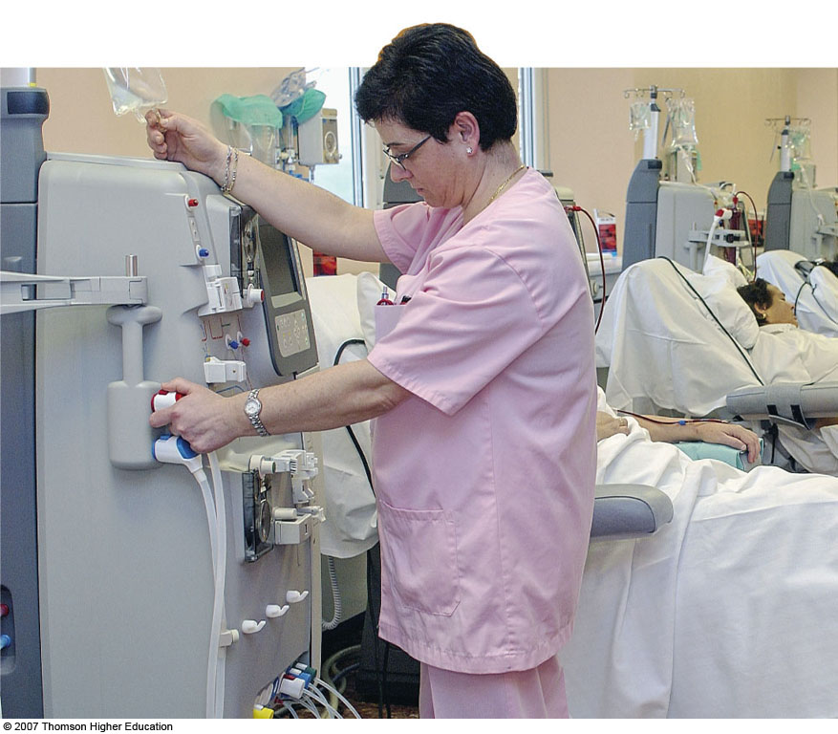
Odessa National Medical University,
0
Department of general surgery N 1

Slide 2
Kidneys
Nephron
  Working unit of the kidney
  Consists of
    Glomerulus: works like a sieve
    Tubules: fluid reabsorbed or sent to bladder

Slide 3
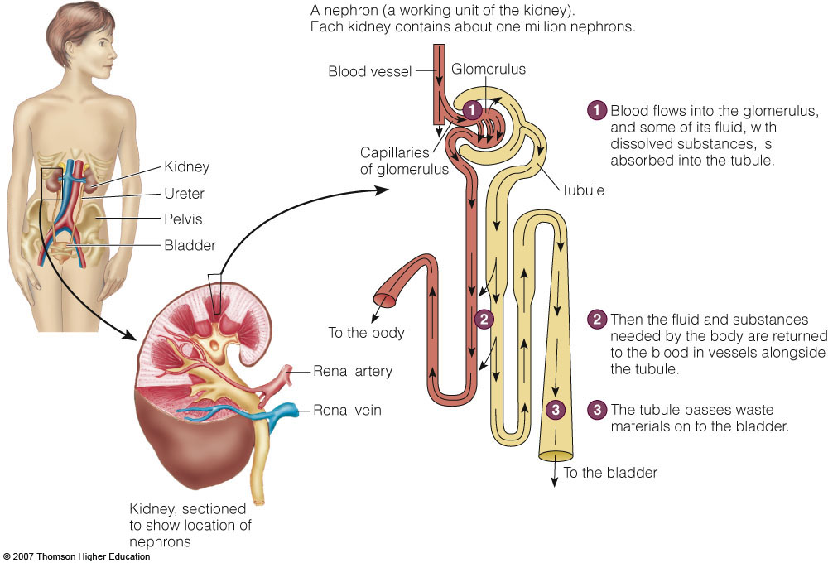

Slide 4
Kidney Functions
Regulates extracellular fluid & osmolarity, electrolyte concentrations, & acid-base balance
Excretes wastes
Secretes renin
Produces erythropoietin
Converts vitamin D to active form

Slide 5
Nephrotic Syndrome
Any kidney disorder that results in proteinuria exceeding 3.5 g/day
Cause
  Any damage to glomeruli increasing their permeability to plasma proteins

Slide 6
Nephrotic Syndrome
Clinical findings
  Proteinuria
  Low serum albumin
  Edema
  Elevated blood lipids
  Blood coagulation disorders
Possible causes
  Infections
  Chemical damage
  Immunological & hereditary disorders
  Diabetes mellitus

Slide 7
Consequences
Disturbances in protein metabolism
Edema
  Loss of albumin
  Sodium retention
Risk of CVD
  Elevated LDL, VLDL & lipoprotein(a)
  Loss of blood clotting proteins
Loss of antibodies
Decreased vitamin D-binding protein
  Lower D & calcium levels
Protein energy malnutrition (PEM)

Slide 8
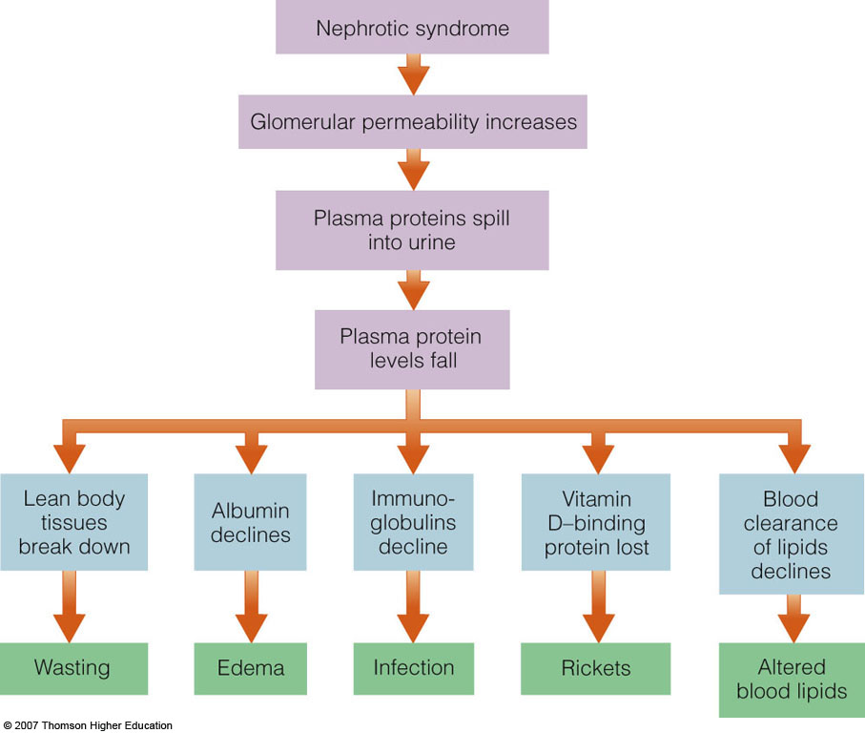
Consequences of Protein Loss

Slide 9
Treatment
Medications
  Anti-inflammatory drugs, ACE inhibitors, antihypertensives, immunosuppressants, lipid-lowering drugs, diuretics
Protein & energy
  0.8-1.0 grams/day
  35 kcalories/kg
Fat
  Low saturated fat, cholesterol, & refined sugars
Sodium
  2-3 g/day
Vitamin D & calcium
Multivitamin

Slide 10
Acute Renal Failure
Function rapidly deteriorates
  Reduced urine output
  Build up of nitrogenous wastes
Mortality rates are high

Slide 11
Causes
Prerenal
  Heart failure
  Shock
  Blood loss
Intrarenal
  Infections
  Toxins
  Drugs
  Direct trauma
Postrenal
  Factors preventing excretion of urine
  Urinary tract obstructions

Slide 12
Consequences
Uremia
  BUN, creatinine & uric acid accumulate in blood
  Fatigue, lethargy, confusion, headache, anorexia, metallic taste, N & V, diarrhea
Oliguria < than 400 mL urine/day
Sodium retention
Elevated potassium, phosphate, & magnesium
Edema

Slide 13
Treatment
Drug therapy
  Diuretics
  Potassium exchange resins
  Insulin, glucose
  Bicarbonate
Protein
  Depends on kidney function, degree of catabolism, use of dialysis
Fluids
  Measure output and add 500 mL
  Can increase if on dialysis
Electrolytes
  Restrict potassium, phosphorus, sodium

Slide 14
Chronic Renal Failure
Is a gradual & irreversible deterioration
Usually not diagnosed until 75% of function is lost
Causes
  Diabetes mellitus 43%
  Hypertension 26%
  Inflammatory, immunological, or hereditary diseases
  May follow acute failure

Slide 15
Consequences
Nephrons enlarge to compensate
Overburdened nephrons degenerate
End-stage renal disease occurs
Evaluation
  Glomerular filtration rate (GFR)
  Rate at which kidneys form filtrate

Slide 16
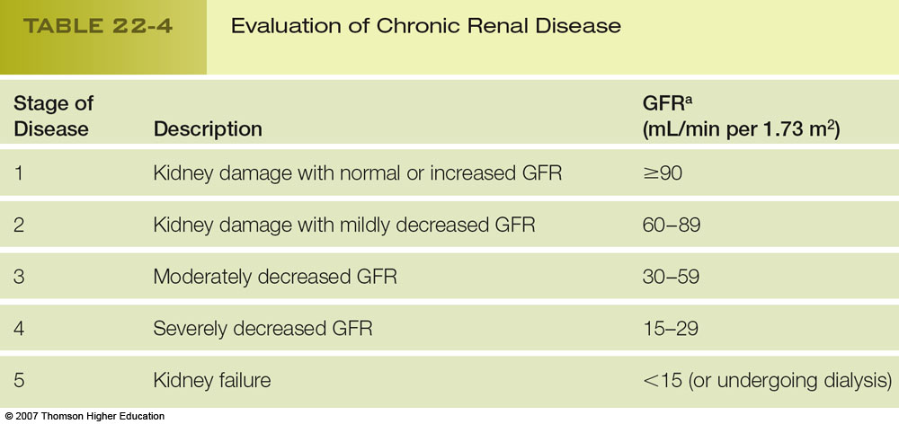

Slide 17
Consequences
Electrolyte imbalances occur when
  GFR becomes extremely low
  Hormonal adaptations are inadequate
  Intake of water & electrolytes are very restrictive or excessive
Renal osteodystrophy
  Increased parathyroid hormone contributes to bone loss
Acidosis may develop
Uremic syndrome
  Mental dysfunctions
  Neuromuscular changes
  Muscle cramping, twitching, restless leg syndrome
Protein energy malnutrition

Slide 18
Complications of Uremic Syndrome
Impaired hormone synthesis
Impaired hormone degradation
Bleeding abnormalities
Increased cardiovascular disease risk
Reduced immunity

Slide 19
Treatment
Goal
  Slow disease progression
  Prevent or alleviate symptoms
Drugs
  Antihypertensives
  Erythropoietin
  Phosphate binders
  Sodium bicarbonate
  Cholesterol-lowering medications
  Active vitamin D supplements

Slide 20
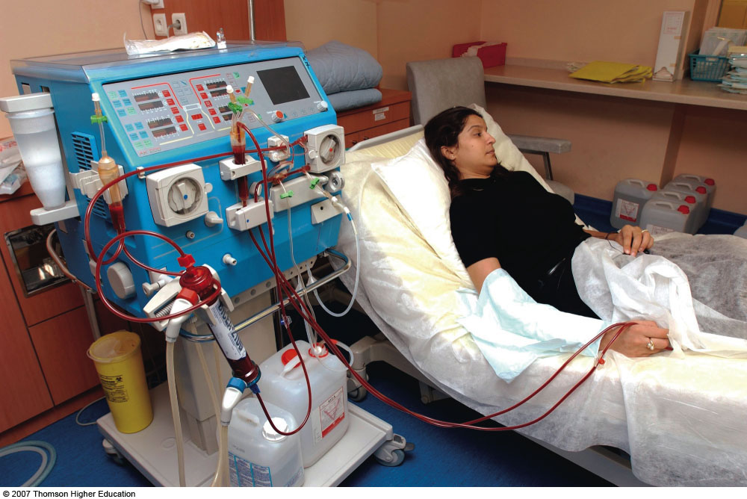
Dialysis
Removes excess fluid & wastes from blood
Blood is circulated though a dialyzer
Blood is bathed by dialysate
Hemodialysis & peritoneal dialysis

Slide 21
Medical Nutrition Therapy
Energy
  Enough to maintain healthy weight & prevent wasting
Low-protein diet
  Can increase when on dialysis
Lipids
  Restrict saturated fat & cholesterol
Fluids
  Not restricted until output decreases
Sodium
  Mild restriction
Potassium
  May need to restrict high-potassium foods

Slide 22
Medical Nutrition Therapy
Calcium & vitamin D needs increase
May need phosphorus restrictions
  Restrict protein
  Restrict milk & milk products
Dietary supplements
  Generous folate and B₆
  Recommended amounts of water-soluble vitamins except vitamin C
  IV iron administration
Intradialytic parenteral nutrition

Slide 23
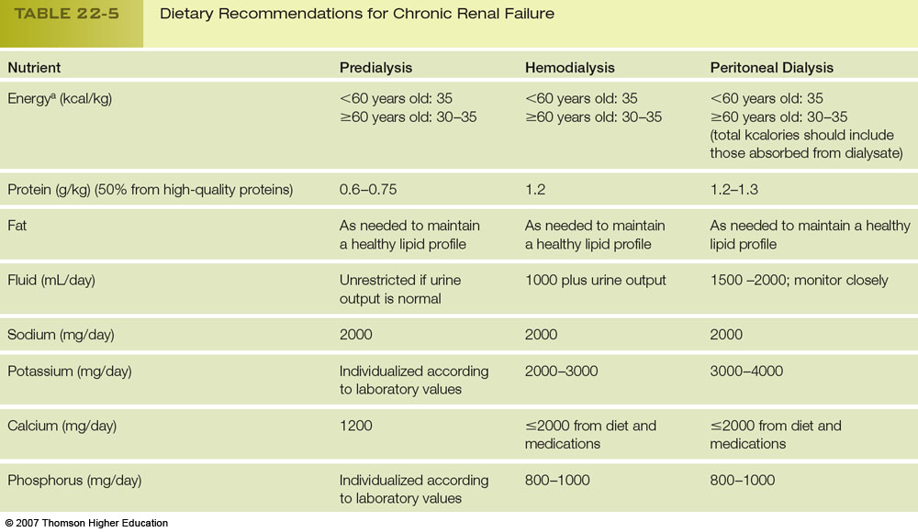

Slide 24
Kidney Transplants
Restores function
Allows a more liberal diet
Frees patient from dialysis
Immunosuppressive drug therapy
  Many side effects affecting nutrition
Protein & energy requirements increase
Control CHO & lipids
Sodium, potassium, & phosphorus intakes liberalized
Calcium supplementation
Be alert for potential food borne infection

Slide 25
Kidney Stones
Affects 12% of men & 5% of women
Crystalline mass in urinary tract
  Severe pain
  Can obstruct tract
Formation is promoted by:
  Reduced urine volume
  Blocked urine flow
  Increased concentrations of stone-forming substances

Slide 26
Types of Stones
Calcium oxalate stones
  Most common
  Reduce intake of oxalate
  Avoid vitamin C supplements
Uric acid stones
  Abnormally acidic urine
  Associated with gout
  Low-purine diet
Cystine stones
  Inherited disorder cystinuria
Struvite stones
  Form in alkaline urine

Slide 27
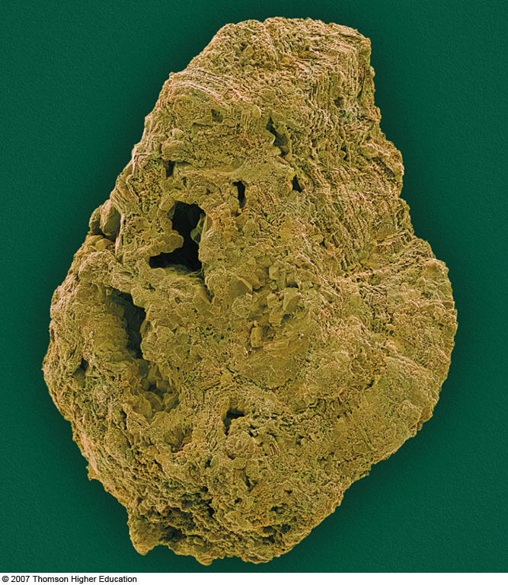
Calcium Oxalate Stone

Slide 28
Consequences
Renal colic
  Severe, continuous pain
  Begins in the back & travels toward bladder
  Nausea & vomiting
Urinary tract complications
  Urgency
  Frequency
  Inability to urinate
  Obstruction
  Infection

Slide 29
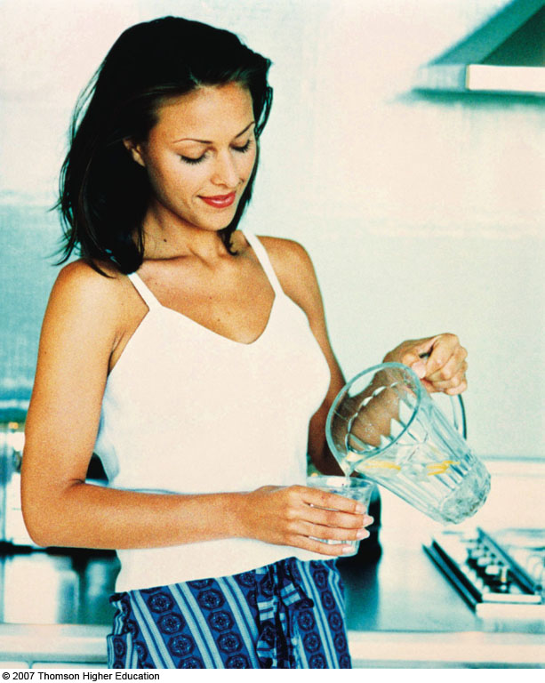
Prevention & Treatment
Drink 12-16 cups of fluids/day
Tea, coffee, wine, beer
No apple or grapefruit juices

Slide 30
Other Dietary Measures
Consume enough calcium to control oxalate absorption
Restrict dietary oxalate & purine
Moderate protein intake
Sodium restriction

Slide 31
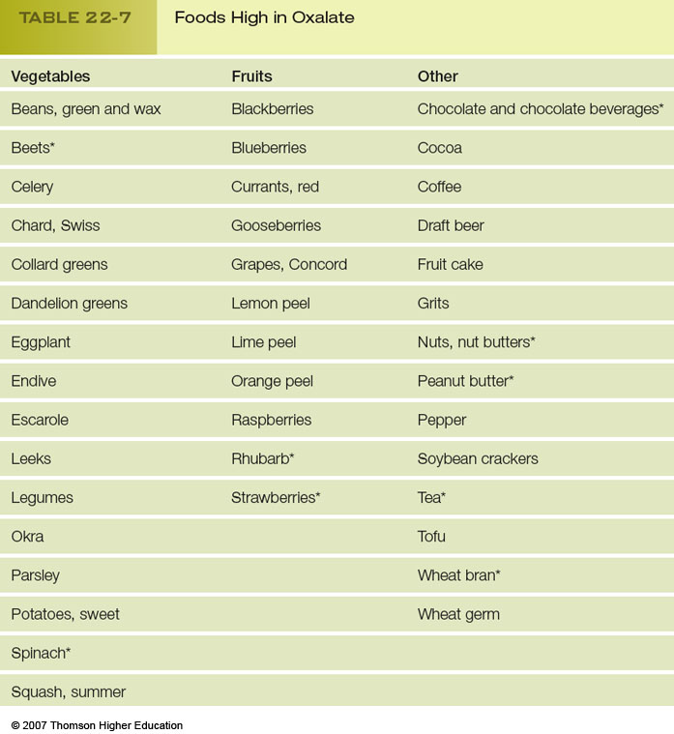

Slide 32
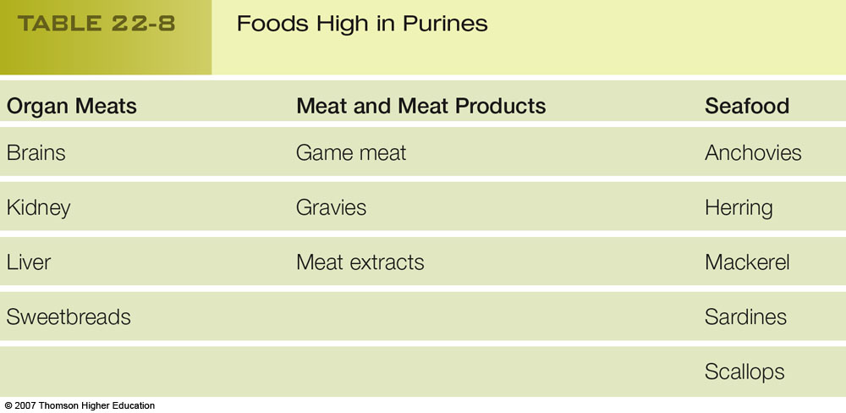

Slide 33
Nutrition in Practice
Dialysis

Slide 34
How Does Dialysis Work?
Employs diffusion, osmosis, & ultrafiltration
If a substance is lower in dialysate, substance will diffuse out of the blood
If substance is higher in the dialysate, substance will diffuse into the blood
Ultrafiltration removes fluid from the blood

Slide 35
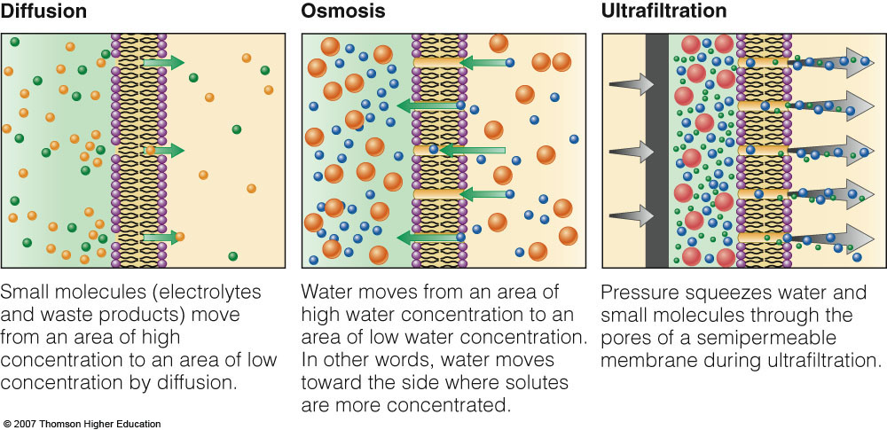

Slide 36
Dialysis
Hemodialysis
  Lasts 3-4 hours
  3 times/week
  Complications
    Infections
    Blood clotting
    Hypotension
    Muscle cramping
    Headaches, weakness
    Nausea & vomiting
    Agitation
Peritoneal dialysis
  Vascular access not required
  Fewer dietary restrictions
  Can be scheduled when convenient
Acute failure
  Continuous renal replacement therapy (CRRT)

Slide 37
