Slide 1
Odessa national medical university
Department of oral surgery
Benign odontogenic tumors
in children
Lecture # 2 child. onco. for 5 year

Slide 2
Odontogenic epithelium with mature, fibrous stroma without odontogenic
ectomesenchyme

Slide 3
Ameloblastomas have been classified as follows (WHO 2005 classification)
• Ameloblastoma, solid/multicystic type
• Ameloblastoma, extraosseous/peripheral type
• Ameloblastoma, desmoplastic type
• Ameloblastoma, unicystic type

Slide 4
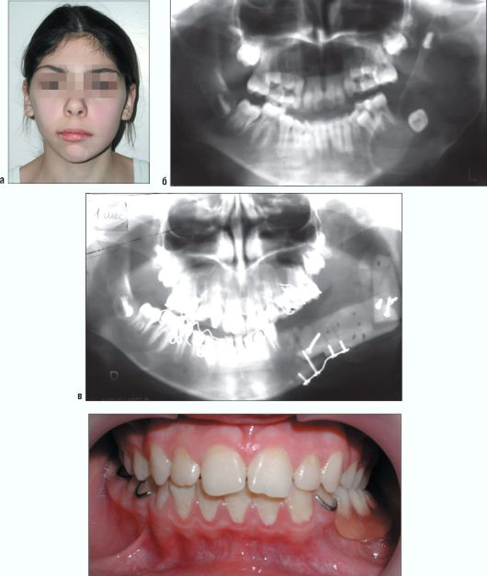

Slide 5
Ameloblastoma is a tumor of the odontogenic epithelium, first described by Cusick in 1827.
Ameloblastoma is perhaps the most perplexing of all odontogenic neoplasms due to its unexplainable clinical and histopathological behavior It accounts for less than 1% of all odontogenic cysts and tumors.

Slide 6
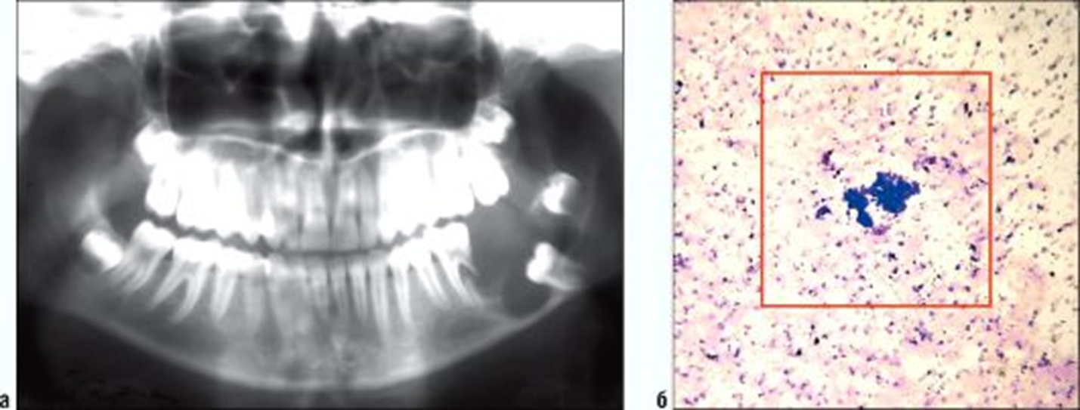

Slide 7
Although all ameloblastomas have the same cell of origin, there are several biologically distinct forms. The differences are especially important in pediatric cases. Central ameloblastomas occur as unicystic, multicystic or solid lesions. Ameloblastoma is non-encapsulated and infiltrates surrounding bone marrow.

Slide 8
Even though they are locally
infiltrative, they can rarely metastasize. They may occur in any part of both jaws but most are in the middle and posterior regions of the mandible. Ameloblastomas are always purely radiolucent and may be unilocular but frequently become multilocular as they increase in size.
If not found and treated early, they will expand the jaws.

Slide 9
Despite being categorized as benign
tumors, ameloblastomas have a high rate of recurrence, and there is a risk of malignant transformation when treated inadequately!

Slide 10
Clinically, ameloblastoma frequently manifests as a painless swelling, which can be accompanied by facial deformity, malocclusion, and loss of dentition, ulceration and periodontal disease. Sometimes pain occurs with varying intensities, but often quite low. It is not known whether the cause of the pain is pressure from the tumor on peripheral nerves or secondary infection

Slide 11
Early diagnosis is the most important component of therapy for this odontogenic tumor, which does not have specific radiographic features in the early stages. In particular, unilocular ameloblastoma may be difficult to diagnosis for the surgeon. Surgical enucleation with bony curettage and intra-operatory cryostat examination of the lesion allows preservative treatment and reduction of the risk of relapse

Slide 12
Squamous odontogenic tumor

Slide 13
The squamous odontogenic tumor (SOT) is a rare and benign neoplasm frequently located
within the jaws. In 1975, Pullon et al. identified this entity and reported it for the first time in
a series of 6 cases. This benign tumor has a slow and gradual growth that might invade the
trabecular bone, destroying the cortical bone and infiltrating adjacent structures. Its

Slide 14
Its aetiology remains unknown although it could be originated from the epithelial remnants of the Malassez. It usually appears over the lateral radicular surface of an erupted tooth and diminishes the height of alveolar bone causing tooth mobility.

Slide 15
There is a similar entity that is characterized
by squamous odontogenic tumor like proliferations (SOTLP) with a very similar histological pattern than the SOT. This lesion commonly is located in the wall of an odontogenic cyst and has a non-neoplastic character like in the SOT, representing probably, an hamartomatous lesion.

Slide 16
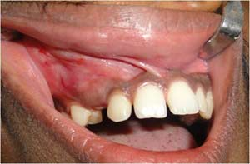
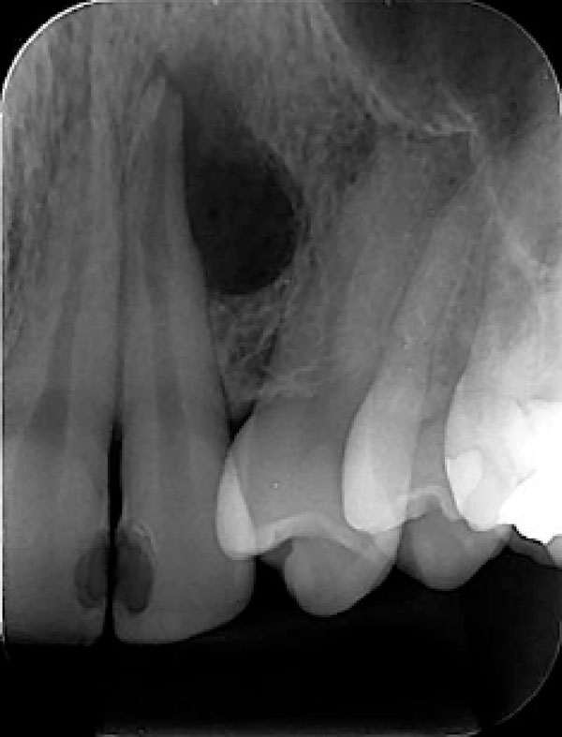


Slide 17
Calcifying epithelial
odontogenic tumor

Slide 18
The calcifying epithelial odontogenic tumor (CEOT) is a rare tumor. It was first described as a separate pathologic entity by a Dutch pathologist Jens Jorgen Pindborg in 1955. The term “Pindborg’s tumor” was first used by Shafer and colleagues in 1963. CEOT is a rare benign odontogenic epithelial neoplasm representing about 0.4-3% of all odontogenic tumors. This tumor more frequently affects adults in the age range of 20-60 years, with a peak incidence in the 5th decade of life with equal sex predisposition.

Slide 19
Etiology of this lesion is not clear. In the 113 cases reviewed by Franklin and Pindborg, patients ranged from 8 to 92 years with a mean age of 40 years. Radiographically, this tumor is often mistaken for a dentigerous cyst or ameloblastoma

Slide 20
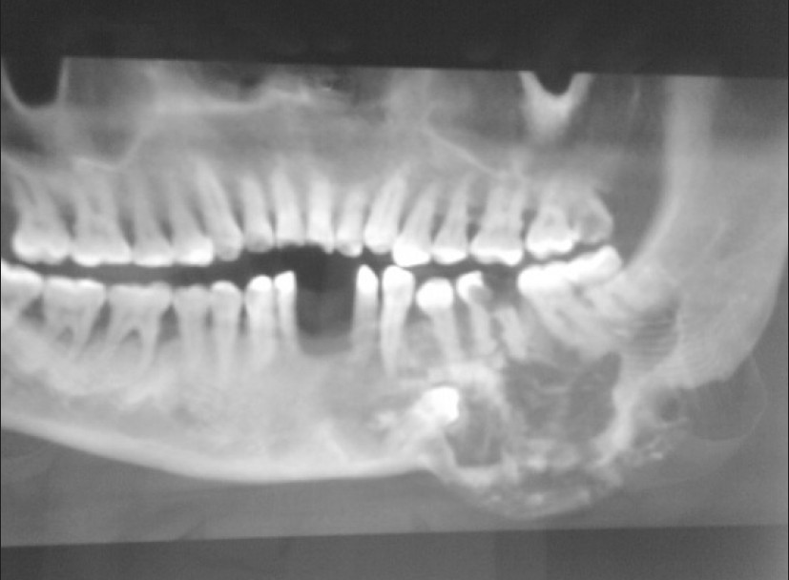

Slide 21
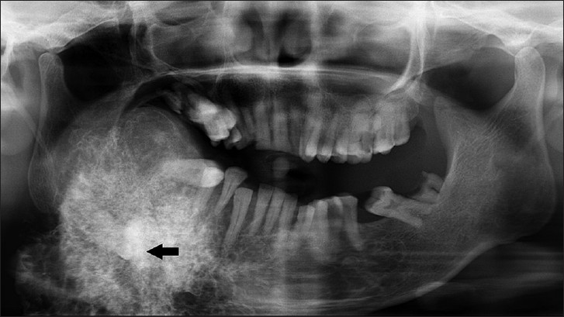

Slide 22
The diagnosis of CEOT is based on histological examination, revealing polyhedral neoplastic
cells which have abundant eosinophilic, finely granular cytoplasm with nuclear pleomorphism and prominent nucleoli.

Slide 23
The differential diagnosis includes adenomatoid odontogenic tumor, calcifying odontogenic cyst, dentigerous cyst, ameloblastic fibro-odontoma and odontoma. It is an infiltrative neoplasm and causes destruction with local expansion.

Slide 24
Definitive resection of the entire mass with tumor-free surgical margins (en bloc resection) is the preferred treatment as tumor will recur if not completely removed. Long-term follow ups are recommended. Local recurrence rates of 10-15% have been reported

Slide 25
Adenomatoid Odontogenic Tumor

Slide 26
This is a tumor mostly of teenagers. It occurs in the middle and anterior portions of the jaws
in contrast to ameloblastoma which is found mostly in the posterior segment. Two-thirds occur in the maxilla and it is more common in females. The tumor may be partially cystic, and in some cases solid lesion may be present as masses in the wall of a large cyst.

Slide 27
These variants have common histologic
characteristics that indicate a common origin as derived from the complex system of dental lamina or its remnant

Slide 28
The most frequently associated tooth is the maxillary canine rarely the permanent molars. Based on the clinical and radiographic examination the follicular variant is often initially mistaken as dentigerous cyst.

Slide 29
The radiographic appearance is a unilocular radiolucency, often around the crown of an
unerupted tooth in which case they resemble a dentigeous cyst.. A homogeneous, eosinophilic
and amorphous material may occasionally be found in AOT . If they are present in
sufficient size and number, they may show on the radiograph as a “snow-flake” pattern

Slide 30
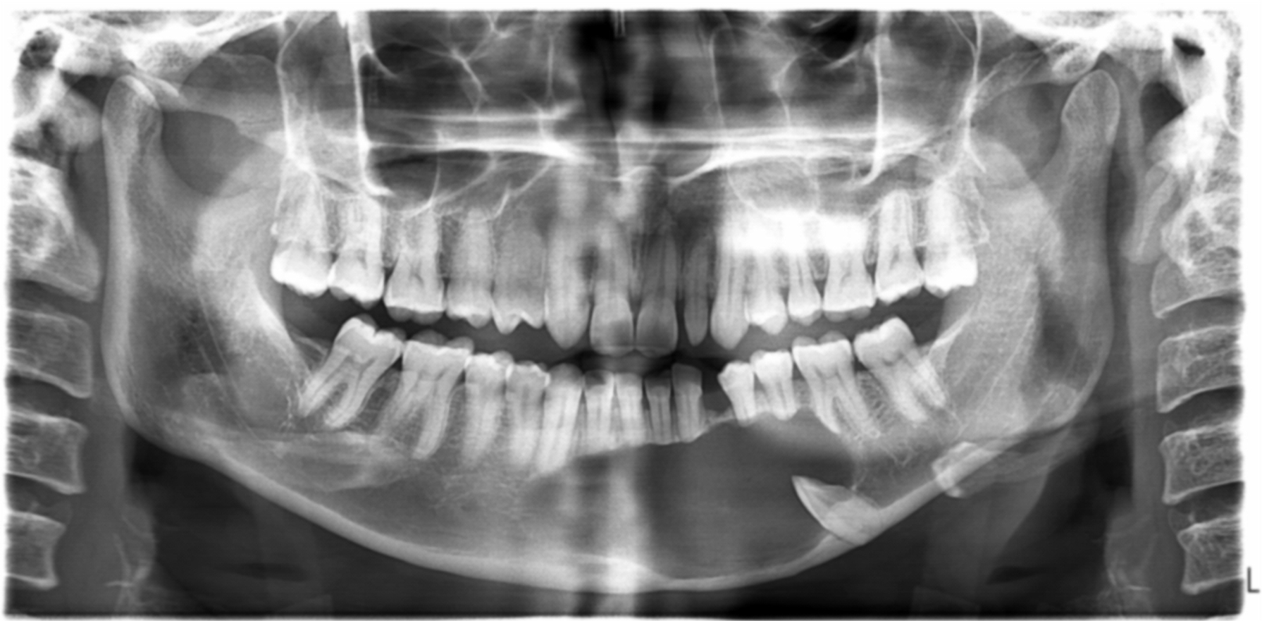

Slide 31
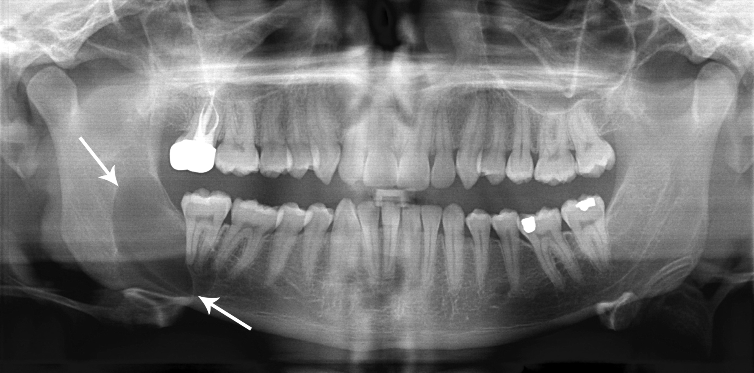

Slide 32
Keratocystic odontogenic tumor

Slide 33
The Keratocystic Odontogenic Tumor (KCOT) has been defined by the World Health Organization In 2005, as a benign intraosseous neoplasm of odontogenic origin with characteristic lining of parakeratinized squamous epithelium. It represents approximately 10 percent of all jaw cysts and may occur in a wide age range of patients.

Slide 34
Symptoms such as pain, swelling and drainage may be present, especially with larger lesions. However, at least half of all lesions are discovered as incidental radiographic findings. Due to the propensity of KCOTs to grow within the medullary bone, they have the potential to become extremely large without causing any clinical signs or symptoms

Slide 35
Radiographically, the KCOT presents as a well defined radiolucency with thin corticated margins. These tumors are normally diagnosed histologically from a sample of the lining.

Slide 36
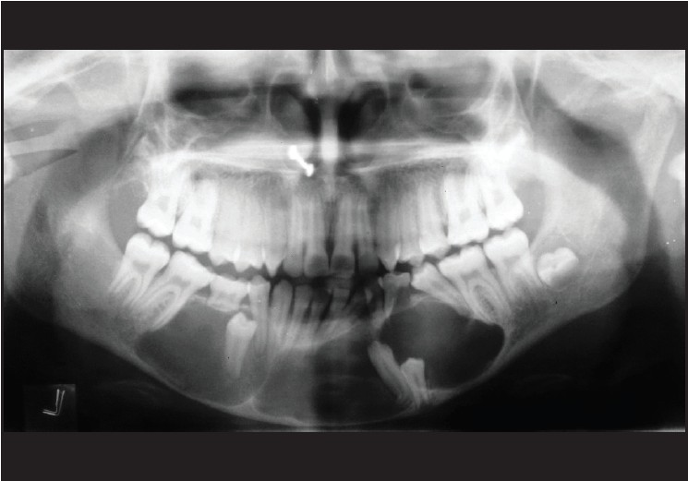

Slide 37
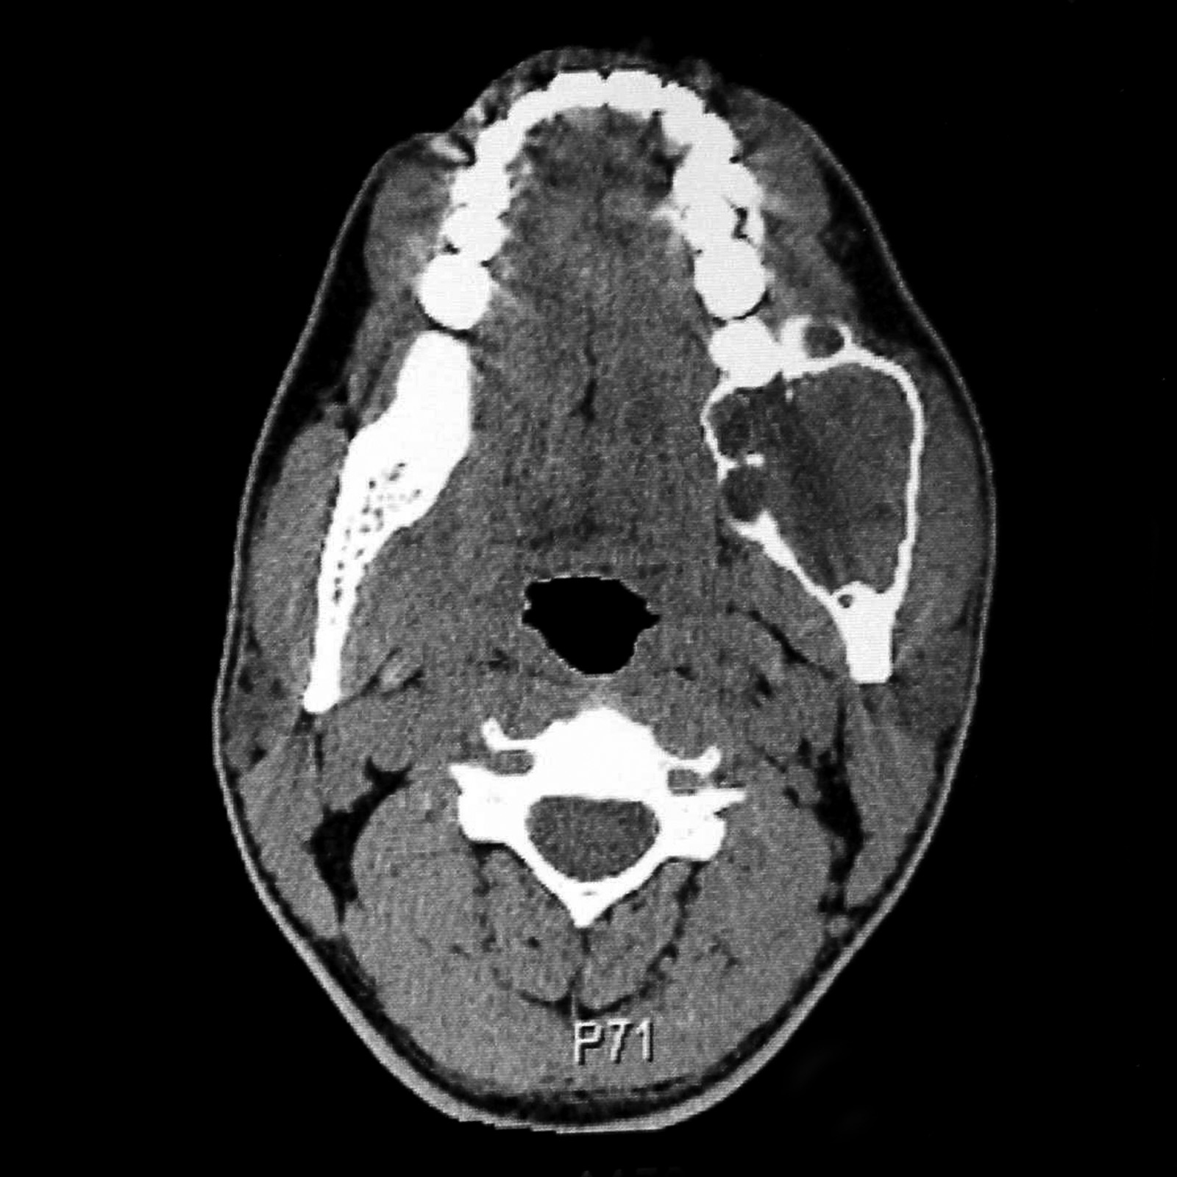

Slide 38
Odontoma

Slide 39
• Odontoma, complex type
• Odontoma, compound type

Slide 40
Odontomas are hamartomas of aberrant tooth formation, which occur due to budding of extraodontogenic epithelial cells or detachment of odontogenic cells from the dental lamina. These odontogenic cells may in turn differentiate and deposit enamel, dentine, cementum or pulp in the form of multiple teeth like structures (compound odontoma), amorphous calcified masses (complex odontoma) or a combination of both (composite odontoma and compoundcomplex odontoma).

Slide 41
These tumors are mostly radiodense. In the compound odontoma, multiple small and malformed tooth-like structures are formed creating a “bag of marbles” radiographic appearance. In the complex odontoma, there is little or no tendency to form tooth-like structures. The dentin and enamel are entwined in a mass that bears no resemblance to teeth.
Both types of odontoma are found in the early years, usually in the teens or early twenties

Slide 42
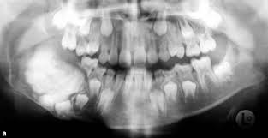

Slide 43
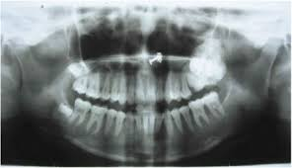

Slide 44
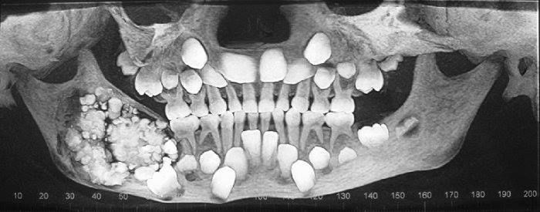

Slide 45
Mesenchyme and/or odontogenic ectomesenchyme with or without odontogenic epithelium

Slide 46
Odontogenic fibroma

Slide 47
Central odontogenic fibromas are encountered as unilocular radiolucencies that turn out to be
solid, rather than cystic, following enucleation. They are rare, far rarer for example than
ameloblastomas, and arise usually anterior to the molars, more commonly in the maxilla and
mainly in women, as a small, well-circumscribed radiolucency that may cause resorption and ⁄or displacement of adjacent vital teeth

Slide 48
A wide age-range is noted among the
relatively few reported cases, and a scalloped radiographic margin may denote a more aggressive behavior pattern. Following enucleation, most odontogenic fibromas do not recur, although there have been occasional reports of some following a more aggressive course; however, there seems to be little correlation with the histological pattern

Slide 49
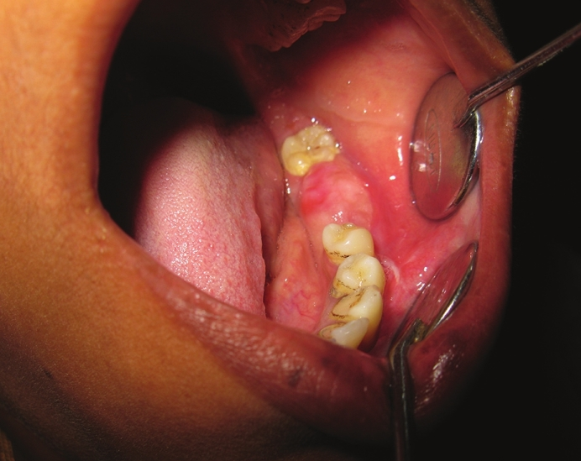

Slide 50
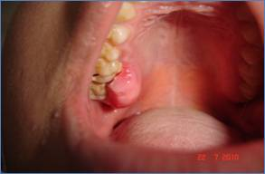

Slide 51
Odontogenic myxoma/myxofibroma

Slide 52
Despite the name similarity, the odontogenic myxoma is quite a different entity from the
odontogenic fibroma in almost all respects. Odontogenic myxoma (OM) of the jaws, first
described by Thoma and Goldman in 1947, is believed to arise from odontogenic ectomesenchyme. It is a rare benign tumor characterized grossly by mucoid or gelatinous grayishwhite tissue that replaces the cancellous bone and expands the cortex.

Slide 53
Radiographically, the tumor presents as a unilocular or multilocular radiolucent lesion
with fine, bony trabeculae within its interior structure expressing a honeycombed, soap bubble, or tennis racket appearance . A histologic characteristic of this tumor resembles the mesenchymal portion of a tooth in development. The lesion is not encapsulated being characterized by the proliferation of a few rounded cells, fusiforms and star cells, being
included in abundant myxomatous stroma with a few collagen fibers

Slide 54
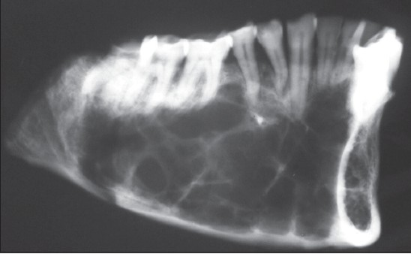

Slide 55
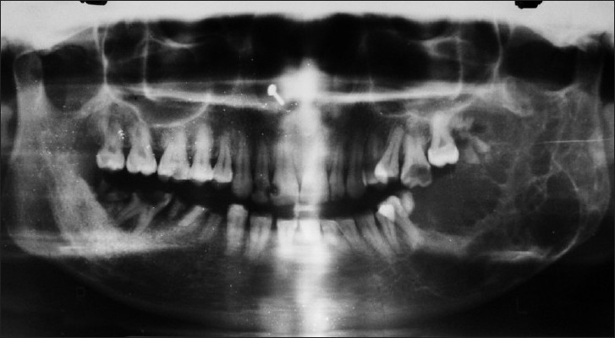

Slide 56
Cementoblastoma

Slide 57
Cementoblastoma in the current World Health Organization classification of odontogenic
tumors, is in the category of tumors of mesenchyme and/or odontogenic ectomesenchyme with or without odontogenic epithelium. The lesion was first recognized by Noeberg in 1930. The lesion is considered as the only true neoplasm of cementum origin. It generally occurs in young persons, comprises <1-6.2% of all odontogenic tumors and is characterized as being attached to the roots, most frequently associated with first permanent molars

Slide 58
The majority of these tumors are radiopaque, but a radiolucent tumor may occur in rare instances. Histologically, it presents as a well-circumscribed tumor composed of cementum like tissue surrounded by a fibrous capsule. Surgical enucleation of the cementoblastoma with the associated tooth is usually curative, although recurrences have been reported following incomplete excision

Slide 59
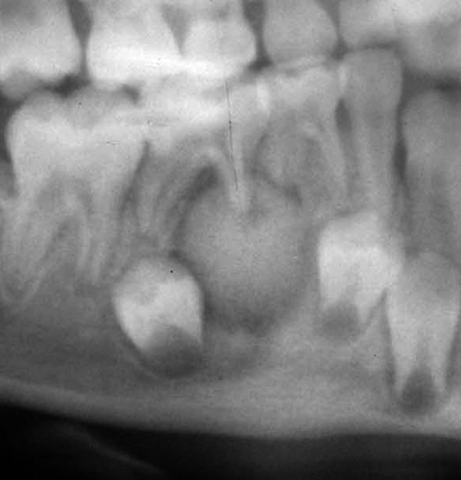

Slide 60
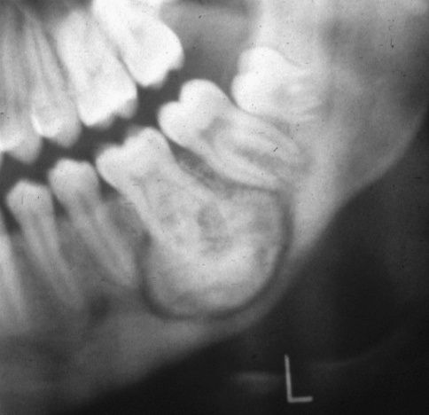

Slide 61
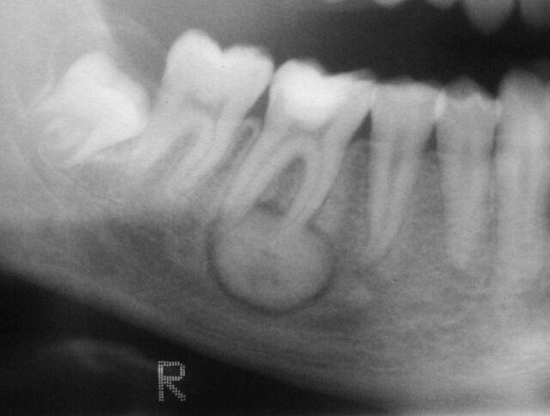

Slide 62
Bone-related
(Fibro-osseous) lesions

Slide 63
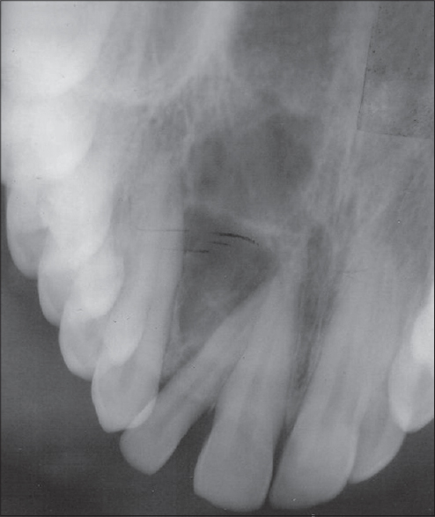

Slide 64
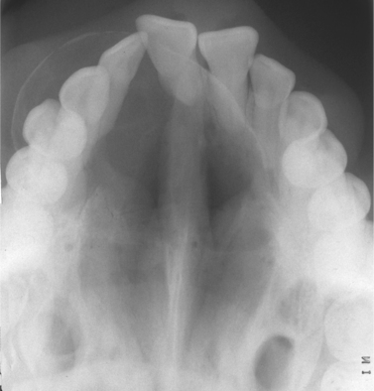

Slide 65
Juvenile ossifying fibroma

Slide 66
Benign fibro-osseous lesions of the head and neck region are uncommon and constitute a
wide range of tumors sharing some histopathological features. This group includes developmental, reactive or dysplastic lesions as well as neoplasm such as fibrous dysplasia (FD), ossifying fibroma (OF), and cemento-osseous dysplasia (COD). Ossifying fibromas are rare benign, neoplasms arising from undifferentiated cells of the periodontal ligament tissues

Slide 67
There are two types of ossifying fibroma, central and peripheral. The central type arises from the endosteum or periodontal ligament adjacent to the root apex and expands from the medullary cavity of the bone. The peripheral type occurs solely on the soft tissue overlying the alveolar process.

Slide 68
They are mainly seen in the sino-nasoorbital
region of young individuals. Males and females are equally affected. The maxilla
and the mandible are the dominant sites of incidence. Occurrence in the maxilla is slightly
more frequent than in the mandible

Slide 69
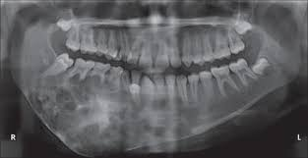

Slide 70
Central giant cell granuloma

Slide 71
There are a number of lesions that occur in the jaws that contain giant cells within them. They include cherubism, giant cell granuloma of the jaws, giant cell tumor, aneurysmal bone cyst, traumatic bone cyst and brown tumor of hyperparathyroidism. Their relationship to each other, however, is ill defined.

Slide 72
The histological similarities with the finding of multinucleated giant cells of osteoclastic origin and the lesions themselves greatly differ in their genetic origin,
etiopathogenesis and clinical behaviour.

Slide 73
The clinical behavior of CGCG ranges from a slowly growing asymptomatic lesion
to an aggressive lesion manifesting with pain, local bone destruction, root resorption, or
displacement of teeth. The highest rate of occurrence is the mandible, and most mandibular
lesions occur anterior to the first molars.

Slide 74
Its etiology is still unknown and its biological behavior is poorly understood. This lesion occurs almost exclusively within the jaw bones. It usually presents as a painless swelling of the jawbone. Radiographically, CGCG presents as radiolucent defect, which may be unilocular or multilocular.

Slide 75
Conventional treatment for the CGCG has been local curettage and this has been associated with a high success rate and low recurrence rate. The conservative surgical treatment of CGCG usually involves curettage alone or along with peripheral
ostectomy with no evidence of disease in a 2 year follow up perior

Slide 76
Radical surgical techniques of resection without continuity defect, peripheral ostectomy and en-bloc resection have sometimes been justified for aggressive CGCG. Pediatric patients necessitate conservative management to prevent long term developmental defects. Steroids and calcitonin have been advocated recently for inhibition of osteoclastic activity. Equal parts of triamcinolone acetonide (10mg/ml) and 0.5% bupivacaine injected into the lesion for a period of 11 weeks has been shown to be effective in a child patient.

