Slide 1
Odessa national medical university
Department of oral surgery
Diseases and injuries of the temporomandibular joint (TMJ): inflammatory, inflammatory-dystrophic processes, muscular-articular dysfunction, ankylosis, dislocations of TMJ, contractures.
Lecture # 8 for 5 year

Slide 2
TMJ belongs to one of the most functionally complex joints. Being a paired joint, it is a united system of two articulations, its work being possible only synchronically, with participation of both articulations. Due to evolution of the joint development and the fact that humans are omnivorous, it performs all types of movements in three dimensions providing biting, grinding and mastication of any type of food.

Slide 3
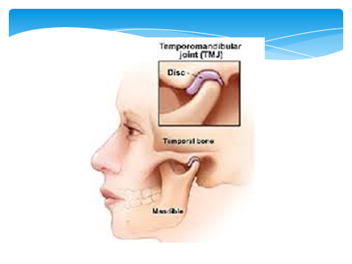

Slide 4
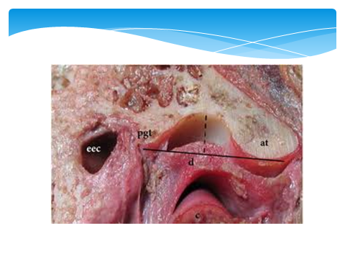

Slide 5
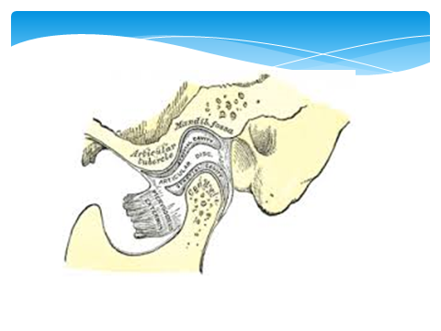

Slide 6
The joint consists of condyle of the mandible, articular fossa, to restore the congruence of the articular surfaces, biconcave fibrochondral meniscus that separates the condyle and the temporal bone.

Slide 7
Depending on correlation of the components, the joint can be deep, middle and flat. It is necessary to bear in mind that correlation of the joint components depend on age, sex, condition and type of bite and can change both within norm and with various pathologic processes.

Slide 8
Structure of TMJ lesions is diverse, not all pathologic processes have been studied and comprehended. According to many authors, diseases of TMJ affect from 35 to 75% population of the globe. Multifarious classifications only confirm complexity and difficulty in diagnostics, prevention and treatment of diseases of TMJ. Up to the present time from 20 to 40% wrong diagnosis and inadequate treatment have been observed.

Slide 9
Practically all classifications designate inflammatory disorders of various etiology and character of course, i.e. arthritis; primary and secondary, dystrophic or proliferative processes, i.e. arthrosis, osteoarthrosis, arthroso-arthritis. A great percentage belongs to processes manifested as impaired functions of the joint caused by changes in the muscular, nervous, ligamentous apparatus of the joint – these are so-called algetic or muscular dysfunctions. Besides, the fusion of a joint, often in an abnormal position, usually resulting from destruction of articular cartilage and subchondral bone caused by growth of fibrous, cartilaginous or osseous tissues between joint surfaces, i.e. ankylosis of TMJ is designated.

Slide 10
Among disorders of TMJ first place belongs to processes of inflammatory origin of various nature – specific, non-specific, traumatic, non-infectious, which can have acute or chronic course.

Slide 11
In acute arthritis all components of acute inflammation both local and systemic – altered blood count, systemic immune response etc are observed. Diagnostics of acute arthritis commonly does not cause specific difficulties, especially in determination of etiologic moment, for example previous acute otitis, parotitis, influenza, rheumatic attack, acute trauma etc.

Slide 12
Chronic arthritis has less pronounced clinical picture, its diagnostics is complicated. It manifests mainly by pains while moving the jaw and masticating hard food, difficulties with opening the mouth in the morning, possible crepitation in the joint. Laboratory indices rarely detect pathology, radiographic changes in the elements of the joint are not detected.

Slide 13
Treatment of arthritis is performed according to general principles with mandatorily providing joint immobility and administering anti-inflammatory and antibacterial medication.

Slide 14
Dystrophic-degenerative and sometimes proliferative processes designated as sclerogenic or deforming arthrosis can be primary or secondary. The latter are classified by many authors as arthroso-arthritis.

Slide 15
These processes lead to degeneration of the joint cartilages, change of osseous structures towards sclerosis of cortical plate – sclerogenic arthrosis, which can be regarded as the most favorable outcome. Another, more severe, type can be deforming osteoarthrosis when the joint surfaces look like “mount peaks” causing dramatic impairment of movements of the jaw possibly resulting in complete dysfunction. Unlike ankylosis, in deforming arthrosis, the joint cavity is always radiographically observed, though dramatically deformed and narrowed, but still preserved.

Slide 16
Treatment at early stages is possible by means of physiotherapy, rational prosthesis, at a later stage of deforming arthrosis treatment is only surgical.

Slide 17
A large group of the diseases comprise the so-called dysfunctions of TMJ having numerous synonyms: pain dysfunction, pain dysfunction syndrome, muscular-articular dysfunction, Kosten syndrome etc. These processes manifest as pains, impaired movements, joint crepitation, possible spasms of masticatory muscles, S-shaped displacement of the mandible while opening mouth. Typical radiographic changes are absent.

Slide 18
Causes of developing dysfunctions have not been clearly understood up to now. There is an occlusion theory, a theory of psychological stress and a number of others. It is connected with very complex reflexogenic chain beginning with the correlation: tooth – periodontium – parodontium – muscle – joint and up to regulatory mechanisms of CNS, condition of the cervical section of the vertebra (osteochondrosis) etc. Failure of even one of the links first of all results in forming dysfunction with different degree of manifestation.

Slide 19
In diagnostics and planning of the treatment the most important is thorough examination of the patient, mandatorily including analysis of anamnesis with consideration of psychoemotional status, examination, palpation and auscultation of the joint, evaluation of condition of muscles, including muscles of the neck, evaluation of occlusion. To specify the diagnosis, electromyographic investigations, various types of radiography including that of the cervical section of the vertebra must be used. Study of laboratory, biochemical, immunologic indices allows to perform differential diagnostics and detect true character of the disorder.

Slide 20
Treatment of dysfunctions is composite where the first place belongs to orthopedic correction of the bite by means of splints and devices and anti-inflammatory therapy. Surgery is used rarely, mainly abroad and consists in meniscectomy.

Slide 21
Unlike inflammatory diseases and dysfunctions, ankylosis is characterized by developing utter immobility of the joint due to intra-articular growth of connective (fibrous, cartilaginous, osseous) tissues possibly resulting in formation of a single conglomerate of the condyloid process, articular fossa, zygomatic arch.
As a rule, ankylosis results from either intrauterine or postnatal infections. They can be omphalitis, hematogenic osteomyelitis, otitis, parotitis, sepsis. Odontogenic osteomyelitis hardly ever leads to ankylosis.

Slide 22
In adults ankylosis develops rarely, predominantly at adolescence resulting from acute purulent arthritis or intra-articular comminuted fracture of the condyle. During formation in childhood, ankylosis leads to development of uni- or bilateral microgenia. In ankylosis can occur severe complications of breathing and swallowing sometimes requiring urgent aid even as tracheostomy. Due to inadequate hygiene of the oral cavity, multiple caries develops, lesions of the oral mucosa such as stomatitis and gingivitis occur.

Slide 23
Diagnostics of ankylosis is not complicated. Main method is radiography ranging from conventional radiographs in a standard lateral position to CT.

Slide 24
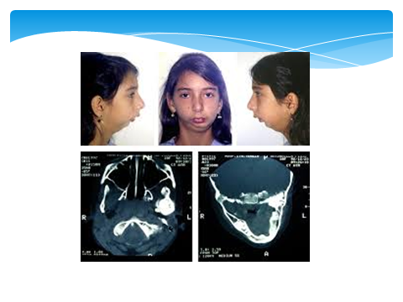

Slide 25
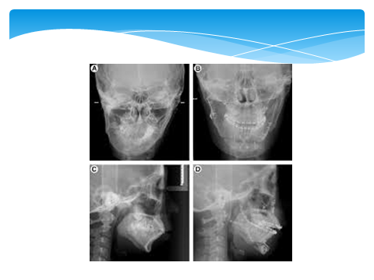

Slide 26
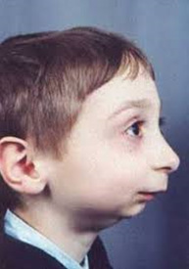
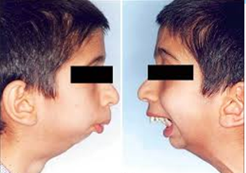
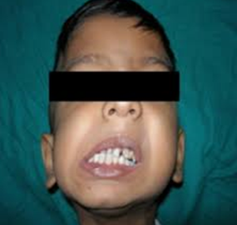

Slide 27
Treatment of ankylosis only at its early stages with fibrous cohesions can be conservative as redressation i.e. forceful break of cohesions by means of a mouth prop. The method is of little efficacy, relapses are frequent up to osseous ankylosis.

Slide 28
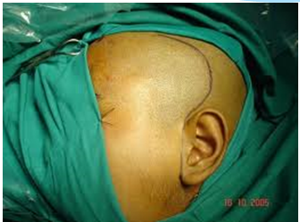
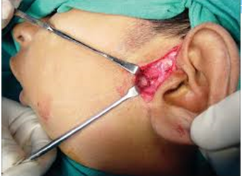

Slide 29
Owing to the structure of TMJ, frontal dislocations prevail when caput mandibulae comes out of the articular fossa forwards rolling over the articular tubercle of temporal bone. A blow into the jaw, excessive opening of the mouth while yelling, yawning or during dental manipulations make it possible. Posterior dislocation, i.e. intrusion of caput mandibulae into the outer auditory passage with fracture of its internal osseous wall is very rare. Dislocation can be uni- or bilateral. In a flat form of the joint, which is more common for women or in secondary adentia, development of habitual temporomandibular joint luxation is possible.

Slide 30
Practically all classifications designate inflammatory disorders of various etiology and character of course, i.e. arthritis; primary and secondary, dystrophic or proliferative processes, i.e. arthrosis, osteoarthrosis, arthroso-arthritis. A great percentage belongs to processes manifested as impaired functions of the joint caused by changes in the muscular, nervous, ligamentous apparatus of the joint – these are so-called algetic or muscular dysfunctions. Besides, the fusion of a joint, often in an abnormal position, usually resulting from destruction of articular cartilage and subchondral bone caused by growth of fibrous, cartilaginous or osseous tissues between joint surfaces, i.e. ankylosis of TMJ is designated.

Slide 31
Contracture of the mandible is stable restriction of movements of the joint due to organic or functional impairment in the surrounding tissues.

Slide 32
There are cicatrical, algetic, neurogenic, inflammatory contractures. In case of traumatic origin of contractures, a scar is formed which can contain any tissues. Algetic contractures result from irritation of muscular and peripheral nervous fibers in damaged bone. Inflammatory ones are caused by secondary changes of muscular and peripheral nervous tissue caused by developing inflammation in the surrounding cellulose. Postimmobilizing contractures occur as a result of prolonged deactivation of muscular function. Neurogenic contractures of central origin, known as trismus, are connected with dysfunction of the CNS in rabies, tetanus, spastic paralysis etc.

Slide 33
Depending on etiology of contracture, its treatment can be surgical, using various plastic surgeries, and conservative when first priority becomes cure of the underlying disease: treatment of fracture of the mandible, incision and drainage of phlegmon with further use of means and methods of restoration of functional state of the muscular tissue.

Slide 34
