Slide 1
Odessa national medical university
Department of oral surgery
Free bone and cartilage plasty in the maxillofacial surgery.
Lecture # 9 for 5 year

Slide 2
The purpose of the lecture:
To introduce tasks and possibilities of osteoplasty and chondroplasty in treatment of various diseases; to analyze main types and requirements to plastic materials, indications and technique.

Slide 3
The plan of the lecture:
1.Brief historical review, contribution of domestic scientists.
2.Classification, types of transplants, harvesting and methods of preservation of transplant material.
3.Classification of defects of jaw bones, use of transplants depending on the character of the defect.
4.Possibilities of usage of various plastic materials in outpatient surgery.

Slide 4
Necessity to restore continuity of osseous structures is an important task in treating various pathologic processes in the jaw bones. These are defects of traumatic and inflammatory origin, defects resulting from excision of cysts, tumors, elimination of congenital and acquired deformities of jaws

Slide 5
Lately plastic materials have found a broad application in parodontal surgery and implantology

Slide 6
History of osteoplasty is connected with N.I. Pirogov who was the first to perform transplant of a region of the heel bone on the muscle pedicle to create a supportive stump in 1852. In the maxillofacial surgery academician B.D. Kabakov designates several stages of development of this trend up to ‘50s, which after this time has gone a very long and beneficial way.

Slide 7
To orientate in modern options of osteoplasty, it is necessary to learn the classification and types of transplant materials on the one hand, and the classification, types of defects and diseases of the jaws when plastic replacement of the defect is indicated, on the other.

Slide 8
First of all plastic materials are divided into borrowed from the patients themselves (auto) and borrowed from a donor of the same species (alloplastic). Obtained from a representative of another biologic species material is xenogenic. Any other non-biologic, artificial, synthetic material is called by some authors explant, but by the majority – implant.

Slide 9
Basing on harvesting and preservation, alloplastic materials are subdivided into lyophilized, frozen, demineralized, formalinized and others depending on method of preservation and processing. According to morphologic structure, transplants can be harvested on cortical or sponge bone, used in split, whole, minced condition. All of the abovementioned types have their advantages and disadvantages for particular surgery.

Slide 10
Depending on the type of defect and its location, different bones of the skeleton are used. Commonly transplant is obtained from a rib (whole or split), iliac spine, fibula, or metatarsals. Recently possibility to obtain split transplants from bones of the skull has been proved

Slide 11
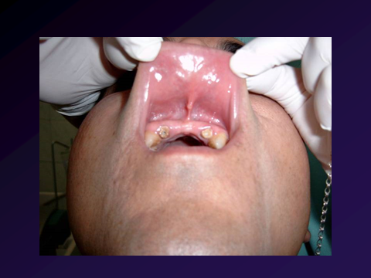

Slide 12
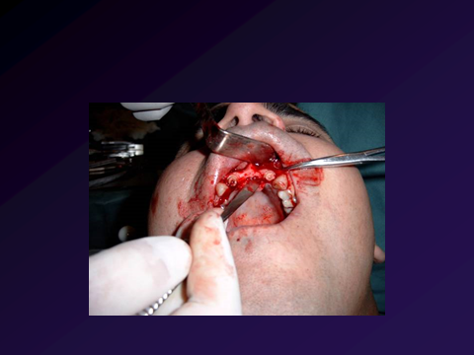

Slide 13
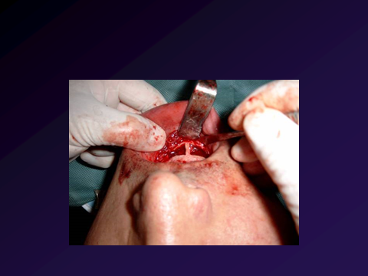

Slide 14
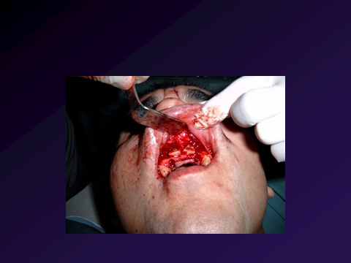

Slide 15
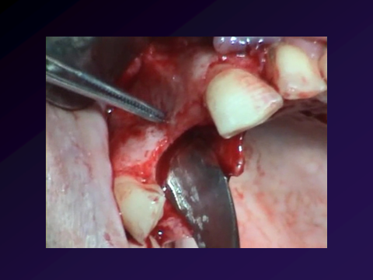

Slide 16
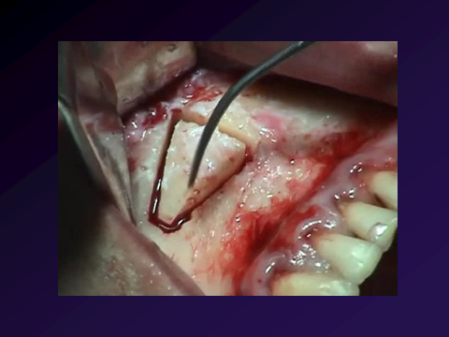

Slide 17
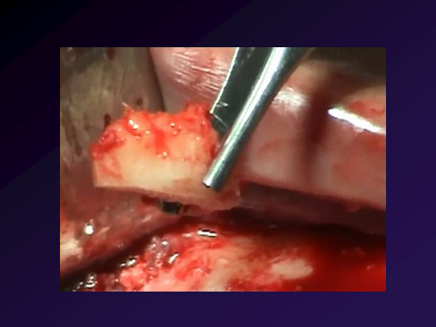

Slide 18
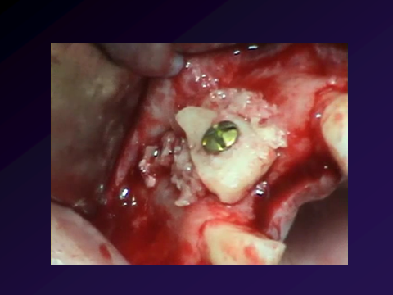

Slide 19
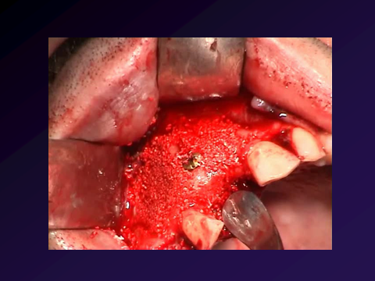

Slide 20
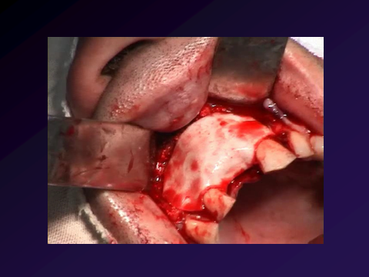

Slide 21
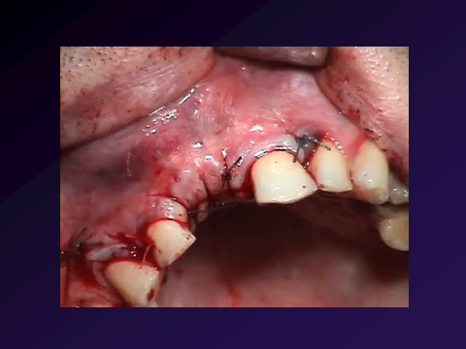

Slide 22
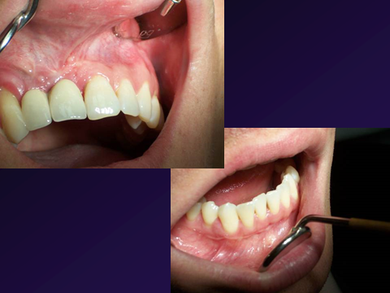

Slide 23
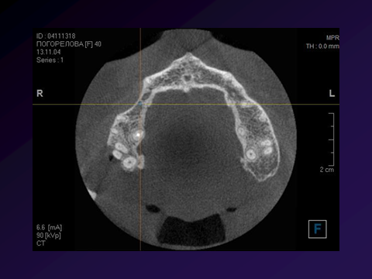

Slide 24
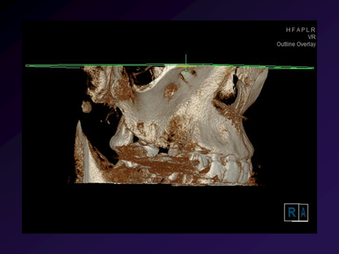

Slide 25
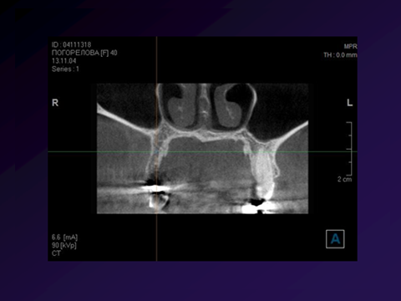

Slide 26
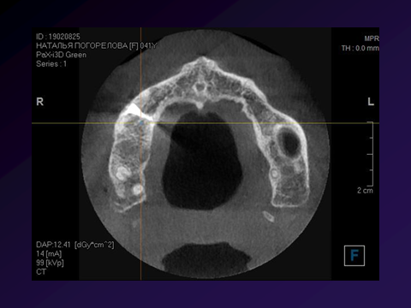

Slide 27
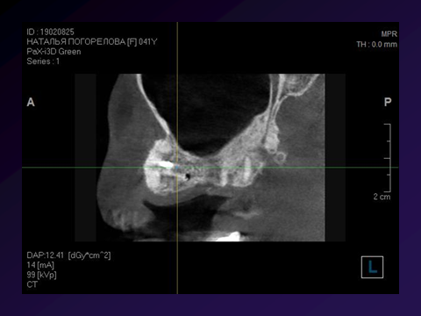

Slide 28
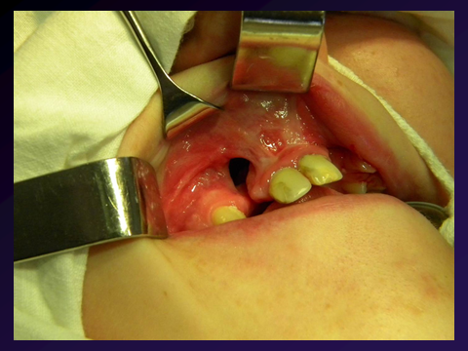

Slide 29
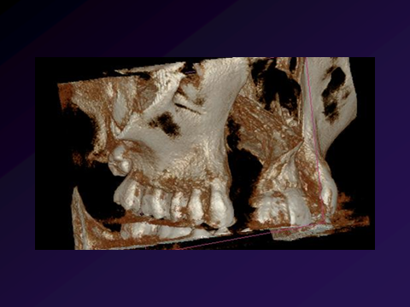

Slide 30
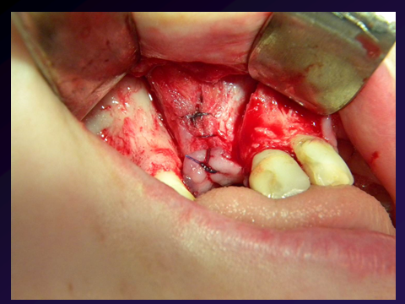

Slide 31
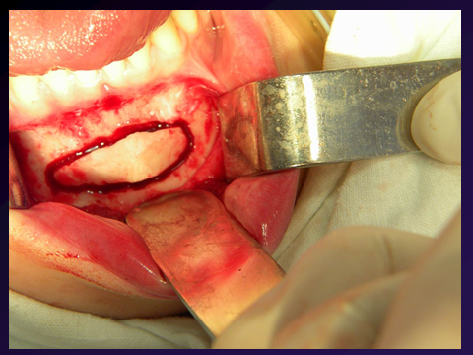

Slide 32
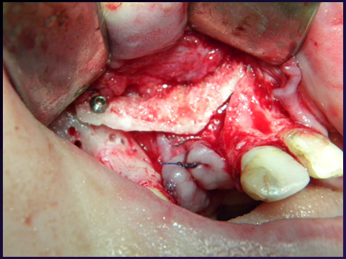

Slide 33
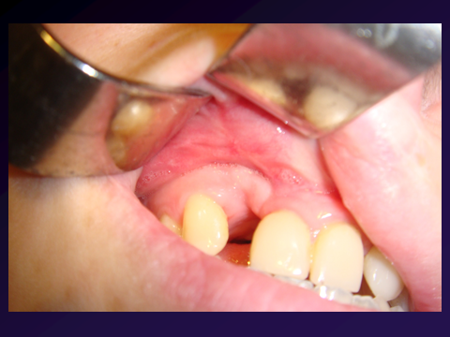

Slide 34
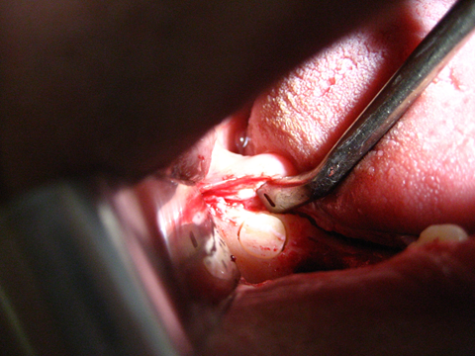

Slide 36
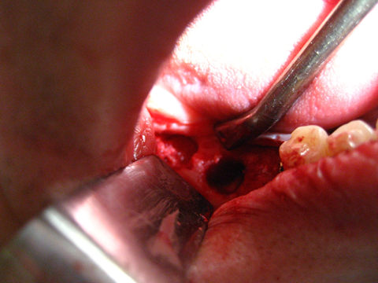

Slide 37
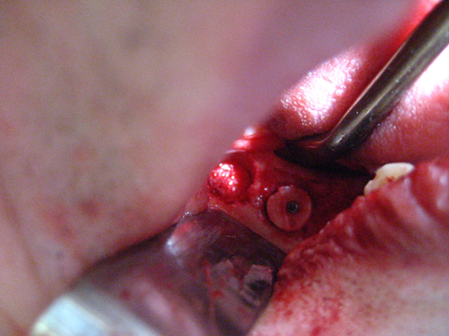

Slide 38
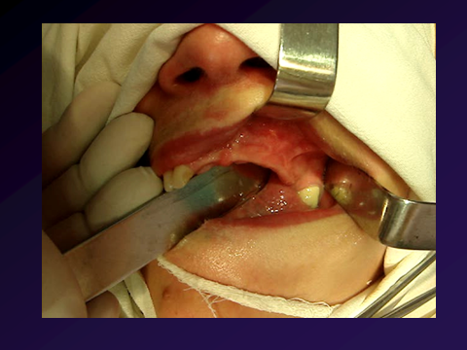

Slide 39
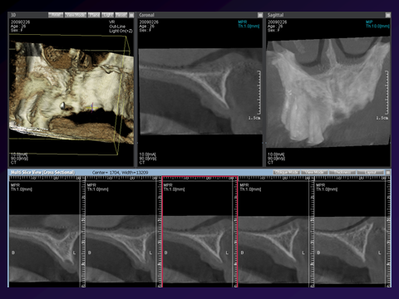

Slide 40
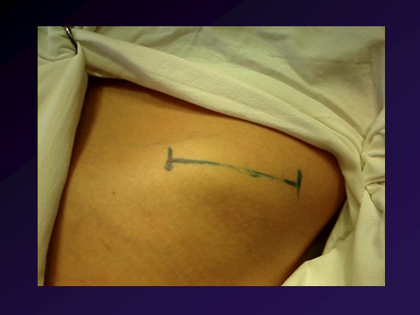

Slide 41
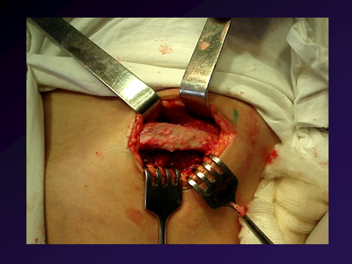

Slide 42
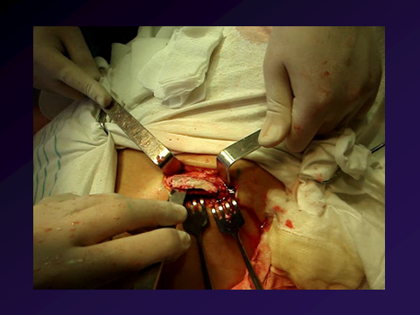

Slide 43
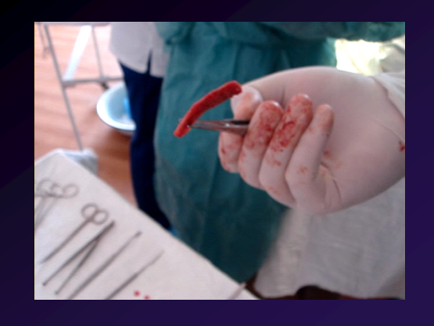

Slide 44
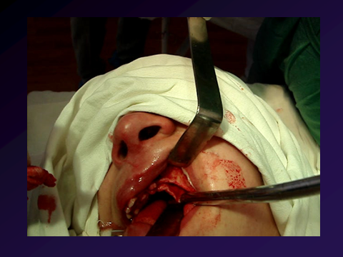

Slide 45
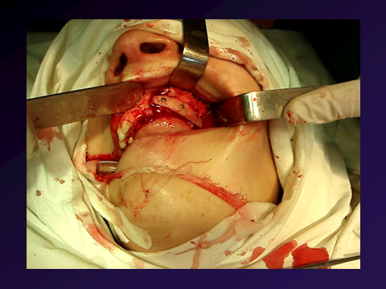

Slide 46
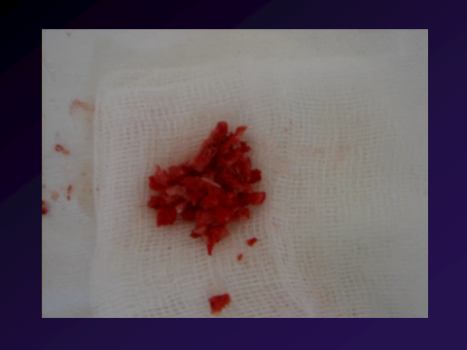

Slide 47
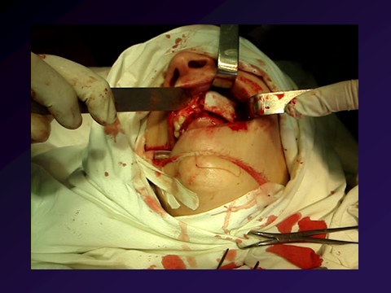

Slide 48
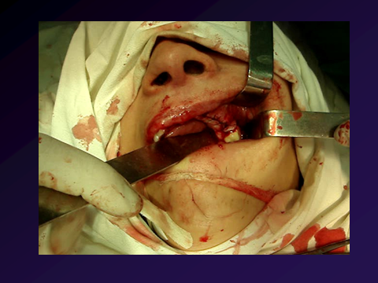

Slide 49
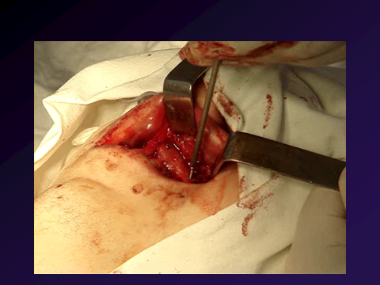

Slide 50
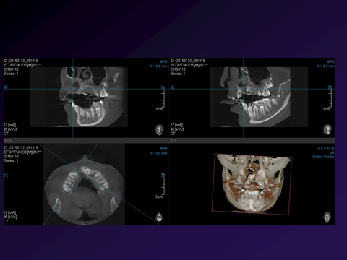

Slide 51
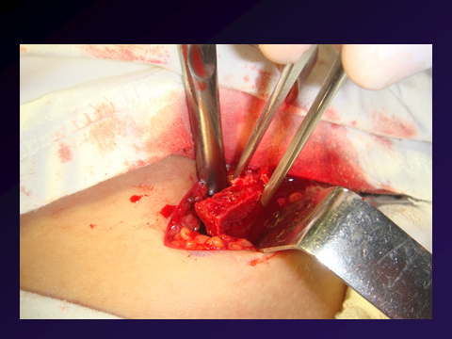

Slide 52
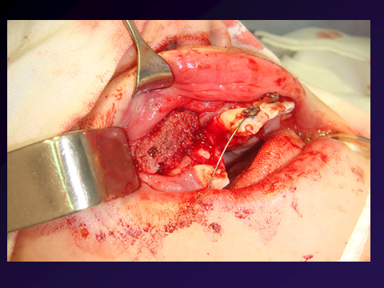

Slide 53
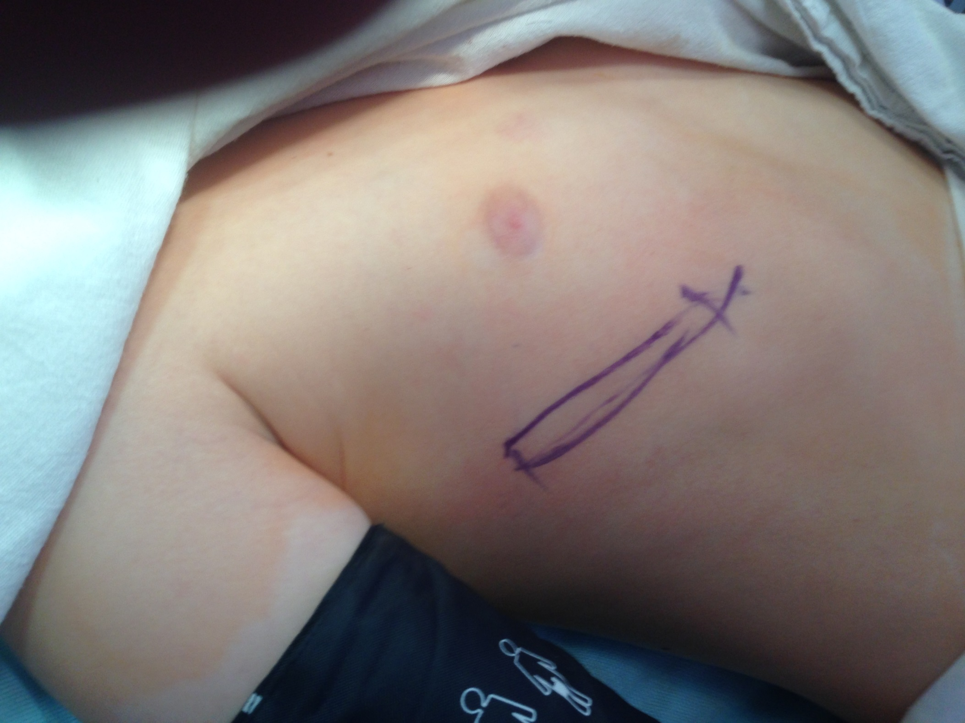

Slide 54
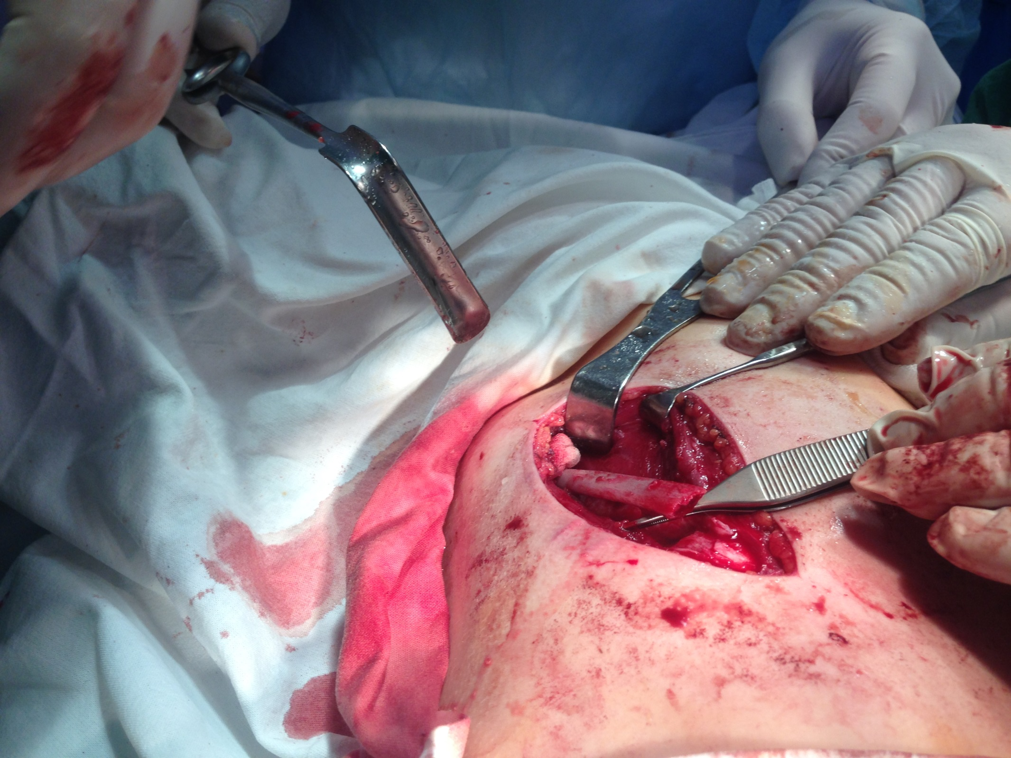

Slide 55
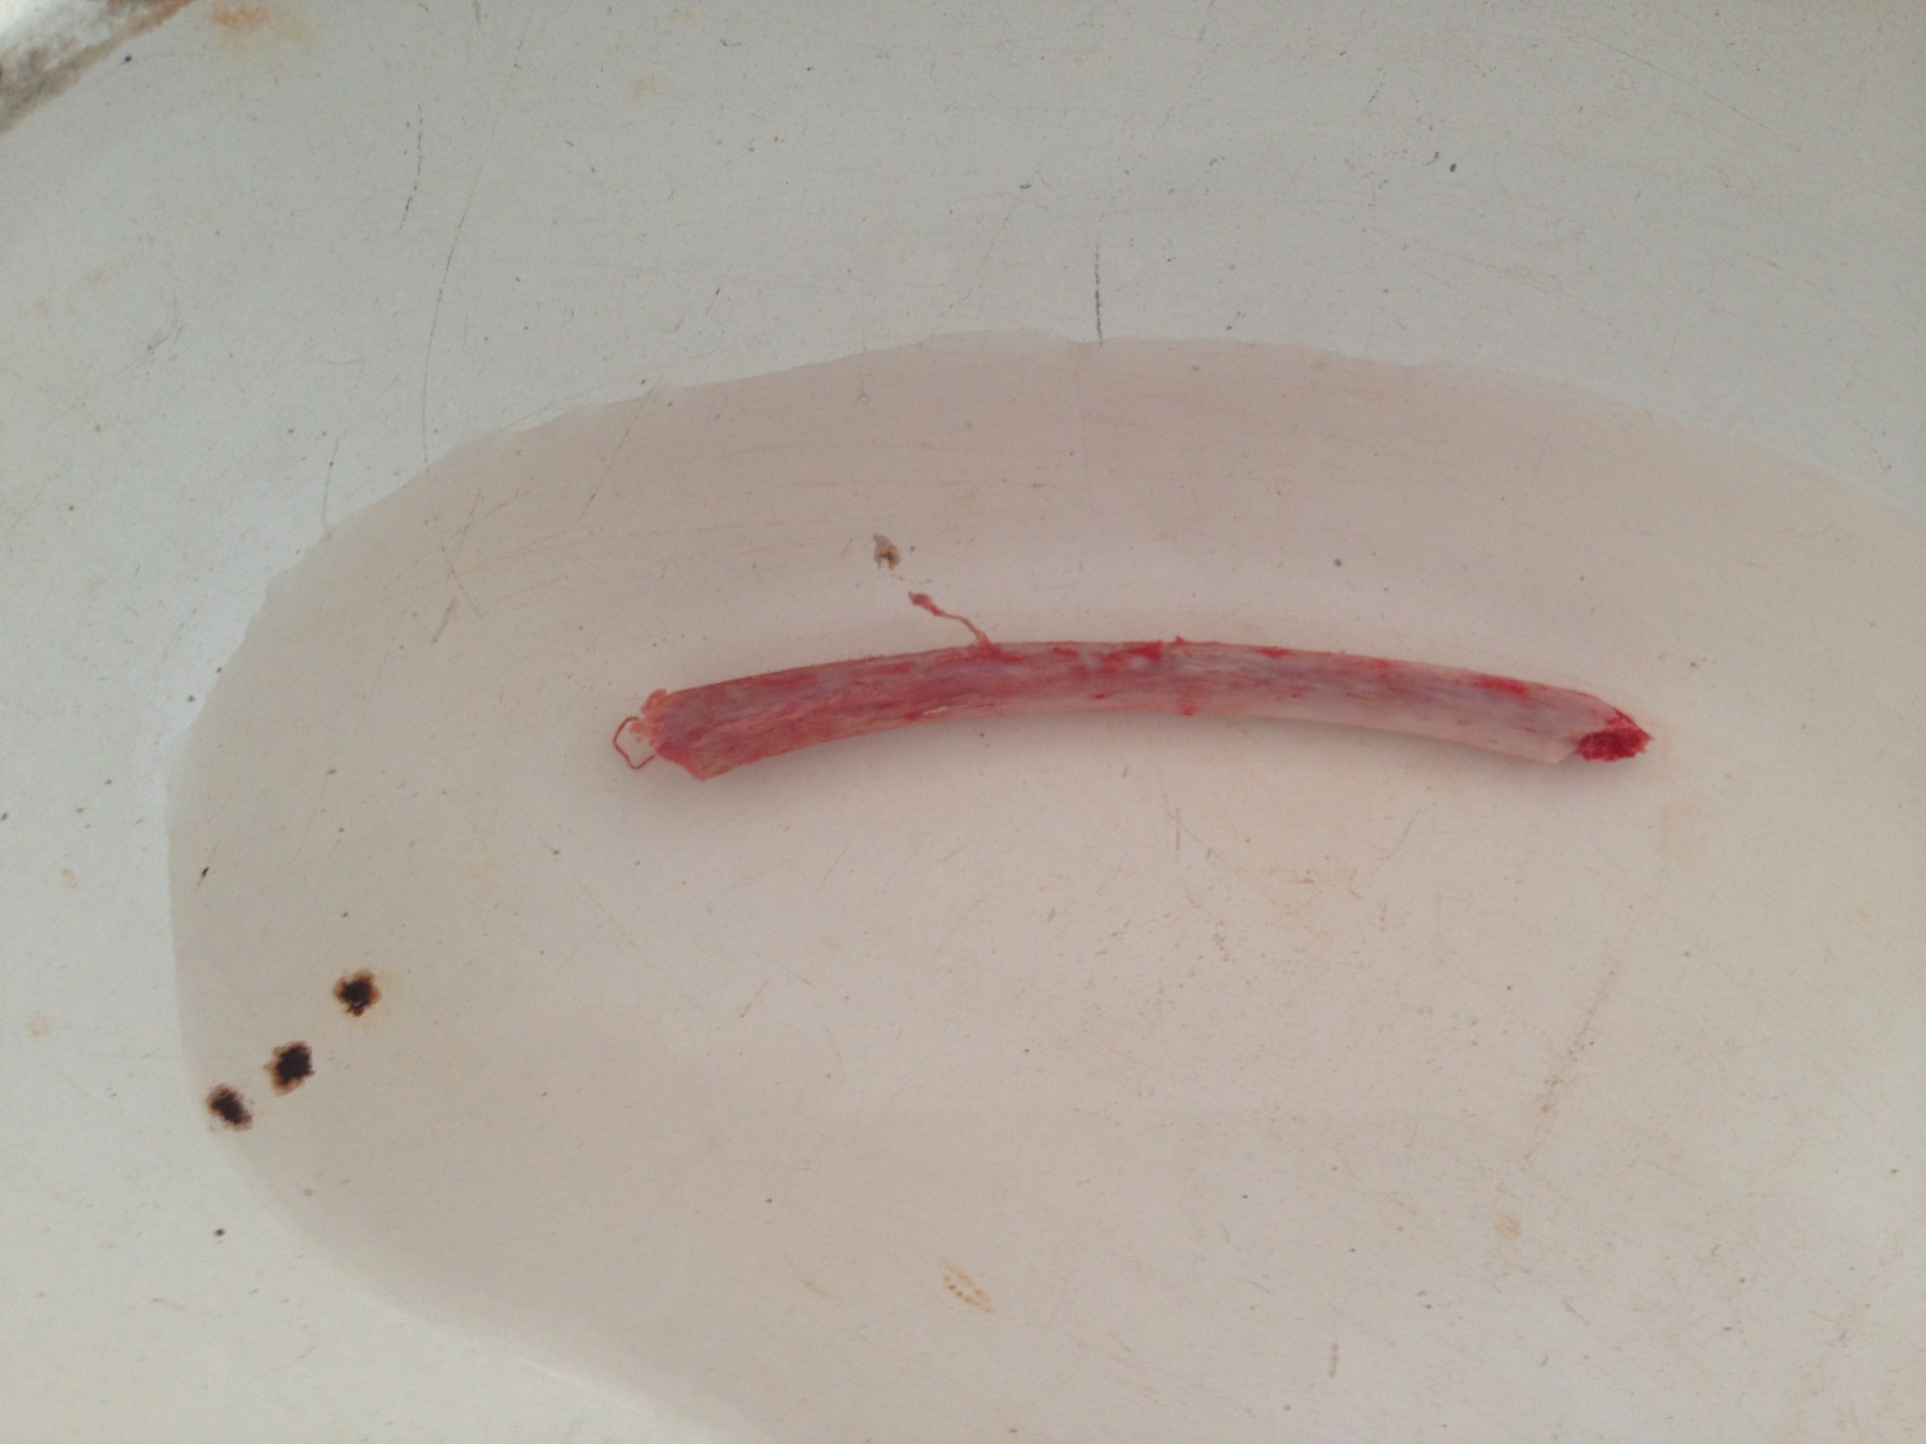

Slide 56
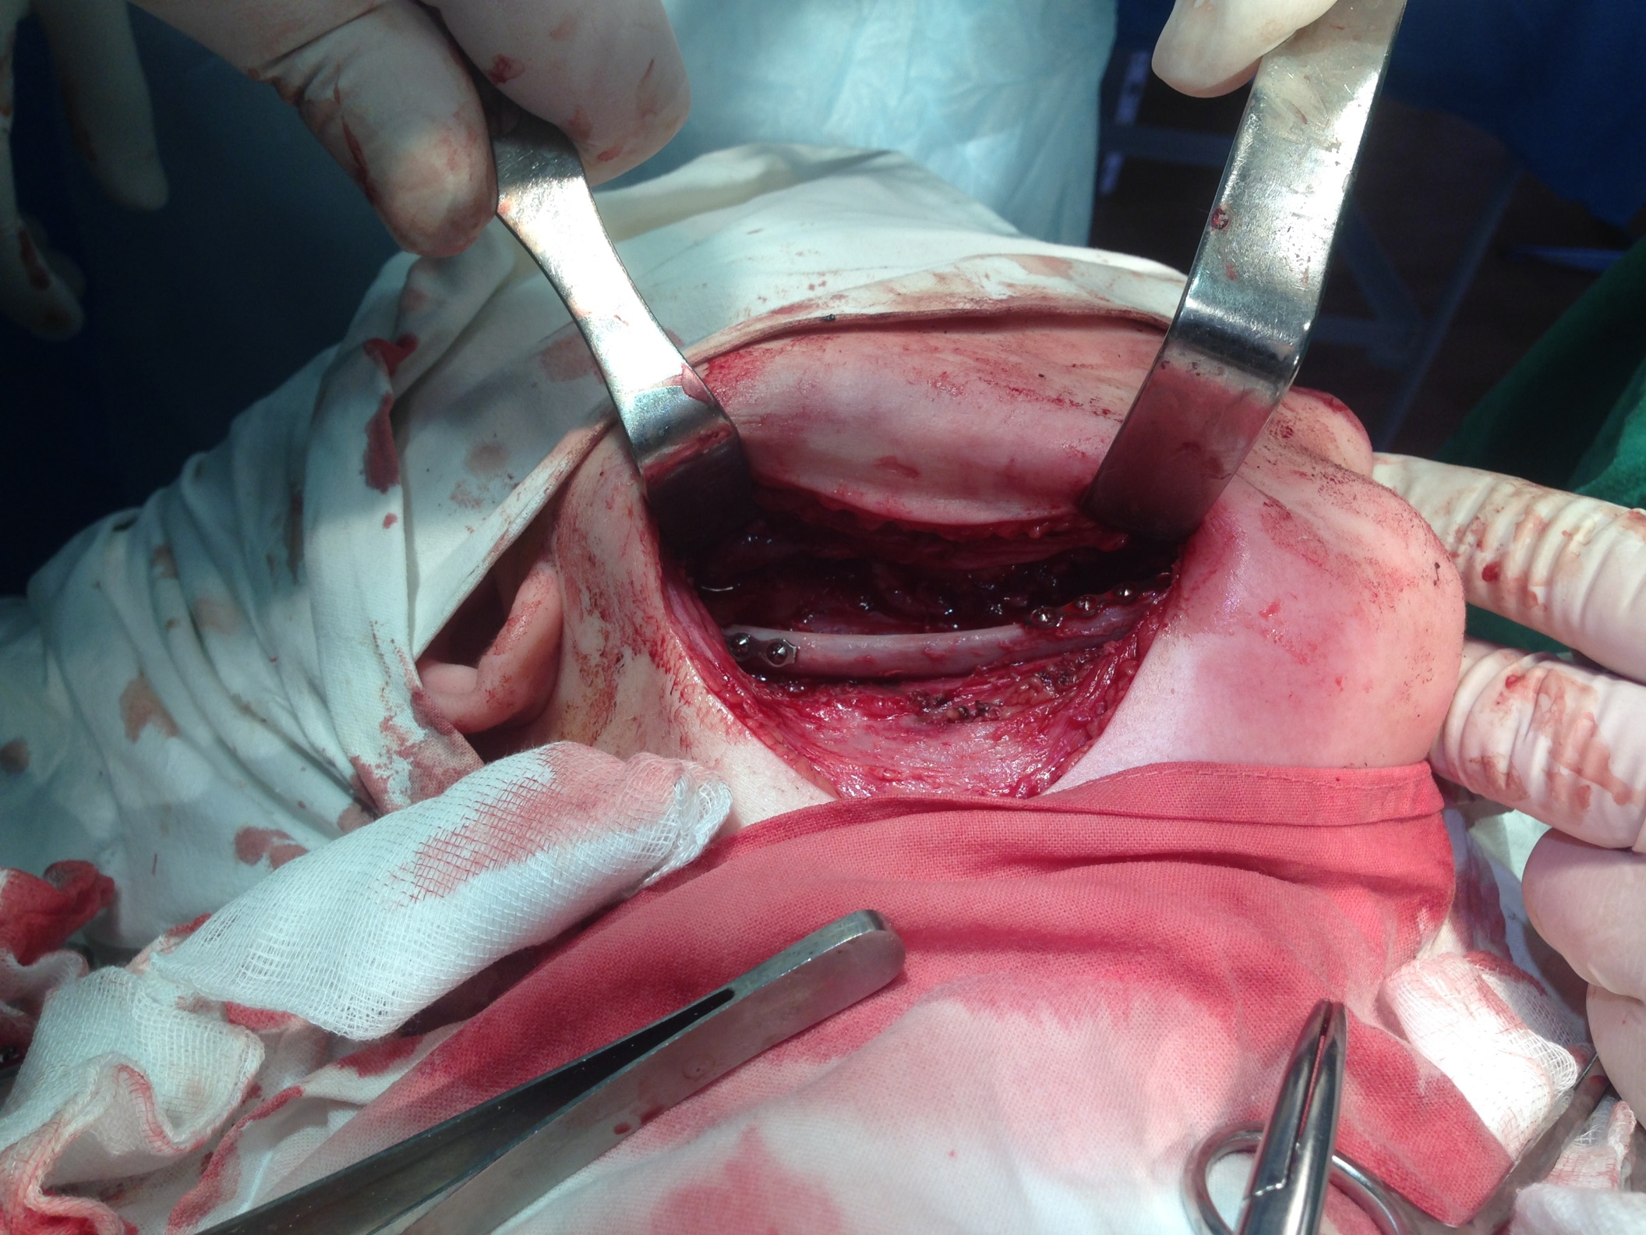

Slide 57
Cartilaginous tissue is usually obtained from costal cartilage. Up to present the idea to use multicomponent transplant from pinna to eliminate partial defects of the wing and tip of the nose, introduced by Syslov in 1897, has not lost its value.
Choice of transplant is mainly determined by several conditions, main of which are character, location and size of the defect, condition of the surrounding tissues and recipient site.

Slide 58
Cartilaginous tissue is usually obtained from costal cartilage. Up to present the idea to use multicomponent transplant from pinna to eliminate partial defects of the wing and tip of the nose, introduced by Syslov in 1897, has not lost its value.
Choice of transplant is mainly determined by several conditions, main of which are character, location and size of the defect, condition of the surrounding tissues and recipient site.

Slide 59
Owing to new biologically inert materials, such as silicone, various biologic gels, use of cartilage for these purposes has greatly decreased, though possible usage of allogenic cartilage is by far not exhausted.

Slide 60
