Slide 1
Multidisciplinary Management of Benign Jaw Tumors in
Children
Odessa national medical university
Department of oral surgery
Lecture # 1 child. Onco 5 year

Slide 2
A tumor is defined, in brief, as abnormal growth of tissue; tumoral formations are classified
under two main headings, benign and malignant. The oro-facial region including the jaw
bones, maxilla and mandible, is a site for a multitude of neoplastic conditions. Odontogenic
tumors (OTs) constitute a wide range and diverse kind of lesions derived from tooth forming
apparatus and its remnants. OTs originate from epithelium or ectomesenchyme or from both,
showing varying degrees of inductive interaction between these embryonic components of the
developing tooth germ.

Slide 3
Etiology of odontogenic tumors

Slide 4
According to current literatures, it is known that the potential sources for development of an odontogenic tumor are varied, and these include:

Slide 5
1. The pre-functional dental lamina (odontogenic epithelium with ability to produce a
tooth), which is more abundant distal to the lower third molars.
2. The post-functional dental lamina, a concept that covers those epithelial remnants such
as Serre´s epithelial rests, located within the fibrous gingival tissue; the epithelial cell rests
of Malassez in the periodontal ligament and the reduced enamel organ epithelium, which
covers the enamel surface until tooth eruption.

Slide 6
3. The basal cell layer of the gingival epithelium, which originally gave rise to the dental
lamina.
4. The dental papilla, origin of the dental pulp, which has the potential to be induced to
produce odontoblasts and synthesize dentin and/or dentinoid material.

Slide 7
5. The dental follicle.
6. The periodontal ligament, which has the potential to induce the production of fibrous
and cemento-osseous mineralized material

Slide 8
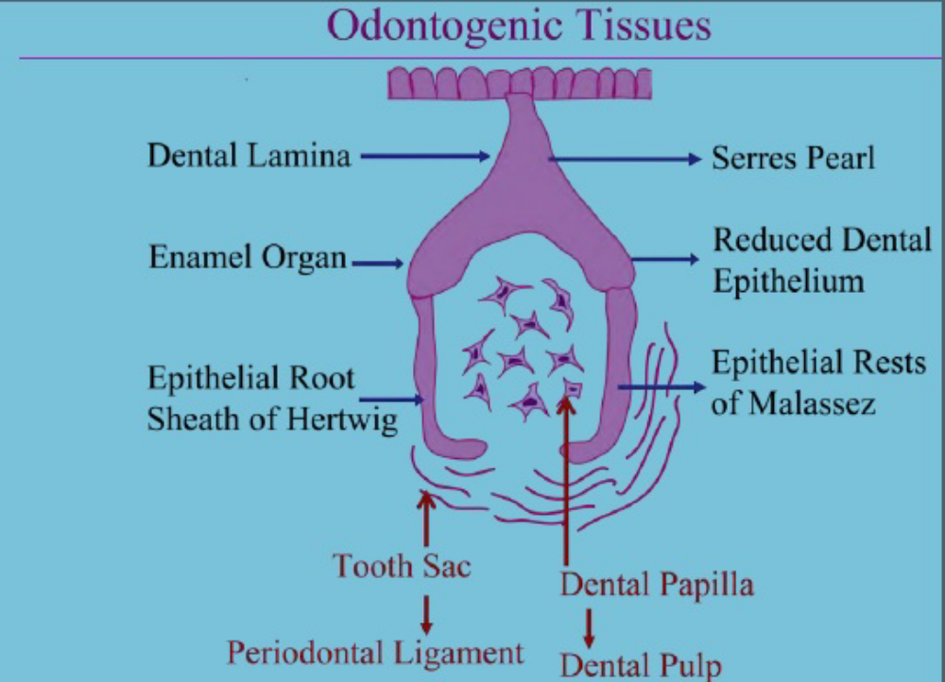

Slide 9
From a biological point of view, some of these lesions represent hamartomas with varying degrees of differentiation, while the rest are benign or malignant neoplasms with variable aggressiveness and potential to develop metastases. These tumors constitute a heterogeneous group of diseases with diverse clinical and histopathological features

Slide 10
Primary jaw tumors are broadly classified into odontogenic and nonodontogenic groups. The World Health Organization (WHO) classified this group of lesions in 1971 and 1992. In 2005, the WHO published the latest updated edition of the classification of OTs. There were 6 major changes in this schema from the previous versions namely:

Slide 11
1. parakeratinized variant of odontogenic keratocyst is now classified as a benign tumor and termed KCOT
2. adenomatoid odontogenic tumor (AOT) originates from the odontogenic epithelium with mature fibrous stroma and without ectomesenchyme

Slide 12
3. calcifying odontogenic cyst (COC) is divided into 2 benign and 1 malignant groups
4. clear cell odontogenic tumor is a malignant lesion and termed clear cell odontogenic carcinoma (CCOC)

Slide 13
5. odontogenic carcinosarcoma is not included due to the lack of evidence for the existence of this type and
6. some changes were made regarding terminology and subtypings

Slide 14
Classification of pediatric jaw tumors
The various classifications systems proposed by authors are enumerated as below:
1. Jaw Tumors in Children
1.Classification of non-odontogenic jaw tumors in children

Slide 15
I. Benign mesenchymal tumors
a) Giant cell lesions
b) Fibro-osseous lesions
c) Myxoma

Slide 16
II. Hematopoietic and reticuloendothelial tumors
a) Langerhans cell histiocytosis
b) Burkitt’s lymphoma
c)Lymphoma

Slide 17
III. Neurogenic tumors
a) Neurofibroma
b) Neurilemmoma
c) Neuroma
d)Ganglioneuroma
e) Neuroblastoma
f)Melanotic neuroectodermal tumor

Slide 18
IV. Vascular lesions
a)Vascular malformation (capillary, lymphatic, venous, arterial, combined)
b)Hemangioma
c)Aneurysmal bone cyst

Slide 19
V. Malignant mesenchymal tumors
a) Osteogenic sarcoma
b) Chondrosarcoma
c) Fibrosarcoma
d) Ewing’s sarcoma

Slide 20
VI. Malignant epithelial tumors
a)Squamous cell carcinoma
b)Mucoepidermoid carcinoma
c)Adenoid cystic carcinoma
d)Adenocarcinoma

Slide 21
2. Classification of odontogenic jaw tumors in children

Slide 22
I. Epithelial tumors
a) Ameloblastoma (Peripheral, Unicystic, Solid, Multicystic)
b) Adenomatoid odontogenic tumor
c) Calcifying epithelial odontogenic tumor

Slide 23
II. Mesodermal tumors
a)Cementoma
b)Periapical cemental dysplasia
c)Cementifying fibroma
d)Cementoblastoma
e)Odontogenic fibroma

Slide 24
III. Mixed tumors
a)Ameloblastic fibroma
b) Odontoma

Slide 25
3. Classification of Small Round Cell Tumors in children

Slide 26
1. Soft tissue Rhabdomyosarcoma
Soft tissue (extraosseous) Ewing’s sarcoma
Hemangiopericytoma

Slide 27
2. Osseous Ewing’s sarcoma
Small cell osteosarcoma
Mesenchymal chondrosarcoma
Hemangiopericytoma of bone

Slide 28
3. Neural
Neuroblastoma
Peripheral neuroectodermal tumors
- Askin’s tumor
- Neuroepithelioma
Pheochromocytoma

Slide 29
4. International classification of childhood cancer

Slide 30
Malignant Bone tumors
a) Osteosarcomas
b) Chondrosarcomas
c) Ewing tumor and related sarcomas of bone
d) Other specified malignant bone tumors
e) Unspecified malignant bone tumors

Slide 31
Soft tissue and other extraosseous sarcomas
a) Rhabdomyosarcomas
b) Fibrosarcomas, peripheral nerve sheath tumors and other fibrous neoplasms
c) Kaposi’s sarcoma
d) Other specified soft tissue sarcomas
e) Unspecified soft tissue sarcomas

Slide 32
Clinical sign and symptoms of pediatric jaw tumors

Slide 33
Pediatric patients encompass a very interesting study group, as several long term physiological changes take place in the maxillofacial area. During the mixed dentition period, children can refer with a complaint of swelling in the maxillofacial area, which may or may not be associated with pain. These mostly include both hard and soft tissue pathologies.

Slide 34
When involving bone, only odontogenic cysts or odontogenic tumors as a category have been considered. Intraosseous
pediatric jaw lesions can present in diverse clinical patterns and their diagnoses can vary from odontogenic to non-odontogenic pathogeneses, which can rarely include connective tissue pathology. The great majority of pediatric jaw tumors are non-odontogenic

Slide 35
During the mixed dentition period, children can report with complaint of swelling in the maxillofacial area, which may or may not be associated with pain. A history of trauma also needs to be elicited, because they are prone to falling down during playing, which can affect the jaws. Because of the complex anatomy and development of the head and neck, neoplasms during infancy and childhood arising at this site represent the most difficult challenges in clinical practice.

Slide 36
Diagnosis of pediatric jaw tumors

Slide 37
The odontogenic cysts and tumors are a diverse group of lesions that represent deviation from normal odontogenesis. The physical signs and symptoms of odontogenic cysts and tumors will depend to a certain extent on the dimensions of the lesion. A small lesion is unlikely to be diagnosed on a routine examination of the mouth because signs will not be demonstrable. Such lesions are only likely to be detected at an early stage as the result of routine radiographic examination.

Slide 38
Clinically evident expansion is often a late finding, especially in lesions developing within the ramus or angle of the mandible or within the maxillary sinus. Lesions in these areas may become extremely large before expansion is observed clinically. Masses in the neck confront the pediatrician with greater opportunities for evaluation before a decision regarding biopsy or excision is reached. Signs of systemic involvement must also be determined

Slide 39
Radiographic and imaging studies

Slide 40
The primary goals of radiographic assessment are to more precisely define the primary
lesion and to detect metastatic disease for clinical staging
• Chest radiographs are useful screens for mediastinal lymphadenopathy
• Ultrasound is able to differentiate a solid from a cystic mass, and give general relationships
of the mass to adjacent structures

Slide 41
• Axial and coronal computerized tomography (CT) allows documentation of bone erosion and invasion of adjacent structures
• Magnetic resonance imaging (MRI) offers improved tissue contrast and definition

Slide 42
• Angiography delineates the blood supply to a lesion, and offers the ability to embolize specific factors to decrease blood loss associated with excision of vascular lesions
• Bone scans and liver spleen scans offer modalities to detect systemic disease.
A tissue diagnosis becomes necessary in order to diagnose and initiate proper therapy.

Slide 43
Biopsy

Slide 44
• Biopsy of OTs allows histologic evaluation of the mass
• Excisional biopsy is often therapeutic as well as diagnostic
• Incisional biopsy is required in cases where the lesion is large, or the lesion is relatively
inaccessible

Slide 45
• Fine needle aspiration for cytologic study is useful in salivary gland and thyroid gland lesions. However, its generalized use for all pediatric head and neck masses is limited due to the rarity of squamous or glandular neoplasms developing in children
• Large bore needle biopsy has no established role in the evaluation of head and neck malignancies in children and has been reported to cause seeding along the needle tract in children.

Slide 46
Odontogenic tissue is programmed to produce dentin and enamel due to active interactions between odontogenic mesenchyme and epithelium. Tooth formation is achieved via
odontogenic mesenchyme and epithelium stage- and spatial-specific differentiation from early tooth development to late maturation

Slide 47
Treatment of pediatric jaw tumors

Slide 48
Treatment consists of a range of surgical methods, from surgical curettage to hemimandibulectomy and reconstruction with bone graft. Generally, surgical excision, curettage, cryosurgery or en bloc resection are adequate for treatment of these tumors. However, some patients
need multiple treatment because of its specific criterias such as the clinical behavior and extent
of the lesion.

Slide 49
Odontogenic lesions encompasses a wide spectrum of lesions and their variants, which either can be a cyst or a tumor. Odontogenic cysts are derived from the epithelium associated with the development of the dental apparatus while a tumor forms through some
aberration from the normal pattern of odontogenesis. But the fact, that these lesions can mimic
each other can complicate the diagnosis.

Slide 50
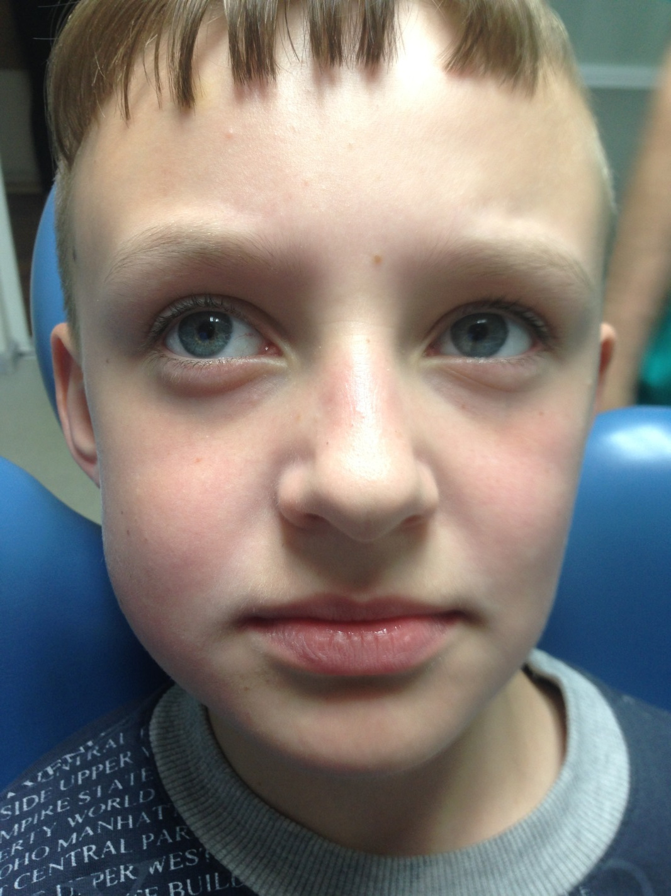

Slide 51
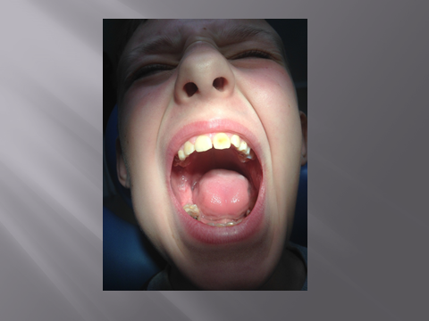

Slide 52
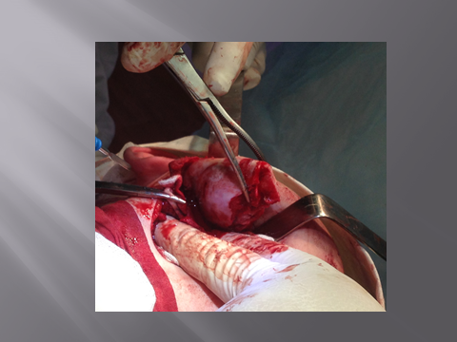

Slide 53
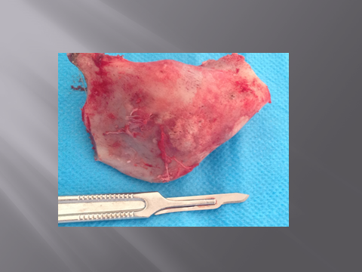

Slide 54
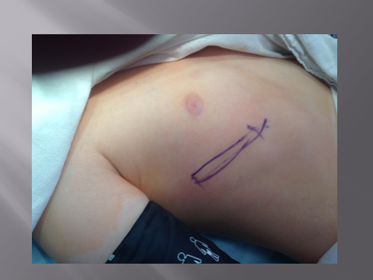

Slide 55
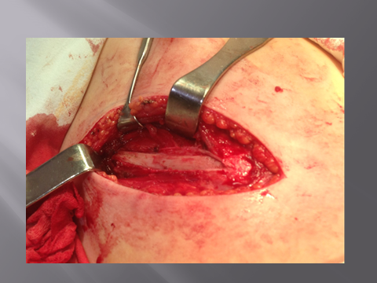

Slide 56
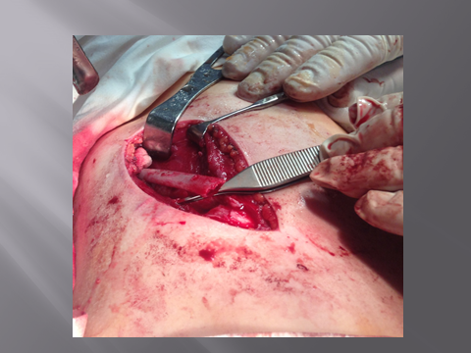

Slide 57
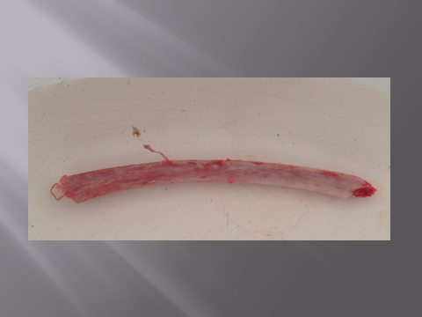

Slide 58
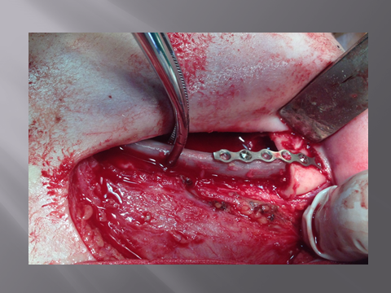

Slide 59
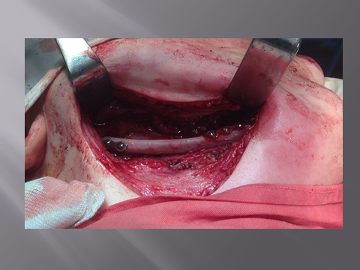

Slide 60


