Slide 1
Odessa national medical university
Department of oral surgery
STUDY GUIDE:
«Anatomico-physiological morphologic patterns of salivary glands and temporomandibular joint in children of different age. Acute and chronic inflammation of salivary glands and temporomandibular joint in children. Clinical course, diagnosis and differential diagnosis, complex treatment and rehabilitation of patients with salivary glands and TMJ disorders.»
Prof. GULYUK A.G.

Slide 2
The salivary glands make saliva. Saliva keeps the mouth and other parts of the digestive system wet and slippery. This helps food go down the throat to the stomach.

Slide 3
There are three main pairs of salivary glands.They arethe parotid, the submandibular and the sublingual glands.

Slide 4
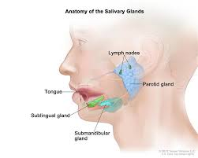

Slide 5
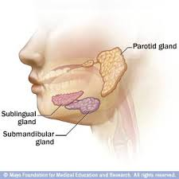

Slide 6
There are also many small glands in the tongue, cheeks, lips and palate. All of those glands make mucous.

Slide 7
Salivary secretions and structure
Saliva consists of two fluids, mucous and serous.

Slide 8
Mucous
Mucous (slime) is a saccharide glycoprotein called mucin. With water it makes the slippery lubricant used in many parts of the body, where it lines the moving parts, surfaces and tubes. Here it lubricates the mouth, throat and alimentary canal.

Slide 9
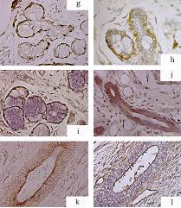

Slide 10
The mucous also has antiseptic qualities: it contains lysozyme and immunoglobulins. Mucous, with its antiseptic molecules and slime, traps fungi, bacteria and viruses and prevent infections. The body produces about a litre of mucous per day, in the mouth and other places.

Slide 11
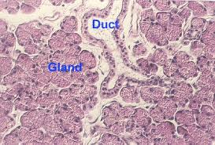

Slide 12
Serous
The serous fluid contains the enzyme amylase which acts in the digestion of carbohydrates. Minor salivary glands on the tongue secrete the amylase. The parotid gland produces purely serous saliva. The other major salivary glands produce mixed (serous and mucus) saliva.

Slide 13
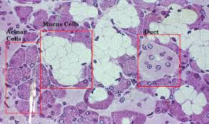

Slide 14
Types of salivary gland
The parotid gland makes serous secretions only.
The submandibular glands are mixed glands. They give serous and mucous secretions.
The sublingual glands make mucous only.

Slide 15
Structure of salivary glands
The glands are inside a capsule, of connective tissue. Inside, it is made of little parts called lobules. Blood vessels and nerves go into the lobules. There are 3 main types of cells in the major salivary glands:
Serous cells are shaped like a pyramid. They are joined together in a group that is shaped like a ball.
Mucous cells are usually shaped like a cube. They are joined together to make a tubules, which are very small tubes.

Slide 16
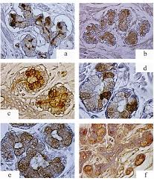

Slide 17
Myoepithelial cells are all around the part of the gland where the saliva comes out. They can squeeze the saliva gland so the saliva comes out faster.
The small tubes go into ducts. Those ducts go into larger ducts that have little stripes on them, called striations. Those go into ducts between the lobes of the gland (called interlobar or excretory ducts). The main duct of the salivary glands then opens into the mouth.

Slide 18
Where the glands are
There are three salivary glands:
The two parotid glands are near the ear (par- = next to, -otid = ear). They are the largest salivary glands.
The sublingual gland is under the tongue.
The submandibular gland is in the shape of a “U”. It is under the chin bone which is called the mandible.

Slide 19
The minor glands, although they produce less than 10% of the total volume of saliva, play an important role in lubricating the mucosa, as even in the absence of local stimuli they produce saliva. The minor glands, which are distributed throughout the oral mucosa (labial, buccal, lingual, palatinal mucosa), are mixed glands largely comprising mucous acinar cells. However, the palatinal glands are strictly mucous, whereas the lingual von Ebner’s glands are strictly serous.

Slide 20
Investigation of major salivary glands

Slide 21
Presentation and diagnosis
The clinician should record the presence of pain, swelling, altered salivary flow and a bad taste. The periodicity and duration of the swelling is often of great assistance in making a diagnosis. A subjective view of either an increase or decrease in salivary flow is made.

Slide 22
However, this is difficult to confirm except by physiological methods of measuremet which are not always easy to perform. Probing the ducts can be carried out with care to dilate strictures. A stepwise increase in the size of the probes is used. Salivary flow rates can be recorded for the submandibular and parotid glands following initial milking of the ducts and glands.

Slide 23
Radiography

Slide 24
Radiographs in more than one plane are required. The submandibular gland can be examined using a lateral oblique projection of the mandible with occlusal views to show the duct. The parotid gland is seen on a postero-anterior view of the mandible with the central ray directed parallel to the ramus of the mandible or on a lateral radiograph, taken with the head extended to avoid superimposition of the vertebral column.

Slide 25
Sialography
The indications for sialography include:
- Presence of a calculus, obstruction on eating
- Progressive enlargement - chronic, secondary to infection
- Visible and palpables welling, lymphadenopathy, cystic lesion, tumour
- Recurrent sialadenitis
- Sjôrgen's syndrome
- Post-trauma
- Pre-surgical assessment to determine the extent of a lesion and the appropriate site for biopsy
- Therapeutic reasons

Slide 26
Scintiscan
This investigation has the advantage of examining all major salivary glands together. An intravenous injection of technetium is performed and the isotope is concentrated by the salivary glands. The head of the scanner picks up the radiation emissions producing a picture of the glands.

Slide 27
Biopsy
Minor salivary gland biopsies are performed where Sjogren's syndrome other connective tissue disorders are suspected. Major gland biopsies can be performed. Fine needle aspiration is used to provide definitive diagnosis. It is indicated for determining whether a lesion is benign or malignant. It should indicate the tissue of origin and dictate the mode of treatment.

Slide 28
The technique involves providing an aseptic field. A wide-bore needle, 18-20 gauge, is inserted into the gland. The target lesion is fixed between the index finger and thumb. The needle is aimed in the direction of the shortest distance to the lesion. The lesion is aspirated and the cellular contents deposited onto a glass slide and fixed immediatelv.

Slide 29
Mumps (epidemic parotitis)

Slide 30
Is a viral disease of the human species, caused by the mumps virus. Before the development of vaccination and the introduction of a vaccine, it was a common childhood disease worldwide. It is still a significant threat to health in developing countries, and outbreaks still occur sporadically in developed countries.

Slide 31
Painful swelling of the salivary glands – classically the parotid gland – is the most typical presentation. Painful testicular swelling (orchitis) and rash may also occur. The symptoms are generally not severe in children. In teenage males and men, complications such as infertility or subfertility are more common, although still rare in absolute terms. The disease is generally self-limiting, running its course before receding, with no specific treatment apart from controlling the symptoms with pain medication

Slide 32
Fever and headache are prodromal symptoms of mumps, together with malaise and anorexia. Other symptoms of mumps can include dry mouth, sore face and/or ears and occasionally in more serious cases, loss of voice. In addition, up to 20% of persons infected with the mumps virus do not show symptoms, so it is possible to be infected and spread the virus without knowing it.

Slide 33
Cause
Mumps is a contagious disease that is spread from person to person through contact with respiratory secretions, such as saliva from an infected person. When an infected person coughs or sneezes, the droplets aerosolize and can enter the eyes, nose, or mouth of another person. Mumps can also be spread by sharing food and drinks. The virus can also survive on surfaces and then be spread after contact in a similar manner

Slide 34
A person infected with mumps is contagious from approximately 6 days before the onset of symptoms until about 9 days after symptoms start. The incubation period (time until symptoms begin) can be from 14–25 days, but is typically 16–18 days.

Slide 35
Diagnosis
A physical examination confirms the presence of the swollen glands. Usually, the disease is diagnosed on clinical grounds, and no confirmatory laboratory testing is needed. If there is uncertainty about the diagnosis, a test of saliva or blood may be carried out; a newer diagnostic confirmation, using real-time nested polymerase chain reaction (PCR) technology, has also been developed. An estimated 20%-30% of cases are asymptomatic. As with any inflammation of the salivary glands, serum amylase is often elevated.

Slide 36
Prevention
The most common preventative measure against mumps is a vaccination with a mumps vaccine, invented by American microbiologist Maurice Hilleman at Merck.

Slide 37
Treatment
There is no specific treatment for mumps. Symptoms may be relieved by the application of intermittent ice or heat to the affected neck/testicular area and by acetaminophen/paracetamol for pain relief. Warm saltwater gargles, soft foods, and extra fluids may also help relieve symptoms. Acetylsalicylic acid (aspirin) is not used due to the risk of Reye's syndrome.

Slide 38
The temporomandibular joint

Slide 39
Is the joint of the jaw and is frequently referred to as TMJ. There are two TMJs, one on either side, working in unison. The name is derived from the two bones which form the joint: the upper temporal bone which is part of the cranium (skull), and the lower jaw bone called the mandible.

Slide 40
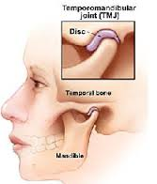

Slide 41
In different ages TMJ has the features of the structure, which often determine the clinical picture and outcome of the disease.

Slide 42
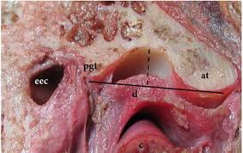

Slide 43
In newborn articular fossa is weak, flat, almost has a rounded form, the articular tubercle at the base of the zygomatic process of the temporal bone only starts to develop. The head of the condyle is rounded, covered with a thick layer coarse fiber connective tissue. Articular disc (meniscus) is not fully formed and is represented by connective tissue that fills the fossa as soft layer between the head and the future articular tubercle.

Slide 44
In the neonatal period mandible is located distally (infant distal position of the mandible), which is the physiological. the head of the condyle is in the posterior part of the glenoid fossa, and thus, the movement of the mandible makes the entire glenoid fossa functioning, not just the front portion, as in adults.

Slide 45
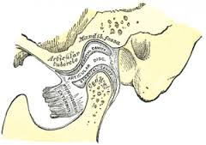

Slide 46
Glenoid fossa and a tubercule in the newborn are lined just with a periosteum and devoid of cartilage cover. This explains the rapid destruction of joint tissues, as a result of inflammation or injury, the uncovering of articulating surfaces initiates the formation of adhesions between the bone.

Slide 47
The mandible develops by endochondral ossification of the cartilage situated on the upper part of the condyle. The location of this growth centre is specific for the temporomandibular joint and is responsible for condylar growth.

Slide 48
Damage to the cartilage of the condylar growth zone, whether of an inflammatory or traumatic origin, can cause a shortening of the condyle and ramus.

Slide 49
Ankylosis of the TMJ

Slide 50
Ankylosis of the TMJ most often results from trauma or infection, but it may be congenital or a result of RA. Chronic, painless limitation of motion occurs. When ankylosis leads to arrest of condylar growth, facial asymmetry is common.

Slide 51
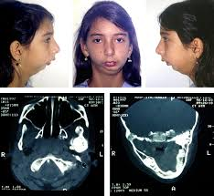

Slide 52
Intra-articular (true) ankylosis must be distinguished from extra-articular (false) ankylosis, which may be caused by enlargement of the coronoid process, depressed fracture of the zygomatic arch, or scarring resulting from surgery, irradiation, or infection. In most cases of true ankylosis, x-rays of the joint show loss of normal bony architecture.

Slide 53
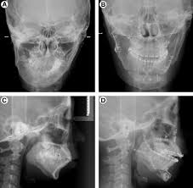

Slide 54
What are the causes of TMJ Ankylosis?
-Trauma to the joint during an accident, fall etc
-Trauma during birth, forceps delivery etc
-Congenital or birth defect
-Disease or infection in the joint, ear infection etc
-Enlargement of the coronoid process
-fracture of the zygomatic arch, condylar neck fracture etc
-Surgery to or around the joint
-Rheumatoid arthritis
-Ankylotic conditions such as ankylosing spondylitis may also be inherited.
-Destruction of the joint cartilage

Slide 55
What are the problems associated with TMJ Ankylosis?
Problems associated with ankylosis of TMJ are manifold and can be Functional, Aesthetic (Cosmetic), Psychological (Emotional) or Social.

Slide 56
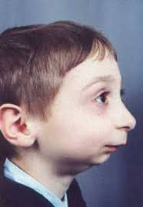

Slide 57
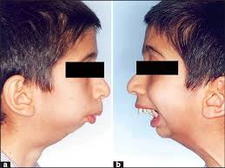

Slide 58
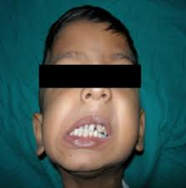

Slide 59
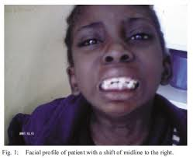

Slide 60
Ankylosis of Temporomandibular joint may result in:
- Restricted jaw movements
- Inadequate masticatory (chewing) function
- Restricted mouth opening
- Inhibited facial and physical growth
- Impaired speech
- Reduced growth of mandible resulting in “Bird Face”
- Facial asymmetry if only one side is affected
- Difficulty in breathing and swallowing
- Snoring and difficulty in sleeping on lying down
- Insufficient access for dental care resulting in multiple decayed teeth
- Misaligned teeth because of lack of space for the eruption of the normal component of teeth

Slide 61
What are the treatments for TMJ ankylosis?
Over the past few decades numerous treatment methods have been designed and developed by various surgeons for the correction of TMJ ankylosis.

Slide 62
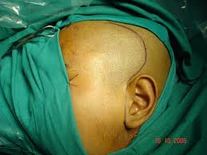

Slide 63
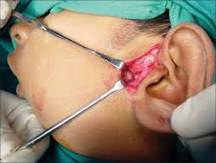

Slide 64
1.Excision of ankylosis (gap arthroplasty)
2.Arthroplasty with or without autogenous, alloplastic or allogenic replacement
3.Condylectomy if the ankylosis is intra-articular or an osteotomy of a part of the ramus if the coronoid process and zygomatic arch are also affected.
4.Total condylectomy and joint replacement (autogenous, allogenic, alloplastic)
5.Myotomy
6.Coronoidectomy or coronoidotomy: This is the excision of the coronoid process of the mandible to release the temporalis muscle.

Slide 65
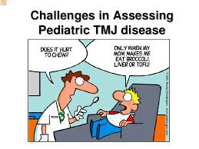

Slide 66


