Slide 1
Odessa national medical university
Stomatological faculny
Oral surgery dep.
Lecture № 5 «The causes and prevention of traumatic injuries in children. Modern diagnostic methods. Surgical treatment of wounds. Plastic surgery principles. Free skin transplantation and chondrocutaneous grafting. Treatment and rehabilitation of patients with soft tissue injuries. “
Year 4 Stomatological faculty
prof. Gulyuk A.G.

Slide 2
Traumas of the soft tissues. Clinic, diagnostic, treatment, consequences.

Slide 3
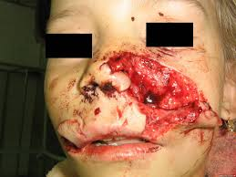

Slide 4
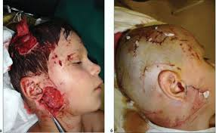

Slide 5
The initial examination involves evaluating and stabilizing the trauma patient. Any life-threatening conditions should be identified and managed immediately. The conditions of the airway, breathing, and circulation are examined, followed by a general neurologic assessment with particular attention to cervical spine and cranial
injuries.

Slide 6
It is important to achieve hemostasis when stabilizing and evaluating the patient who has sustained trauma. Most bleeding will respond to application of a pressure dressing. Occasionally surgical exploration and packing of the wound under general anesthesia may be indicated.

Slide 7
Secondary risk of infection increases with the lapse of time. Because of the rich vascularity of the face there is no “golden period” for suture repair of facial wounds. In fact healing of facial wounds is unaffected by the interval between injury and repair.

Slide 8
Patients who are immunized and have received a booster injection within the last 10 years do not require tetanus prophylaxis if the wound is not tetanus prone. Tetanus-prone wounds are those with heavy contamination from soil or manure, devitalized tissue, or deep puncture wounds. If the wound is tetanus prone and the patient has not received a booster injection within 5 years prior to the injury, a 0.5 mL tetanus toxoid boost injection should be given. If the patient has not received a booster within 10 years prior, they should receive a booster injection for any wound. Patients who are not immunized should receive both a booster injection and 250 units of tetanus immunoglobulin, followed by a full course of immunization.

Slide 9
Types of Injuries

Slide 10
Abrasions. Shear forces that remove a superficial layer of skin cause abrasions. The wound should be gently cleansed with a mild soap solution and irrigated with normal saline. These superficial injuries usually heal with local wound care. It is important to determine whether foreign bodies have been embedded in the wound. Failure to remove all foreign material can lead to permanent “tattooing” of the soft tissue

Slide 11
After the wound is cleansed the abrasion is covered with a thin layer of topical antibiotic ointment to minimize desiccation and secondary crusting of the wound. Reepithelialization without significant scarring is complete in 7 to 10 days if the epidermal pegs have not been completely removed. If the laceration significantly extends into the reticular dermal layer, significant scarring is likely

Slide 12
Contusions. Contusions are caused by blunt trauma that causes edema and hematoma formation in the subcutaneous tissues. The associated soft tissue swelling and ecchymosis can be extensive. Small hematomas usually resolve without treatment; hypopigmentation or hyperpigmentation of the involved tissue can occur, but is rarely permanent. Large hematomas should be drained to prevent permanent pigmentary changes and secondary subcutaneous atrophy.

Slide 13
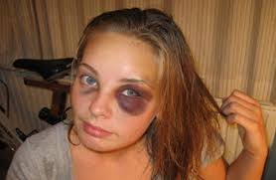

Slide 14
Lacerations . Lacerations are caused by sharp injuries to the soft tissue. Lacerations can have sharp, contused, ragged, or stellate margins. The depth of penetration should be carefully explored in the acute setting.

Slide 15
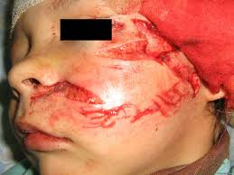

Slide 16
Closure is performed using a layered technique. If the margins are bevelled or ragged they should be conservatively excised to provide perpendicular skin edges to prevent excessive scar formation. Rarely is there an indication for changing the direction of the wound margins by Z- plasty at the time of primary wound repair. Flap-like lacerations occur when a component of the soft tissue has been elevated secondary to trauma. Eliminating dead space by layered closure and pressure dressings is especially important in these “trapdoor” injuries.

Slide 17
Avulsive Injures . Avulsive injures are characterized by the loss of segments of soft tissue. Undermining the adjacent tissue, followed by primary closure, can close small areas. When primary closure is not possible, other options are considered. These include local flaps or allowing the wound to heal by secondary intention followed by delayed soft tissue techniques. If a significant amount of soft tissue is missing, then a skin graft, local flaps, or free-tissue transfer may be necessary.

Slide 18
Traumas of the teeth (displacement, dislocation and fracture). Methods of diagnostics, peculiarities of the treatment, consequences

Slide 19
Injury to both the primary and permanent teeth and the supporting structures is one of the most common dental problems occured in children. Researchers have shown that 30% of school children suffer traumatic dental injury in the primary dentition and 22% - in the permanent dentition. Therefore, just over 50% of children will sustain a traumatic dental injury before leaving school.

Slide 20
Trauma to the dentition should always be considered an emergency situation. It occurs frequently and results in functional and esthetic disturbances accompanied by concern from both the patient and the parent. The dentist’s responsibility is to act objectively and efficiently in such a situation.

Slide 21
Etiology. Trauma to the dentition can be either direct or indirect. Direct trauma occurs when the dentition is struck by one of a variety of objects such as a hard ball, stick, or a fist. Indirect trauma is produced by sudden forceful closure of the mandibular teeth with their maxillary opponents as may follow a blow to the chin in a fall, a fight, or road accident. The etiology of the various types of dental trauma is, to a large extent, dependent on age. The age and the type of trauma experienced can be divided into well-defined sections.

Slide 22
Age 18 Months to 2 Years. The age from 18 months to 2 years is an important time in the child’s development. He is discovering and exploring his environment. The ability to stand unsupported has not been perfected, and locomotive movement is
provided by crawling on hands and knees. Children at this age are notoriously adventurous and inquisitive, resulting in many traumatic incidents, fortunately mostly of a trivial nature. In the primary dentition, injury is usually confirmed to the supporting structures, resulting in displacement or avulsion of the tooth rather than fracture of the crown or root.

Slide 23
Age 2 to 5: The Toddler Stage. At the beginning of the period between the age of 2 and 5, the child is just learning to walk and is very unsteady on his feet. This may result in a fall injury to the anterior teeth. Quite often the child is taken to a park where there are swings, slides, and the like. A common cause or dental injury in this setting is the swing. At this stage the child’s oral cavity is just about on the same level as the average swing seat. Often, the child will stand in front or behind a moving swing and will receive the full force of the blow at the level of the teeth, resulting in their fracture or displacement.

Slide 24
Between 5 and 10 Years. At the stage between the ages of 5 and 10, the child has reached school age, and playground accidents are very common. These accidents tend to be falls, characterized by a high frequency of crown fracture. Also, it is the time to learn to ride a bicycle, to roller skate, and to ice skate. Falls from bicycles and skates cause multiple crown fractures with associated soft tissues injuries to the upper lip and chin.

Slide 25
The Teenage Years. Injuries during the teenage years tend to be due sporting activities, especially contact sports such as soccer, baseball, football, basketball, and hockey.

Slide 26
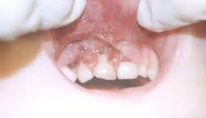

Slide 27
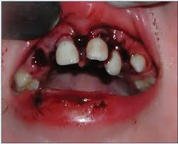

Slide 28
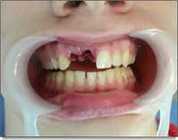

Slide 29
Road Traffic Accidents.

Slide 30
Facial injury owing to road traffic accidents is frequently seen in the late teens. In such an accident the passenger next to the driver is often thrown forward and may contact the windshield, causing lacerations of the soft tissues of the lip and chin. The driver and the front seat passenger are not most risk,
especially if seat belts are not worn.

Slide 31
The trauma experienced is typified by soft tissue and bony injuries as well as damage to teeth due to contact with the windshield, dashboard, or steering wheel. Young children in rear seats are particularly at risk. If no restraint is worn, they can be thrown around the car interior in an accident, resulting in severe total body injury.

Slide 32
Injuries to the Tooth

Slide 33
Crown
A crack or craze of the enamel without loss of tooth structure can be horizontal or vertical or oblique.
Fracture of the crown can be enamel only; involving enamel and dentine; or enamel, dentine, and pulp.

Slide 34
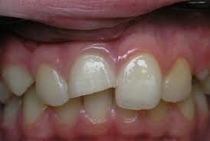

Slide 35
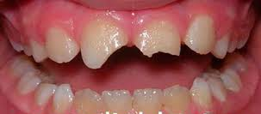

Slide 36
Root
Fracture of the root can involve the apical third, the middle third, or the cervical third.

Slide 37
Entire tooth
Concussion. A mild blow to the teeth may result in injury only tothe periodontal membrane, so “concussion” the tooth. The tooth may be sensitive to touch and tender to percussion. No mobility or displacement will be observed.
Subluxation. More severe blow may result in more drastic injury to the periodontal membrane resulting in tooth mobility. Any displacement is not observed.

Slide 38


Slide 39
Displacement. Various types of displacement can result from trauma:
- Intrusion—displacement of the tooth into the socket;
- Extrusion—partial displacement of the tooth out of its socket;
- Labial displacement—displacement of the tooth labially;
- Linguopalatal displacement—displacement toward the tongue/palate;
- Lateral displacement—displacement of the tooth mesially or distally;
- Avulsion—complete loss of the tooth from its socket.

Slide 40
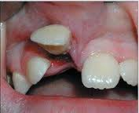

Slide 41
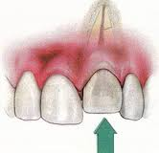

Slide 42
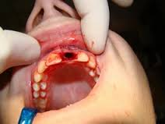

Slide 43
FIRST AID FOR AN AVULSED TOOTH

Slide 44
I. PRIMARY TOOTH
· A primary tooth that has been avulsed is usually not reimplanted. The risk of injury to the developing permanent tooth bud is high.

Slide 45
II. PERMANENT TOOTH
· 1. Do not touch the root of the tooth. Handle the tooth by the crown only.
· 2. Rinse the tooth off only if there is dirt covering it. Do not scrub or scrape the tooth.
· 3. Attempt to reimplant the tooth into the socket with gentle pressure, and hold it in position.
· 4. If unable to reimplant the tooth, place it in a protective transport solution, such as Hank's solution, milk, or saline. This will hydrate and nourish the periodontal ligament cells which are still attached to the root. A small container of Hank's Balanced Salt Solution can be purchased in dental emergency kit form at many drug stores. Contact lens solution is not an acceptable storage medium

Slide 46
5. The tooth should not be wrapped in tissue or cloth. The tooth should never be allowed to dry.
· 6. Take the child to a dentist or hospital emergency room for evaluation and treatment.
· 7. Radiographs may need to be taken of the airway, stomach, and mouth if the tooth cannot be found.
· 8. Tetanus prophylaxis should be considered if the dental socket is contaminated with debris.

Slide 47
DENTAL OFFICE TREATMENT FOR AN AVULSED TOOTH

Slide 48
I. PRIMARY TOOTH
· The primary avulsed tooth is generally not reimplanted – to avoid injury to the developing permanent tooth bud.

Slide 49
II. PERMANENT TOOTH
· 1. Place the tooth in Hank's Balanced Salt Solution.
· 2. Take a medical and dental history, and perform a physical examination. Rule out CNS injury.
· 3. Examine the orofacial area. Inspect the oral soft tissue for embedded tooth fragments, lacerations, or ecchymosis (bruising).
Palpate the teeth and dentoalveolar area to check for mobility.
Evaluate TMJ function.

Slide 50
· 4. If the tooth is missing, rule out aspiration or ingestion.
· 5. Take a maxillary occlusal radiograph, as well as a lateral anterior radiograph of the injured area. Consider taking a panoramic radiograph to rule out condylar or mandibular fractures.
· 6. Gently aspirate the injured area without entering the socket. If a clot is present, dislodge and remove it using light saline irrigation. Do not curette the socket.
· 7. The tooth should be carefully held by the crown, and not by the root. The avulsed tooth should be reintroduced into the dental socket slowly.

Slide 51
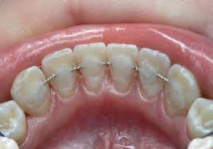

Slide 52
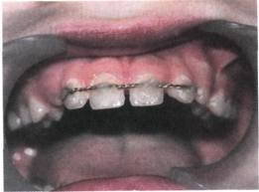

Slide 53
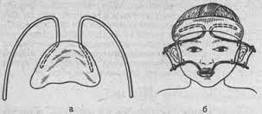

Slide 54
TOOTH REIMPLANTATION GUIDELINES

Slide 55
· 1. For A Mature Tooth With A Closed Apex: If the extraoral dry time is <60 minutes, reimplant as soon as possible. If the extraoral dry time is >60 minutes, soak in citric acid or curette the root; then soak in stannous fluoride for 10 minutes. Rinse with saline. Perform root canal therapy one week following the trauma.
· 2. For An Immature Tooth With An Open Apex: If the extraoral dry time is <60 minutes, soak in doxycycline (1mg/20 ml saline) for 5 minutes. If the extraoral dry time is >60 minutes, provide the same treatment as for a closed apex.
· 3. Apply a flexible, functional splint for 7 to 10 days. If an alveolar fracture is present, provide a very rigid splint for 4-6 weeks.

Slide 56
· 4. After reimplantation, gently compress the facial and lingual bony plates. Suture any lacerations.
· 5. Provide antibiotic coverage for 10 days to prevent infection. Consider prescribing tetracycline or penicillin. Penicillin is prescribed as: PenVK 500mg, 4X per day, for 10 days.
· 6. Prescribe chlorhexidine gluconate rinses, and provide oral hygiene and diet instructions.

Slide 57
7. Provide analgesics to control pain. For children, consider prescribing acetaminophen and codeine (Tylenol #3) for mild to moderate pain. The dose is 15 mg/kg/dose of acetaminophen, every 4 hours. Do not exceed 2.6 g/day of acetaminophen.
· 8. Arrange for tetanus vaccination if the wound was dirty, or if the vaccination requires updating.

Slide 58
FIRST AID WITH TOOTH DISPLACEMENT

Slide 59
I. PRIMARY TOOTH
Place a cold wet cloth over the mouth, and bring the child to a dentist. Provide pain relief by giving children’s Tylenol.

Slide 60
II. PERMANENT TOOTH
Rinse with cold water, and keep an ice pack over the lip and mouth to reduce swelling. Give Tylenol for pain relief. Try to reposition the luxated tooth back to its normal position using gentle to moderate finger pressure. The patient is then instructed to gently hold the tooth in position. Obtain definitive dental care as soon as possible.

Slide 61
DENTAL OFFICE TREATMENT OF TOOTH DISPLACEMENT

Slide 62
I. PRIMARY TOOTH
· A primary tooth with a luxation in the labial direction needs to be extracted, to avoid further damage to the developing permanent tooth bud.
· In other cases, however, it is possible to splint the luxated primary tooth back into normal position using resin-modified glass ionomer cement. The cement is mixed fairly thick, and placed on the labial and lingual surfaces of the luxated tooth – and a few adjacent teeth. The luxated tooth is held in the ideal position while the cement is setting. The splint is removed after 10 days using a composite finishing bur

Slide 63
II. PERMANENT TOOTH
· For any severe luxation injury: an anti-inflammatory agent (Motrin), an analgesic (Tylenol #3 or Percoset), and an antibiotic (Penicillin) are prescribed.
· For a lateral luxation, treatment includes: repositioning after local anesthesia, and applying a semi-rigid splint for 2-3 weeks. A post-treatment radiograph should be performed to assure proper position of the tooth in the socket. For an extrusive luxation, treatment includes: immediate repositioning and placement of a semirigid (flexible) splint for 7-14 days.

Slide 64
Traumas of the maxillo-facial bones of the children. Classification, methods of diagnostics. Treatment. Rehabilitation

Slide 65
Maxillary fractures most often occur in conjunction with other facial fractures and are most often associated with injuries such as lacerations, other facial fractures, orthopaedic injury, and neurologic injury.

Slide 66
Le Fort Classification System
In his description of maxillary fractures Le Fort considered several factors: the vector of force overcoming the inertia of the face; the thickness of the bone and buttresses counteracting the mass, velocity, and point of application; and the maxilla, which he
noticed was unaffected by muscle pull, unlike the long bones. These considerations resulted in a classification of three levels of fracture.

Slide 67
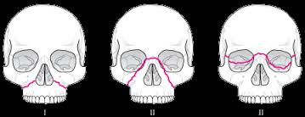

Slide 68
Le Fort I Leve l .Maxillary fractures at the Le Fort I level traverse the lateral antral wall, the lateral nasal wall, and the lower third of the septum, and they separate at the pterygoid plates. Thus, the entire mobilized segment consists of the maxillary alveolar bone, the palatine bone, the lower third of the nasal septum, and the lower third of the pterygoid plates. The superior two-thirds of these bones remain associated with the face.

Slide 69
Le Fort II Level Maxillary fractures at the Le Fort II level involve most of the nasal bones, the maxillary bones, the palatine bones, the lower two-thirds of the nasal septum, the dentoalveolus, and the pterygoid plates. Unlike the horizontal separation noted in the Le Fort I fracture, the Le Fort II fracture is pyramidal in shape. The fracture extends from below the nasofrontal suture through the nasal bones along the maxilla to the zygomaticomaxillary suture and includes the medial inferior third of the orbit. The fracture then continues along the zygomaticomaxillary suture to and through the pterygoid plates. The septum is also separated superiorly. The segments may be intact below this line of fracture, but they are most often comminuted.

Slide 70
Le Fort III Level Fractures at the Le Fort III level involve the nasal bones, the zygomas, the maxillae, the palatine bones, and the pterygoid plates. These fractures essentially separate the face along the base of the skull. The fracture line extends from the nasofrontal suture along the medial wall of the orbit through the superior orbital fissure. It then extends along the inferior orbital fissure and the lateral orbital wall to the zygomaticofrontal suture. The zygomaticotemporal suture is also separated. The fracture then extends along the sphenoid bone, separating the pterygoid plates. The septum becomes separated at the cribriform plate of the ethmoid. Le Fort III fractures are most often comminuted. With highly comminuted fractures, patients may sustain fractures at more than one level. Virtually all combinations of Le Fort I, II, and III fractures are possible on either side of the face.

Slide 71
Clinical Examination

Slide 72
Advanced trauma life-support protocols should be followed for all patients who have suffered trauma. Detailed examination of maxillofacial fractures is completed in the secondary survey, after the primary survey and successful resuscitation have been completed. As has been done historically the clinical examination should begin with the initial observation of the patient, followed by palpation of the fractures..

Slide 73
Lacerations, abrasions, and ecchymotic areas should be recorded. Periorbital ecchymosis and facial edema should be noted and are very typical of these fractures. Epistaxis with any evidence of cerebrospinal fluid leakage (clear fluid mixed with blood, “tram lines”) should be identified. Asymmetry of the nose, traumatic telecanthus, a flat nasal bridge, and a dish-shaped face should all be noted.

Slide 74
. Intraorally the examiner may see fractured teeth, vestibular ecchymosis and edema, palatal ecchymosis, mucosal lacerations and bleeding, steps or diastema in the maxillary teeth, and malocclusion. The skeletal framework of the face should be carefully palpated. With respect to the maxilla, the alveolus should be palpated and any fractures or mobility noted

Slide 75
The examiner should also observe the maxilla for movement as a unit, while palpating the forehead, the nasal bridge, and the zygomaticofrontal sutures. The nose should be examined grossly for contour irregularity. A nasal speculum should be used to identify compound fractures of the
septum or septal hematoma. Both hands should be used to palpate the orbital rims and in particular the zygomaticomaxillary suture.

Slide 76
The intraoral examination should be complete, and the examiner should note accumulation of blood, debris, or avulsed teeth that could compromise the airway, as well as the presence of laceration, abrasion, or ecchymosis. Abnormal occlusion with an anterior open bite and posterior prematurities should be noted and correlated with pretraumatic occlusion if possible (family members, photographs, dental records).

Slide 77
Imaging

Slide 78
Fractures are identified clinically and confirmed radiographically. In the past the Waters’ view and lateral facial radiographs were used in identifying maxillary fractures and may still be used today in remote areas without access to a computed
tomography (CT) scanner. Fine details of the fracture sites are difficult to visualize.

Slide 79
Axial and coronal CT scans of the midface should be obtained if a scanner is available. If clinical evidence strongly indicates maxillary fracture (midface mobility and malocclusion with intact mandible), then CT imaging is a confirmatory test for maxillary fractures. Important indications for CT scanning are suspected orbital floor
fractures (best diagnosed in the coronal view) and surgical planning

Slide 80
. CT scans can also demonstrate the soft tissue differences of hematoma or edema of the subcutaneous tissue, muscle, and fat. For severe midface trauma or maxillary displacement, the three-dimensional CT scan is a valuable tool.

Slide 81
Treatment

Slide 82
Patients do not die of maxillary fractures, but they may die of concomitant injury or failure to manage the sequelae of maxillary fractures. As is true for all injuries initial attention should be directed at establishing an airway and controlling hemorrhage.

Slide 83
The most frequent cause of hemorrhage in Le Fort level fractures is a fractured septum. This bleeding may be addressed by placing nasal packs of one of a number of materials, including gauze packing. Bleeding from sites of laceration or abrasion may be controlled by tamponade.

Slide 84
Exsanguinating hemorrhage is rarely encountered with facial fractures; however, its occasional occurrence has long been noted: “Hemorrhage, which is not readily amenable to successful treatment, as in the case of rupture of the internal maxillary artery or its terminal branches, may be followed by fatal results.

Slide 85
Pediatric Maxillary Fractures
Treatment

Slide 86
Pediatric maxillary fractures occur infrequently. Because the pediatric sinuses are not highly pneumatized, these fractures tend to be less comminuted in children than in adults. No long-term studies have been undertaken with populations large enough to
determine what alterations in maxillary growth will occur after pediatric maxillary fractures.

Slide 87
When fixation is undertaken, consideration should be given to the contour and the root length of the primary dentition. The use of occlusal splints and skeletal
fixation should be entertained. Resorbable plating systems have been advocated for use in pediatric patients so that potential complications of translocation, extrusion, and growth restriction can be avoided.

Slide 88
The mandible is the second most commonly fractured part of the maxillofacial skeleton because of its position and prominence.
Basic principles of orthopedic surgery also apply to mandibular fractures including reduction, fixation, immobilization, and supportive therapies.

Slide 89
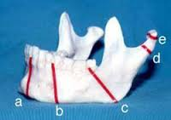

Slide 90
Reduction of the fracture can be achieved either with an open or closed technique. In open reduction, as the name implies, the fracture site is exposed, allowing direct visualization and confirmation of the procedure. This is typically accompanied by the direct application of a fixation device at the fracture site. A closed reduction takes place when the fracture site is not surgically exposed but the reduction is deemed accurate by palpation of the bony fragments and by restoration of the functioning segments, for example, restoration of the dental occlusion by wiring the teeth together, using splints, or employing external pins Fixation must be able to resist the displacing forces acting on the mandible.

Slide 91
Patients often complain of the following:
•Pain or tenderness is often present at the site of impact with the possibility of a direct fracture, or at a distant site in the case of an indirect fracture.
•Difficulty chewing. Pain could be limiting mandibular function or there may be a malocclusion or mobility at the fracture site.

Slide 92
•Malocclusion. The patient may be able to tell the clinician of an alteration in the bite from normal; however, patients are not always reliable and may claim that the bite feels normal when it is not and vice versa.
•Numbness in the distribution of the inferior alveolar nerve. This usually indicates a displaced fracture in the region of the body or angle of the mandible on the affected side. A nondisplaced fracture often does not give rise to numbness in the distribution of the inferior alveolar nerve.

Slide 93
Principles of plastic and reconstructive surgery

Slide 94
LOCAL FLAPS OVERVIEW

Slide 95
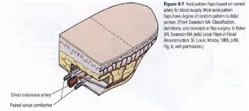

Slide 96
It is helpful to subclassify local flaps based on the type of tissue movement involved in transferring the flap from the donor site to the recipient site . The two basic classes of flaps are sliding and lifting

Slide 97
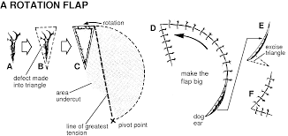

Slide 98



Slide 99
Sliding flaps move tissue by direct advancement, leaving a donor defect adjacent to the newly covered recipient site that is of unequal length and is closed primarily. Included in this class are the subcutaneous pedicle=advancement flaps (cheek, V–Y, island pedicled, O–T=A–T plasty); and rotation flaps (dorsal nasal).

Slide 100
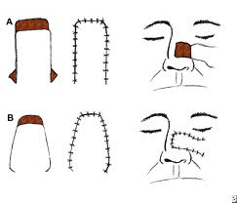

Slide 101


Slide 102
Lifting flaps cross normal issue to reach the recipient site and include transposition flaps (bilobe and rhombic flaps); and interpolation flaps (melolabial, midline forehead). A transposition flap is adjacent to the defect and transfers tissue in one stage. An interpolation flap is remote from the defect and transfers tissue in two stages: the second stage is for sectioning of the pedicle after an appropriate period of time (usually 2–3 weeks).

Slide 103


Slide 104
There are several local cutaneous flaps described for limited defects on the face. It is helpful to consider the following in preoperative planning:
1. The desires of the patient: Does the patient value cosmesis over the expediency of a skin graft or healing by secondary intention?
2. Medical comorbidities: Is there a history of radiation therapy, tobacco use, or insulin-dependent diabetes mellitus? All these factors increase the likelihood of ischemic flap loss.

Slide 105
3. Is a skin graft capable of obtaining similar or better results than tissue transposition or advancement? In general, concave areas such as the medial canthal areas and nasal sidewall subunits do very well with full-thickness skin grafts.
4. Is primary closure possible without undue tension or disfigurement

Slide 106
BASIC LOCAL FLAPS

Slide 107
Some local flaps involve fundamental soft tissue movement and can be considered for general use depending upon the surrounding characteristics of the skin. After skin
grafting, these basic local flaps should be considered before more complicated or staged procedures.

Slide 108
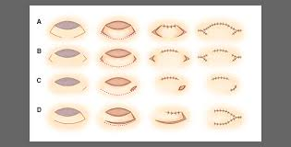

Slide 109
The basic local flaps include the single=bilateral pedicle advancement (U-plasty=H-plasty), island subcutaneous V–Y advancement, O–T=A–T plasty, rotation, banner, bilobe, and rhombic.

Slide 110
First, the characteristics of the defect are noted including its size, shape, and location. Good and bad lender units adjacent to the defect are outlined. Good lender units supply adjacent tissues with little distortion or tension of surrounding structures that are distortable such as the eye or lip.

Slide 111
Second, the characteristics of each available flap must be considered, including:
The amount of skin undermining required for tissue movement expressed in diameters of the defect size:
if a defect is 2 cm in diameter, an A–T plasty requires two times the defects diameter (2D or 4 cm) of adjacent tissue undermining for adequate advancement. Diameter ratios are listed for the flaps discussed by Calhoun including the rhomboid, bilobed, subcutaneously pedicled, V–Y, and A–T plasty.

Slide 112
2. The arc (in degrees, 90–360) of territory required for skin undermining: the diameters of skin undermining and the arc describe the surface area and direction of dissection required for each flap.
3. The vector of maximum tension after flap inset: this is important in determining if structures in line with the tension vector may be distorted.

Slide 113
4. Final scar orientation with respect to the resting skin tension lines (RSTLs): although most of these flaps have multidirectional scars that inevitably cross the RSTLs. The vector of maximum tension runs perpendicular to a radial line bisecting
the arc.

Slide 114
The flap should be oriented around a defect so as to place its tension vector away from distortable structures such as the lower eyelid and lip vermilion. If this is not possible, another flap should be considered

Slide 116


