Slide 1

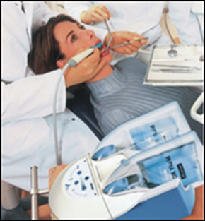
Historical stages development of therapeutic dentistry. Meaning of сongresses, works of Ukrainian scientists.
Communication with the theoretical and other dental disciplines.
Head of the Department
of therapeutic dentistry
ONMedU, Doctor of Medicine, Professor
Skyba V.Y.

Slide 2
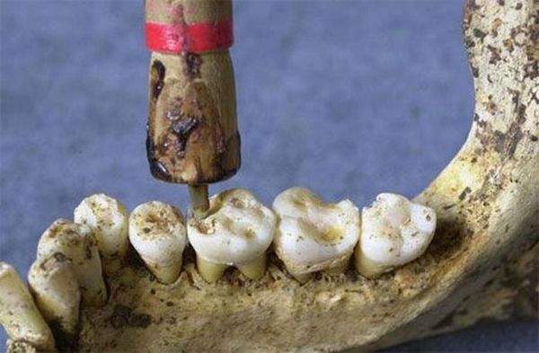
The history of dentistry goes into the depths of centuries, even in Neanderthal skulls from the early Paleolithic (100-50 thousand. BC. ) paleoanthropologists had traces of caries. That is the problem of dental pain accompanied by a man, almost from the beginning of history.
We do not know how Neanderthals treated their teeth. It is believed that the first time people began to treat the teeth appeared about 9000-8000 years ago - in 2001, during an archaeological dig in Pakistan the oldest in the history of the dental drill was found , which had been lying under the ground 9 thousand years. It was made like a tool for making fire and looked like this:
Other than that eleven people buried there were found traces of dental treatment. Now this is the first well-known page in the history of dentistry.

Slide 3
With the advent of the most ancient advanced civilizations, it is quite advanced dentistry appeared. It earned particularly significant development in ancient Egypt. So the Egyptian priests- stomatologists first learned to put dental fillings, to make artificial teeth (they are tied with a special wire to neighboring healthy teeth). Detailed description of dental disease is mentioned in ancient Egyptian medical document - Hebert Papyrus (1550 BC. ). А And it was in Egypt there was a first in the history of toothpaste, created from a mixture of pumice, eggshell, myrrh and ash from burnt entrails of a bull.
Besides the Egyptians Etruscans were expert dentists ancient times, which could produce dentures. They were made by cutting out the appropriate animal teeth. They were inserted in a special way and is durable and perfectly suited even for chewing coarse food. Later dental skills of the Etruscans adopted the ancient Greeks and Romans.
Since the days of antiquity come down to us many works of Greek and Roman physicians, these works were dedicated, including dental treatment. New page in the history of dentistry already in the I century AD. Roman surgeon Arhigen discovered who was the personal physician of the Roman Emperor Trajan - he was the first with a medical purpose to the tooth cavity drilled with a trephine. Later, with the onset of the Middle Ages, this technique for several centuries has been forgotten.

Slide 4
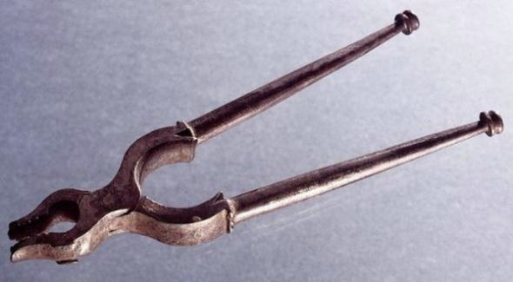
Here is on picture depicted ordinary forceps. It is this tool for many centuries has become a universal curative dental instrument of the Middle Ages. Medical treatises of antiquity were somehow partially forgotten, and with them is forgotten and the different ways treatment of teeth, such as fillings, dentures, etc. Dental treatment of the Middle Ages is to remove bad teeth with the help of forceps like these here.

Slide 5
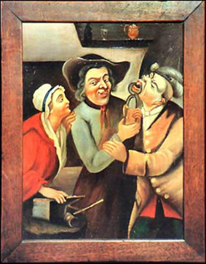
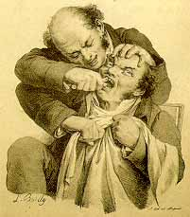
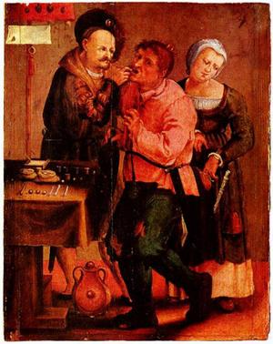
Place a of dentists in the Middle Ages occupied did not even doctors, but the usual bath attendants, barbers, the latter could not only cut and shave, but also to remove the tooth.
However, a total of medieval darkness of ignorance Dental had its pleasant exceptions, glimpses of the light of knowledge. One of these glimpses became Professor University of Bologna Giovanni di Arcola, who lived in the 15th century. He employed a method Arhigena, and started dental treatment.
Another one the next page in the history of dentistry has opened a personal dentist of George Washington - John Greenwood, who in 1790 invented the first dental drill. He first contrived and drill, which is actuated by a foot.

Slide 6
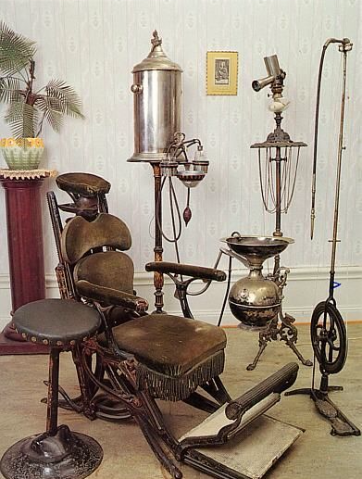
And this is actually a dental office looked at the time. Later another American doctor - James Morrison improved Greenwood’s machine, and that is important - he patented this invention. On the calendar was already in 1871, after 5 years later created by him the company launched the SS White dental innovation in mass production, and it soon spread throughout the world.

Slide 7
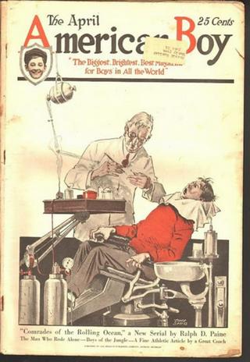
And this is a picture from the beginning of the 20th century, dentistry has undergone such a transformation in a relatively short time and came to the look in which we know it today.

Slide 8
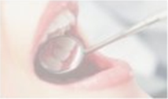
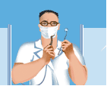
Dental schools have made a significant step in the training of dental case. The first dental school in Russia was opened in 1881 in St. Petersburg VI Vazhinsky. However, these schools have many shortcomings, and in 1900 was officially banned by the apprenticeship training of dentists. The first course in dentistry in Russian institutions in the medical faculties was introduced on the recommendation of Prof. N.V Sklifosofskiy. He is the founder of the study of dental caries in Russia in the epidemiological aspect. They first established the prevalence of dental caries in urban residents.

Slide 9

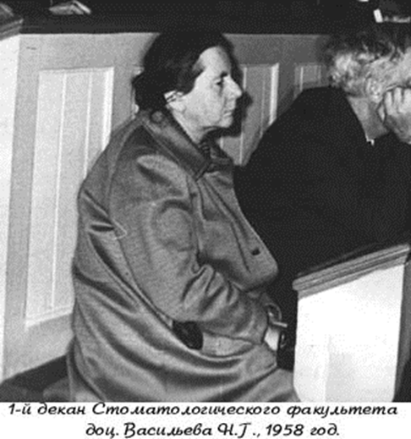
In Ukraine, dentists T.A. Tychinskii (1893) and I.I. Margolin (1896) organized a school in Odessa, LS Blank - in Kiev (1897). Later odontoiatric school appeared in Kharkov. 1919 - nationalization of private dental schools with a 4-year education. , 1920. - Medical Academy formed in Kharkov, Kiev and Odessa with two faculties: medical and dental. In 1928 - in Odessa was organized by the Scientific and Research Institute of Stomatology.
Faculty of Dentistry at the Odessa Medical Institute N.I Pirogov was opened in 1958.

Slide 10

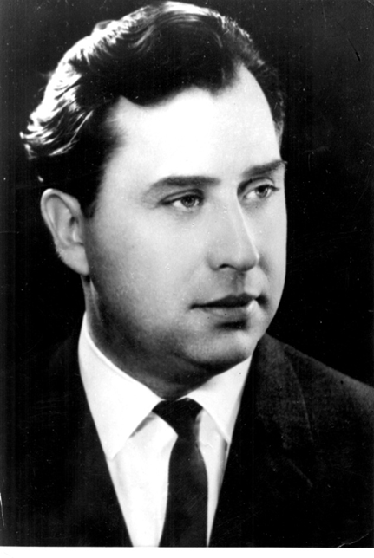
Founder and first head of the Department of Therapeutic Dentistry was director of the Odessa Scientific Research Institute Dentistry, PhD of medicine, Assoc. Prof. Alexey Marchenko, a graduate of the Kyiv’s School of Dentistry.
During the leadership of the Department (1960 - 1977)
employees were written 1 doctor (A.I Marchenko) and 15 candidate theses.

Slide 11

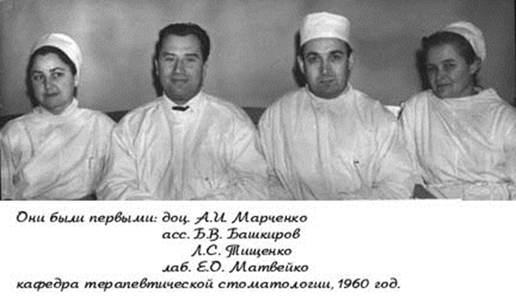
Since 01.09.1960y. to work at the department began working the first assistants – B.V. Bashkirs and L.F. Tishchenko. Much time and energy formation of the department gave veterans – G.N. Varava, I.V. Shvets, V.N. Pinchuk, M.A. Nikitin Y.I. Tarasenko, N.M. Esin. In 1966, A.I. Marchenko defended his doctoral thesis in 1967 and he was given the title of professor.

Slide 12
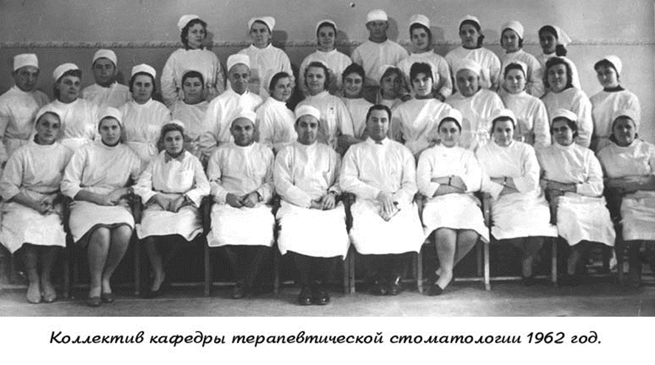
The first of the assistants defended their dissertations B.V. Bashkirs (1965), G.N. Varava (1966), I.V. Shvets (1967). Professor A.I. Marchenko (1966) first studied the physiological mechanisms of absorption of the oral mucosa of drugs used in the clinic therapeutic dentistry. The results of these studies formed the basis for new treatments for periodontal disease and oral mucosa.

Slide 13
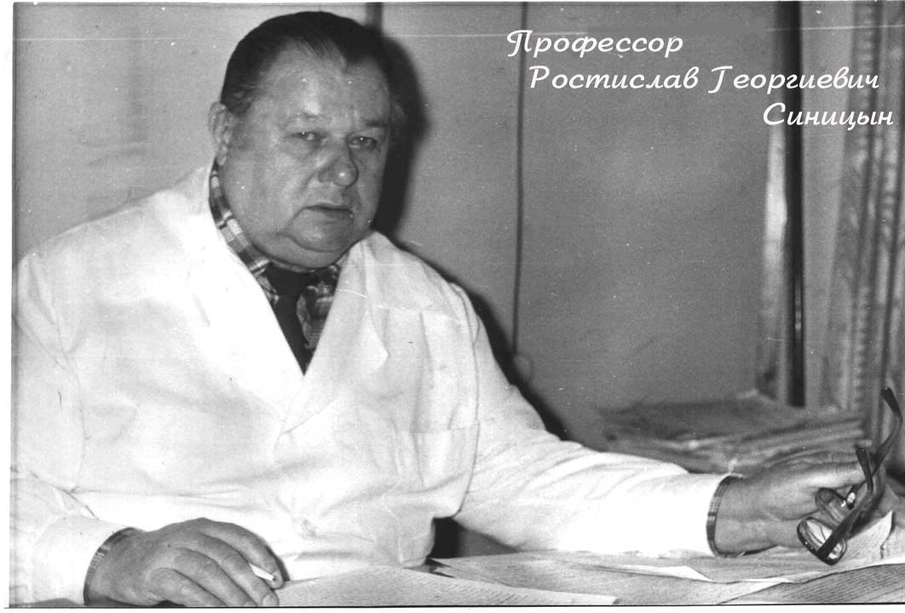
From 1977 to 1978 headed the Department Professor B.V. Bashkirs, and from 1979 to 1989 headed the Department Professor Sinitsyn R.G, he was a graduate of the Kyiv School of Dentistry.

Slide 14

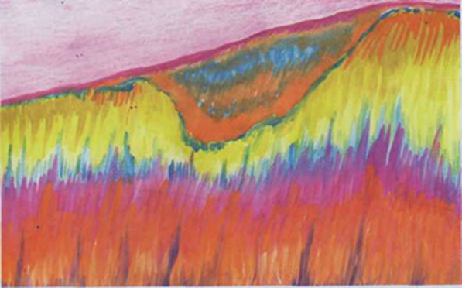
Prof. RG Sinicyn - the author of about 200 scientific works, including 2 guides, 12 methodological recommendations 6 manuals, 17 inventions. While working in the department, under his leadership made ​​1 doctoral and 13 master's theses. In 1979, the department was included in the development of the country's total integrated program of prevention of dental diseases. The main scientific direction of the department all subsequent time - development of diagnostics, treatment and prevention of dental caries and periodontal disease.
Research carried out for the first time prof. RG Sinitsyn it possible to obtain new data on the pathogenesis of
dental caries and clinical features of the initial stage of the disease manifestations. Experimental studies, the data of electronic, infrared, Luminet-stsentnoy and polarizing microscopy, x-ray microphotography, histochemical studies have shown that pathological changes in caries develop simultaneously in mineral and organic substances of dental hard tissues.
From December 1989 to November 1990
and from November 1991 to December
1993 acting Head of the Department
Associate Professor V.I. Potiyko.
From October 1990. to November 1991
the Department headed the Doctor
of Medical Sciences V.E.Sklyar.

Slide 15
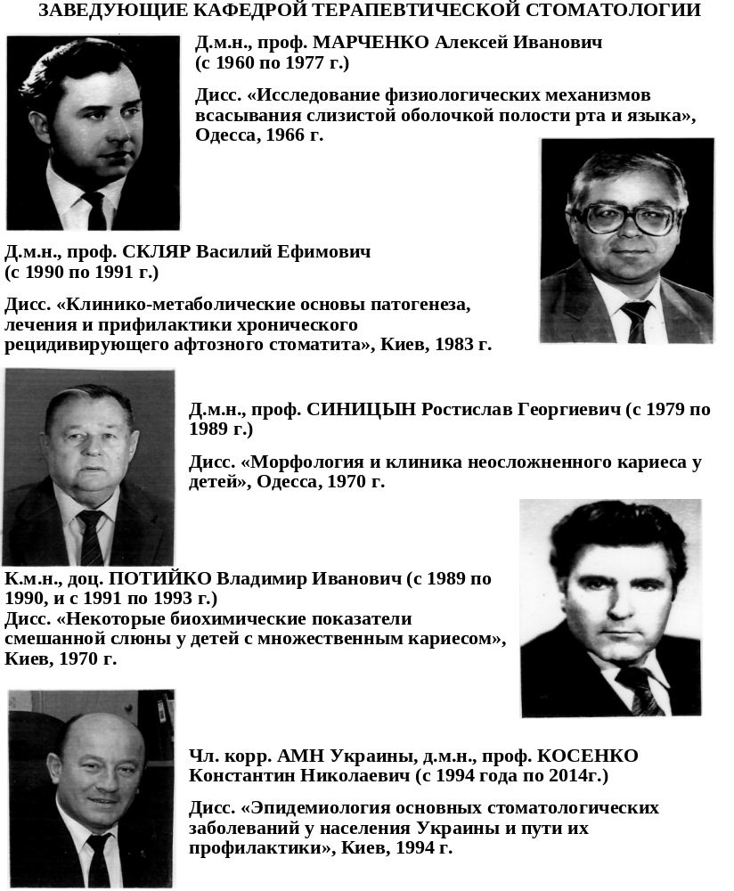

Slide 16
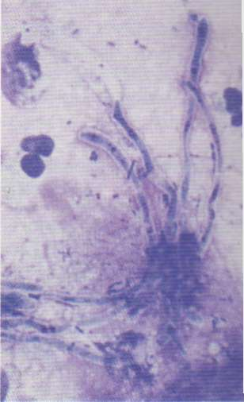
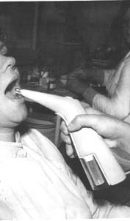
Under the guidance of prof. R.G. Sinitsyn developed an original method of fluorescent diagnostics of primary caries, methods purposeful influence on the main elements of the pathological process in caries with new means remineralizing therapy, treatment and prevention of periodontal tissues diseases. Доцент A.A. Bas experimentally established expediency of application of remodent-cyanoacrylate lacquer that provides high caries-preventive effect (1987). Graduate student of H.H. Iftekhar, who studied the mechanism of violation and correction of specific humoral immunity to actinomycetes in the pathogenesis of periodontitis , proposed a method of preventive treatment (1987).
N.I. Putintsev developed a method for the diagnosis of primary caries, which is based on determining the degree of demineralization of tooth enamel by measuring the optical density of the treated the dye tissue that improves the diagnostic accuracy of a factor of 2-3 (1992). Treatment of hypersensitivity of dental hard tissues using Pantogamum prolonged action proposed Associate Professor A.N. Zherebko (1992).

Slide 17

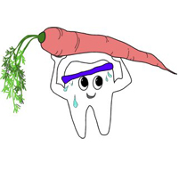
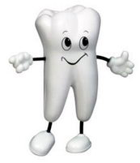
Associate Professor N.A. Ivchenko has developed a method of preventive treatment of periodontal disease using the dosed vacuum focal medium degree and defined indications for its use (1995).
The method significantly increases the duration of remission, which creates a real opportunity for the expansion of periodontal care.
S.N. Koval first identified 10 complexes professionally principal activities related to the diagnosis and treatment of dental diseases, revealed the psychological mechanisms influence the direction of motivation, intelligence level, the characteristics of the emotional sphere of students on the effectiveness of professional mastering fundamental action (2001).
Was established method of estimating the level of formation of professionally principled actions of the students - dentists, developed psychological - pedagogical system directed formation and pinning them in learning activities, which significantly increases the level of development of practical skills and theoretical knowledge of students.

Slide 18

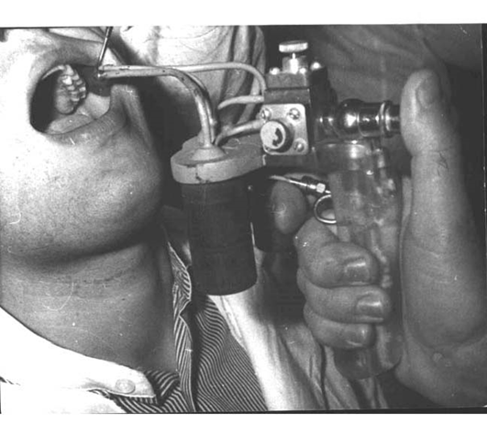
At the department developed original methods of administration of therapeutic and prophylactic agents in the tissue of the teeth and the mucous
membrane of the mouth, protected by patents. Designed device for insertion into tissue teeth remineralizing means for caries prevention and treatment of early-stage disease. A device for coating the surface of the teeth and oral mucosa therapeutic and prophylactic agents to aerosols which provides sustained beneficial effects.

Slide 19
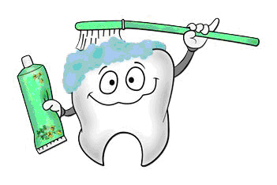
Professor of the Department V.Y. Skiba (1996) suggested an experimental basis and introduced into clinical dentistry new biogenic stimulator "Biotrit" mouthwash "Biodent-2" and a comprehensive antioxidant drug "Katomas", which significantly accelerates the regeneration of the oral mucosa. Associate Professor V.S. Burdeinyi (2000) developed member of the tablets "Biotrit-Dent" and he experimentally established methodology sublingual use in the prevention of dental caries and periodontal diseases in children.
Associate Professor I.K. Nowicka (2003) developed a method of exogenous prevention of dental caries, which combines the effect on dental plaque and active introduction of major mineral components of the enamel by using electrophoretic toothbrushes specially designed for its remineralizing toothpaste First demonstrated the possibility of applying the proposed complex for remineralization of tooth enamel in children, orthodontic treatment was carried out by using bracket system. Developed an original, effective scheme stimulation of mineralization of enamel by successive introduction into hard teeth tissues of mineral components such as calcium, phosphorus and fluorine.

Slide 20
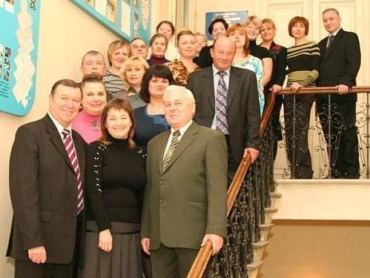
Associate Professor O.I. Aksinorskaya (2004) theorized experimental and clinical and laboratory research has shown that calcium dobesilate, strengthens tooth enamel mineralization processes, normalizes the homeostasis of the oral fluid, improves microcirculation in periodontal tissues, increases nonspecific resistance of the oral cavity. She had developed scheme of the drug in the treatment of chronic catarrhal gingivitis in combination with dental caries.
Assistant N.N. Zaporogec (2005) proved that chronic catarrhal gingivitis is a violation of local immunity of the oral cavity, reduced factors of nonspecific resistance, increased production of antibodies. She had developed way to pharmacological correction of immunity in the oral cavity with an immune response-modulating agent local effects ("Lisobakt", "Imudol").
Assistant O.N. Davidenko (2005) suggested using magnetophoresis namatsit and cholecalciferol (vitamin D3) for generalized periodontitis, has proven their high efficiency.

Slide 21
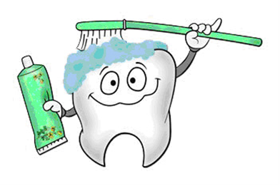
Associate Professor A.A. Siedleckaja (2005) justified the need for an integrated use of lecithin in elderly patients with periodontitis, has proven
their high efficiency.
Assistant N.A. Bas (2005) developed a method
of treating and prevention of inflammatory diseases
periodontal tissues, based on the combined impact
electrophoretic toothbrush and biologically active
components of a toothpaste "Pelodeks.“
Aspirant O.I. Anshukova (2006) first explored the possibility of directed influence on osteogenesis of the alveolar bone in patients with periodontitis generalizovanym toothpaste "Guarantor" containing osteoapatit with osteokonduktivnymy properties and other biologically active substances, with severe bone-seeking properties.
Graduate student O.V. Skiba (2007) reviewed in detail the pathological changes in GPRS and jaw bone tissue in diabetes mellitus type I, which was the justification for the creation of the gel "Soflipin" on the basis of Sophora japonica fruit, α-lipoic acid and inulin chicory with antioxidant, anti-inflammatory and membranotropic properties.

Slide 22
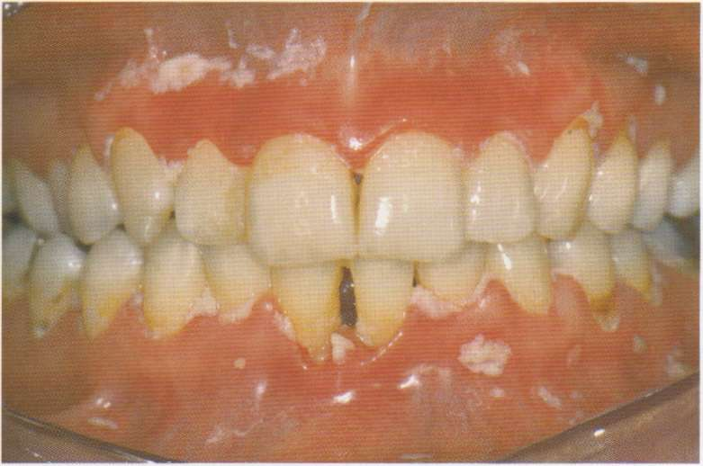
Assistant I.A.Panenko (2007) theoretically substantiated and confirmed in practice, expediency of application in-time chronic oral candidiasis in patients with removable dentures "Laktogelya" containing laktobakterin, chlorhexidine, sodium tetraborate and Biotrit C.
Assistant O.V. Goncharenko (2008) studied the effects of hygiene on the microbiocenosis oral cavity in patients without dental disease, and in patients with dental caries and chronic catarrhal gingivitis. Finishing what she had varying degrees of influence of antibacterial toothpastes on the microflora of the oral cavity, the effect of brushes for cleaning the tongue on the microbiocenosis mouth. She offered recommendations for optimal selection of personal oral hygiene.
Associate Professor L.V. Goncharuk (2009), examined the clinical course and treatment of inflammatory periodontal disease in patients with urolithiasis, studied the effectiveness of the use of ozone therapy and magnetic therapy in complex treatment of patients with this pathology. Associate Professor EL Zagradskaya (2011) developed a scheme of prevention of chronic candidiasis of the oral mucosa, depending on the level of contamination by fungi Candida and clinical symptoms: differential prescription antifungal drugs and immunomodulatory
action (echinacea tincture, mouthwash "Lizomukoid“
1% solution "Orasept" 5% ointment and
levorinovaya laktobakterin) which helps to activate
the natural defense mechanisms oral intensity
reduction inflammatory process, increase the
rate of salivation.

Slide 23

Assistant K.P. Rogko (2011) introduced a laser correlation spectroscopy to assess functional state of the
periodontal tissues, which displays tissue
homeostasis, permeability Bridges and
perfusion of the capillary bed and the severity
of the pathological process. She has proven
effectiveness of toothpastes «Colgate® Treatment
grass "and« Lacalut Fitoformula »chronic
periodontitis, and "Forest Balsam" and «Parodontax® Classic" an exacerbation of the process.
Assistant I.V. Luchak (2012) found that the functional activity of the salivary glands of children has a significant impact stressful hormones. Demonstrated the dependence of the intensity of the caries process on the level of salivation. Detected pattern to reduce salivation with somatic morbidity, especially when using anticholinergics, frequent and long-term therapy with atropine. Proves the necessity of such children activities to increase salivation: the use of tincture of centaury to rinse, toothpaste «Colgate total», tablets "Revit".

Slide 24
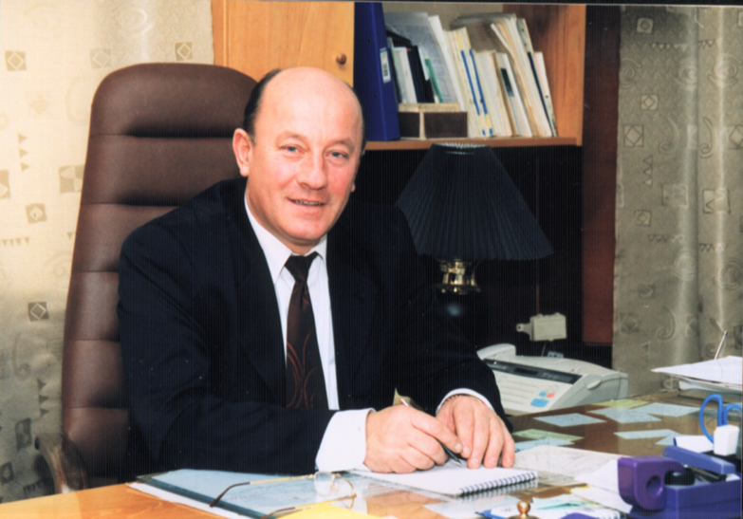
From 01.09.1994 till 29.12.2013 department was headed by Corresponding Member NAMS of Ukraine, Honored Worker of Science and Technology, Professor K.N. Kosenko.
The main directions of his scientific activities related to the development of scientific bases of prevention of dental caries and periodontal disease, sialotrophic concepts of the pathogenesis of oral diseases, the development of scientific and organizational principles of the reform of dental care in Ukraine. Organized and chaired several international scientific conferences, exhibitions and Dentistry First Congress of Ukrainian Dental Association, where he proposed the concept of reforming of dental care in Ukraine.

Slide 25
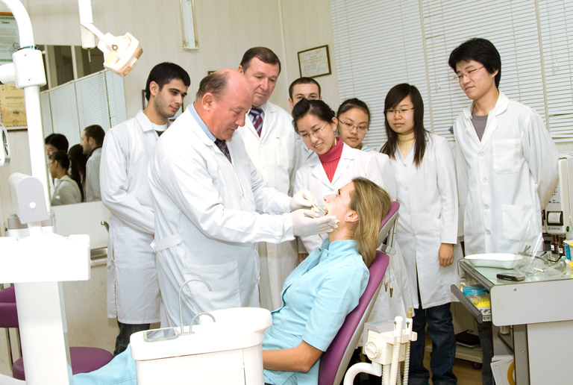
K.N. Kosenko is coauthor of dental program sections DKNT Ukraine "Human Health", the initiator and the scientific director of "National Program for the prevention of dental diseases among the population of Ukraine." Under his leadership, made ​​a number of complex topics in the epidemiology, prevention and treatment of major dental diseases using new methods, tools and organizational measures.
K.N. Kosenko is author of over 250 scientific publications, 27 inventions, innovations 6, 3 departmental criteria (standards), aimed at the development and improvement of the dental services of Ukraine. Directly under his supervision at the Department holds and is protected by 14 master's theses. Proposed for caries prevention with fluoride varnish composition of tin. Studied in detail the monitoring of dental diseases in Ukraine, created the first national bank of dental disease in different regions of Ukraine, has studied the dynamics of the disease, depending on age, social and economic conditions, outlined concrete ways to prevent its. The results of studies formed the basis of the program of dental care in Ukraine. Devoted to this problem and dissertations, made under his leadership.

Slide 26
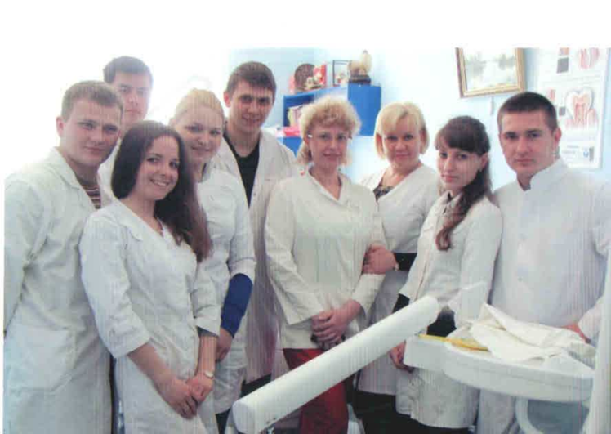
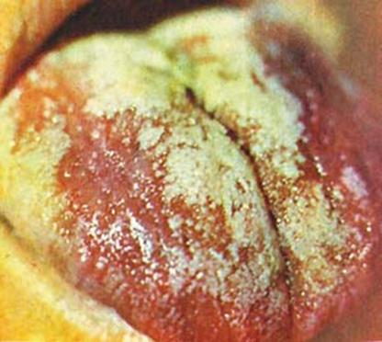
From 04.24.2014, the Head of the Department Doctor of Medicine Sciences, Professor is
Yuliya G. Romanova.
In her thesis Y.G. Romanova has proven that a violation of systems homeostasis of the oral cavity is a decrease in functional activity of the salivary glands, which leads to the development of dry oral mucosa, there is a deficit in the oral cavity of biologically active substances that are involved in the processes of maintaining the stability of the environment, which leads to inflammation due to the activation of lipid peroxidation, enhance the effects of toxins aggressive microorganisms, including Candida albicans. Found that candidiasis should be considered as a violation of the immune system and microbial homeostasis of the oral cavity, which have a direct causal link with removable acrylic dentures. She has clinically substantiated the effectiveness of probiotic and prebiotic and adaptogenic plant resources in a period of adjustment with removable acrylic dentures in patients with altered homeostasis
oral cavity. She created antiallergic gel "Profial"
for the prevention of toxic allergic prosthetic stomatit,
mouthwash "Biodent - 4“, oral gel "Laktogel "that reduce
the degree of adsorption of fungi Candida spp. and normalize
microbiocenosis oral cavity; dentistry gel "Maltcit" for prevention
hyposalivation.

Slide 27
At the department since its organization (1960)
the present time (2014) co-workers and
candidates was performed 12 doctoral and
52 master's theses. The pupil of the department,
prof. G.N. Varava headed OSRIS (1973-1990).
She is currently in charge of the organizational
methodological department of the State
Institution "Institute of Dentistry of NAMS of Ukraine." Corresponding Member. NAMS of Ukraine, Professor K.N. Kosenko also was director of the State Institution "Institute of Dentistry of NAMS of Ukraine" and headed the department until the last days of his life, professor V.J. Skiba heads the therapeutic dentistry in the State “NAMSU ."
At the department trained 20 graduate students, 23 medical residents, 22 undergraduates. Published 15 monographs, 15 manuals, received 46 patents, 196 scientific research rooted in the practice of dentistry.

Slide 28
Over the years, the department staff carried out a 22 planned research, published 12 monographs and manuals, more than 650 scientific articles, 50 guidelines and information sheets, received 43 patents, 186 scientific developments implemented in the practice of dentistry.
Employees of the department regularly make presentations at union and republican congresses and conferences, take an active part in the work of the regional scientific community dentists, Ukrainian Dental Association.
Research of the department "Functional state of the oral mucosa under the influence of the hygiene for chronic candidosis and after radiation exposure" (2011-2015.)
Therapeutic dentistry - is an independent branch of dentistry, including basic dental diseases - dental, periodontal and oral mucosa diseases. Therapeutic dentistry is the basis of dentistry, as timely treatment diseases of teeth and periodontal tissues contributes to its conservation.

Slide 29
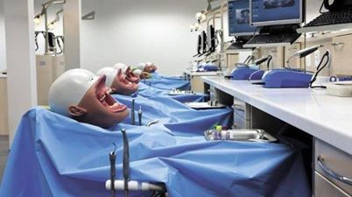
The main sections of Therapeutic Dentistry
preclinical course
clinical course
Non-carious lesions
Caries
Complications of caries(pulpitis, periodontitis)
Parodontium diseases
Diseases of tunica mucosa of mouth
Leading position in the therapeutic dentistry occupied by problems of treatment of caries and its complications, as well as periodontal disease. Dental care is the most common type of health care and is one of the leading places in the general system of measures aimed at maintaining the health of the population.

Slide 30
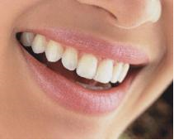
Thank you for your attention

