Slide 1
"Materials for root canal filling"

Slide 2
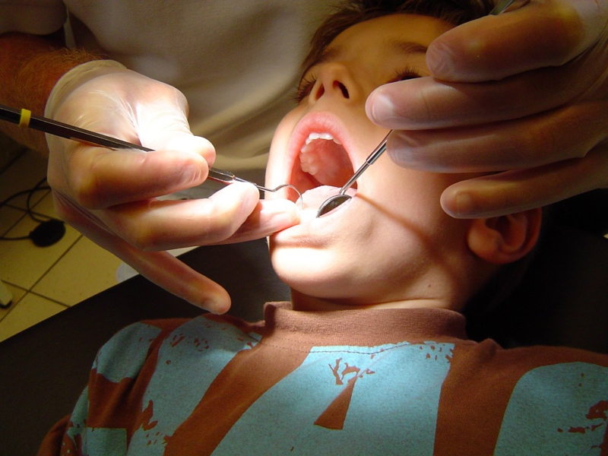
The final step in endodontic treatment is root canal filling.
The purpose of root canal filling: warning exchange between the channel and periodontiti

Slide 3
Pulpectomy (devital or vital pulpectomy)
Indications:
1. is carried out in an interim single rooted teeth or molars with acute diffuse form a temporary single rooted teeth or molars with acute diffuse and chronic gangrenous pulpitis;
2. the presence of bone weakening pattern cross members and pulping cortical plate wells on the radiograph of the tooth;
3. as a stage in the conservative treatment of all forms of periodontitis in temporary and permanent teeth; acute, chronic gangrenous pulpitis the permanent teeth of all groups of teeth formed at the tip.

Slide 4
METHODS OF DEVITAL EXTIRPATION:
The method is carried out in two visits.
1. Active tooling cavity - removing softened dentin - pulp horns autopsy –put in on devital paste (arsenic paste, paraformaldehyde) - setting a temporary filling.
2. Active removal of temporary fillings - the disclosure of the tooth cavity - removal of coronal pulp - removal of pulp coronal - instrumental and pharmacological treatment of root canal - root canal filling to physiological opening of the tooth root under X-ray control - setting the insulating gaskets, seals constant.

Slide 5
Requirements for filling materials
Requirements for endodontic filling materials, can be combined into three groups.
Biological requirements: filling material must have antiseptic and antibacterial properties; not to irritate the periodontal tissue.
Physical and chemical requirements: filling material must be characterized by high adhesion, which provides adhesion to the wall of the channel, it must be tightly closed apical foramen and the dentinal tubules; I should not have shrinkage not dissolve in interstitial fluid, have radiopacity not stain teeth.
ITechnology requirements: filling material must have plasticity, easily introduced into the root canal, if necessary - to succumb to remove from the channel.

Slide 6
Classification of materials for root canal filling
Filling material: 1. Temporary 2.
Permanent Pastes based on a mixture of long-acting antiseptic;
Pastes on the basis of antibiotics and corticosteroids;
Pastes zinc evgenolovye prepared ex tempore with the addition of X-ray contrast agents
Pastes based on metronidazole; Pastes based on calcium hydroxide; Materials based on resorcinol-formalin

Slide 7
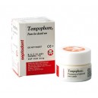
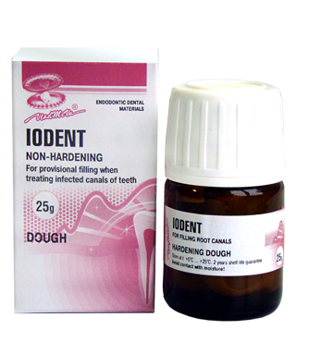
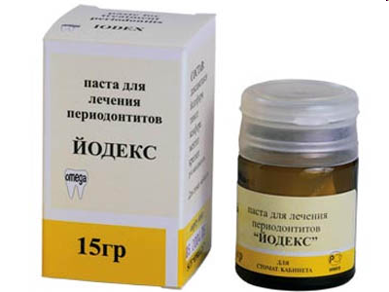
Pastes on the basis of a long-acting antiseptics
The composition of this group of drugs usually include potent antiseptics: thymol, creosote, iodoform, camphor, menthol, etc.
Representatives:
1. Tempofor
2. Yodent
3. Yodeks
Key features include:
Antiseptic properties
Paste radiopaque
Slowly dissolve in the channel
Not harden
Ease of insertion and removal
Low toxicity
The absence of toxic effects on periodontal

Slide 8
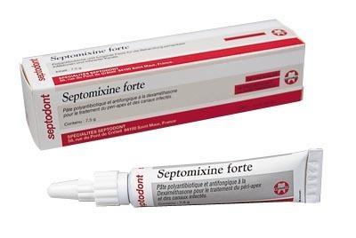
Pastes on the basis of antibiotics and corticosteroids
Representative: "Fort Septomiksin"
Properties:
Radiopaque;
Reduces inflammation and allergic reactions;
Antibacterial and antifungal activity;
Harmless for the periapical tissues.

Slide 9
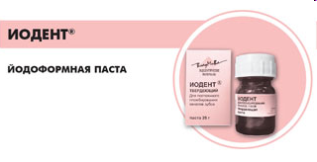
IODENT (Yodoformnaya paste)
Available in two forms:
- not hardening paste
- hardening paste.
Indications:
- Not applicable hardenable paste as a therapeutic and prophylactic agent in cases of acute and chronic periodontitis, treatment of infected channels, pulpitis, granulomatous granulating and periodontitis, as well as re-infection after sealing.
- Hardening paste is applied to the permanent canal filling of teeth with pulpitis, acute and chronic periodontitis, for canal filling of primary teeth and prevents the formation of the underlying tooth germ

Slide 10
"Iodent":
- It has disinfectant and antibacterial properties.
- Contains strong antiseptics - iodoform, thymol and camphor
-Develops the protective properties of the periapical tissue
- Well tolerated by the body, in the case of a possible withdrawal of the apex, the reaction low.
- Pasta is radiopacity.
- Allows canal filling in a few visits,
- There is no postfilling pain.

Slide 11
Hardening paste "Iodent":
has a prolonged disinfectant and bactericidal action,
it comprising: a chlorophenol; camphor; iodoform;
+ Radiopaque additive;
filler stimulates osteoblastic bone formation at the apex, as well as providing a radiopaque material.
When multi-stage treatment of channels are not filled with hardening paste "Iodent" and a temporary filling material is left for a few days.Then, using a needle or root canals filled with purified kanalonapolnitelya settable paste "Iodent" which is structured for 72 hours.

Slide 12
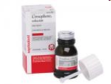
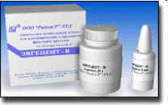
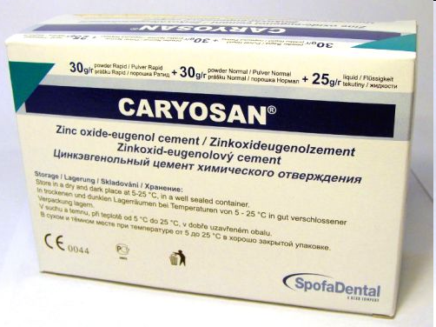
PASTE Zinc EVGENOLOVYE EX TEMPORE with the addition of radiopaque substance
Properties:
- Antibacterial
- Soothing, calming effect
- Anti-inflammatory effect
- Easy to dry canal
Representatives: Cariosan Evgetsent-In Evgetsent-P Zinoment IRM (Dentsply)

Slide 13
Pastes based on metronidazole
Representatives Grinazol
Features:
inhibits anaerobic microflora of root canals
stops the catabolic tissue damage by blocking the inflammation at the biochemical level
There were no allergic reactions or habituation

Slide 14
Pastes based on calcium hydroxide
Representatives
Gidroksiapol-85
Biocalex,
Sealapex,
Endokaleks
Properties:
- has a bactericidal effect
- destroys necrotic tissue
- promotes osteoporosis, and cementogenesis dentinogenesis

Slide 15
Materials based on resorcinol-formalin.
Benefits:
Has an antiseptic effect
It does not resolve the root canal
Slowly solidified
Easy to enter
Radiopaque
It does not violate the properties of other materials
It has mummified action
Do not disturb the formation of the root
Do not break the root resorption of deciduous teeth
Indications:
Temporary teeth began to root resorption
Temporary and permanent teeth with unformed roots.

Slide 16
Thank you for attention!!!

